Slide 1
CROSSFUZE / SALES ENABLEMENT
INTERNAL ONLY · DO NOT PRESENT
Meeting breakdown & sales process
From an executive AI readiness conversation to an evidence-led, paid delivery engagement.
01
MEETING 1
02
ASSESSMENT
03
MEETING 2
04
AI RUNSTATE
Executive discovery · 30–45 min
Evidence-led workshop · 90 min
Working session · 45–60 min
Paid delivery · 12 months
Create the case for readiness
Establish the first decision
Turn findings into a delivery plan
Plan. Prioritise. Ship.
›
›
›
Connect AI ambition to the ServiceNow AI Readiness Gap. Establish business priorities, risks and a potential first outcome.
Review seven readiness dimensions, controls and indicative consumption. Capture uncertainties, owners and a candidate use case.
Walk the dependencies, Permission to Automate, Assist assumptions and first 90-day priorities. Agree measures and decision owners.
AI Action Plan, up to four backlog cycles and Extend capacity (80 hours a month for nine months). Release and measure governed outcomes.
ADVANCE WHEN
OUTPUT
ADVANCE WHEN
RESULT
90-minute assessment agreed
AI Readiness Decision Brief
Sponsor and scope agreed for quote
Continuous, measurable delivery
QUOTE / APPROVAL
After Meeting 2: issue a scoped 12-month AI RunState proposal and quote (priority outcomes, first 90-day plan, investment). Customer approves scope, price and terms before paid delivery starts.
INTERNAL ONLY • HIDDEN IN SLIDE SHOW • PRESENT FROM SLIDE 2 • EXAMPLE SCORES AND TIMINGS REMAIN PROVISIONAL
Notes:
INTERNAL FACILITATOR PAGE — DO NOT PRESENT. This slide is intentionally hidden.
Sales process: (1) Meeting 1 is the original 30-slide executive AI Readiness narrative. Aim to secure consent for the 90-minute assessment, not to close RunState in the first conversation. (2) The assessment is evidence-led; the free self-serve tools can be used before it. Record evidence, limitations, owners, risks, possible first outcome, and indicative Assist consumption in the AI Readiness Decision Brief. (3) Meeting 2 is this separate technical/commercial follow-up. Confirm the use case, technical dependencies, Permission to Automate, measures, workload and first 90 days. Invite CIO/platform owner, process owner and governance/commercial decision makers as appropriate. (4) AI RunState is a paid 12-month advisory, backlog and Extend delivery engagement: 2 advisory reviews, up to 4 backlog cycles, and Extend 80 hours per month for 9 months.
Commercial stage gates are suggested sales guidance, not agreed customer commitments. Keep results provisional until verified. Do not share the hidden presenter page with customers. Start the customer-facing slides at slide 2.

Slide 2


EDITION 2026
MEETING TWO · WORKING SESSION
The Road
to Zero.
From readiness to results.
Your first governed AI outcome. And the plan to keep delivering.
Part of Preparing for the Autonomous Enterprise
Crossfuze · ServiceNow Elite Partner
Notes:
OPENING | Meeting 2 begins where the 90-minute assessment left off. Ask what changed since that session. The buyer should leave with one first-Zero hypothesis, agreed evidence gaps, control conditions, measurable success criteria and a clear path to a priced and approved scope. This is a working session, not another demonstration.
--- EXISTING FACILITATOR NOTES ---
MEETING 2 | FROM READINESS TO RESULTS
Unlike the first presentation, this is a follow-up working session, not a broad AI market vision. Its purpose is to agree one measurable, appropriately controlled first use case; identify evidence and dependencies; size consumption; and determine if an AI RunState engagement is commercially appropriate.
Ask: what changed since the first discussion? Has the 90-minute assessment been completed? Do we have a Decision Brief? If not, keep customer-specific content provisional. All examples are illustrative until customer evidence is supplied.
The original first-meeting 30-slide deck has not been edited in this workflow.

Slide 3


STAGE 02 / THE AI READINESS ASSESSMENT
What did we learn from your assessment?
Four findings turn a 90-minute working session into a defensible first decision.
01
02
03
04
READINESS
OPPORTUNITY
CONSUMPTION
CONTROL
Where you stand
Where AI can help
What it may use
What must be true
[Readiness finding]
[Candidate first Zero]
[Assist / tier finding]
[Permission and owner]
Score status, limiting foundation and evidence confidence.
Priority workflow, business pressure and potential value.
Run volumes, complexity and entitlement assumptions.
Approval boundaries, exceptions and accountable ownership.
ASSESSMENT OUTPUT
AI Readiness Decision Brief → Proposed first outcome, with unknowns clearly identified.
CROSSFUZE / AUTONOMOUS IT · ROAD TO ZERO
03
Notes:
BUYER-SITUATION ASSESSMENT RECAP | Replace all bracketed text from the actual AI Readiness Decision Brief. Report what is evidenced, what remains provisional and what is unavailable. Ask which finding most changes the customer's ability to act. Do not show the placeholders as customer facts.
--- EXISTING FACILITATOR NOTES ---
Stage 02 recap: populate each bracketed finding from the actual 90-minute AI Readiness Decision Brief. Quote whether the evidence is full/provisional/unavailable. Do not invent a score, tier fit, value forecast or customer agreement. Use the summary to introduce the proposed first Zero.

Slide 4

STAGE 02 / OUTCOME RECOMMENDATION
Which Zero should we pursue first?
Start where the business pressure is real and the readiness evidence supports a controlled first move.
BUSINESS VALUE
RECOMMENDED FIRST ZERO
01
[Why this outcome matters]
[Selected Zero]
Baseline, demand, cost or risk to improve.
READINESS FIT
FIRST WORKFLOW
02
[What the assessment supports]
[Selected service / workflow]
Evidence available; dependencies still to validate.
Provisional recommendation — confirm the evidence and agree the outcome with the customer.
FIRST PROOF
03
[How success will be measured]
Metric, accountable owner and review point.
DECISION REQUIRED
Confirm the first-Zero hypothesis, workflow, owner and proof measures.
CROSSFUZE / AUTONOMOUS IT · ROAD TO ZERO
04
Notes:
FIRST DECISION | 'Which Zero creates a meaningful result for your business and can be delivered responsibly with the evidence available?' Present a proposed Zero and workflow, rationale, business baseline, controls, accountable owner and proof measure. Ask for the buyer's agreement or record the gaps. Do not automatically assume Zero-Touch Support.
--- EXISTING FACILITATOR NOTES ---
Present the recommended first Zero from the assessment, not as an assumed result. Replace selected Zero and workflow placeholders. Justify with three decision criteria: business value, actual readiness evidence, and first measurable proof. Obtain customer agreement or record the amendments required. Other Zeros remain destinations. Transition to existing evidence-validation slide: "Now let us test the dependencies for that workflow."

Slide 5

INTERNAL ONLY / HIDE DURING PRESENTATION
Commercial reference — US draft SOW.
Confirm regional pricing and executed terms before presenting a customer quotation.
$15,500
$186,000
USD per month · 12-month term
Total fees in US draft SOW
Pricing excludes taxes, travel and additional third-party licensing / Assist consumption. Contract is non-cancellable for convenience; changes and renewal require signed agreement.
INTERNAL REFERENCE ONLY · NOT AN APPROVED CUSTOMER QUOTE
CROSSFUZE · AI RUNSTATE
20
Notes:
INTERNAL US DRAFT COMMERCIAL REFERENCE - DO NOT PRESENT
Source draft SOW pages 7-8: $15,500 per month, 12 months, total $186,000 USD, excl applicable taxes. Paid monthly from service commencement. Valid for 30 days after delivery of formal SOW. Licences/AI Assist balances are customer-provided, expenses and change orders separate. Noncancellable for convenience. Renewal/change only by signed change order. This is a regional draft not universal commercial packaging. Verify before quoting. This slide is hidden in PowerPoint Show.

Slide 6


One use case. End to end.
01
02
03
04
05
SENSE
DECIDE
ACT
SECURE
MEASURE
Requester, role,
asset and policy
Check entitlement
and confidence
Run approved
access workflow
Audit, exception
and safe stop
Resolution time,
usage and quality
Validate
Bound
Approve
Observe
Reassess
ILLUSTRATIVE: zero-touch access request. The real workflow must be mapped and validated against the customer estate.
© 2026 Crossfuze. All Rights Reserved.
© 2026 Crossfuze. All Rights Reserved.
Notes:
WORKED EXAMPLE | This diagram is an illustrative Zero-Touch Support access request unless the customer's selected Zero is in fact Zero-Touch Support. If another Zero is selected, tell the customer the example is just a demonstration and adapt the workflow before using the deck as customer-specific.
--- EXISTING FACILITATOR NOTES ---
WORKED USE CASE | A ZERO-TOUCH ACCESS REQUEST
Illustrative example, NOT a completed customer implementation: an employee requests access. SENSE: verify identity, role, relevant services, data and request context. DECIDE: test policy and entitlement, knowledge grounding, allowed action, confidence, and whether approval is mandatory. ACT: invoke an approved access or fulfilment workflow only inside the documented boundary. SECURE: log the outcome, escalate exceptions, test a stop and rollback. MEASURE: completions, handling time, escalations, unwanted actions, adoption, cost and Assist consumption.
Readiness decision: if data or policy confidence is insufficient, agent recommends or escalates instead of executing.
This example is illustrative and uses Crossfuze workflow-readiness language.

Slide 7

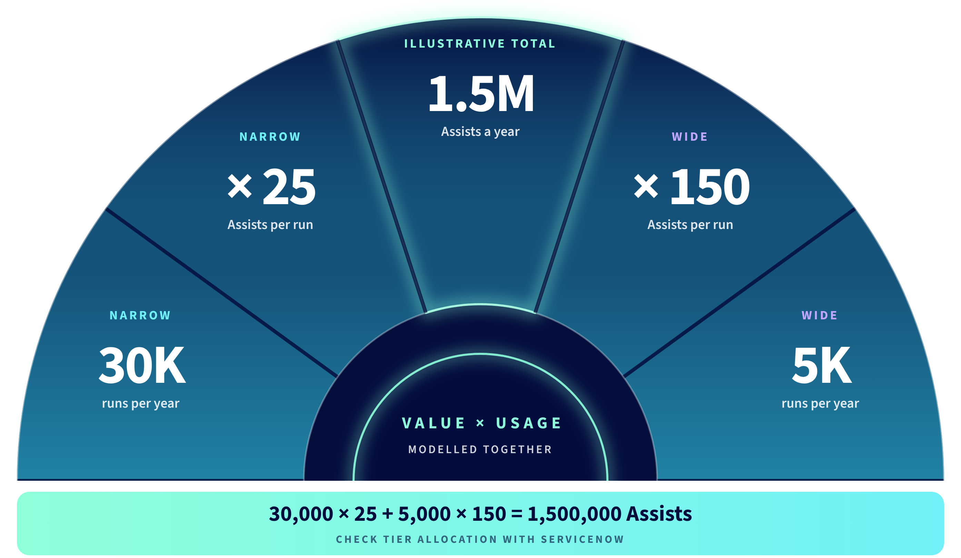
Value and consumption. Model them together.
© 2026 Crossfuze. All Rights Reserved.
7
Notes:
VALUE AND CONSUMPTION | Ask whether the selected workflow's operational benefit justifies its estimated Assists, tier entitlement and potential overage. The worked 1.5M Assist annual mix is illustrative only, not the customer's allocation. Validate actual contract, product availability, Assist rates and P90 demand before proposing a tier.
--- EXISTING FACILITATOR NOTES ---
AI VALUE AND ASSIST CONSUMPTION
Illustrative model directly from the Crossfuze source guide: narrow run = 25 Assists for 0–4 tools; medium run = 50 Assists for 5–8 tools; wide run = 150 Assists for 9–20 tools. Example volume: 30,000 narrow and 5,000 wide runs annually => 1,500,000 Assists. Wide runs use six times more consumption per run than narrow.
This is NOT a customer forecast or quoted pricing. Verify workflows, process volumes, tool count, repeat runs, package entitlements, pooled allocations and renewal specifics with ServiceNow. Data Fabric credits and other meters may be separate.
Evaluate value alongside usage: time saved, cost to serve, successful transactions, escalation rate, customer satisfaction, risk of errors and expected implementation effort.
Source: Crossfuze AI Readiness Assessment pp.13–15.

Slide 8
How will we prove the first outcome?
SUCCESS
SPEED
ESCALATION
Completed requests
Median fulfilment time
Human handovers
QUALITY
CONTROL
ADOPTION
Incorrect actions
Stop/rollback test
Workflow usage
COST
CONSUMPTION
VALUE
Cost per completion
Assists per result
Hours/cost returned
Proposed success measures. Define reporting ownership and baselines in the signed scope.
© 2026 Crossfuze. All Rights Reserved.
8
Notes:
AGREE PROOF | Ask the process owner which 2–4 measures will demonstrate that the first workflow is worth shipping: successful completion, time or cost returned, error/control signals and Assist consumption. Require baselines, owners and a review window; do not promise results without measurement.
--- EXISTING FACILITATOR NOTES ---
PROVE PRODUCTION VALUE
Never substitute ServiceNow Now on Now proof for Crossfuze-delivered results. This is a measurement design, not a claim.
Agree the baseline and target for each selected metric: successful end-to-end completion, time to completion, handover/escalation frequency, wrong or unwanted actions, actual tested stop/rollback capability, adoption and task mix, cost per completion, Assist usage per valid completion and hours or operating costs returned.
Track leading and lagging metrics through the 90-day delivery cycle. Use customer source systems wherever possible. The 90-minute assessment may generate a provisional estimate; real outcome claims require actual operational measurement and an agreed measurement period.
Source: Crossfuze source guide pp.16–19.

Slide 9
Crossfuze AI RunState. Plan it. Prioritise it. Ship it.
Turn the first agreed Zero into a governed delivery plan, within contracted capacity.
AI ACTION PLAN
BACKLOG CYCLES
EXTEND SERVICES
ADVISORY · 2 REVIEWS
UP TO 4 CYCLES
80 HOURS × 9 MONTHS
Baseline, readiness and risks
Experience maps & draft stories
90-day AI roadmap
Feasibility and estimates
Customer-approved stories
Three-month capacity plan
Named Technical Lead
Configure and test approved work
Customer UAT before release
© 2026 Crossfuze. All Rights Reserved.
Notes:
RUNSTATE IN BUYER TERMS | Only now introduce the paid service. The buyer has chosen the first outcome and knows the risks. AI RunState supplies a controlled delivery rhythm: Action Plan, up to four backlog cycles and 80 hours/month of Extend for nine months subject to the scoped SOW. This is capacity and governance, not guaranteed production outputs.
--- EXISTING FACILITATOR NOTES ---
AI RUNSTATE | THREE CONNECTED COMPONENTS
SOW service overview defines AI Action Plan (initial approximately 8 weeks; second review month 7-8), up to four Backlog Prioritization cycles (each about six weeks, starting in month 3), and 80 hours/month of Extend in months 4-12. Action Plan produces a baseline, readiness risks, use case priorities, experience maps, draft user stories and 90-day roadmap. Action Plan stories are explicitly NOT sprint ready. Backlog Prioritization refines, estimates and prepares approved delivery-ready stories and hands the three-month plan to the Extend Technical Lead. Extend builds/configures and tests approved work. The Customer Product Owner approves the work and completes UAT prior to production promotion.
Do not imply guaranteed output volumes or that all proposed stories are accepted. Scope and duration of the second review must be confirmed in writing. First advisory workshops number is still X in draft SOW and should be resolved before issue.

Slide 10
CROSSFUZE / AI RUNSTATE
A 12-month delivery rhythm.
Advisory sets direction. Backlog Cycles prepare customer-approved work. Extend delivers within monthly capacity.
M1
M2
M3
M4
M5
M6
M7
M8
M9
M10
M11
M12
ADVISORY
PLAN
REFRESH
BACKLOG CYCLES
CYCLE 1
CYCLE 2
CYCLE 3
C4
ONBOARDING
M3
EXTEND DELIVERY
80 HOURS / MONTH · NINE MONTHS
MONTH 3 IS ONBOARDING — EXTEND SPRINTS START IN MONTH 4
Delivery depends on approved sprint-ready stories, access, technical acceptance and customer testing.
CROSSFUZE · AI RUNSTATE
10
Notes:
DELIVERY RHYTHM | Translate the year to buyer milestones: months 1–2 advisory/Action Plan; month 3 onboarding; approved Extend work from month 4 through 12 subject to prerequisites. Second advisory review and backlog cycles are included per draft scope. Check final executed regional terms.
--- EXISTING FACILITATOR NOTES ---
AI RUNSTATE | SOW-ALIGNED DELIVERY TIMELINE
Source: 2026_10 AI Run State_US_DRAFTv1.0 4a.docx, Timeline pages 6-7.
Months 1-2 AI Action Plan (initial advisory approximately 8 weeks). Month 3 onboarding and Backlog Cycle 1 (cycle spans months 3-4). Months 4-12 Extend delivery at 80 hours per month for nine months; unused monthly hours expire and never roll over. Further cycles months 6-7, 9-10 and 12. Second advisory review months 7-8.
This supersedes the earlier illustrative 90-day progression that implied delivery/production within 90 days of service commencement. Product owner approval and Crossfuze TL acceptance required. Fourth backlog cycle can prepare a subsequent quarter or potential renewal, but renewal is not automatic. Calendar depends on prerequisites. No specific customer use case is guaranteed to be shipped.

Slide 11
CROSSFUZE / AI RUNSTATE
80 hours of capacity. Clear boundaries.
A defined monthly allocation supporting approved ServiceNow platform work.
80
WITHIN EXTEND SCOPE
SEPARATE SCOPE NEEDED
• Approved enhancements
• Platform administration
• Defect remediation / support
• Configuration and testing
• New-module implementation
• Standalone professional services
• Any single item over 40 hours
• Changes to agreed functionality
HOURS / MONTH
Months 4–12 · 9 months
Unused hours expire monthly.
No rollover or pooled balance.
Work starts only once onboarding, story approval and Technical Lead acceptance requirements are satisfied.
CROSSFUZE · AI RUNSTATE
13
Notes:
CAPACITY AND SCOPE | Establish realistic boundaries in buyer language. Extend is 80 hours/month for nine months, unused hours expire rather than accumulating. The customer must prioritise sprint-ready stories and fulfil the acceptance/UAT obligations. No unlimited implementation promise.
--- EXISTING FACILITATOR NOTES ---
MONTHLY CAPACITY AND EXCLUSIONS
Draft SOW page 4: Extend is 80 hours per month for nine months; monthly maximum, not a pool. Unused hours expire monthly, no rollover. Scope includes approved ServiceNow development stories such as enhancements, administration, defect remediation and support, with configuration/testing. Draft SOW page 6 expressly excludes new-module implementation, professional services projects and any single item scoped over 40 hours; oversized or out of scope work requires separate contract. An enhancement outside agreed User Story acceptance criteria also requires separate scoping/pricing/approval. Customer must maintain sufficient approved delivery-ready work. Crossfuze TL keeps monthly effort within allocation. No commitment to particular number of releases or production outcomes.

Slide 12
Continuous delivery. Shared accountability.
You own demand and priorities.
Customer Product Owner approves stories, UAT and production.
12
months of joint planning
and continuous improvement
We bring approved work into delivery.
Crossfuze TL assesses, plans, configures and tests stories.
3
You retain control of AI decisions.
Customer approves data, human oversight and monitoring.
months · refresh the
approved work plan
© 2026 Crossfuze. All Rights Reserved.
Notes:
SHARED OWNERSHIP | Confirm the named business/workflow owner, platform Product Owner and governance approver. Crossfuze brings advisory, estimation and approved delivery capacity, but the customer retains decisions on backlog priority, data, AI authority, testing and production promotion.
--- EXISTING FACILITATOR NOTES ---
RUNSTATE | CUSTOMER OWNERSHIP AND CROSSFUZE TECHNICAL DELIVERY
Customer owns demand, priority, approvals, UAT, production promotion, AI data approval, human oversight and ongoing monitoring of AI-enabled functionality. Crossfuze provides advisory, backlog refinement and contracted Extend delivery under approved stories; Crossfuze Technical Lead reviews intake, estimates, acceptance and testing and controls 80h monthly maximum. Backlog refreshes roughly quarterly.
Source: draft Run State SOW pages 4-6. A Customer delay does not create rollover or extend the 12-month term. This service is not represented as a managed AI operations monitoring or governance outsourcing service.

Slide 13
Agree the first
safe outcome.
Confirm the first Zero, measures, owners and scope for a tailored AI RunState proposal.
NEXT STEP → Agree scope and request the AI RunState proposal.
Notes:
MEETING 2 CLOSE | Ask: 'Are we aligned that this is the first Zero worth pursuing, with these measures and dependencies? Who will sponsor the scoped AI RunState proposal?' Progress to a quote only after validating scope and regional pricing; no commitment is implied before signed approval.
--- EXISTING FACILITATOR NOTES ---
MEETING 2 | COMMERCIAL NEXT STEP
This slide closes the sales conversation. Agree a proposed first outcome and the evidence/ownership needed. Confirm proposed engagement scope and move into a formal SOW quotation and approval gate. The initial AI Action Plan, 90-day roadmap, backlog refinement and production delivery are only completed within the paid AI RunState term after contracting and prerequisites. Do not suggest first production is guaranteed in 90 days. The SOW draft is region- and opportunity-specific; approved proposal/terms control.

Slide 14
EDITION 2026
MEETING TWO · WORKING SESSION
Appendix
From readiness to results.
Crossfuze · ServiceNow Elite Partner
Notes:
MEETING 2 | FROM READINESS TO RESULTS
Unlike the first presentation, this is a follow-up working session, not a broad AI market vision. Its purpose is to agree one measurable, appropriately controlled first use case; identify evidence and dependencies; size consumption; and determine if an AI RunState engagement is commercially appropriate.
Ask: what changed since the first discussion? Has the 90-minute assessment been completed? Do we have a Decision Brief? If not, keep customer-specific content provisional. All examples are illustrative until customer evidence is supplied.
The original first-meeting 30-slide deck has not been edited in this workflow.

Slide 15

What does your evidence say?
Strategy Governance Data
DATA
KNOWLEDGE
WORKFLOW
CONTROLS
VALUE
—
—
—
—
—
Head of Service Desk
Head of Tech Operations
Head of Asset Mgmt.
CISO
Head of Strategy & Planning
0
0
0
0
0
TO VERIFY
TO VERIFY
TO VERIFY
TO VERIFY
TO VERIFY
CMDB, classification, CSDM and service context
Owned, approved, current grounding content
Deterministic action, exceptions and rollback
Authority, audit, kill switch and escalation
Volume, entitlement, consumption and owner
Touch
Support
Service
Outages
Asset
Issues
Severe
Breaches
Misaligned
Investments
Five decisions for the chosen workflow. The detailed seven-dimension score sits in the Decision Brief.
No implied customer score. Replace TO VERIFY only when findings are observed, validated or explicitly labelled provisional.
© 2026 Crossfuze. All Rights Reserved.
15
Projected outcomes shown are illustrative, not guaranteed.
Notes:
WHAT DOES YOUR EVIDENCE SAY?
This is a customer-specific workshop placeholder, not a scored assessment. In the live call, replace the five TO VERIFY placeholders using the Crossfuze AI Readiness Decision Brief. Seven weighted dimensions feed this view: Data quality 20%, Process determinism 15%, Knowledge and content 15%, Workflow and integration 15%, Governance and security 15%, Platform and entitlement 10%, Ownership and adoption 10%. The score must retain its Full/Provisional/Unavailable status and findings must carry evidence labels. Missing evidence is not scored as zero.
ASK: where is the weakest required foundation for the particular proposed action? What evidence supports our view? What still requires a technical validation?
Source: Crossfuze AI Readiness Assessment, pp. 07–10, 16. This second-meeting diagnostic is a discussion template, not a completed assessment.

Slide 16
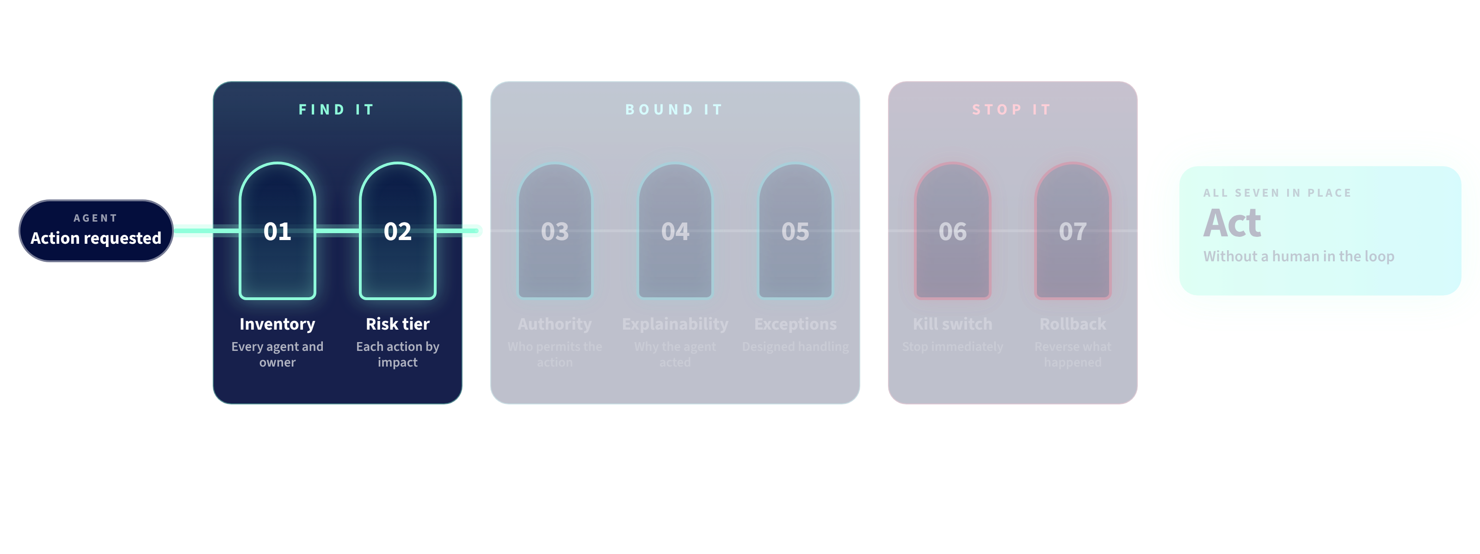
Permission to Automate.
Seven controls determine what an agent may do without a human in the loop.
© 2026 Crossfuze. All Rights Reserved.
Notes:
PERMISSION TO AUTOMATE | Start with the buyer's control concern: what may AI act on and who has authority? Across slides 7–10, the seven checks progressively show Find it / Bound it / Stop it. Do not treat these as four unrelated arguments; move quickly through the build.
--- EXISTING FACILITATOR NOTES ---
PERMISSION TO AUTOMATE
.
Crossfuze requires seven controls before autonomous execution without human-in-the-loop: 01 Inventory every agent and owner. 02 Risk tier each action. 03 Authority over what it may touch. 04 Explainability and a reasoned audit record. 05 Exception handling and handover. 06 A tested kill switch. 07 Rollback capability and accountable owner. If a required control is missing, agent may recommend but should not autonomously act.
Source: Crossfuze AI Readiness Assessment p.10.
Find it: know what agents exist and classify risk. Bound it: specify explicit limits, log why actions happen and define escalation to a person. Stop it: test the stop and know who can reverse the action.
If a required control is missing, AI may recommend, but should not take the autonomous action. This is a boundary decision, not a broad prediction of success.
Source: Crossfuze Readiness Assessment, Permission to Automate, p.10.

Slide 17
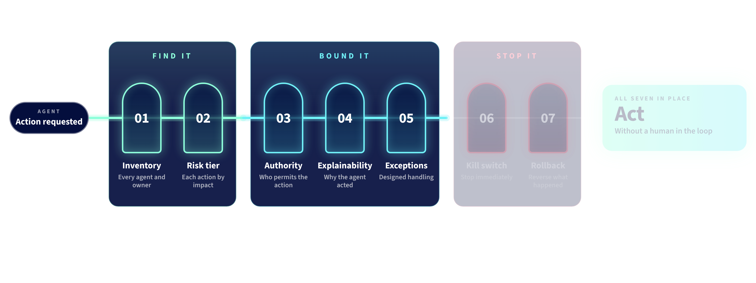
Permission to Automate.
Seven controls determine what an agent may do without a human in the loop.
© 2026 Crossfuze. All Rights Reserved.
Notes:
PERMISSION TO AUTOMATE BUILD | Continue the progression. Ask where explicit human approval is needed and what evidence must exist before an action.
--- EXISTING FACILITATOR NOTES ---
SLIDE 21 — PERMISSION TO AUTOMATE
Seven named controls must be checked before an agent executes actions without a human in the loop: (1) Inventory, (2) Risk tier, (3) Authority, (4) Explainability, (5) Exception handling, (6) Kill switch, (7) Rollback.
Find it: know what agents exist and classify risk. Bound it: specify explicit limits, log why actions happen and define escalation to a person. Stop it: test the stop and know who can reverse the action.
If a required control is missing, AI may recommend, but should not take the autonomous action. This is a boundary decision, not a broad prediction of success.
Source: Crossfuze Readiness Assessment, Permission to Automate, p.10.

Slide 18
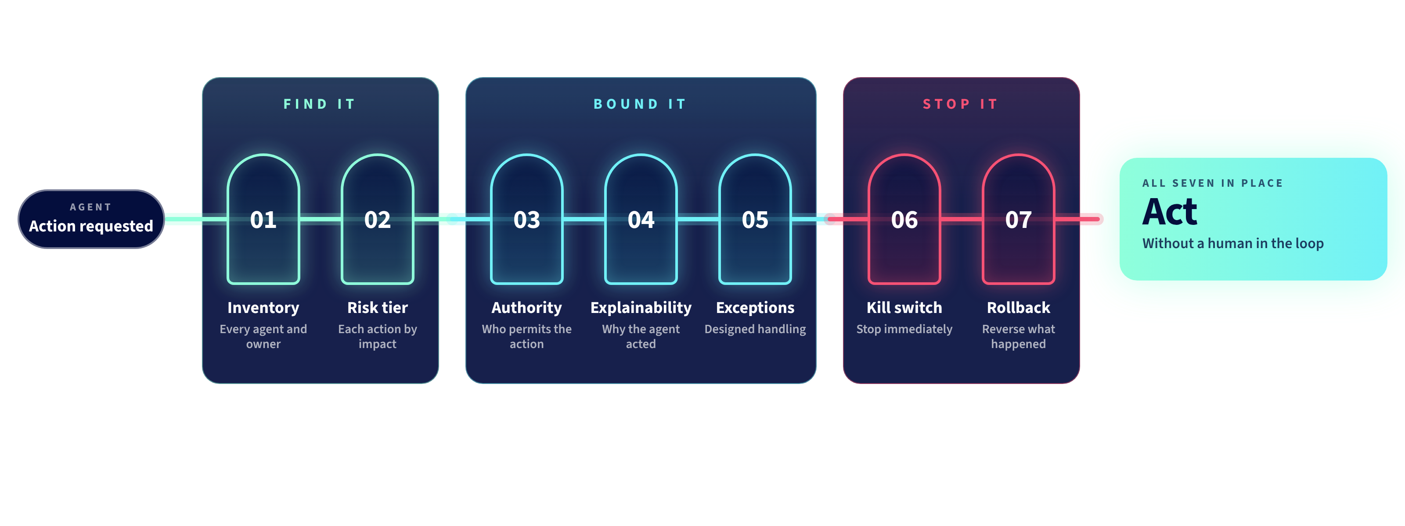
Permission to Automate.
Seven controls determine what an agent may do without a human in the loop.
© 2026 Crossfuze. All Rights Reserved.
Notes:
PERMISSION TO AUTOMATE BUILD | Continue the progression. Ensure tested stop and rollback are part of the boundary, not an afterthought.
--- EXISTING FACILITATOR NOTES ---
SLIDE 21 — PERMISSION TO AUTOMATE
Seven named controls must be checked before an agent executes actions without a human in the loop: (1) Inventory, (2) Risk tier, (3) Authority, (4) Explainability, (5) Exception handling, (6) Kill switch, (7) Rollback.
Find it: know what agents exist and classify risk. Bound it: specify explicit limits, log why actions happen and define escalation to a person. Stop it: test the stop and know who can reverse the action.
If a required control is missing, AI may recommend, but should not take the autonomous action. This is a boundary decision, not a broad prediction of success.
Source: Crossfuze Readiness Assessment, Permission to Automate, p.10.

Slide 19
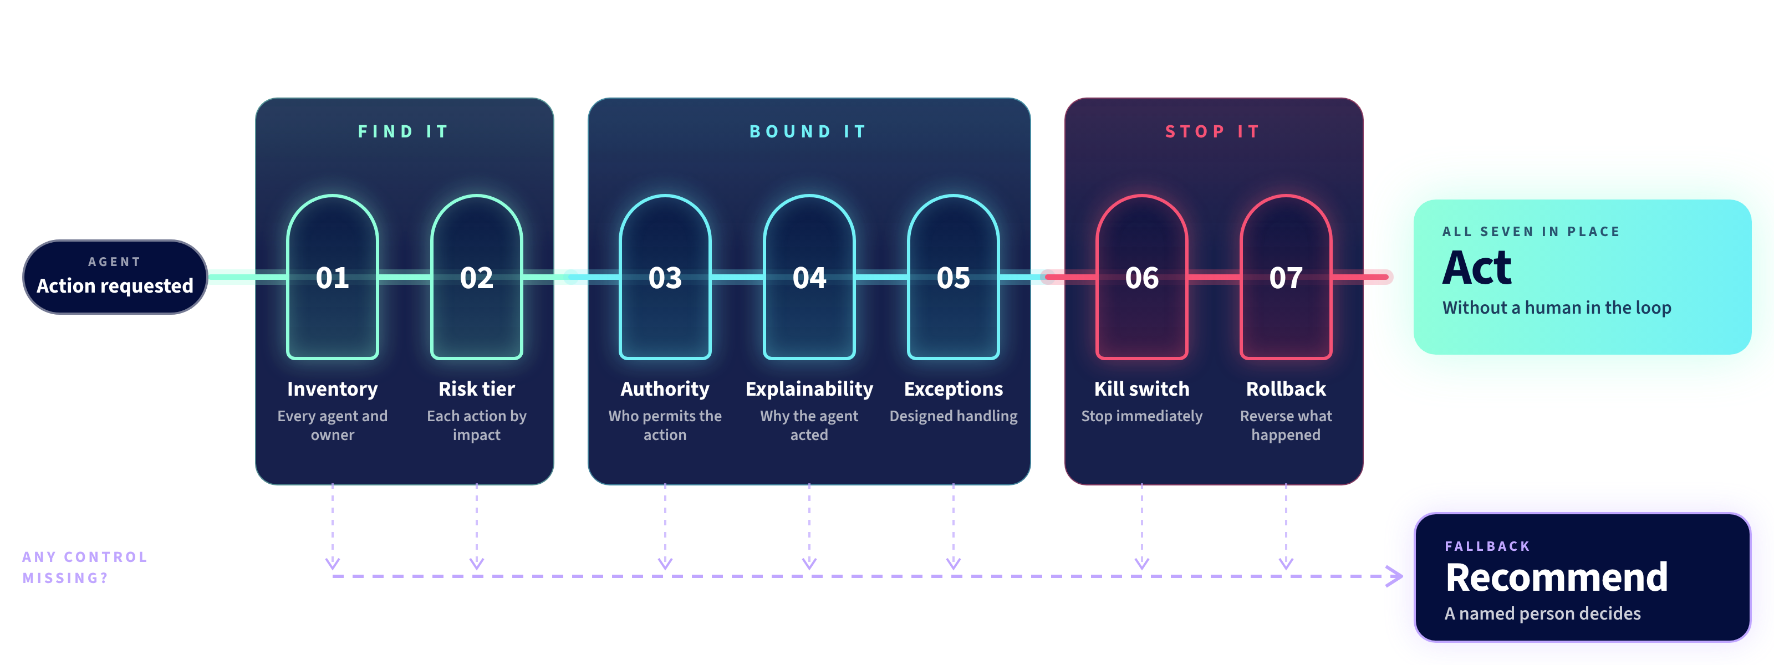
Permission to Automate.
Seven controls determine what an agent may do without a human in the loop.
© 2026 Crossfuze. All Rights Reserved.
Notes:
PERMISSION TO AUTOMATE COMPLETE | If any required control is missing, the agent may recommend, but should not independently perform the action. Record who can approve autonomous execution and which tests remain.
--- EXISTING FACILITATOR NOTES ---
SLIDE 21 — PERMISSION TO AUTOMATE
Seven named controls must be checked before an agent executes actions without a human in the loop: (1) Inventory, (2) Risk tier, (3) Authority, (4) Explainability, (5) Exception handling, (6) Kill switch, (7) Rollback.
Find it: know what agents exist and classify risk. Bound it: specify explicit limits, log why actions happen and define escalation to a person. Stop it: test the stop and know who can reverse the action.
If a required control is missing, AI may recommend, but should not take the autonomous action. This is a boundary decision, not a broad prediction of success.
Source: Crossfuze Readiness Assessment, Permission to Automate, p.10.

Slide 20












Get your data AI-ready
A first use case needs trusted, accessible, governed data.
Workflow Data Fabric
Connect your data where it lives, automatically contextualize it with business meaning, and maintain control as you seamlessly move from insights to automated actions all on one platform.
RaptorDB Pro
Increase AI, workflow,
and reporting performance
with an ultra-fast, next-
gen database engine that’s built for speed and scale.
Data & Analytics
CHECK 01
Validate CMDB / CSDM, critical fields, ownership, freshness and data access before action.
© 2026 Crossfuze. All Rights Reserved.
20
20
Notes:
DATA READINESS | WORKFLOW DATA FABRIC
Workflow Data Fabric connects and contextualises enterprise data; RaptorDB Pro addresses performance. This demonstrates platform possibilities, not evidence that the customer has implemented, configured or entitled these capabilities.
Crossfuze checks record reliability, CMDB and CSDM alignment, data access policy, service mapping, classifications, context freshness and any data movement or access restrictions relevant to the chosen use case.
ASK: which authoritative data sources must a proposed agent use? What are the specific fields where a wrong value would cause a harmful action?
Source: Crossfuze Readiness Assessment pp. 07–09.

Slide 21




Move Fast. Stay in Control.
Check the controls that apply before autonomous execution.
SERVICENOW VAULT
AI GUARDIAN
AI CONTROL TOWER
Secure
your Data
Govern
your workflows
Control, Manage,
& Measure your AI
Protect enterprise data used
to power every AI interaction.
Embed policy and trust into every
autonomous workflow, automatically.
Connect strategy to execution. See performance, cost, and risk in one place.
CHECK 03
Inventory · Risk tier · Authority · Explainability · Exceptions · Kill switch · Rollback
© 2026 Crossfuze. All Rights Reserved.
21
Notes:
PERMISSION TO AUTOMATE | CONTROL ARCHITECTURE
ServiceNow Vault, AI Guardian and AI Control Tower are platform governance components. Availability, configuration and coverage are customer-specific and must be verified.

Slide 22




Knowledge Graph
Requests
Full situational awareness of business and technical context
People
Location
Org Structures
Unified data, clear picture
Knowledge Graph connects data from across your systems into one coherent view of your environment.
Context that makes AI smarter
Business context and institutional knowledge, built in — so AI understands your environment, not just your data.
AI that acts, not just answers
AI that reasons against your Knowledge Graph takes informed action and delivers measurable outcomes.
External / Internal KB
Knowledge Graph
CSDM
Current
Changes
Prior Incidents
Discovery & Integrations
Service
Graph
Software Licenses
Assets
CMDB
ACC
CHECK 02
Confirm trusted articles, named owners, review dates and business-context relationships.
© 2026 Crossfuze. All Rights Reserved.
Notes:
KNOWLEDGE GRAPH | GROUNDING BEFORE ACTION
The ServiceNow Knowledge Graph provides architectural context, showing relationships across CMDB, CSDM, assets, changes, incidents, people and knowledge. This is not an assertion that the customer already possesses a comprehensive Knowledge Graph.
Readiness checks: identify knowledge the agent is permitted to use; verify business ownership; review stale articles and contradictory instructions; test for current, approved procedures; and define what happens when knowledge is absent or confidence is low.
Source: Crossfuze Readiness Assessment, pp. 07–10.

Slide 23

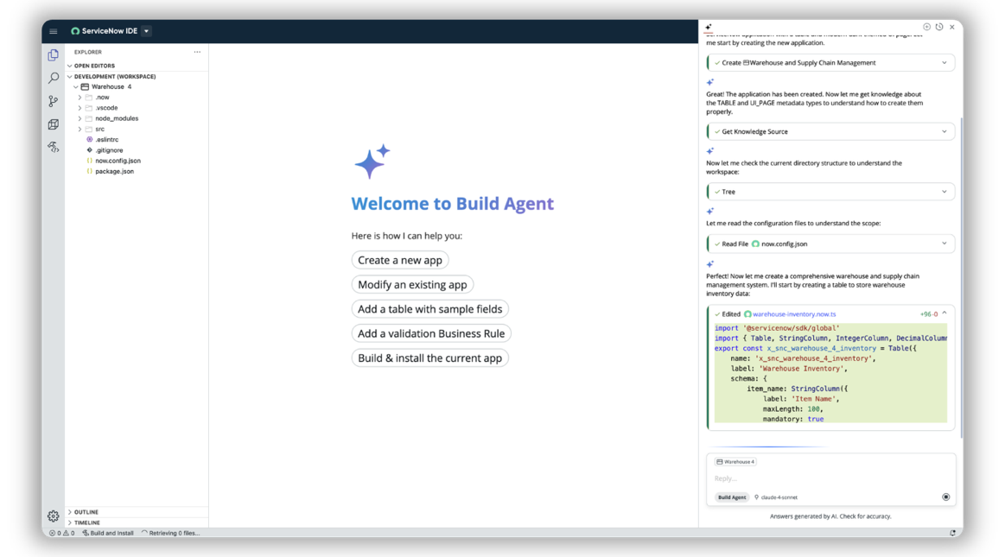
Build the workflow. Not another disconnected pilot.
Example: governed access-request workflow
Scope → configure → test → release
App Engine & Build Agent
Define the work
Map each action, decision and exception.
Design for control
Use approved platform rules and data.
Validate before live use
Test hand-offs, failure paths and rollback.
Release and improve
Ship a bounded use case, then measure.
Illustrative design pathway. Feature availability and configuration depend on the customer environment.
© 2026 Crossfuze. All Rights Reserved.
23
Notes:
FROM FIRST USE CASE TO CONFIGURED WORKFLOW
App Engine and Build Agent are ServiceNow platform capabilities that may help configure or create workflows, if entitled, configured and appropriate. Do not promise production readiness from the screenshot or product demonstration alone.
Proposed delivery gate: define the user story and acceptance criteria; map the data and workflow; agree the controls and owner; test normal, exception and rollback cases; release with measurable success criteria; capture actual performance and consumption. Crossfuze Extend implements approved backlog work rather than unapproved scope.
Source: Crossfuze AI RunState guide pp.17–19.

Slide 24
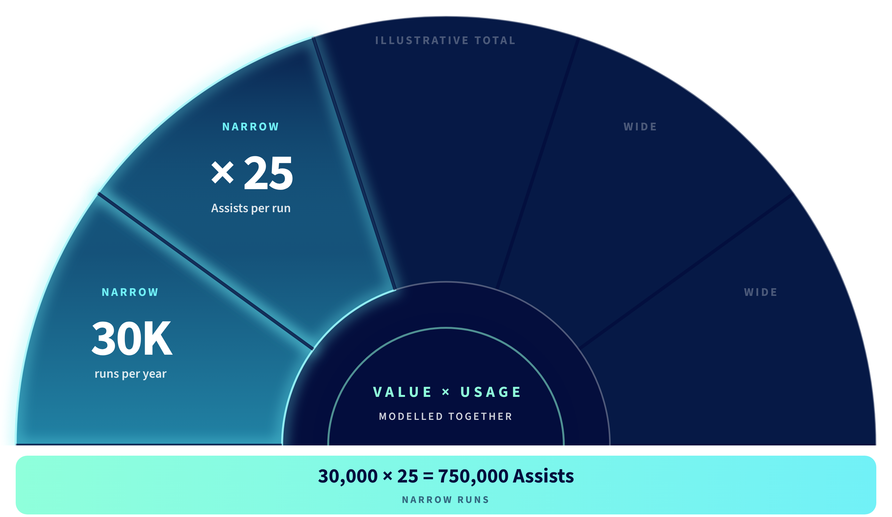
Value and consumption. Model them together.
© 2026 Crossfuze. All Rights Reserved.
24
Notes:
AI VALUE AND ASSIST CONSUMPTION
Illustrative model directly from the Crossfuze source guide: narrow run = 25 Assists for 0–4 tools; medium run = 50 Assists for 5–8 tools; wide run = 150 Assists for 9–20 tools. Example volume: 30,000 narrow and 5,000 wide runs annually => 1,500,000 Assists. Wide runs use six times more consumption per run than narrow.
This is NOT a customer forecast or quoted pricing. Verify workflows, process volumes, tool count, repeat runs, package entitlements, pooled allocations and renewal specifics with ServiceNow. Data Fabric credits and other meters may be separate.
Evaluate value alongside usage: time saved, cost to serve, successful transactions, escalation rate, customer satisfaction, risk of errors and expected implementation effort.
Source: Crossfuze AI Readiness Assessment pp.13–15.

Slide 25
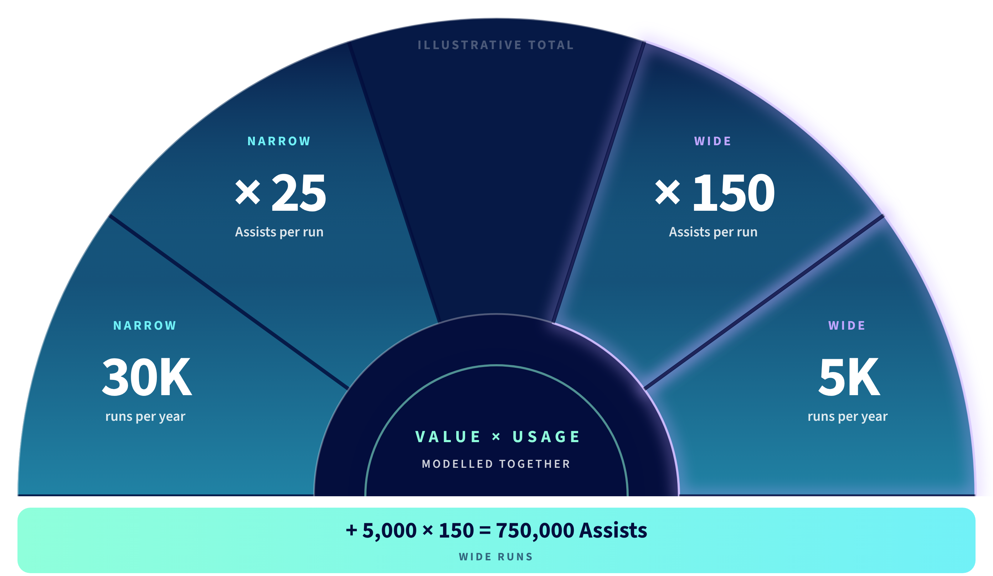
Value and consumption. Model them together.
© 2026 Crossfuze. All Rights Reserved.
25
Notes:
AI VALUE AND ASSIST CONSUMPTION
Illustrative model directly from the Crossfuze source guide: narrow run = 25 Assists for 0–4 tools; medium run = 50 Assists for 5–8 tools; wide run = 150 Assists for 9–20 tools. Example volume: 30,000 narrow and 5,000 wide runs annually => 1,500,000 Assists. Wide runs use six times more consumption per run than narrow.
This is NOT a customer forecast or quoted pricing. Verify workflows, process volumes, tool count, repeat runs, package entitlements, pooled allocations and renewal specifics with ServiceNow. Data Fabric credits and other meters may be separate.
Evaluate value alongside usage: time saved, cost to serve, successful transactions, escalation rate, customer satisfaction, risk of errors and expected implementation effort.
Source: Crossfuze AI Readiness Assessment pp.13–15.

Slide 26
CONCEPT 04
The Annual Wheel
M12
M1
Advisory month
M11
M2
Backlog cycle month
M10
M3
12 months
Extend only
M9
M4
Small dot: Extend running alongside
M8
M5
Month 3 adds onboarding before sprints start in month 4.
M7
M6
Best for: a single-glance view of the whole year that reads like a calendar.

Slide 27
CROSSFUZE / AI RUNSTATE
One repeating loop. Three distinct jobs.
A plan only creates value when it becomes accepted, delivery-ready work.
01
02
03
ADVISORY
➜
BACKLOG PRIORITIZATION
➜
EXTEND
Define value and constraints
Refine and approve stories
Configure and test accepted work
AI Action Plan + strategic refresh
Feasibility, acceptance & estimates
Nine months of monthly capacity
APPROVAL GATE
Customer PO approves stories · Technical Lead accepts them for Extend sprints
Repeat: advisory revisits direction · backlog cycles refresh priorities · Extend consumes accepted stories.
CROSSFUZE · AI RUNSTATE
12
Notes:
FEEDBACK LOOP | SOURCE CONCEPT 01 ADAPTED
Based on AI_Run_State_-_Flow_and_Timeline_Concepts.pptx, The Feedback Loop (concept 01), checked against draft SOW pages 3-4. Advisory generates AI Action Plan. It is not sprint-ready. Backlog Prioritization converts outputs/customer demand into feasible, estimated, approved User Stories. Customer Product Owner approves and Crossfuze TL accepts work before it enters an Extend sprint. Extend delivers only within signed scope and monthly capacity. The second advisory review refreshes direction based on actual circumstances. Flow is cyclical, not automatic acceptance of all ideas.

Slide 28
CROSSFUZE / AI RUNSTATE
Clear ownership. One delivery record.
Crossfuze and the customer each have decision-making and operational responsibilities.
CUSTOMER
CROSSFUZE
• Appoint executive sponsor and Product Owner
• Supply access, licences and demand priorities
• Approve delivery-ready stories and changes
• Perform UAT and approve production use
• Own AI data, human oversight and monitoring
• Facilitate the AI Action Plan and reviews
• Refine, assess and estimate proposed stories
• Assign Technical Lead and schedule sprints
• Configure, test and review approved work
• Report delivery status through the CDP
CROSSFUZE DELIVERY PLATFORM (CDP) · Stories, approvals, tests, risks, decisions and visibility
CROSSFUZE · AI RUNSTATE
15
Notes:
CUSTOMER RESPONSIBILITIES AND CDP
SOW pages 1 and 5-6. Customer appoints executive sponsor, Product Owner, Customer Lead and technical stakeholders; provides relevant systems/access/licensing/information; owns demand and priorities; approves stories and conducts UAT and production approval; retains AI-specific decisions including suitable human oversight, data approvals, AI testing and post-deployment monitoring. Crossfuze provides advisory, backlog prioritization, TL-led Extend review/configuration and technical testing. CDP supports status, user stories, approvals, testing, issues, risks and decisions. Customer delays may cause forfeited unused capacity, no extension or rollover. Do not claim Crossfuze runs ongoing managed AI monitoring unless separately contracted.

Slide 29
CROSSFUZE / AI RUNSTATE
From accepted story to approved release.
No backlog item automatically becomes a sprint deliverable.
01
02
03
04
05
STORY
›
TECHNICAL
›
DELIVERY
›
CUSTOMER UAT
›
RELEASE
Customer PO approves scope and criteria
TL assesses and accepts for sprint
Configure, test and show back
Validate agreed acceptance criteria
Customer authorises production use
DEFECT · Failure to meet approved criteria, where attributable to Crossfuze.
ENHANCEMENT · New or changed functionality requires separate agreement.
CROSSFUZE · AI RUNSTATE
16
Notes:
ACCEPTANCE AND CHANGE CONTROL
SOW definitions pages 1-2 and scope pages 3-5: acceptance criteria define each story; customer PO approves stories; Crossfuze TL must assess/accept before sprint. Sprint showback demonstrates progress and facilitates criteria validation. Customer performs UAT, accepts stories and approves promotion to production. Advisory and Backlog deliverables have a separate five-business-day deemed acceptance period after delivery absent written material nonconformity. Defect is a failure of approved criteria caused by Crossfuze, subject to exclusions. Enhancement is outside agreed criteria/change to functionality and requires separate scope/price approval. Customer delays do not extend Term or roll hours.

Slide 30
CROSSFUZE / AI RUNSTATE
How activity shifts through the year.
An indicative effort heatmap, not a commitment to a fixed number of releases.
M1
M2
M3
M4
M5
M6
M7
M8
M9
M10
M11
M12
STRATEGY
PRIORITIZATION
EXECUTION
M3 = Extend onboarding · M4–M12 = 80 hours/month · All bands indicate activity, not guaranteed output.
CROSSFUZE · AI RUNSTATE
18
Notes:
EFFORT HEATMAP | SOURCE CONCEPT 09 ADAPTED
Adapted from AI_Run_State_-_Flow_and_Timeline_Concepts.pptx, concept 09, but corrected for SOW timeline. Dark/bright cells indicate active phases, not guaranteed fixed intensity or hours apart from Extend 80h monthly cap. AI Action Plan months 1-2 and follow-up 7-8; backlog cycles 3-4,6-7,9-10 and 12; Extend onboarding month 3 then actual delivery months 4-12. Do not present this as an effort utilization promise. Optional supporting visual when explaining annual cadence.

