Slide 1
FluA – Trimer crosslinking results
Samples:
1: DSS-noRNA
2. DSS-RNA
5: DSS-noRNA (pulsed)

Slide 2
Exp. Tag: XLMS_FB03
Number of crosslinks identified in FluA Trimer complex
Exp. Parameters:
ld-score cut-off: >=20
PPM: -4 to +7
deltaS: 0.95
FDR: 0.05
Observation:
1. more InterXLinks in “noRNA” samples
2. 2mM static better than “pulsed” sample (in number of Xlinks identified)

Slide 3
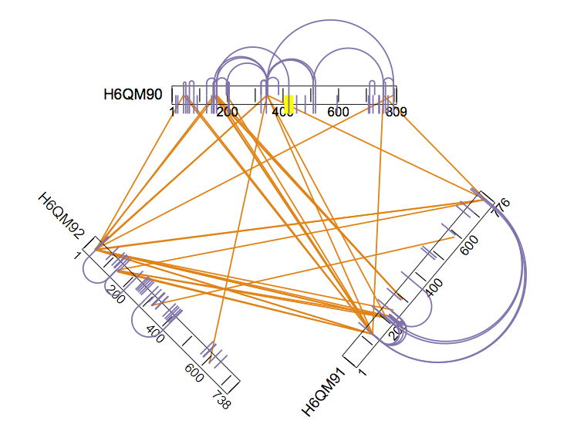
Exp. Tag: XLMS_FB03
FluA-Trimer: 1-DSS_noRNA
PA – H6QM92
PB1 – H6QM91
PB2 – H6QM90
Weblink:
http://webhosting.structures.embl.de/mbecktest/crosslink-viewer/php/uploaded.php?uid=14ab80e71376935004f83a879268da8b41be4887

Slide 4
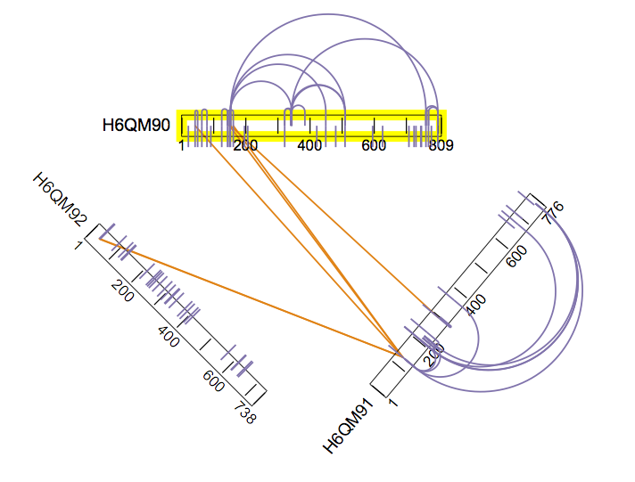
Exp. Tag: XLMS_FB03
FluA-Trimer: 2-DSS_RNA
PA – H6QM92
PB1 – H6QM91
PB2 – H6QM90
Weblink:
http://webhosting.structures.embl.de/mbecktest/crosslink-viewer/php/uploaded.php?uid=d49803cc37befe8491934405f07e0630bfa83772

Slide 5
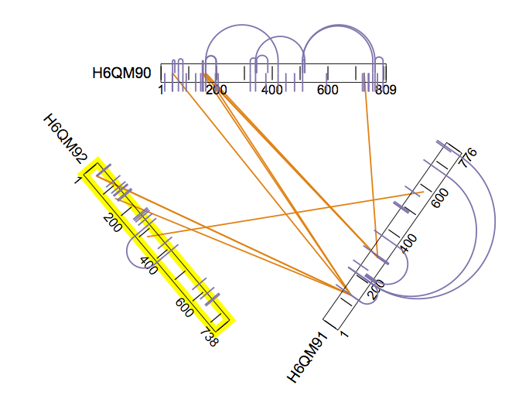
Exp. Tag: XLMS_FB03
FluA-Trimer: 5-DSS_RNA_pulse
PA – H6QM92
PB1 – H6QM91
PB2 – H6QM90
Weblink:
http://webhosting.structures.embl.de/mbecktest/crosslink-viewer/php/uploaded.php?uid=b708f05f35d12d849ec18d0b6909df60e377865f

Slide 6
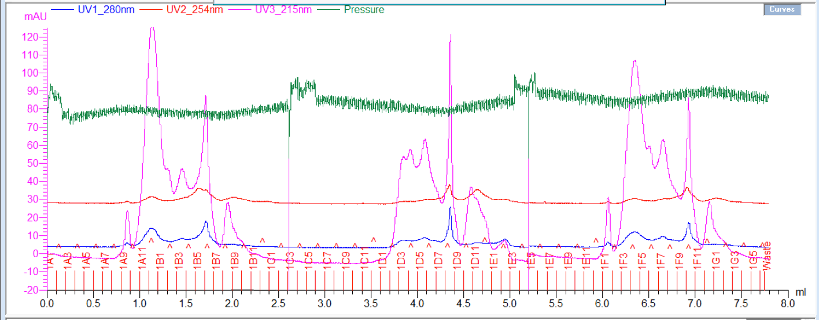
Exp. Tag: XLMS_FB03
Peptide Gel filtration:
FluA-Trimer
Nr5
Nr1
Nr2
Arrow points to “shoulder”, indicating many crosslinked peptides in this sample.
“Shoulder less prominent in Sample Nr5 + Nr2, small separate peak visible here.
“Line” indicates where 3 MS fractions were taken from (duplicate injection each).
-> Nr1 provided most Xlink results (noRNA, static 2 mM DSS)

