Slide 1
OutOfMemoryError
A Distributed Search Engine

Slide 2
Introduction
Goal:
To build a Search Engine Similar to Google’s.
Technologies/Tools Used:
Java
Amazon Elastic Cloud Compute (EC2) Instances. (10 Nodes)
Storage on Amazon S3.
Free Pastry – Substrate for Peer to Peer Applications
Amazon Elastic Map Reduce [Amazon’s version of Hadoop]
Oracle Berkeley DB - high Performance Embedded Database. Key – Value Store.
Ebay API , DuckDuckGo API Integration
REST Based Interface for the Search Engine

Slide 3
Components
Web Crawler / Spider:
Crawls over the Web from a list of seed URL’s.
Peer to Peer Network:
Free Pastry nodes form a decentralized, self-organizing and fault-tolerant overlay network within the Internet.
Keeps all nodes connected to each other. Can send and receive messages between each nodes.
Indexer / TF-IDF Retrieval Engine:
Extracts the contents of a Web Page and processes it.
Page Rank:
Calculates the Popularity of a URL. (Invented by Sergey Brin and Larry Page)
Search Engine:
Calculates the results for keywords based on a “Secret Formula”

Slide 4
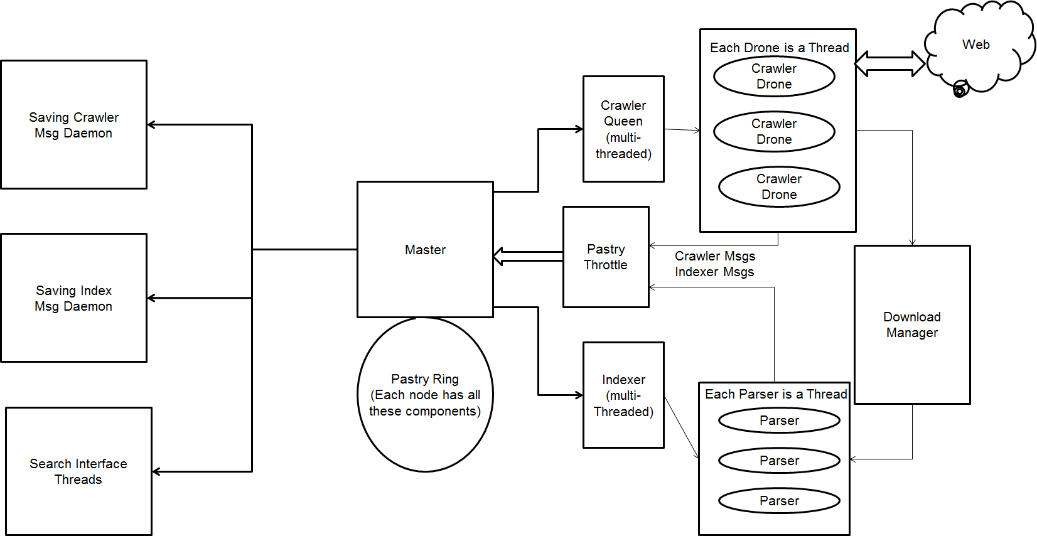
System Architecture

Slide 5
Web Crawler
Distributed & Multi- Threaded Crawler on each node. (Thread pooling)
Needs Seed URL’s to Start on.
Each node contains a single Crawler Queen and a varying number of Crawler Drones
Crawler Queen:
responsible for URL assignment to drones.
Obeys the Robots.txt (Good Netizen)
Breadth first search rather than depth first.
One thread per one domain to avoid too many calls to a particular server
Crawler Drones:
Drones downloads the web page contents and puts them in the Download manager.
Extracts the URL’s in the Downloaded Web Page.
Distributes the Extracted URL’s to other nodes
Sends it to the pastry throttle (URL messages – URL Objects)

Slide 6
Page Manager
Enables Crawler to be entirely persistent, in the event of a force termination
Contains four basic tables
a queue of pages to crawl,
a list of pages already crawled,
a list of hosts and their most recent access,
a table storing the md5 checksum of each crawled page
Host Tracker, [no two drones of the same queen are ever crawling the same host]
Duplicate crawls are easily avoided by consulting both the list of crawled URLs and the list of MD5 hashes of the Webpage Contents.
DownLoad Manager
Singleton used by both Crawler Drones and Indexer processors
Crawler Drones puts in the Web Page Objects that they have downloaded

Slide 7
Indexer / TF-IDF Retrieval Engine
Distributed and Multithreaded; # of Crawler Threads : # of Indexer Threads = 2:1
JSoup Parser to parse the HTML Document. Similar to jQuery.
Each thread retrieves one Web Page from the Download Manager.
Extracts the content based on <b>, <h1>,<h2>, <img alt=“”/>. etc.
Strips of Html tags and gets the remaining content
Calculates Weight of the words based on the Tags.
Calculates Term Frequency (# of Occurrences of the Word in the page)
Forms a Inverted Index of Porter Stemmed Words. [fishing, fished, fish = fish ]
URLDataObjects- >[ Stem word, URL , Weight, TF, List of Indices]
Puts these into pastry throttle. ( Index Messages - URLDataObjects )

Slide 8
Pastry Network
Each node in the Pastry network has a unique, uniform random identifier (NodeId) in a circular 128-bit identifier space based on Hashing of IP Address & Port number.
Handles node joining and leaving. Also, Handles distribution of data on the network based on Node Id.
Pastry Throttle
Crawling and indexing occurred concurrently, [ #URLDataObjects is very high]
A threshold implemented that imposed a maximum number of messages that could remain in the throttle awaiting transmission.
On exceeding, the crawling on that node would be paused while the throttle was emptied at a safe rate; crawling was resumed once the throttle was entirely empty.
Stemmed Word (Key) => List of URLDataObjects [ Stem word, URL , Weight, TF, List of Indices]
Hash the Key and route it to the node responsible for storing the content . Persisted.

Slide 9
Page Rank
Crawler Drones deposit into S3 Uploader [ URL – > List of URL’s]
S3 Uploader
S3 Uploader writes it a file. Uploads to Amazon S3 after certain file size is reached.
Asynchronous uploading by a separate thread.
Hadoop/Map Reduce to calculate the page-rank
Calculates the value for the popularity of a web page. i.e Based on number of URL’s pointing to the page and number of URL’s you are pointing to.
Example :
If more number of URLs are pointing to you. (your page has more legitimacy) [Wikipedia, CNN]
The values that you have aquired are then redistributed to the URL’s you are pointing to.
goes in a loop till the values gets saturated after multiple iterations.
After all the files have been collected. EMR runs the code. That calculates the values. Writes it back to S3.
S3 Downloader downloads the calculated values in a flat file , parses the values and distributes to the nodes based on URL’s Hash value for Seaching.

Slide 10
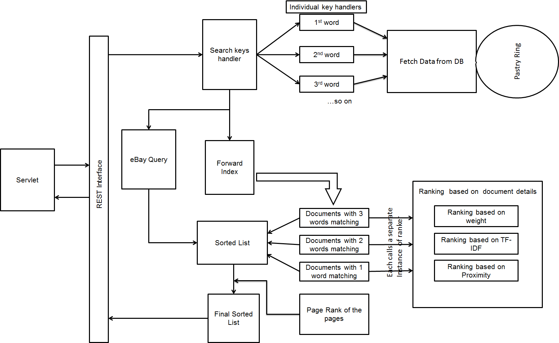
Search Engine Architecture

Slide 11
Challenges & Design Considerations
Most of the Web Pages are badly formed. No closing tags , etc. DOM based parsers (Sax Parser) does not work for html documents.
Spider Traps (Calendar Links – keeps going on , dynamically generated URL’s ).
Network is the biggest Bottle neck in distributed system. Cant handle too many messages.
Memory Leak with Free Pastry. ( Not being Garbage Collected )
Should have implemented two Pastry Rings. URL Messages & URLDataObjects.
Heap space allocation errors and Disk space errors
Disk space errors arose when we observed the Berkeley DB stores occupying 10-20x more
timer that limited the rate of syncing for the Berkeley DB environment
System is capable of running Crawling, Indexing and Searching Simultaneously.
System will give out the result for any query in less than 900ms.
~ 350,000 Web Pages Crawled & Indexed. 800 WebPages /Minute (crawling & Indexing)

Slide 12
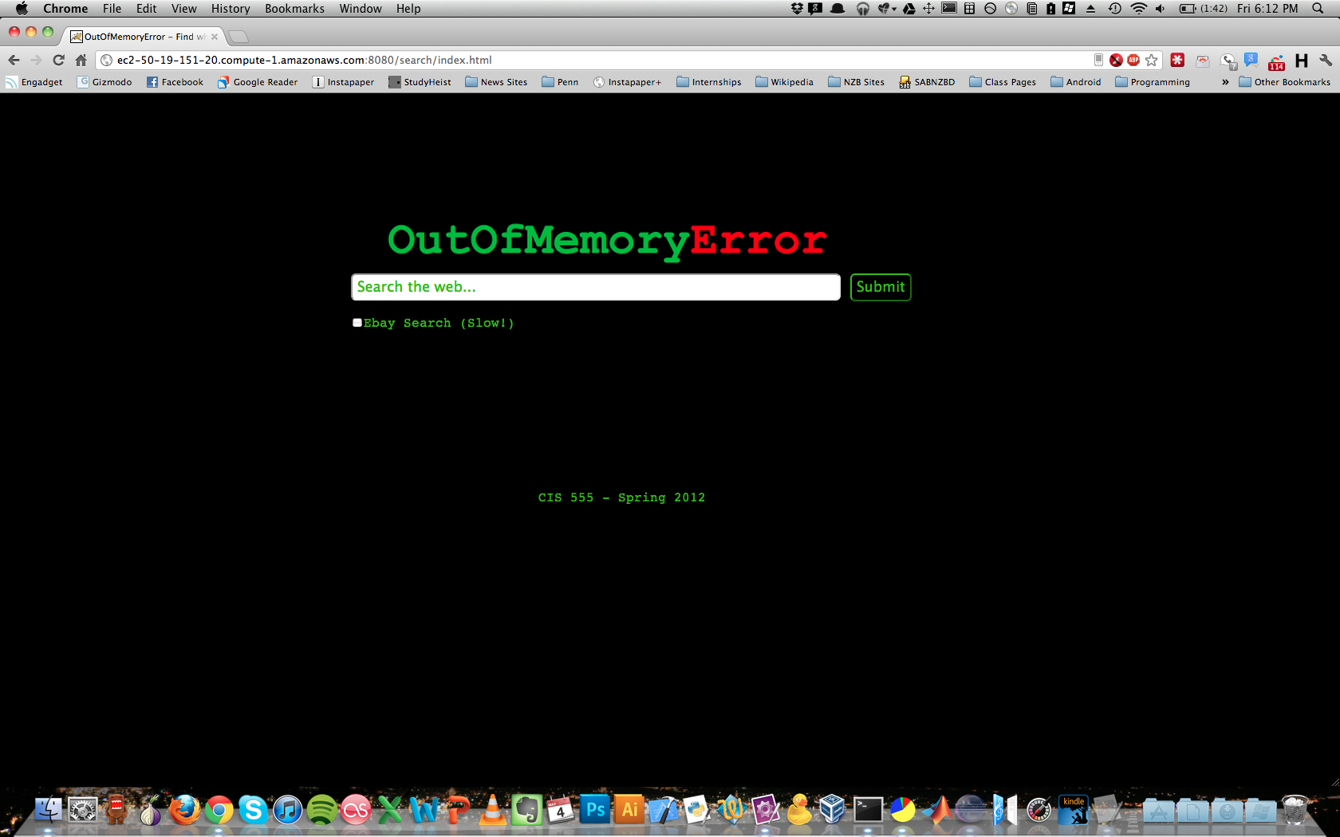

Slide 13
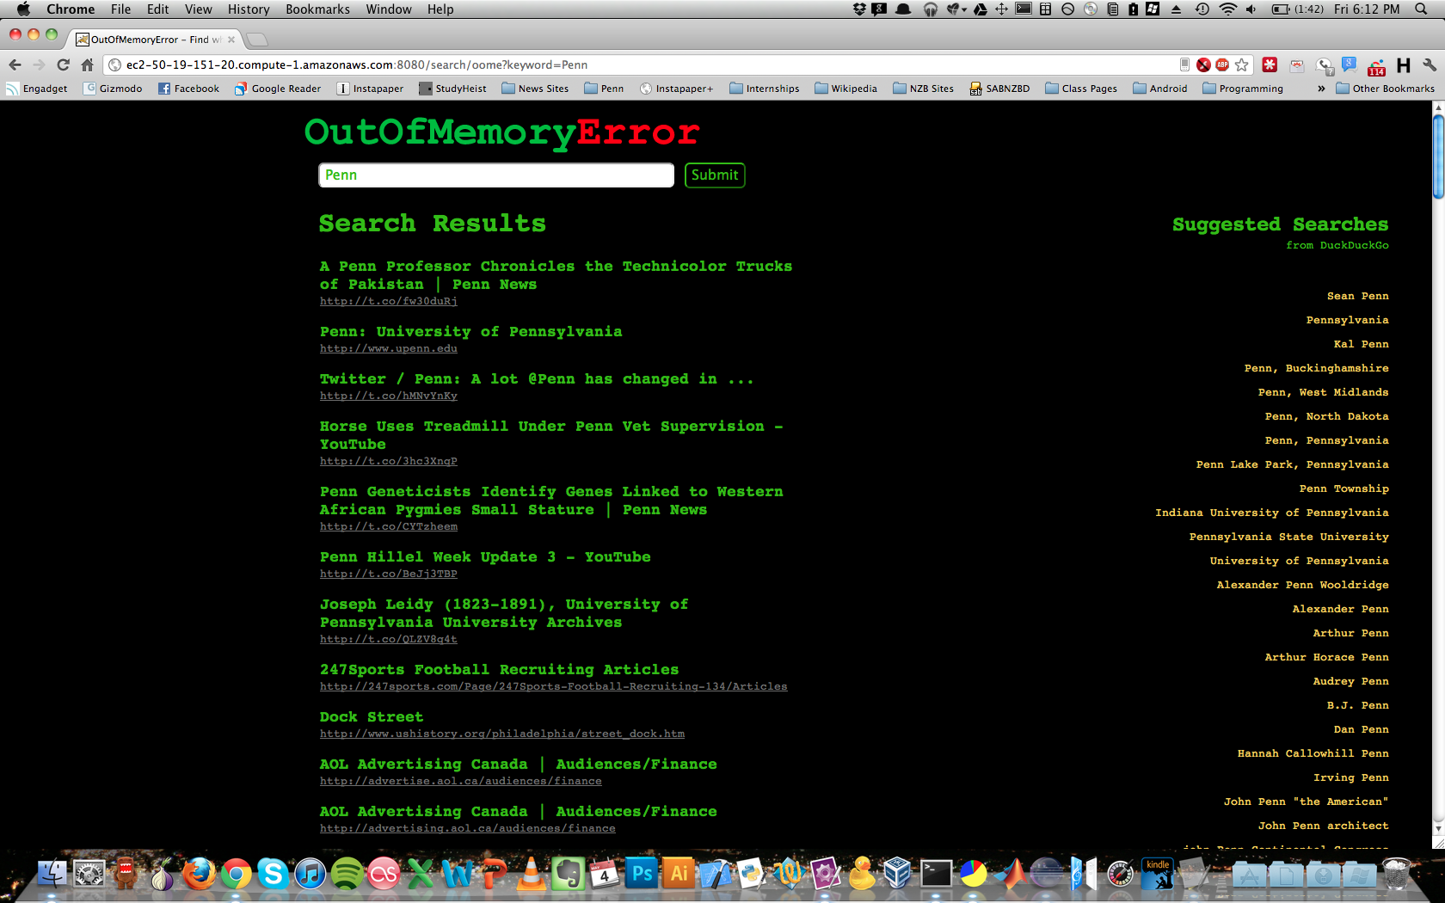

Slide 14
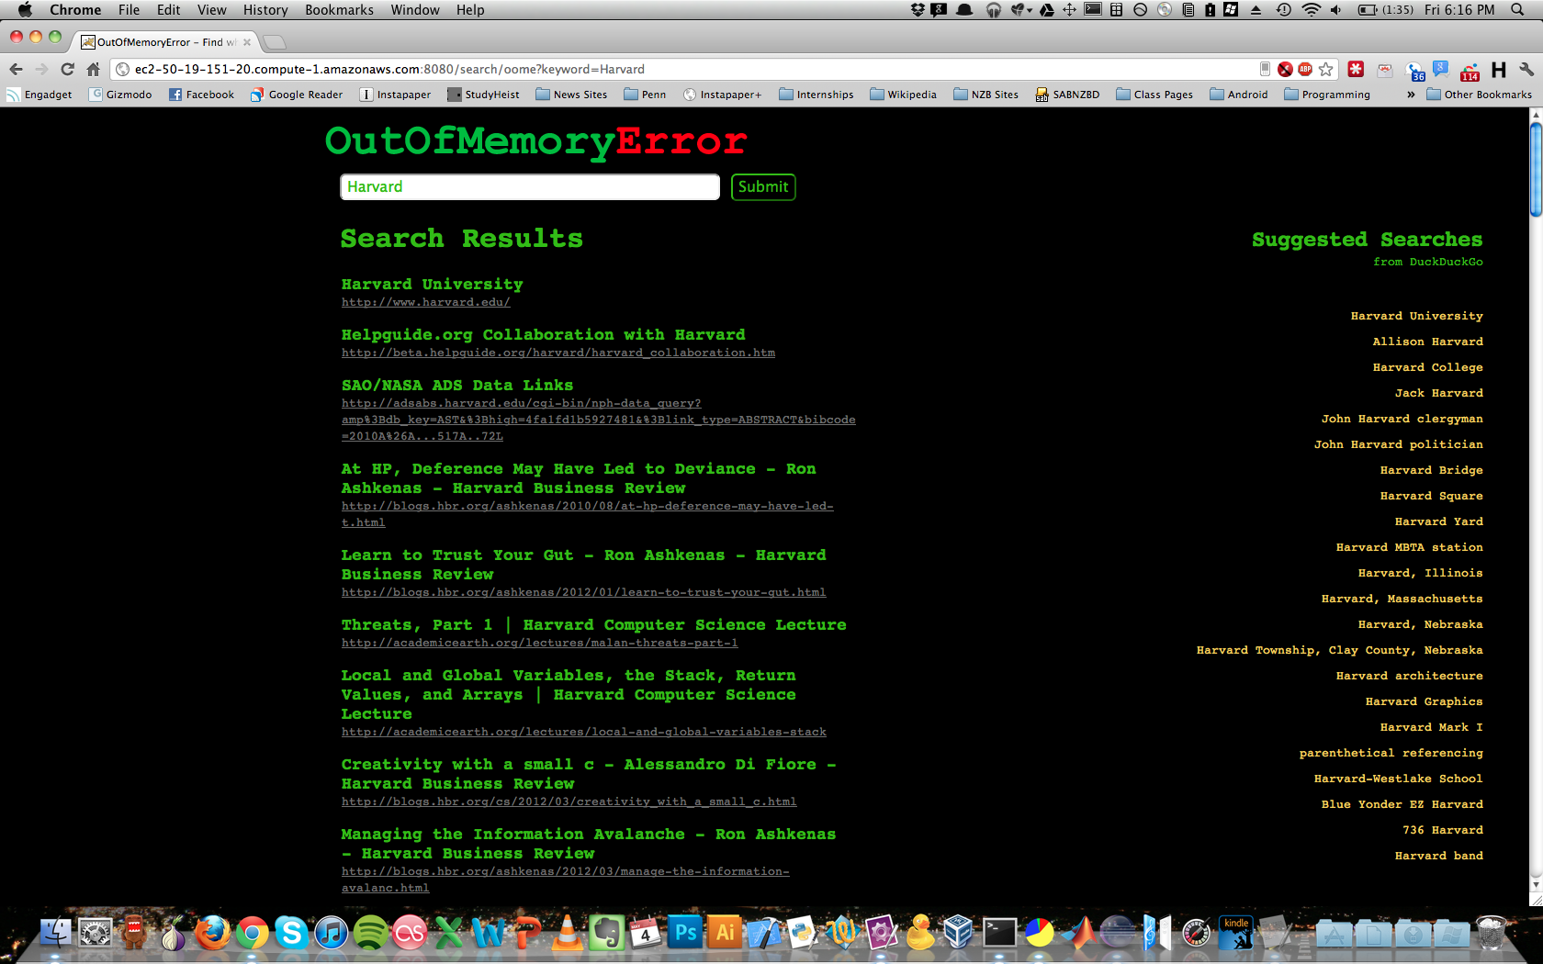

Slide 15
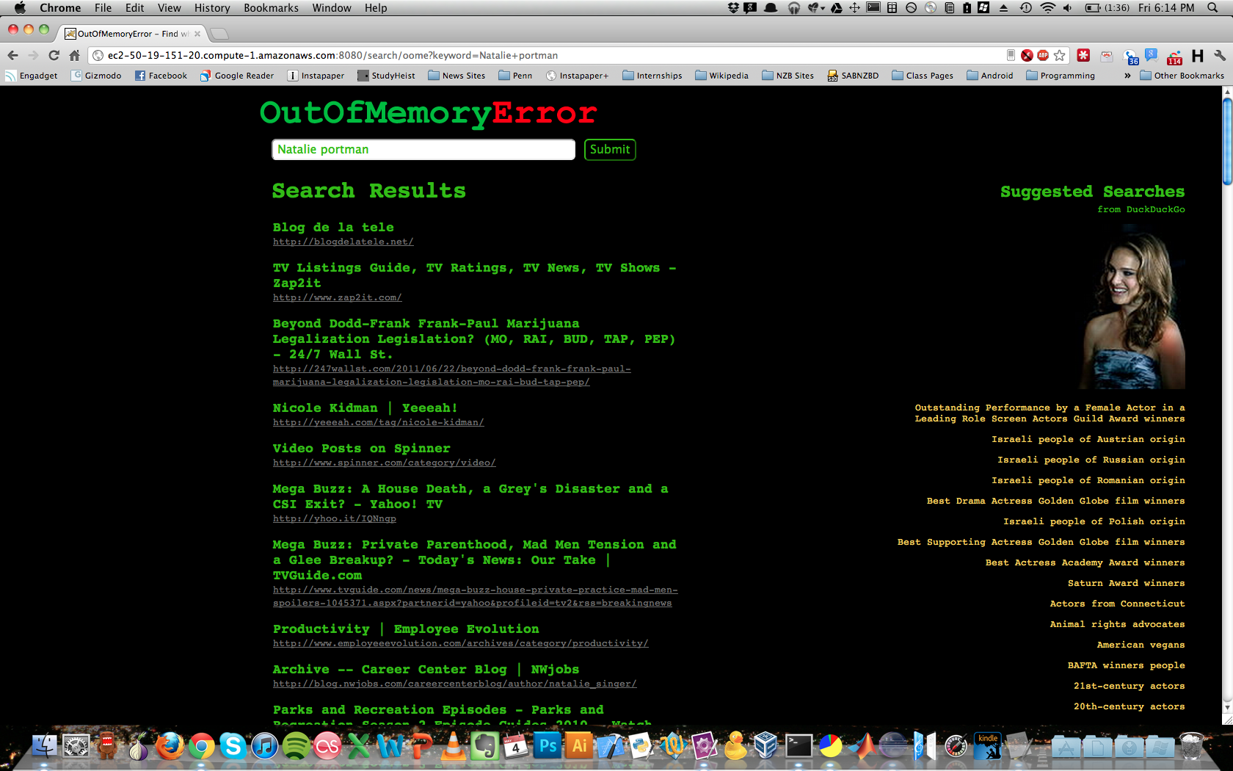

Slide 16
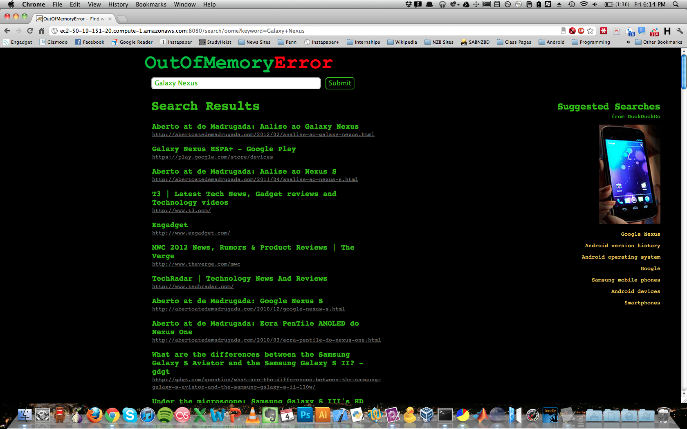

Slide 17
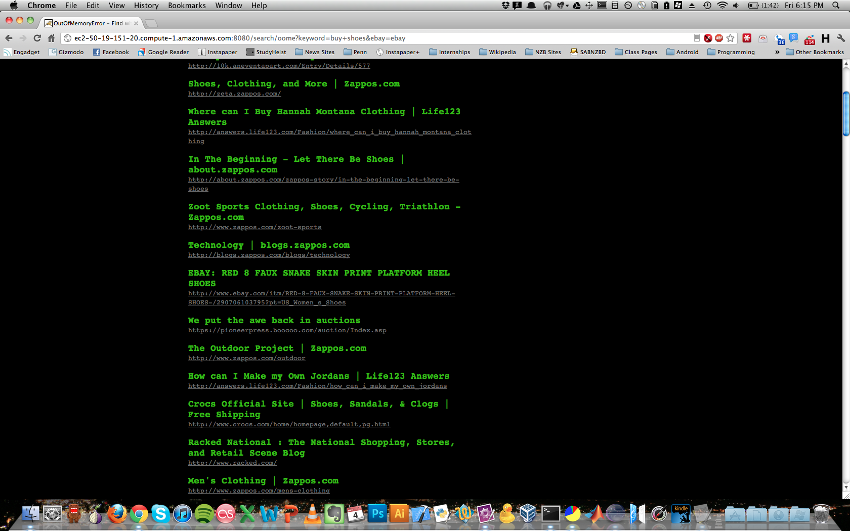

Slide 18
