Slide 1




TEMPLATE 01 — COVER, SIGNAL GRADIENT
Pre-purchase behavioral
intelligence for [Client].
190M
$9B
2 in 3
monthly ad-tier viewers
projected ad revenue by 2029
panelists are [Client] subscribers
49
CONFIDENTIAL

Slide 2


TEMPLATE 02 · COVER, HALF-BLEED
Real-time human behavior
infrastructure for [Client].
HALF BLEED · 6.733 x 7.500 · RIGHT EDGE
The grounded signal that models cannot generate and cannot train without.
300T
human text tokens, gone by 2028
74%
of new web pages are AI-generated
30M
opted-in panelists to date
50
CONFIDENTIAL

Slide 3
TEMPLATE 03 · COVER, FULL BLEED + COPY SHADOW
Every consumer journey
becomes intelligence.
IMAGE · 13.333 x 7.500 · FULL BLEED
One consumer. One ordinary day.
Every moment is an observed signal.
51
CONFIDENTIAL

Slide 4
TEMPLATE 04 — SECTION DIVIDER
SECTION 02
The distribution dynamic.
Where the index goes quiet and where it explodes. Same audience, same study, opposite ends of the retail map.
01 Retail behavior
02 Purchase fingerprint
03 Channel versus format
04 The opportunity
52
CROSSWALK / BEHAVIORAL INTELLIGENCE ENGINE

Slide 5

TEMPLATE 05 — STATEMENT, ORCHID
Signal-driven media buying is replacing audience buying.
Advertisers no longer pay for demographics. They pay for intent, for the person who is about to buy. That signal is the scarce input.
53
CROSSWALK / BEHAVIORAL INTELLIGENCE ENGINE

Slide 6
TEMPLATE 06 — WEIGHT PAIR OVER IMAGERY
Retargeting reaches yesterday's customer.
Crosswalk reaches tomorrow's.
The pre-purchase research window is where a brand is still winnable.
54
CROSSWALK / BEHAVIORAL INTELLIGENCE ENGINE

Slide 7
TEMPLATE 07 — ARGUMENT AND EVIDENCE
You see them on one platform.
We see them everywhere else.
WHAT YOUR STACK SEES
WHAT WE ADD
—
Owned platform viewership
30M panelists to date, 10M active daily
—
Nielsen, MRI, comScore
What subscribers do off-platform
—
First-party CRM
What they do before sign-up and after churn
—
Surveys and focus groups
Cross-platform overlap on any title
Source: Crosswalk single-source behavioral panel
55
CROSSWALK / BEHAVIORAL INTELLIGENCE ENGINE

Slide 8
TEMPLATE 08 — STAT ROW AND CHART
The market just entered
signal-driven advertising.
March 2026: the platform opened its ad inventory to third-party demand, formally entering the signal-driven ad ecosystem.
$9.0B
$7.1B
$5.4B
190M
Monthly ad-tier viewers
$3.6B
$2.2B
325M
Global paid subscribers
$1.4B
~2%
Annual churn, best in class
2024
2025
2026
2027
2028
2029
AD REVENUE TRAJECTORY ($B)
Source: company disclosures; analyst estimates
56
CROSSWALK / BEHAVIORAL INTELLIGENCE ENGINE

Slide 9
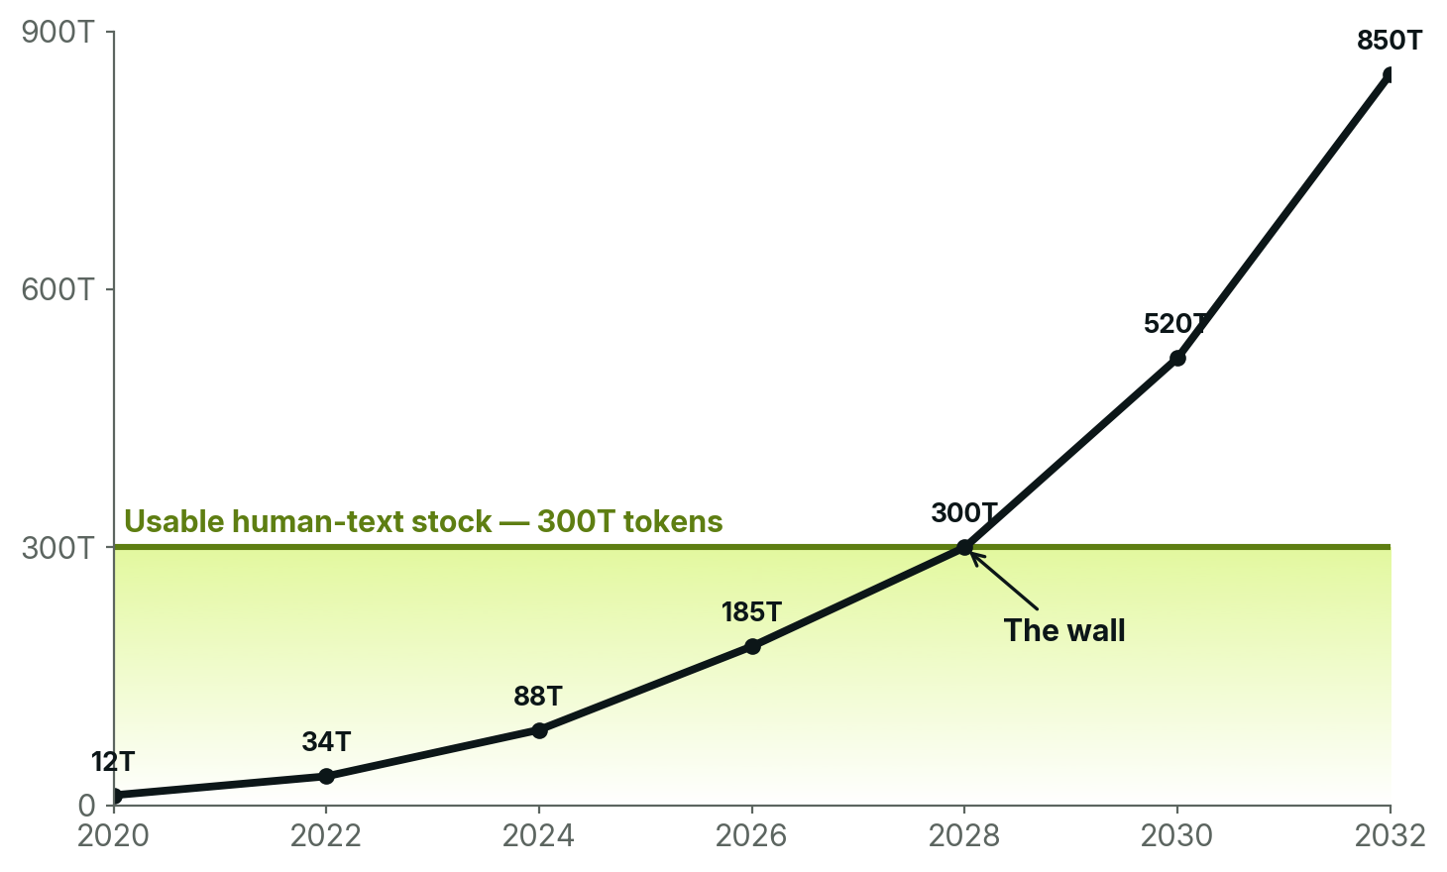
TEMPLATE 09 — HERO CALLOUT
The web is running out of human text.
300T
tokens, the entire usable stock of quality human text, projected fully consumed between 2026 and 2032.
High-quality text goes first, as early as 2026. Licensing cannot refill a finite stock.
For the last frontier model, data ran out before compute did.
Source: Epoch AI (2024)
57
CROSSWALK / BEHAVIORAL INTELLIGENCE ENGINE

Slide 10
TEMPLATE 10 — SIX-CELL PANEL
What Crosswalk adds.
Six ways AI teams use one consented behavioral panel.
01
02
03
Behavioral RLHF
Consumer Reasoning
Intent Modeling
Replace thumbs up and down with real-world behavioral outcomes: engagement sequences, longitudinal satisfaction, revealed preference.
Train on the decision sequences consumers actually follow: research, comparison, trust signals and purchase triggers.
Model how intent forms and evolves. Understand what precedes a query and what follows an answer.
04
05
06
Real-Time RAG
Agentic Ground Truth
Benchmark Validation
Ground behavioral queries in live Crosswalk intelligence via API, refreshed daily.
Commerce agents and autonomous assistants require real-world behavioral reinforcement. Crosswalk is the feedback loop.
Validate or refute any claim about consumer behavior, with outputs that hold up to an audit.
58
CROSSWALK / BEHAVIORAL INTELLIGENCE ENGINE

Slide 11
TEMPLATE 11 — FOUR-STEP PROCESS
The model sees the prompt.
We see the journey.
01
02
03
04
ATTENTION
INTENT
ACTION
AFTEREFFECT
What people watch, read, scroll, search, open, save, and return to.
What they compare, revisit, research, add to cart, price-check, and ask about.
What they buy or abandon, subscribe to or cancel, download, attend and stream.
What changes afterward: loyalty, churn, follow-on purchases, share of time, and next intent.
59
CROSSWALK / BEHAVIORAL INTELLIGENCE ENGINE

Slide 12
TEMPLATE 12 — COMPARISON MATRIX
Signal comparison.
Two sources, one column each, one row per capability. The winning column carries the accent.
Signal Type
Amazon Audiences
Crosswalk
Purchase history
Amazon transactions only
Cross-platform e-commerce
Product search intent
Amazon.com searches
Open-web, social, AI tools
Brand comparison
Limited to Amazon marketplace
Cross-brand, cross-category migration
Pre-purchase research
✗ Not available
Longitudinal behavioral tracking
Competitive media usage
Prime Video only
All streaming, audio, social platforms
Churn / subscription flow
✗ Not available
Real-time platform switching
Emerging trend detection
✗ Not available
Early behavioral shift signals
Key insight: Amazon tells advertisers who already bought. Crosswalk tells advertisers who is about to buy. The difference between retargeting yesterday's customer and capturing tomorrow's.
60
CROSSWALK / BEHAVIORAL INTELLIGENCE ENGINE

Slide 13
TEMPLATE 13 — RANKED INDEX LIST
Ranked by index.
Every entry above a stated penetration floor, ranked by index. Stating the floor shows the list is complete.
Cartoons & animation
377
79.1% pen.
Manga
293
38.9% pen.
Comics
289
52.1% pen.
Goth style
271
38.6% pen.
Anime
266
58.4% pen.
LGBTQ+ activism
219
37.9% pen.
Drop culture
219
25.2% pen.
Nerd culture
204
34.1% pen.
Drawing & sketching
203
21.5% pen.
Teen lifestyle
199
33.6% pen.
LGBTQ+ life
189
42.8% pen.
Writing
187
26.6% pen.
THE AVID SIGNAL
Depth intensifies specificity rather than diluting it. Nerd culture runs 204 across the base and 406 among avid fans. Orchid marks the identity rows.
61
CROSSWALK / BEHAVIORAL INTELLIGENCE ENGINE

Slide 14
TEMPLATE 14 — NUMBERED ROWS
Sell the audience. Not just the show.
The same three products, reframed for ad sales.
01
PROFILE IQ
PRECISION AUDIENCE PACKAGES
Flagship-drama audience: 32M, male skew, luxury-auto intenders, Austin and Miami over-index. Pitch the endemic brands with verified proof.
02
SUBSCRIBER IQ
PROVE UNIQUE REACH
Show advertisers the audience their competitors' buys cannot touch. Non-duplicated reach, on demand, from more than 50K homes.
03
DIGITAL JOURNEY IQ
CLOSE THE LOOP
A 30-second spot ran in the tentpole. Here is the lift in branded search and retail visits in the week after.
62
CROSSWALK / BEHAVIORAL INTELLIGENCE ENGINE

Slide 15
TEMPLATE 15 — THIN-NUMERAL LIST
Noise to Knowledge.
Crosswalk is a behavioral intelligence platform built on ethically sourced, zero-party consented data. We do not ask people what they like. We observe what they do: every click, view, search, watch, and purchase across a single consented digital ecosystem, resolved to one person over time.
01
CONSENTED
Zero-party. Opted in, transparent, revocable. No inference, no scraping, no third-party cookies.
02
SINGLE-SOURCE
Browse, search, stream, and buy observed on the same person, so behavior connects instead of correlating.
10M
5YR
99.2%
03
PROJECTABLE
Daily active panel
Data archive
Human verified
Every study projects to a US population base, so an index becomes a channel plan and a unit forecast.
82TB
1B
Daily
04
GRANULAR
Data lake
New rows / week
Refresh cadence
Over 100 behavioral dimensions, from beauty SKUs to convention attendance to charitable giving.
63
CROSSWALK / BEHAVIORAL INTELLIGENCE ENGINE

Slide 16
TEMPLATE 16 — OPPOSITE ENDS
The distribution dynamic.
Left: every retailer above 30% penetration ranked by lowest index. Right: every retailer above 15% ranked by highest. Same audience, same study.
WHERE THE INDEX GOES QUIET
WHERE THE INDEX EXPLODES
Target
70
Spencer's Gifts
683
Amazon
77
Redbubble
507
Costco
79
Hot Topic
260
Walmart
87
Depop
203
Temu
87
StockX
195
Walgreens
87
Etsy
177
THE COMMERCIAL POINT
Mass retail reaches them; it just does not convert them. Specialty reaches fewer of them but concentrates them 2.6 to 6.8 times over.
64
CROSSWALK / BEHAVIORAL INTELLIGENCE ENGINE

Slide 17
TEMPLATE 17 — HERO FIGURE AND PROOF
Advertisers pay the most
for the in-market moment.
Detected weeks earlier
20-40%
Post-purchase data is a signal after the fact. Ours is a signal before it.
A verified premium tier
Scored on observed behavior. No lookalike segments.
CPM premium on pre-purchase intent targeting. The window before the buyer is visible to Amazon or Google.
Native, not intrusive
Intent-matched placement feels relevant, protecting the viewer experience.
SOURCE: INDUSTRY CPM BENCHMARKS, 2026
Churn-proofed reach
Non-duplicated reach the competitor buys cannot deliver at any price.
65
CROSSWALK / BEHAVIORAL INTELLIGENCE ENGINE

Slide 18

TEMPLATE 18 — IMAGE AND SCRIM CARD
Profile IQ.
SAMPLE READ · ILLUSTRATIVE
The audience for any title, talent, or franchise.
Top apps used
Gmail, Wiki, USPS
Heavy machinery
John Deere, CAT, Kubota
WHAT YOU GET
What they buy
+
Audience size and demographics
Gillette, Carhartt, Bud Light
+
Streaming, brand, and social overlap
Where they shop
Amazon, Walmart, Home Depot
+
Adjacent talent and franchise pull
Post-churn destinations
+
Over 35 behavioral categories
Max, Peacock, Prime
What they drive
Ford, Toyota, Chevy
IMAGE · 8.200 x 7.500 · BLED LEFT
66
CROSSWALK / BEHAVIORAL INTELLIGENCE ENGINE

Slide 19















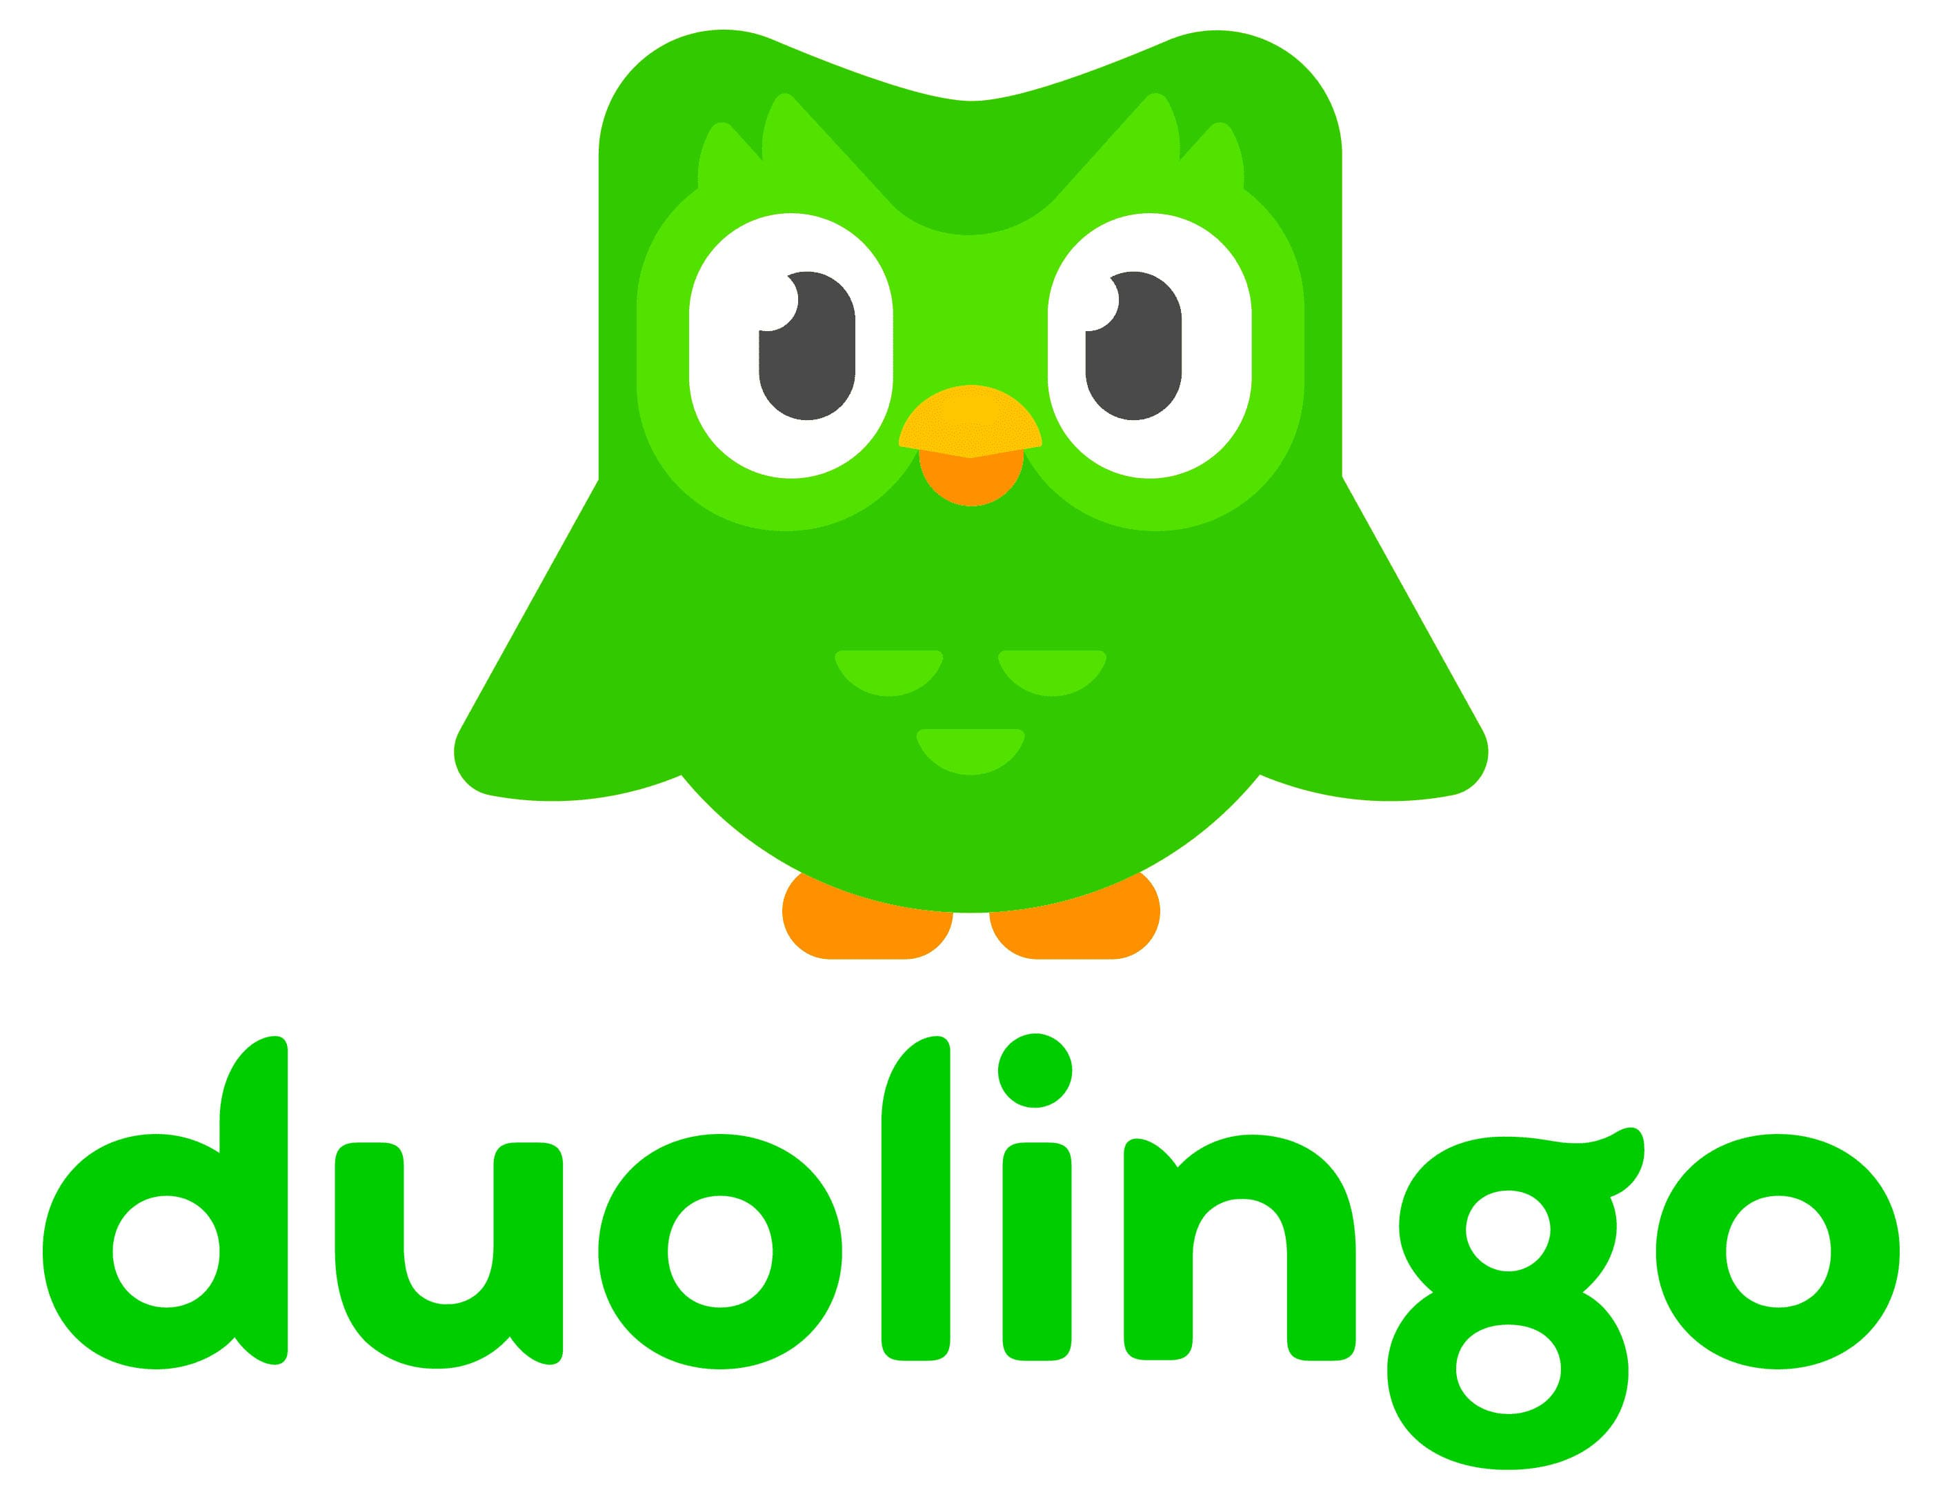


TEMPLATE 19 — CLICKSTREAM DATA
ID
URL
VISIT_TS
112…
mail.google.com/mail/u/0/#inbox
112…
8:19
google.com/search?q=japan+2+week+itinerary
112…
8:20
reddit.com/r/JapanTravel/two-week-itinerary
We capture
the atoms of
digital behavior.
112…
8:21
reddit.com/r/JapanTravel/best-time-to-visit
112…
8:22
instagram.com/explore/tags/japantravel
112…
8:23
instagram.com/reel/kyoto-temple-guide
112…
8:24
tiktok.com/@japan/tokyo-hidden-gems
112…
8:25
tiktok.com/tag/japantrip
112…
8:26
youtube.com/watch?v=japan-first-timer-guide
112…
8:27
youtube.com/watch?v=jr-pass-explained
112…
8:28
google.com/search?q=is+jr+pass+worth+it
112…
8:29
tripadvisor.com/Tourism-Tokyo
112…
8:30
tripadvisor.com/Attractions-Kyoto
112…
8:32
imdb.com/title/lost-in-translation
112…
8:33
google.com/search?q=tokyo+where+to+stay
112…
8:34
chatgpt.com/c/japan-2-week-itinerary
112…
8:35
chatgpt.com/c/tokyo-kyoto-osaka-split
112…
8:37
chatgpt.com/c/daily-budget-japan
Visibility no one else has.
112…
8:40
google.com/travel/flights?q=SFO-HND
112…
8:43
united.com/flight/select-seats
112…
8:45
united.com/booking/confirmation
112…
8:46
booking.com/hotels/tokyo-shinjuku
112…
8:48
booking.com/checkout/confirmation
112…
8:50
airbnb.com/rooms/kyoto-machiya
112…
8:52
airbnb.com/checkout/confirmation
112…
8:53
amazon.com/Japan-Travel-Guide/dp/B0…
112…
8:55
amazon.com/Portable-WiFi-Japan/dp/B0…
112…
8:56
amazon.com/cart
112…
8:57
amazon.com/checkout/order-confirmation
112…
8:58
uber.com/global/cities/tokyo
Five prompts.
No idea a $6,000 trip was just booked.
112…
9:00
duolingo.com/course/japanese
112…
9:02
open.spotify.com/playlist/tokyo-city-pop
112…
9:04
en.wikipedia.org/wiki/Kyoto
112…
9:06
reddit.com/r/JapanTravel/packing-list
112…
9:08
chatgpt.com/c/kyoto-1-day-walking-route
112…
9:11
chatgpt.com/c/tokyo-food-recommendations
112…
9:14
google.com/maps/search/kyoto+temples
112…
9:16
youtube.com/watch?v=tokyo-food-tour
112…
9:17
instagram.com/save/japan-trip-collection
112…
9:18
google.com/travel/my-trips
9:19
One hour. Connected in sequence.
67
CROSSWALK / BEHAVIORAL INTELLIGENCE ENGINE

Slide 20
TEMPLATE 20 — STAT WALL / OPTION 1
One consented panel.
Grounded in what people do.
30M
82TB
10M
Panelists to date
Data lake
Daily active panel
1B
40+
Daily
New rows / week
Blue-chip brand partners
Refresh cadence
Source: Crosswalk single-source behavioral panel, August 2026
68
CROSSWALK / BEHAVIORAL INTELLIGENCE ENGINE

Slide 21

TEMPLATE 21 — STAT WALL / OPTION 2
One consented panel.
Grounded in what people do.
2 in 3
30M
10M
Are Prime subscribers
Panelists to date
Daily gen pop panel
82TB
5YR
99.2%
Data lake
Data archive
Human verified
1B
150M
Daily
New rows / week
New rows / day
Refresh cadence
69
CROSSWALK / BEHAVIORAL INTELLIGENCE ENGINE

Slide 22
TEMPLATE 22 — PROPOSED PILOT
Four weeks. Three reads.
One Profile IQ. One Subscriber IQ. One Digital Journey IQ.
SCOPE
BUILD
READOUT
DECIDE
WEEK 1 /
WEEK 2 /
WEEK 3 /
WEEK 4 /
Lock the three reads with your team.
We run. Your analysts get Agent access in parallel.
Joint readout. Deck + dashboard + raw data.
Expand, retain, or walk. No long contract.
$35K PILOT FEE WAIVED ON CONVERSION TO ANNUAL.
70
CROSSWALK / BEHAVIORAL INTELLIGENCE ENGINE

Slide 23
TEMPLATE 23 — TIMELINE
Canceled in 2002. Still on shelves.
A license history, read as one column of dated entries.
2004 to 2006
Palisades Toys
Series 1 and 2 figures, each with a specialty-exclusive variant on new head sculpts.
2015
Oni Press
Monthly comic launches with the original creator, running to issue #50.
2015 to 2016
Funko
First Pop debuts. Glow-in-the-dark variant given an exclusive pre-release.
2018
Diamond Select
Vinimates as specialty exclusives, alongside a Pop Rides two-up.
2019
Funko
Second Pop released alongside the streaming feature.
2025 to now
CultureFly · Thrilljoy
New Pop and Pix! collectibles, specialty and sister-banner exclusives.
Six licensees, one retailer, two decades of continuous distribution. That is the argument the dates make on their own.
71
CROSSWALK / BEHAVIORAL INTELLIGENCE ENGINE

Slide 24
TEMPLATE 24 — AUDIENCE SEGMENTS
Four audience profiles.
The base is not homogeneous. Four behavioral clusters, each with a different price point, channel, and reason to buy.
01
02
03
04
THE ALT BADDIE
THE ARCHIVIST
THE MAKER
THE IRONIST
Female, 25 to 34, dresses the fandom. Buys apparel, hair color and cosmetics.
The completist. Attends conventions, tracks canon, buys scarcity. Responds to numbered runs.
Draws it, prints it, sells it. Already monetizing the IP informally, without a license.
Lives in absurdist internet comedy. Buys almost nothing, drives every share.
Goth style 271 · Killstar 712 · Hot Topic 260
Comic-Con 269 · Dragon Con 566 · NYCC 317
Redbubble 507 · Cricut 264 · Kickstarter 429
Dropout 1,369 · Reddit 152 · Letterboxd 154
COMMERCIAL IMPLICATION
Three of the four segments already spend against the IP. The fourth spends against it without a license. Sizing it separately turns an enforcement problem into a revenue line.
72
CROSSWALK / BEHAVIORAL INTELLIGENCE ENGINE

Slide 25
TEMPLATE 25 — TEAM GRID
Operators at the top of the business.
LH
JM
SC
KF
Liz Huszarik
Jenna Menking
Scott Carlin
Keith Friedenberg
CO-FOUNDER
CO-FOUNDER
PRESIDENT
CHIEF ANALYTICS & DATA SCIENCE OFFICER
Chief Research & Data Officer, Warner Bros. Discovery.
Two-time founder with two exits: Black Sheep Social to IPG and a QR valet-payments platform.
Founding President of HBO Domestic TV Distribution; architect of the Friends and Sopranos syndication deals.
Founder of Endeavor Analytics. Chief Analytics & Insights Officer at Endeavor.
JG
AR
DP
BD
Jared Goetz
Alexia Raven
Debi Pomerantz
Bria Dotson
HEAD OF ENTERTAINMENT SALES
HEAD OF INSIGHTS
INFLUENCER COMMERCIALS
HEAD OF STATISTICS
President TV Distribution, Lionsgate;
22 years at Disney.
VP Global Research & Insights, Warner Bros. Discovery.
Head of Research at Warner Bros. Discovery before Crosswalk.
SVP Research & Statistics, WME.
73
CROSSWALK / BEHAVIORAL INTELLIGENCE ENGINE

Slide 26

TEMPLATE 26 — EIGHT CALLOUTS
One signal set. Eight decision centers.
Every unit below buys the same underlying behavioral feed and asks a different question of it.
01
02
03
04
Retail & Category
Demand Formation
AI Shopping
Prime Lifecycle
The whole wallet, beyond Amazon's share of it
Where product discovery now begins: social, video, forums, AI
Whether LLM-mediated journeys end at Amazon or elsewhere
Why a member joins, drifts, lapses, and where they go
Leakage detection, demand recapture
Upper-funnel presence where it forms
The honest read on Rufus and agentic commerce
Lapse reduction, timed win-back
05
06
07
08
Merchandising
Marketplace & Sellers
Prime Video & MGM
Amazon Ads
What shoppers compared and bought elsewhere instead
Off-Amazon demand for every seller's own category
Cross-platform content demand and subscription switching
Off-Amazon outcome proof and matched-control incrementality
Assortment gaps, pricing, 1P buying inputs
A new high-margin seller-facing line
Content investment and churn intelligence
CPM repricing on inventory already sold
74
CROSSWALK / BEHAVIORAL INTELLIGENCE ENGINE

Slide 27

Amazon knows what subscribers bought.
Crosswalk knows what they're about to buy.
LIZ HUSZARIK / CO-FOUNDER
SCOTT CARLIN / PRESIDENT
liz@crosswalknyc.com
scott@crosswalknyc.com
75
CROSSWALK / BEHAVIORAL INTELLIGENCE ENGINE

