Slide 1
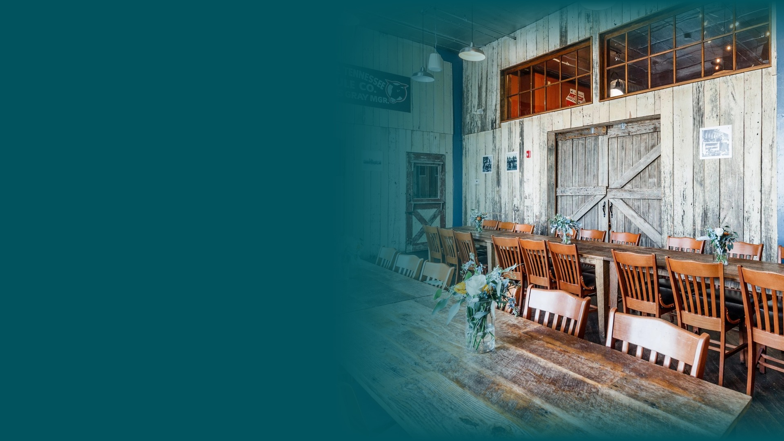




A PARTNERSHIP PROPOSAL / JUNE 2026
A. Marshall
Hospitality
behavioral intelligence: making visitors feel like locals
PRESENTED BY CROSSWALK TECHNOLOGIES INC
A. MARSHALL HOSPITALITY / PARTNERSHIP PROPOSAL

Slide 2
OVERVIEW
What's inside.
CONTENTS
03
Profile IQ by Location
A. Marshall Hospitality operates distinctive brands across multiple markets - Puckett's, Deacon's and Scout's Pub. Crosswalk proposes a twelve-month partnership to deliver location-level Profile IQ, competitive benchmarking and digital journey intelligence so each restaurant can act on guest behaviors and conversion motivators.
04
Competitive Benchmarking
05
Digital Journeys & Media Conversion
06
Your Restaurant Portfolio
07
Investment Options
08
Next Steps
A. MARSHALL HOSPITALITY / PARTNERSHIP PROPOSAL
02

Slide 3
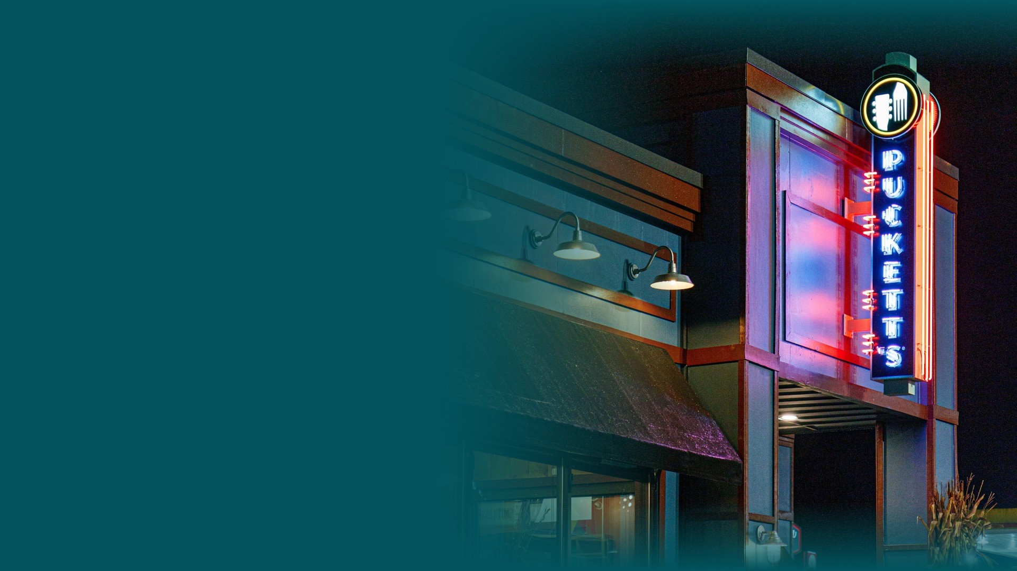
A. MARSHALL HOSPITALITY / PROFILE IQ
Profile IQ for Every Location
A dedicated audience portrait for each restaurant location, refreshed on your cadence.
WHY IT MATTERS
Each location draws a different guest - different ages, incomes, dining occasions and media habits. Location-level Profile IQ turns that variance into actionable strategy.
DELIVERABLES PER LOCATION
• Demographic profile (age, gender, income, ethnicity and more)
• Behavioral affinities and interests
• Geographic concentration and DMA views
• Crosswalk dashboard access for your team
• Deck-ready exports for internal and external sharing
A. MARSHALL HOSPITALITY / PARTNERSHIP PROPOSAL
03

Slide 4
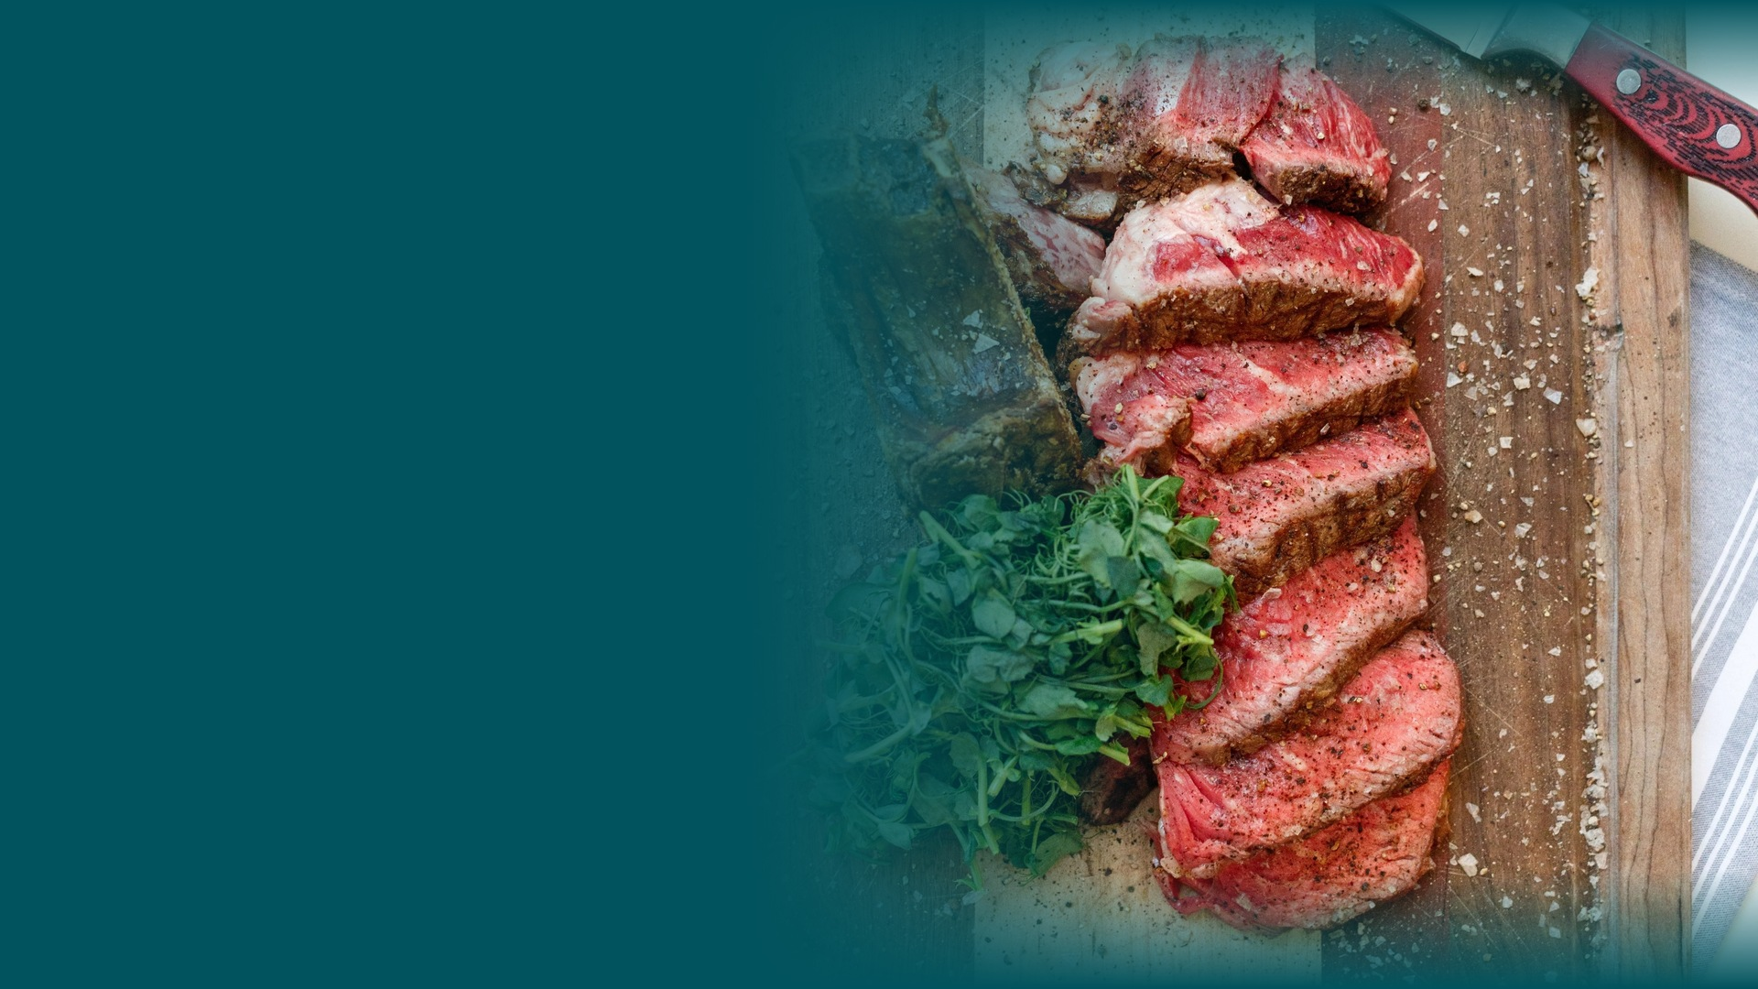
A. MARSHALL HOSPITALITY / COMPETITIVE INTEL
Competitors Loaded by Location
You identify the competitive set; we benchmark each location against them in the Crosswalk dashboard.
WHY IT MATTERS
Each market competes differently. We upload your named competitors per location, reflecting indexing and gap analysis to show real market dynamics, rather than generic category averages.
WE HANDLE
YOU PROVIDE
• Competitor profile upload per location
• Location list across your portfolio
• Side-by-side index comparison
• 2-3 named competitors per site
• Quarterly refresh of comp lists
A. MARSHALL HOSPITALITY / PARTNERSHIP PROPOSAL
04

Slide 5
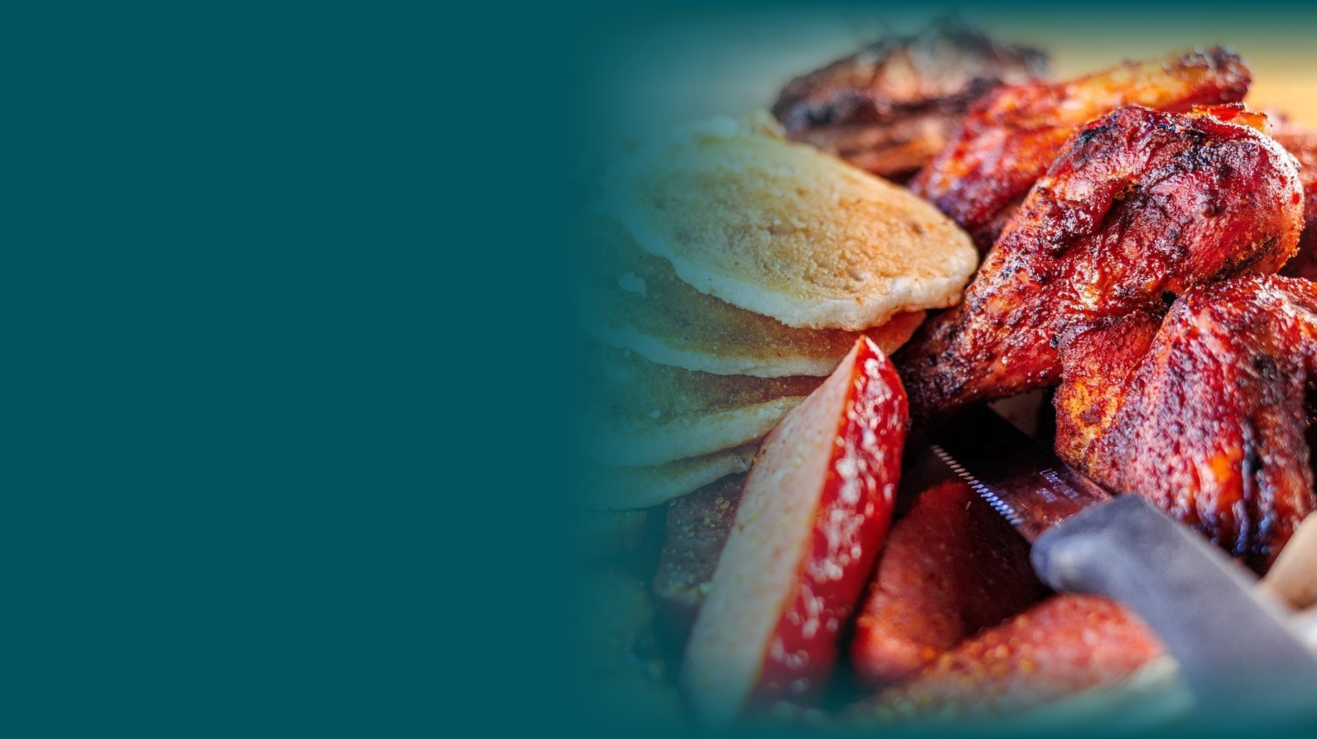
A. MARSHALL HOSPITALITY / DIGITAL JOURNEYS
Digital Journeys & Media Conversion
Per-location path-to-plate intelligence - from discovery to reservation to delivery.
WHY IT MATTERS
Guests discover you on Yelp, book on OpenTable and order on DoorDash or Uber Eats, often before they ever walk through the door. Digital journey maps show where each location wins, leaks and converts across the platforms that drive covers and checks.
PLATFORMS IN SCOPE (PER LOCATION)
• OpenTable
• Yelp
• DoorDash
• Uber Eats
• Google / Maps
• Meta and programmatic media
INCLUDED WITH EACH DIGITAL JOURNEY
• Media conversion analysis per location
• Platform affinity indexes
• Full journey stage mapping (discover → book → order → visit)
A. MARSHALL HOSPITALITY / PARTNERSHIP PROPOSAL
05

Slide 6
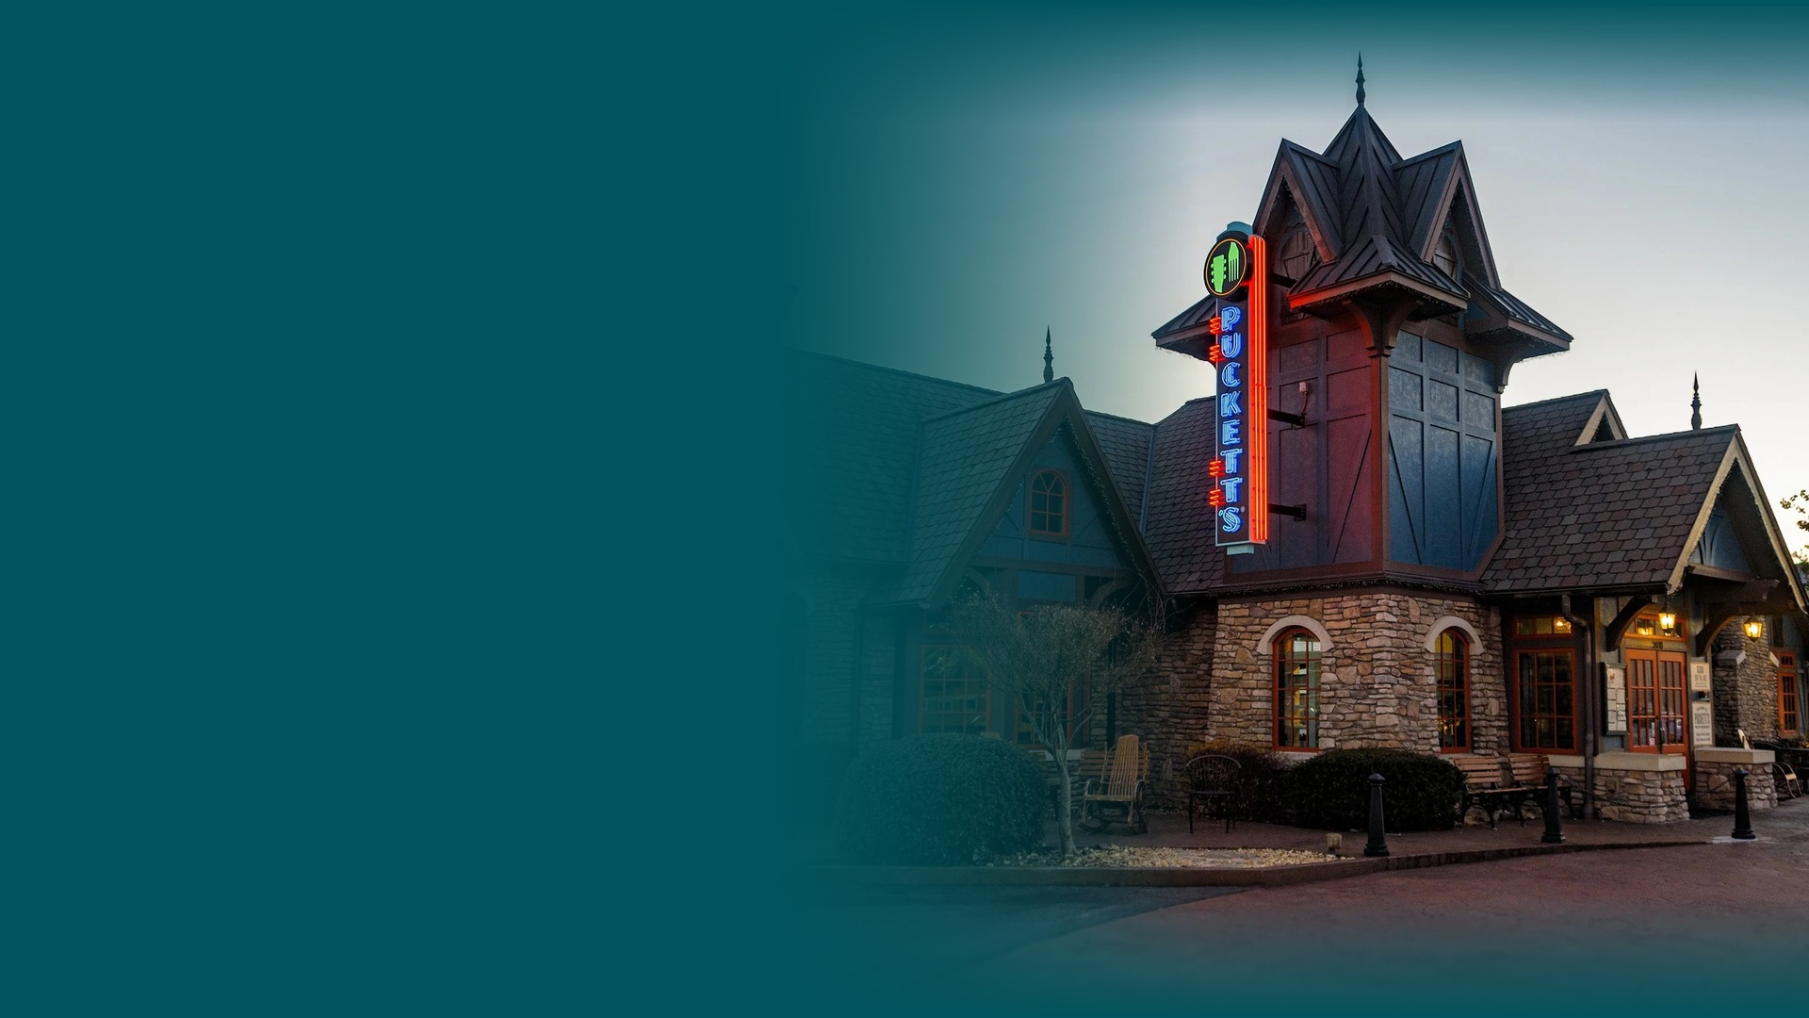
A. MARSHALL HOSPITALITY / PORTFOLIO
Your Restaurant Portfolio
One partnership covering every location across Puckett's, Deacon's and Scout's Pub.
WHAT'S INCLUDED AT EVERY LOCATION
• Profile IQ - full demographic and behavioral portrait
• Competitive benchmarking with your named comp set
• Digital journey mapping across reservation, delivery and discovery platforms
• Media conversion analysis tied to each journey
• Crosswalk dashboard access and deck-ready exports
A. MARSHALL HOSPITALITY / PARTNERSHIP PROPOSAL
06

Slide 7
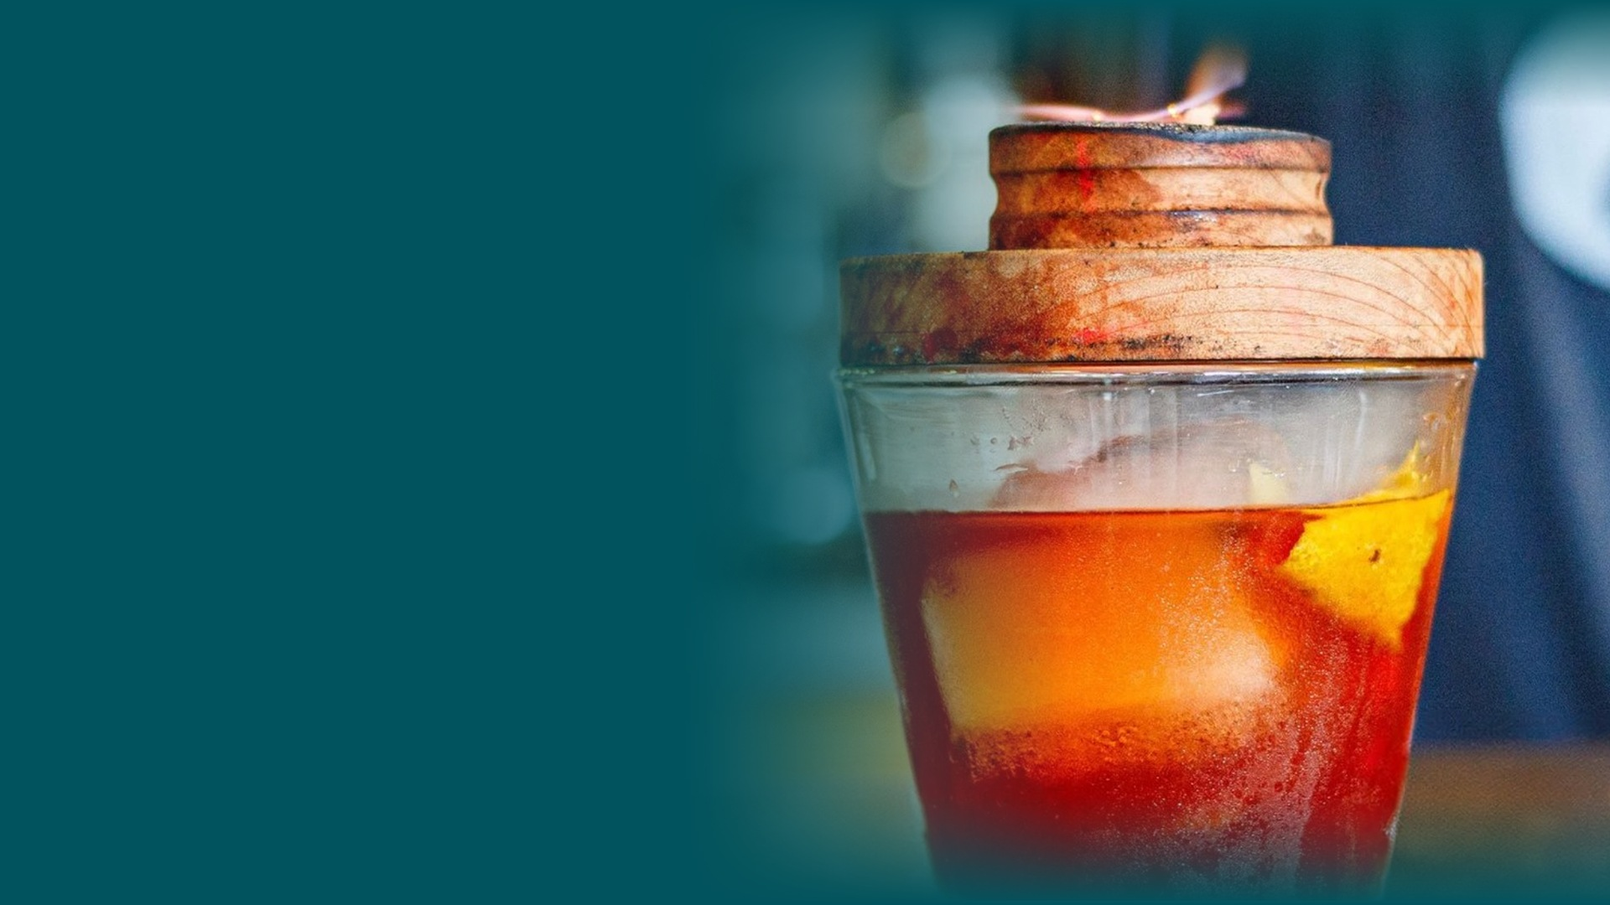
A. MARSHALL HOSPITALITY / INVESTMENT
Investment Options
Twelve-month contract · All tiers include full Profile IQ, competitive uploads, digital journeys and media conversion per location.
Panel participation lowers your cash investment while enriching the behavioral dataset that powers sharper profiles. The more locations participate, the better the intelligence and the lower your cost.
OPTION A — ALL CASH
$10,000/mo
Full service, no panel obligations.
OPTION B — PANEL INCENTIVE
$5,000/mo
One panel ingestion incentive per location per month.
OPTION C — FULL PANEL PARTNERSHIP
No Charge
Weekly incentives per location per month.
All options: 12-month initial term
A. MARSHALL HOSPITALITY / PARTNERSHIP PROPOSAL
07

Slide 8
A. MARSHALL HOSPITALITY / NEXT STEPS
Let's get started.
We're ready to scope locations, load your competitive sets and stand up your first Profile IQ dashboards within weeks of contract execution.
• Confirm location list across your portfolio
• Select investment tier and panel cadence
• Kickoff: competitor uploads and journey mapping
• First location profiles delivered to dashboard
CROSSWALK TECHNOLOGIES INC
jessie@crosswalknyc.com
A. MARSHALL HOSPITALITY / PARTNERSHIP PROPOSAL
08

