Slide 1
Intro to Time Series Regression
William Chiu

Slide 2
About Me
MSIA Class of 2013
Works for a bank
Team develops models to explain and forecast:
Credit Losses
Loan Prepayments
Mortgage Rates
Deposit Attrition
Primarily uses SQL and R

Slide 3
Time Series Regression
Time series is data collected in equally-spaced time intervals.
Linear regression estimates the linear relationship between a continuous response (y) and one or more predictors (x).
Ordinary least squares (OLS) is the most common implementation of linear regression, and estimates the coefficients that minimize the error sum of squares:
$ESS=\sum_{i=1}^{n}{{\left(y_{i}−\left(\hat{β_{0}}+\hat{β_{1}}X_{1,i}+...+\hat{β_{p}}X_{p,i}\right)\right)}^{2}}$
Using linear regression on time series is called time series regression.

Slide 4
OLS Assumptions for Time Series
Population data generating process (dgp) most suitable for OLS:
$y_{t}=β_{0}+β_{1}X_{1,t}+...+β_{p}X_{p,t}+ε_{t}$
$ε_{t}∼N\left(0,σ^{2}\right)$
Linear parameters
Independent errors (no serial correlation)
Normally distributed errors
Equal variance errors (homoscedasticity)
Stationary response and predictors (unless there is co-integration)

Slide 5
Violation: Serial Correlation
Unfortunately, the data generating process (dgp) for time series often violates the independent errors assumption. For example:
$y_{t}=β_{0}+β_{1}X_{1,t}+...+β_{p}X_{p,t}+ε_{t}$
$ε_{t}=ρε_{t−1}+v_{t}$
$v_{t}∼N\left(0,σ^{2}\right)$
If $ρ=0$, then there is no serial correlation.
If $−1<ρ<1$, then there is serial correlation.

Slide 6
Simulate predictors with serial correlation
set.seed(2013) x1 <- arima.sim(list(order = c(1,0,0), ar = 0.6), n = 200, sd=2, mean=2) x2 <- arima.sim(list(order = c(1,0,0), ar = -0.6), n = 200, sd=3, mean=2) x3 <- arima.sim(list(order = c(1,0,0), ar = 0.6), n = 200, sd=4, mean=2)

Slide 7
Simulate response with serial correlation
epsilon <- arima.sim(list(order = c(1,0,0), ar = 0.6), n = 200, sd=5, mean=0) y <- 10 + 3.5*x1 - 1.5*x2 + epsilon ## x3 is not part of the dgp df <- data.frame(y=y, x1=x1, x2=x2, x3=x3, t=1:length(y))

Slide 8
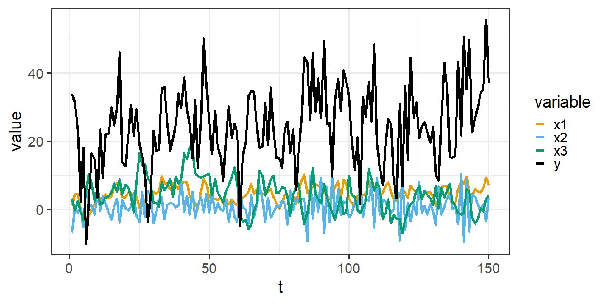
Plot simulated data (Train)

Slide 9
Split between train and test
train <- head(df, 150) test <- tail(df, 50)

Slide 10
OLS ignores serial correlation
Under serial correlation, OLS parameter estimates are unbiased and consistent
However, standard errors are incorrect
And p-values are incorrect
x3 should not be statistically significant
term | estimate | std.error | statistic | p.value
(Intercept) | 8.98 | 1.147 | 7.84 | 0.000
x1 | 3.61 | 0.204 | 17.74 | 0.000
x2 | -1.50 | 0.121 | -12.40 | 0.000
x3 | 0.17 | 0.101 | 1.68 | 0.094

Slide 11
Detecting serial correlation
Durbin-Watson test is a popular test for serial correlation, but suffers from some major drawbacks.
Breusch-Godfrey Test is a better test.
statistic | p.value | parameter | method
37.4 | 9.84e-10 | 1 | Breusch-Godfrey test for serial correlation of order up to 1
Null Hypothesis: No serial correlation

Slide 12
Remediating serial correlation
Replace OLS with GLS
Keep OLS but estimate robust (HAC) standard errors
Keep OLS but bootstrap the standard errors

Slide 13
Generalized Least Squares (Cochrane–Orcutt)
Estimate $ρ$
Transform each response and predictor into “partial differences” (e.g., $y_{t}−\hat{ρ}y_{t−1}$)
Estimate the transformed model using OLS
Re-calculate the coefficient estimates in terms of the original training data
term | estimate | std.error | statistic | p.value
(Intercept) | 9.40 | 1.431 | 6.566 | 0.000
x1 | 3.60 | 0.224 | 16.064 | 0.000
x2 | -1.47 | 0.078 | -18.933 | 0.000
x3 | 0.10 | 0.116 | 0.863 | 0.389

Slide 14
Newey-West HAC Correction
Keep OLS but estimate robust (HAC) standard errors
term | estimate | std.error | statistic | p.value
(Intercept) | 8.98 | 1.067 | 8.42 | 0.000
x1 | 3.61 | 0.237 | 15.26 | 0.000
x2 | -1.50 | 0.087 | -17.33 | 0.000
x3 | 0.17 | 0.123 | 1.38 | 0.169

Slide 15
Andrews HAC Correction
Keep OLS but estimate robust (HAC) standard errors
term | estimate | std.error | statistic | p.value
(Intercept) | 8.98 | 1.119 | 8.03 | 0.000
x1 | 3.61 | 0.247 | 14.62 | 0.000
x2 | -1.50 | 0.086 | -17.58 | 0.000
x3 | 0.17 | 0.114 | 1.49 | 0.139

Slide 16
Block Bootstrap
Keep the OLS coefficient estimates but bootstrap the standard errors
Break the time series into sequential blocks (non-random)
Randomly sample blocks with replacement
Unfortunately, results are sensitive to block size
term | estimate | std.error | statistic | p.value
(Intercept) | 8.98 | 1.076 | 8.35 | 0.000
x1 | 3.61 | 0.221 | 16.35 | 0.000
x2 | -1.50 | 0.088 | -17.11 | 0.000
x3 | 0.17 | 0.126 | 1.36 | 0.177

Slide 17
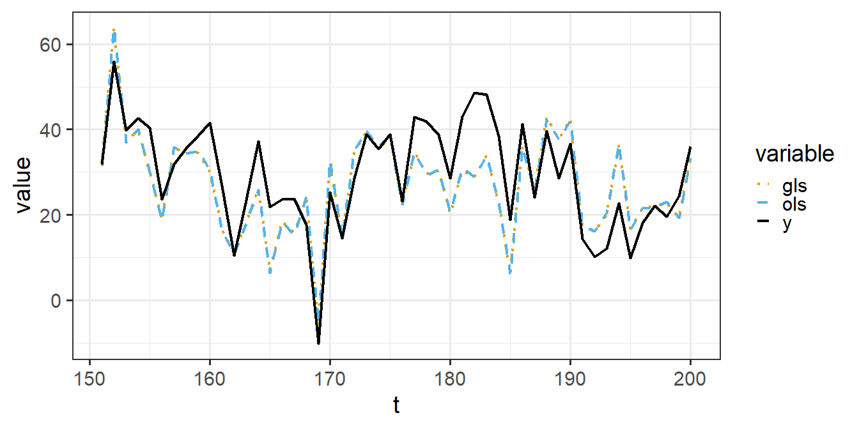
Test Set Performance (Ex-post, OLS vs. GLS)

Slide 18
Inference is harder than prediction
Test set performance appears similar between OLS and GLS
However, the p-values for x3 differ substantially by method: lm, gls, newey-west, andrews, bootstrap.
The p-values from simulated data are sensitive to the random seeds
In order to measure the quality of the methods:
Re-simulate the training data ($K=2.5×{10}^{4}$) with varying seeds and $ρ$
Measure how often Type 1 errors occur ($α=0.10$)
Measure test set error (i.e., average MSE over K simulations, then take the square root)
Since $β_{3}=0$ in the simulation, any p-values <= $α$ is a Type 1 Error

Slide 19
Type 1 Error Frequency
rho | method | Prob_Type_1_Error | Avg_Train_RMSE | Avg_Test_RMSE
1-Low (0.1) | gls | 0.106 | 4.95 | 5.1
1-Low (0.1) | lm | 0.106 | 4.95 | 5.1
1-Low (0.1) | bootstrap | 0.111 | NA | NA
1-Low (0.1) | andrews | 0.116 | NA | NA
1-Low (0.1) | nw | 0.126 | NA | NA
rho | method | Prob_Type_1_Error | Avg_Train_RMSE | Avg_Test_RMSE
2-Moderate (0.7) | gls | 0.104 | 6.81 | 7.17
2-Moderate (0.7) | andrews | 0.134 | NA | NA
2-Moderate (0.7) | nw | 0.144 | NA | NA
2-Moderate (0.7) | bootstrap | 0.177 | NA | NA
2-Moderate (0.7) | lm | 0.326 | 6.72 | 7.26

Slide 20
Very High Serial Correlation
Under very high serial correlation, most of the previous methods struggle to return the correct p-values.
If $\hat{ρ}$ is close to -1 or 1, then check for non-stationary residuals (e.g., Phillips-Ouliaris Cointegration Test; Pesaran-Shin-Smith Cointegration Test).
Non-stationary residuals could be a strong sign of spurious regression
rho | method | Prob_Type_1_Error | Avg_Train_RMSE | Avg_Test_RMSE
3-Very High (0.9) | gls | 0.107 | 10.7 | 12.0
3-Very High (0.9) | andrews | 0.199 | NA | NA
3-Very High (0.9) | nw | 0.205 | NA | NA
3-Very High (0.9) | bootstrap | 0.246 | NA | NA
3-Very High (0.9) | lm | 0.572 | 10.2 | 12.6

Slide 21
Serial Correlation and Test Set RMSE
$$RMSE_{test}=\sqrt[​]{σ_{ε}^{2}}=\sqrt[​]{\frac{σ_{v}^{2}}{1−ρ^{2}}}$$
The Pennsylvania State University. (2018). 10.3 - Regression with Autoregressive Errors. Applied Regression Analysis. Retrieved February 27, 2022, from https://online.stat.psu.edu/stat462/node/189/

Slide 22
Violation: Non-stationary response and predictors
The data generating process (dgp) for time series is often non-stationary. For example, $z_{t}$ and $w_{t}$ are independent random walks:
$$z_{t}=z_{t−1}+v_{t}$$
$$v_{t}∼N\left(0,σ_{v}^{2}\right)$$
$$w_{t}=w_{t−1}+e_{t}$$
$$e_{t}∼N\left(c,σ_{e}^{2}\right)$$
When the response and predictors are non-stationary, OLS and GLS could be biased and inconsistent (i.e., spurious) – except in the case of cointegration
Non-stationary errors adversely affect both prediction and inference (while serially correlated errors affect only inference)

Slide 23
Simulate non-stationary predictors
set.seed(2013) w1 <- arima.sim(list(order = c(0,1,0)), n = 200, sd=2, mean=2) w2 <- arima.sim(list(order = c(0,1,0)), n = 200, sd=3, mean=2) w3 <- arima.sim(list(order = c(0,1,0)), n = 200, sd=4, mean=2)

Slide 24
Simulate non-stationary response
Suppose $z_{t}$ is a random walk and does not depend on any predictors
$$z_{t}=z_{t−1}+v_{t}$$
$$v_{t}∼N\left(0,σ^{2}\right)$$
The predictors $w_{1}$, $w_{2}$, $w_{3}$ should not affect $z_{t}$
z <- arima.sim(list(order = c(0,1,0)), n = 200, sd=5, mean=0) ## w1, w2, w3 are not part of the dgp (and z is a random walk) df_nonstationary <- data.frame(z=z, w1=w1, w2=w2, w3=w3, t=1:length(z))

Slide 25
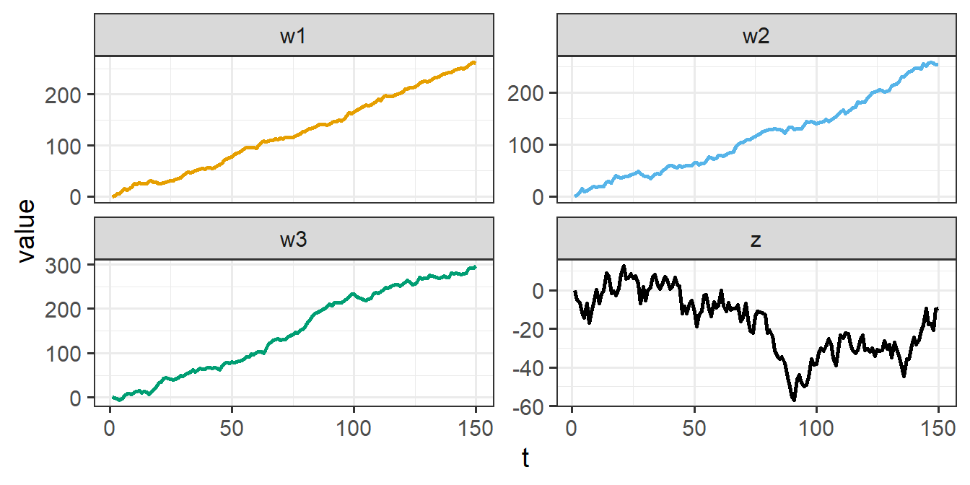
Plot simulated data (Train)

Slide 26
Split between train and test
train_ns <- head(df_nonstationary, 150) test_ns <- tail(df_nonstationary, 52) # helps with plotting

Slide 27
OLS ignores non-stationarity
term | estimate | std.error | statistic | p.value
(Intercept) | -0.291 | 1.338 | -0.217 | 0.828
w1 | 0.234 | 0.086 | 2.718 | 0.007
w2 | 0.173 | 0.065 | 2.675 | 0.008
w3 | -0.441 | 0.042 | -10.598 | 0.000
r.squared | adj.r.squared
0.736 | 0.731

Slide 28
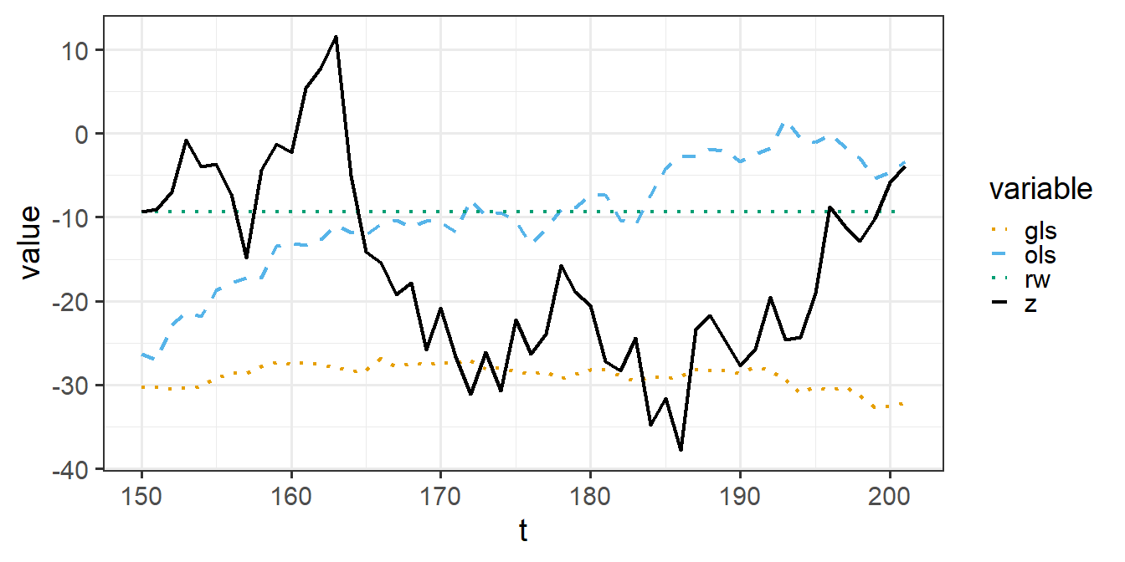
Test Set Error Explodes

Slide 29
Non-stationarity is a very big problem
Simulate $K=2.5×{10}^{4}$ data sets where the response and predictors are independent random walks (non-stationary)
OLS inferences are highly unreliable
OLS and GLS both perform worse than a naive model (i.e., take the last response from the training set and assume the response never changes in the test set)
method | Prob_Type_1_Error | Avg_Train_RMSE | Avg_Test_RMSE
rw | 0.000 | NA | 25.7
gls | 0.131 | 17.5 | 31.7
andrews | 0.305 | NA | NA
nw | 0.307 | NA | NA
bootstrap | 0.350 | NA | NA
lm | 0.740 | 13.3 | 39.5

Slide 30
Remediating non-stationarity
Transform each response and/or predictor into “first differences” (e.g., $y_{t}−y_{t−1}$)
Estimate the transformed model using OLS or GLS
Forecast with the last historical value and the cumulative sum of the predicted first differences:
$\hat{y_{t+h}}=y_{t}+\sum_{i=t+1}^{t+h}{\hat{Δy_{i}}}$

Slide 31
Conclusions
OLS is most suitable for independent errors
The independent error assumption is often violated with time series regression
Under serial correlation, standard errors and p-values from OLS are unreliable
Fortunately, OLS coefficient estimates remain unbiased and consistent
Remediating serial correlation:
GLS
OLS with HAC standard errors
OLS with block bootstrapped standard errors
Under non-stationary errors, beware of spurious regressions

