Slide 1

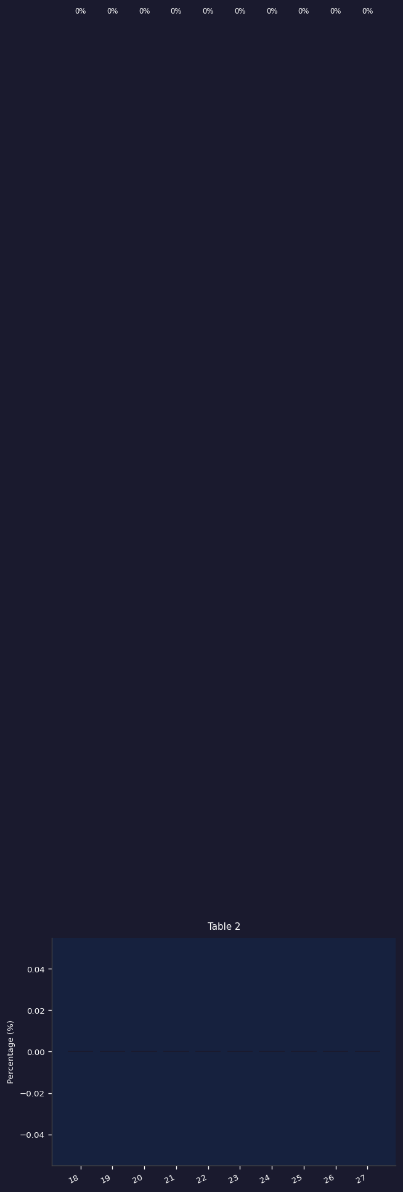
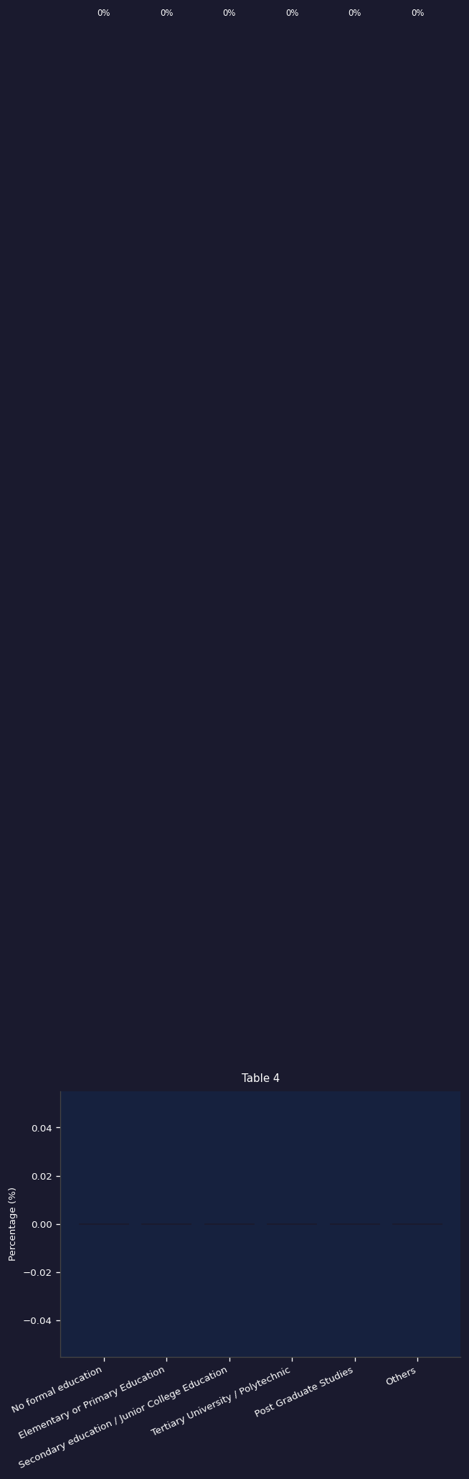
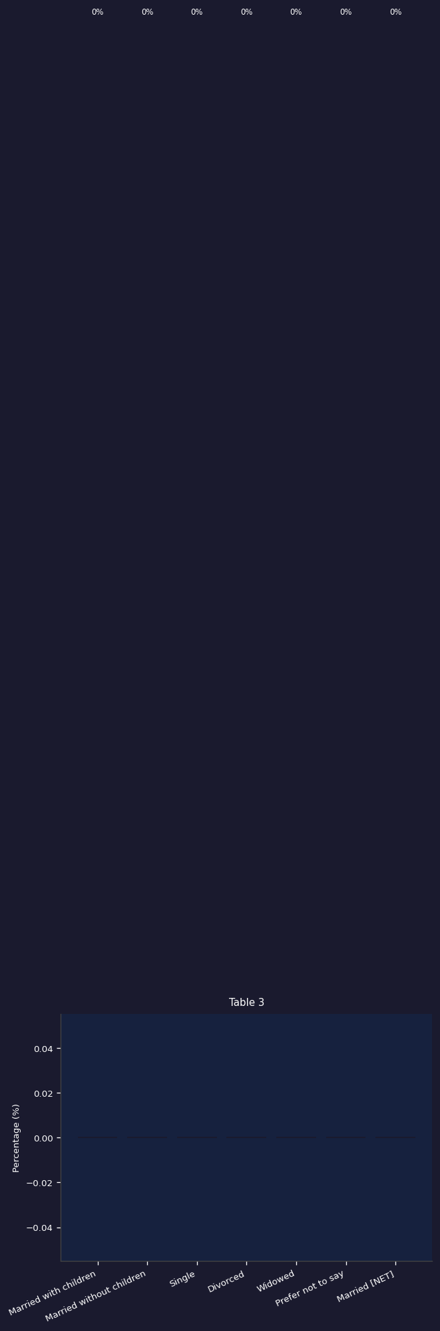

Slide 2
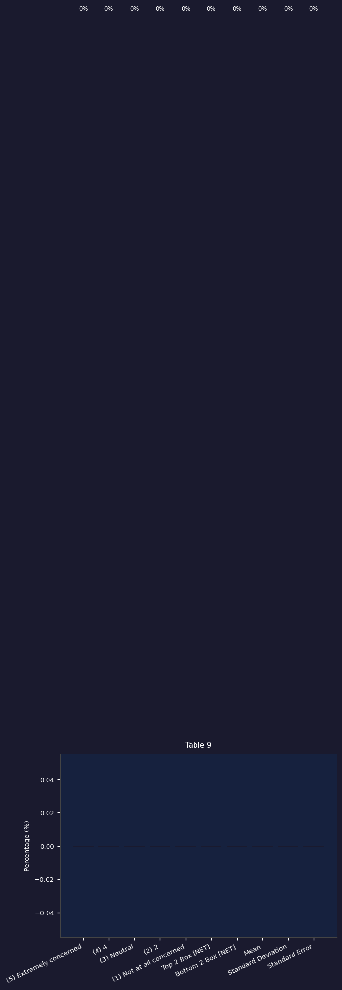

Slide 3
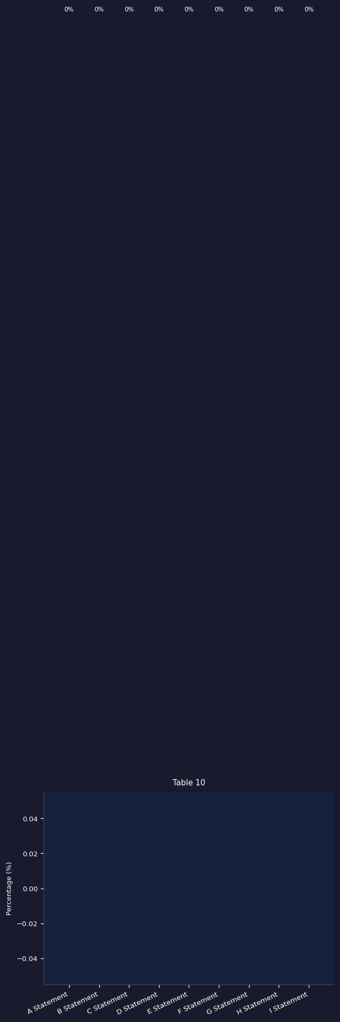
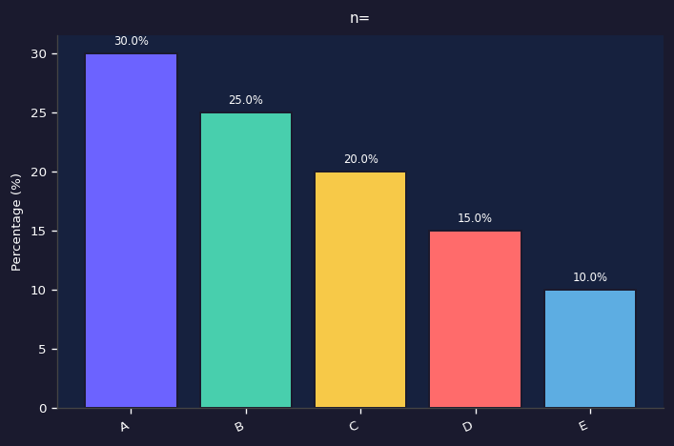
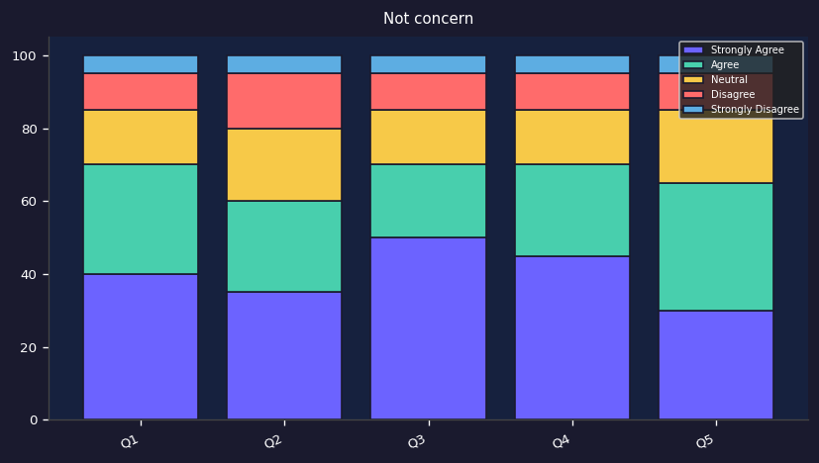
Total | Heat Stress |  | Heat Exposure |  | Age |  |  |  | Occupation |  | TLC
 | Concern | Not concern | High | Low | Gen Z | Millen | Gen X | Boom | Office | Non-office | Aware | Not aware
(n=) | n= | n= | n= | n= | n= | n= | n= | n= | n= | n= | n= | n=

