Slide 1
IB290
Topics in Phylogenetics
Meeting 1: Introductions,
Thurs Sept 14

Slide 2
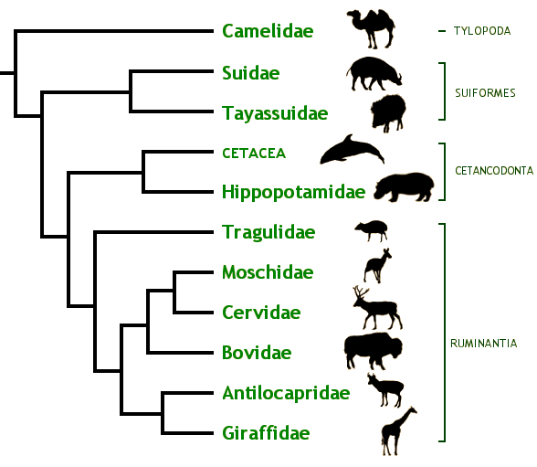
Phylogeny…
Phylogenies are cartoons depicting the evolutionary history of a group of organisms
(they’re trees-of-life)
Concepts:
  Most recent common
  ancestor
  Closest relative
  (“sister group”)
  “Monophyletic”, “Clade”
  Cladograms vs
  phylograms vs chronograms
  Ancestral vs. derived characters
  Sampling, extinction, primitive lineage fallacy, etc
Notes:
Can “swivel” the nodes

Slide 3
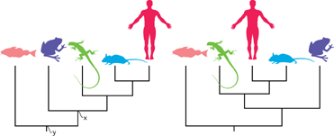
Phylogeny, quiz
From Baum, Smith, & Donovan: The Tree-Thinking Challenge
Notes:
-Which of the species included in this phylogeny is most closely related to the lizard?

Slide 4
Phylogeny, quiz
From Baum, Smith, & Donovan: The Tree-Thinking Challenge
Notes:
-ancestral vs. derived characters – e.g., cold-bloodedness vs. hair

Slide 5
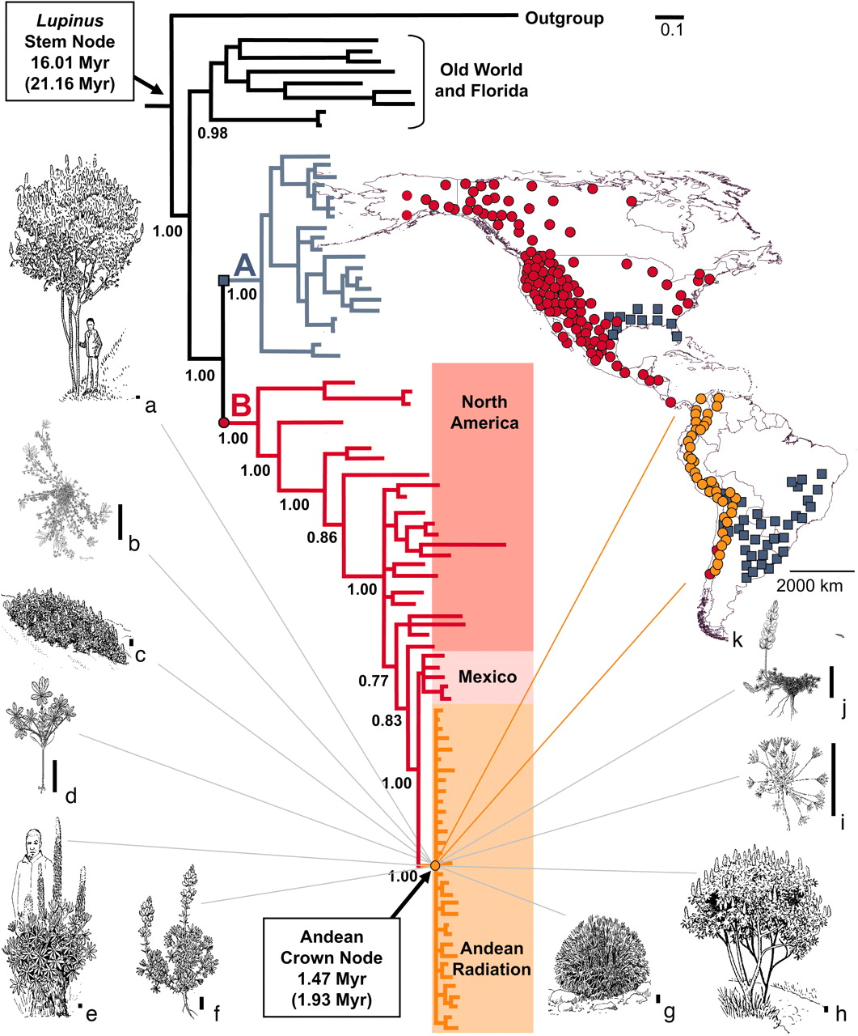
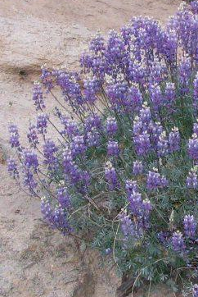
Applications of phylogeny
Hughes & Eastwood 2006. PNAS

Slide 6
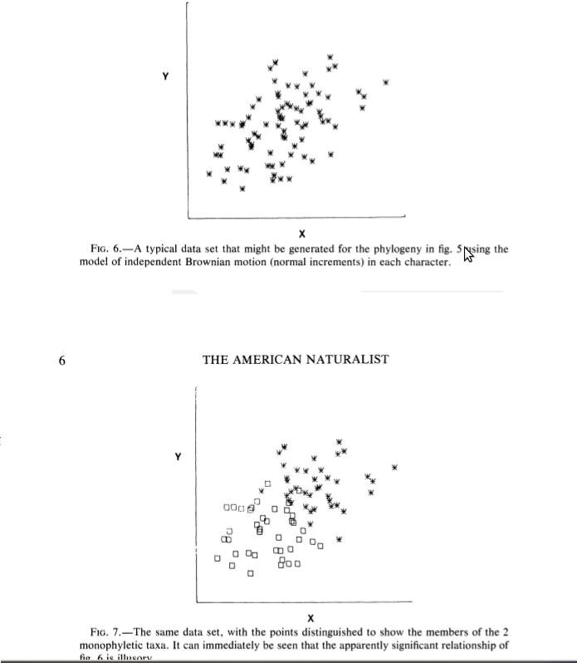

Slide 9
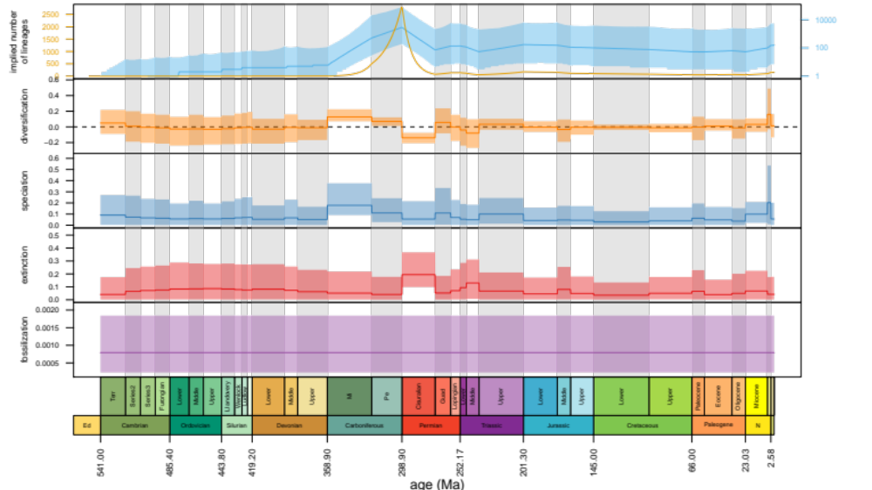
Phylogenetics
Seeing into the past

Slide 10
Split, from one lineage into two?
Divergence, which may lead to speciation
Pre-existing feature?
Plesiomorphy (ancestral feature)
New feature?
Apomorphy (derived feature)

Slide 11
Autapomorphy?
Apomorphy for a single lineage
Synapomorphy?
Apomorphy for two or more lineages

Slide 12
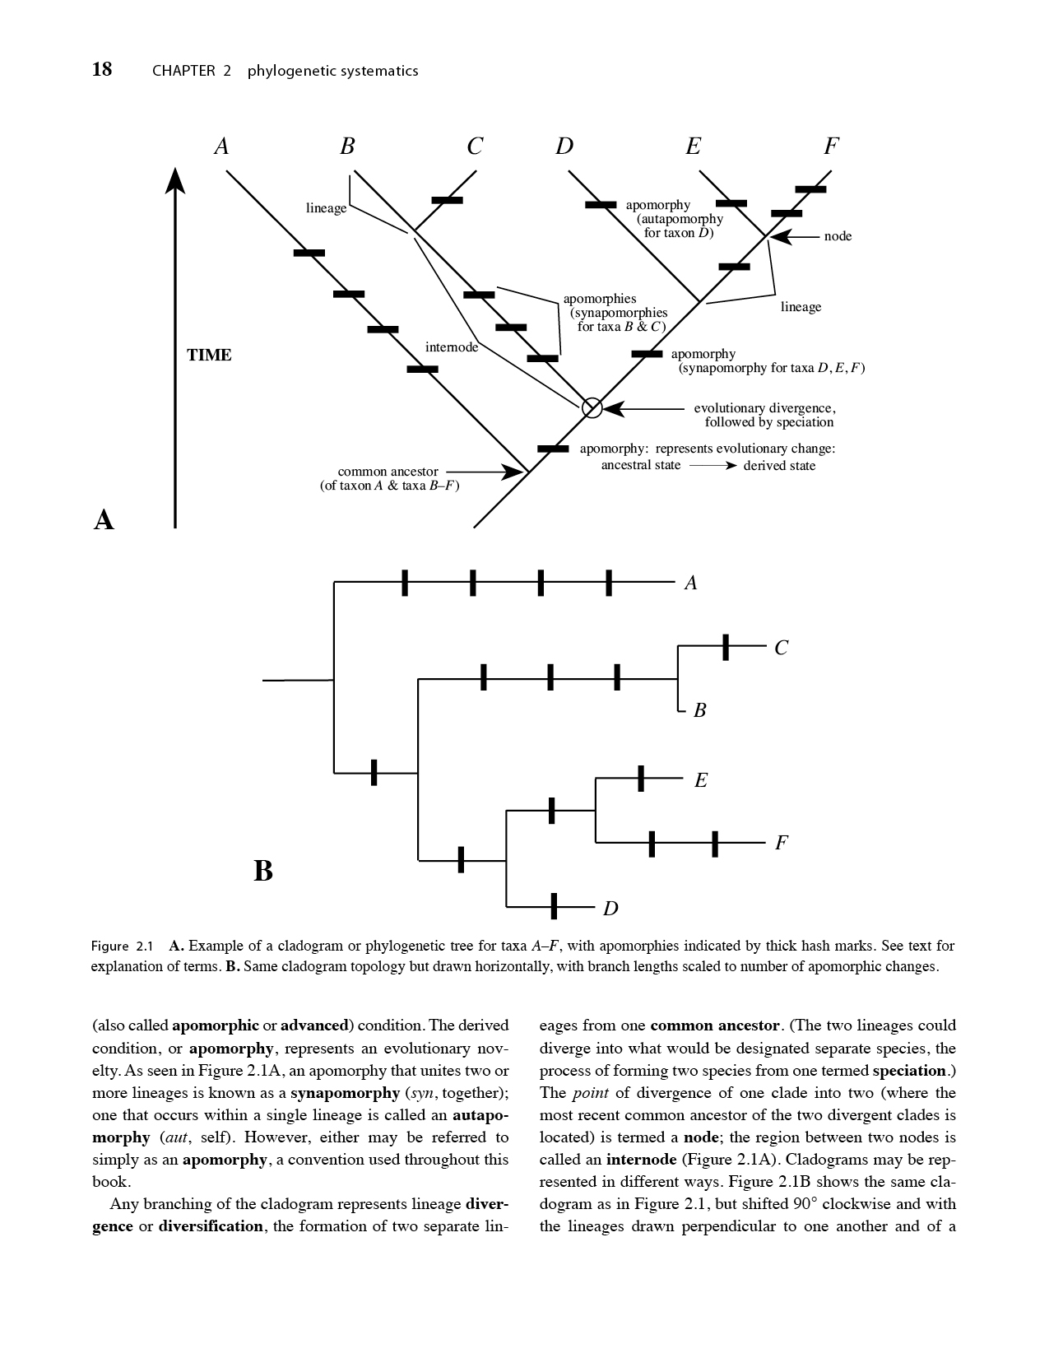

Slide 13
Topology
Structure of the branching diagram; how branches are connected together
Ingroup, outgroup, rooting

Slide 14
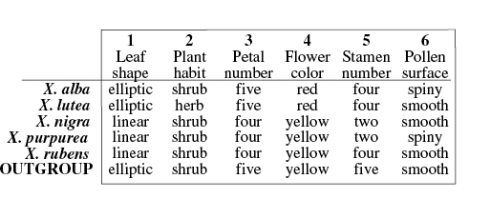
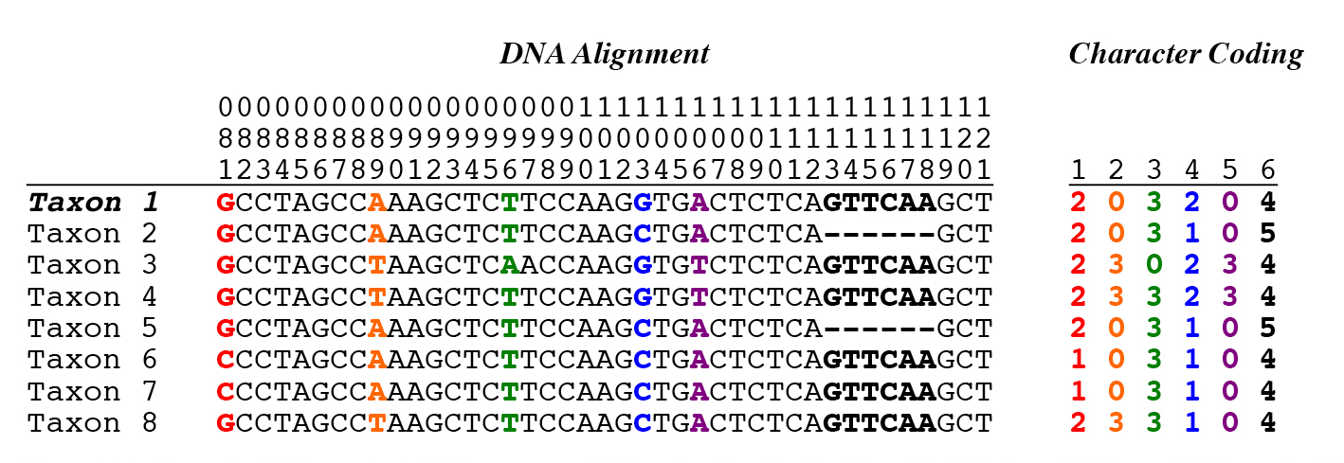
Homology: characters, character states

Slide 15
Primary tenet of phylogenetic systematics?
Taxa (O.T.U.’s) can be grouped by synapomorphies,
because these represent unique evolutionary events. Synpleisiomorphies, on the other hand, don’t provide information for grouping taxa.
Note: This is subtly different from grouping taxa by similarity (similarity can be due to synapomorphies or synpleisiomorphies)
Notes:
-Only made it here in lecture, although I had planned to get further

