Slide 1
Wearable Allergy Analyzer
(Wearable Allergy Alarm G1)
By: Sandy Fata, Breanna Slessman, Gracie Parham, Mak McKinney

Slide 2

BLE + Sensor Integration
Sensors: BMP180, MAX30102
Wired using I2C protocol
BLE connection utilizes BLEUart
SpO2 uses red light data
BPM uses infrared light data
BPM takes 100 samples over 1s intervals
Real-time data being sent every 2 seconds
If infrared data < threshold ->
(no finger detected) -> no health data
Issues: Temp. in C -> F

Slide 3
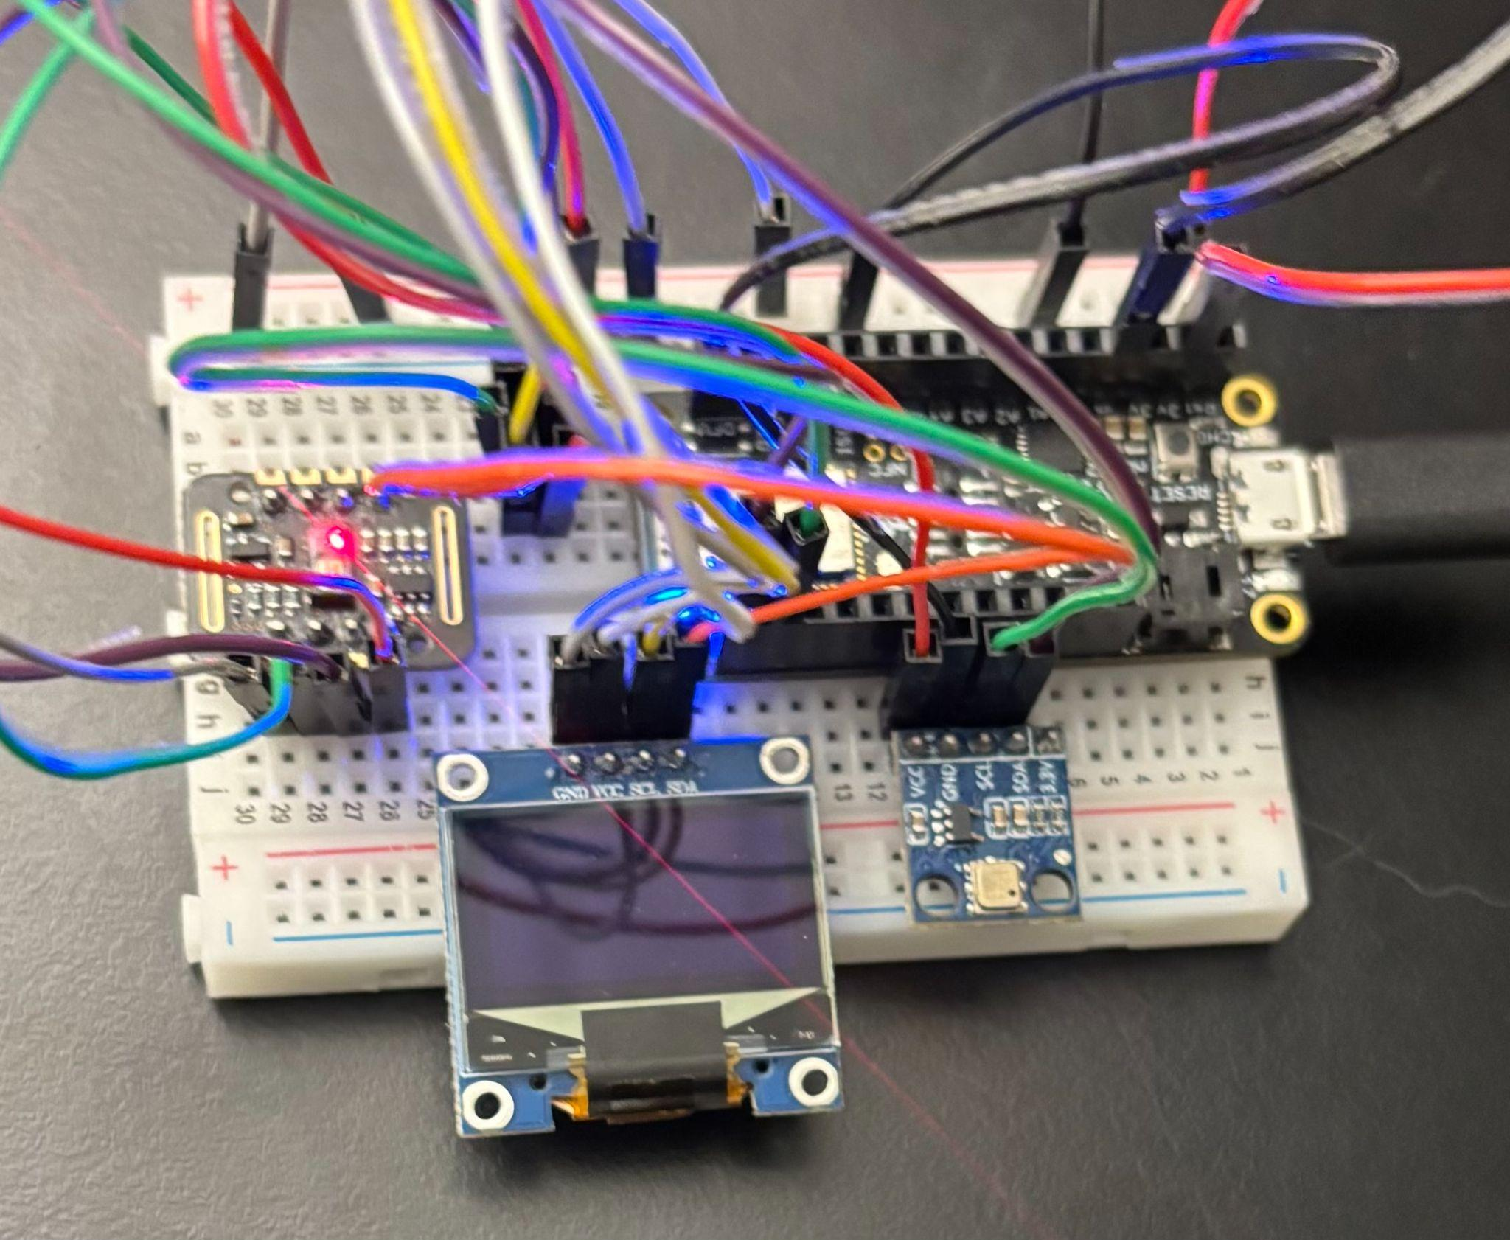
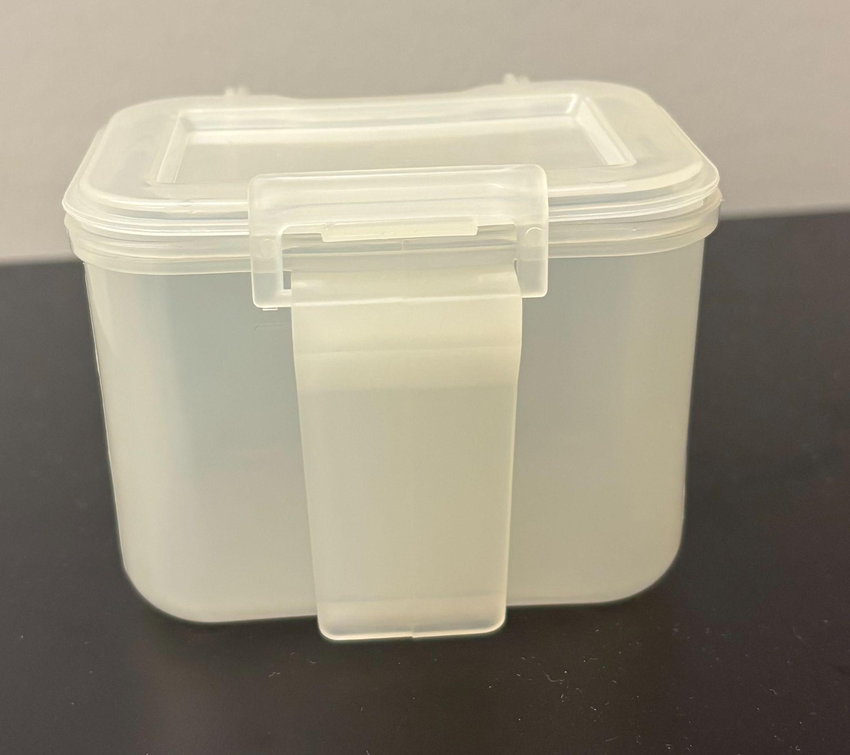
Encasing + Battery Management
Components | Average Current Draw
OLED Display | 15mA
MAX30102 | Sampling rate = 100, 5mA
BMP180 | 2mA
nRF52 Feather | 15mA using BLE
Total: | 37 mA
Battery Capacity (mAh) = 10 hr * 37mA = 370 mAh
For 10 hours of continuous runtime need battery to be around 370 mAh
Issues: box slightly too small

Slide 4
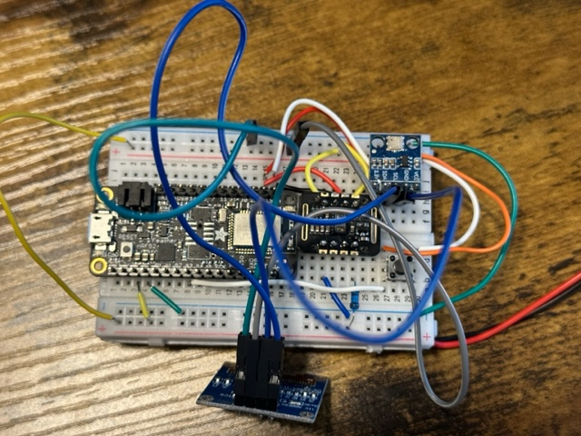
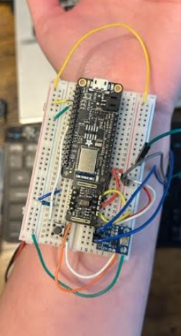
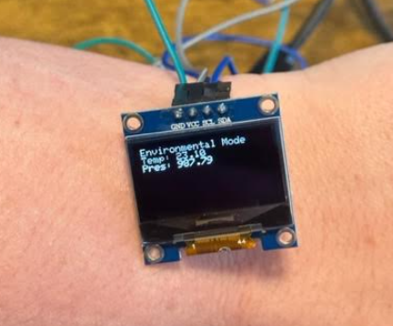
Display Warning System

Slide 5
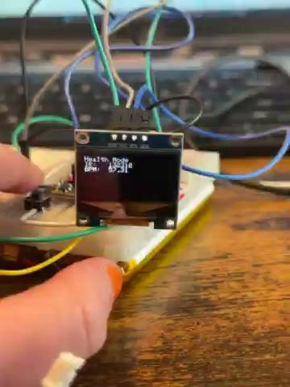

Slide 6
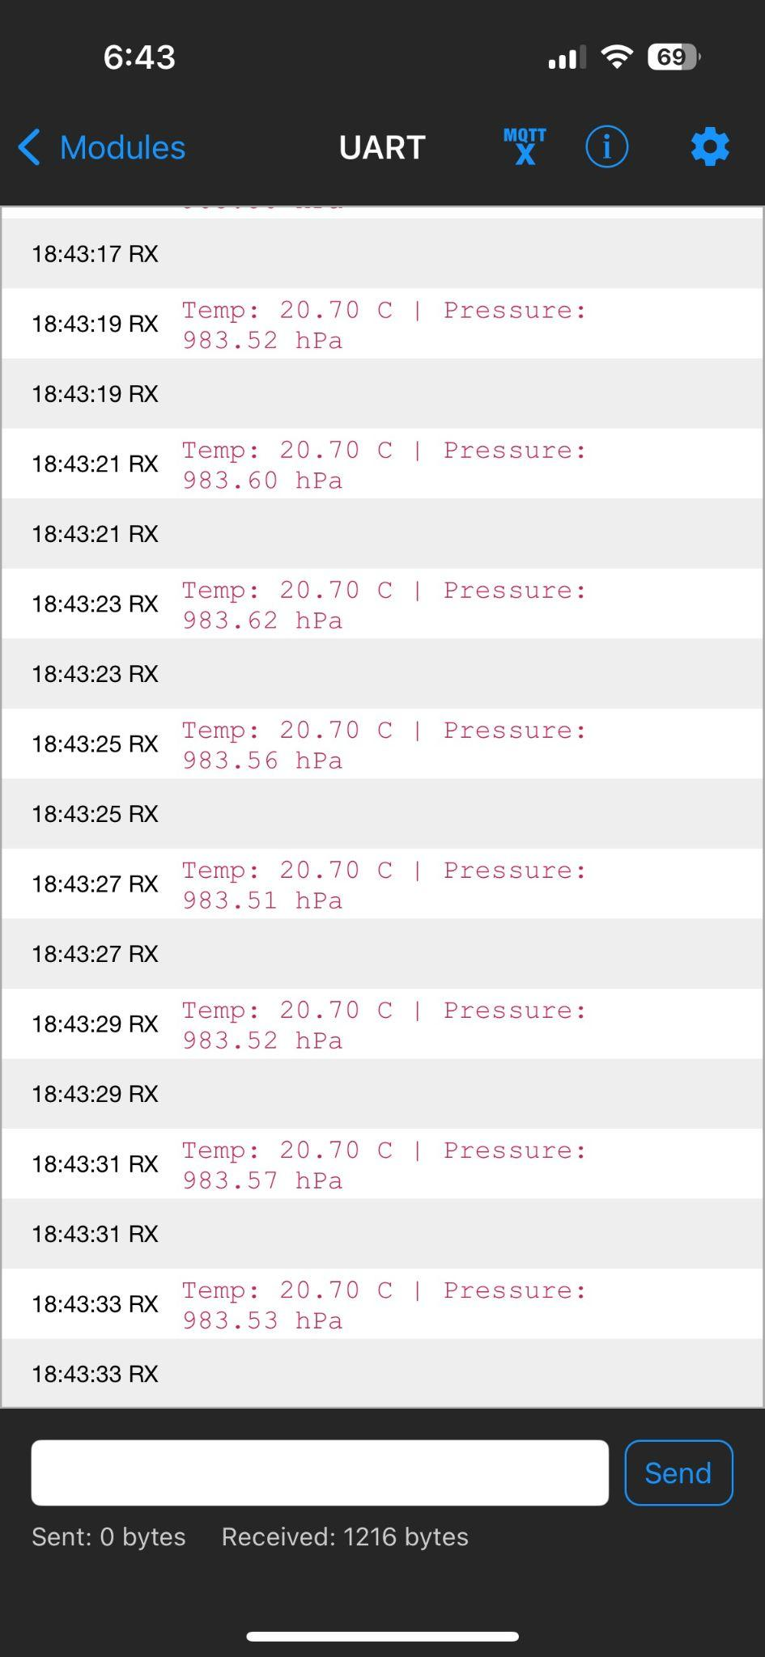
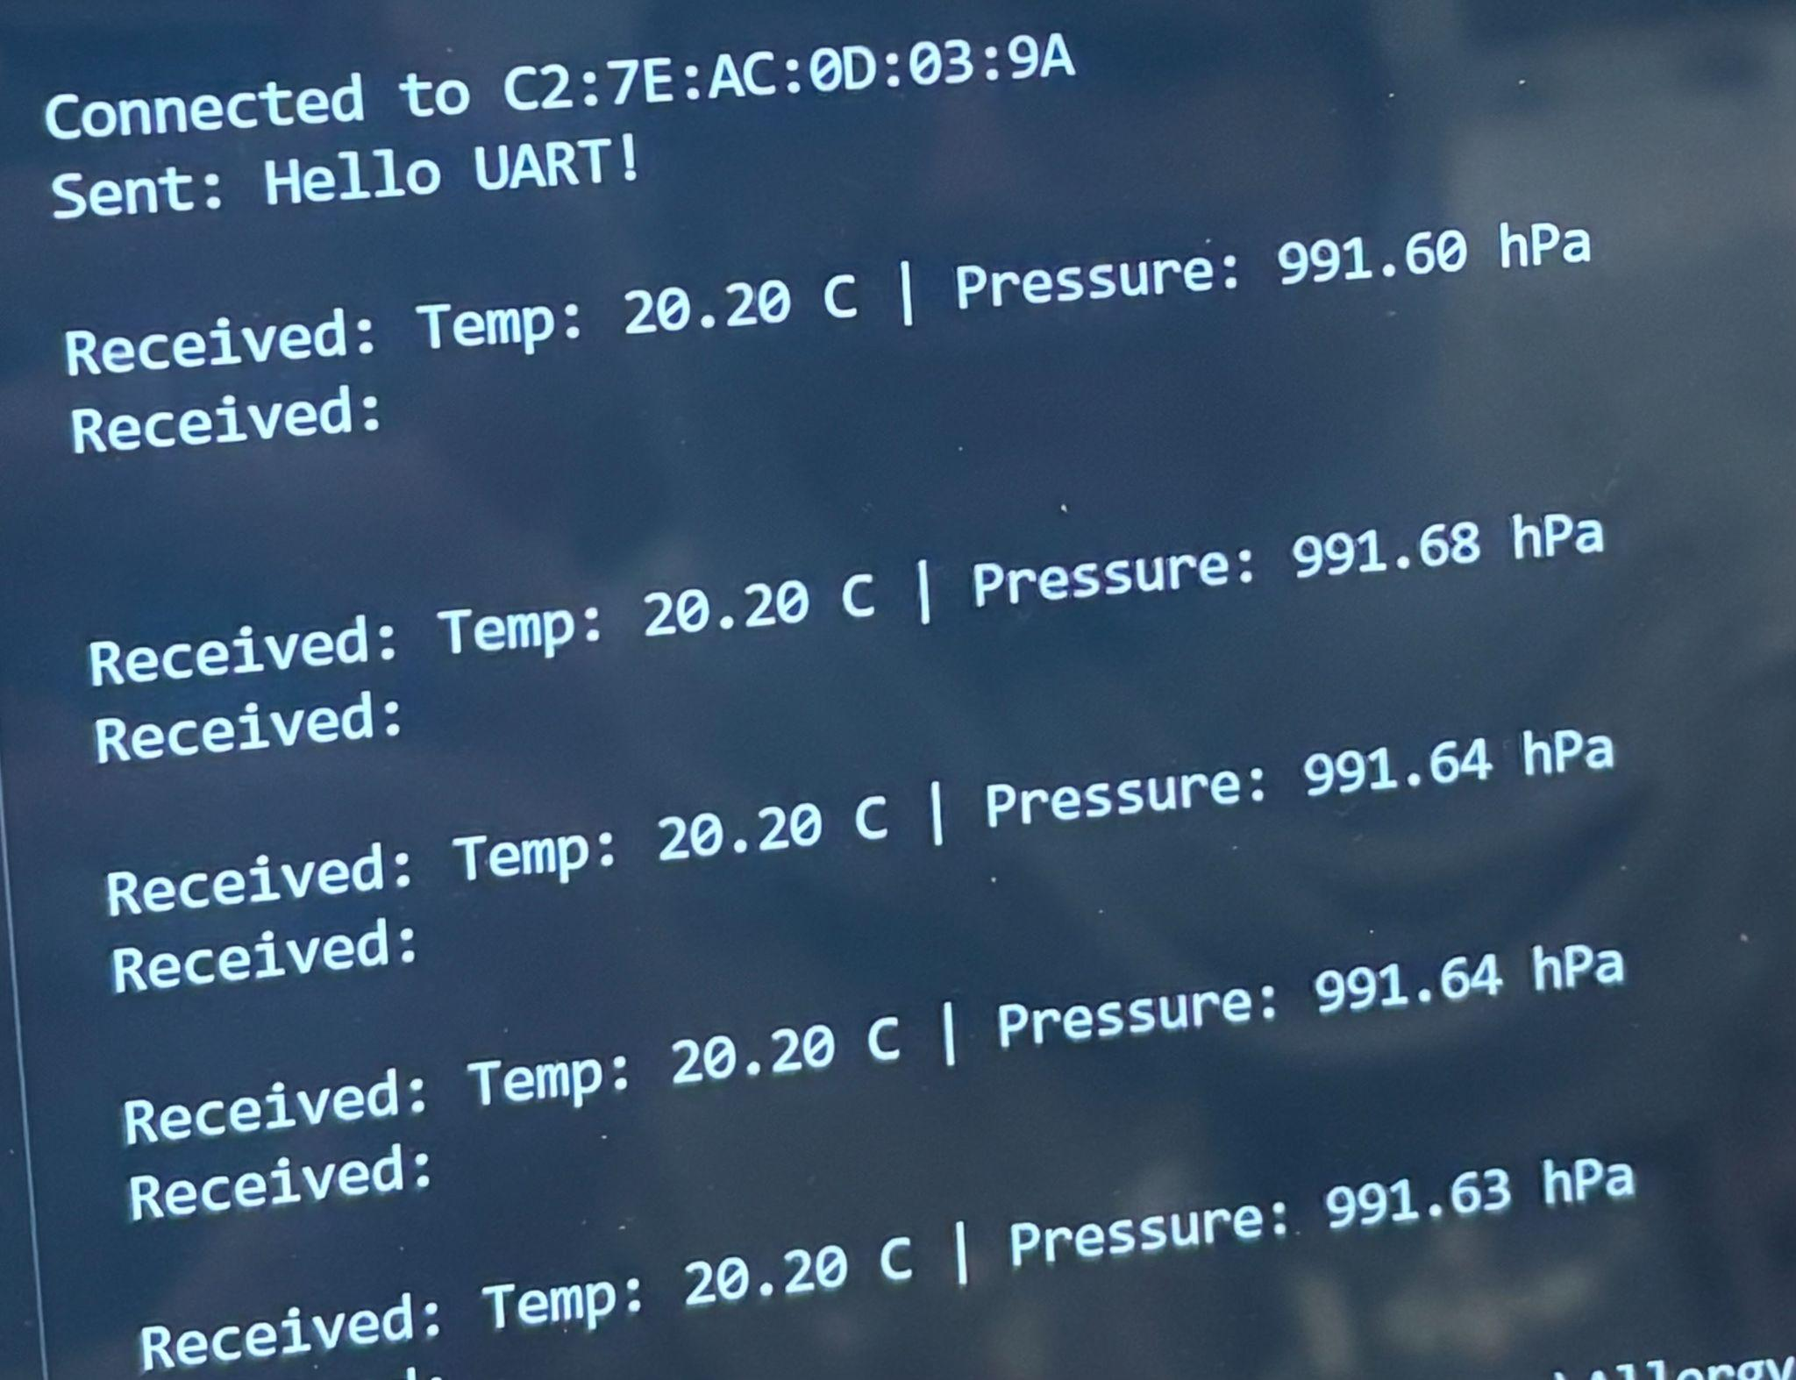
BLE + App Database
Verification of BLE data to backend
Initial test of BLE connection

Slide 7
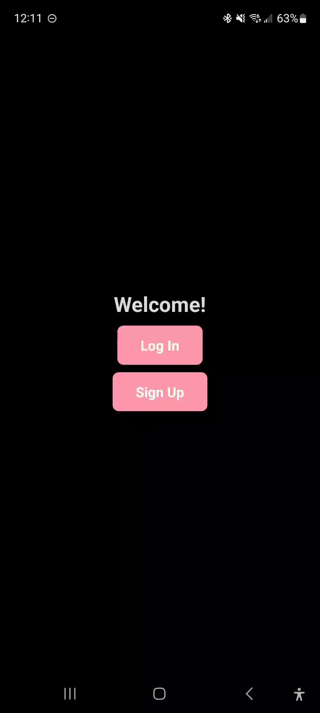
Frontend
User can input personal information, conditions, allergies, and symptoms
User input correction almost complete
Next steps will be improving algorithm, improving symptom page, and adding polish
App aesthetic not necessary but we should have time to make it look nicer than it does/fix visual glitches

Slide 8
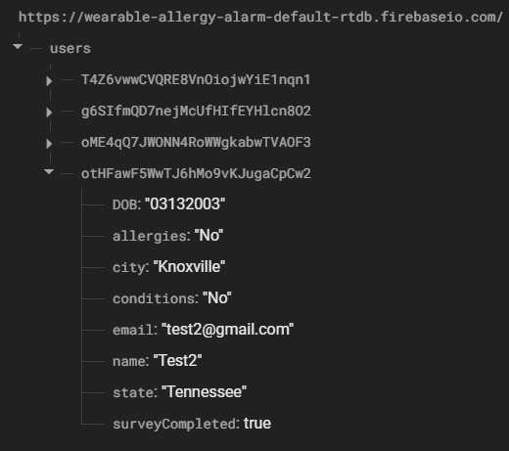
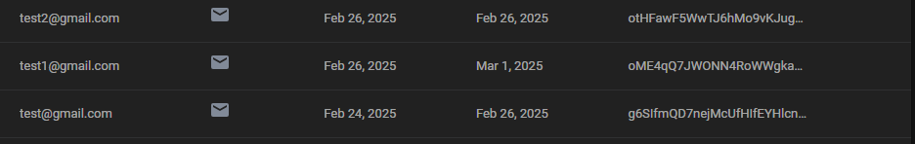
Backend/Database
Database allows authenticated sign up and login
User specific data (survey) is stored in realtime database
User specific data is accessed through tokens in frontend and sent to our Flask backend

Slide 9

Software/Hardware Connection
Python script that collects live sensor data
Data gets displayed at correct pages
Page refresh allows user to see most up to date data

