Slide 1


PIPBoy MARK I
Anika Roskowski and Mak Mckinney Present

Slide 2
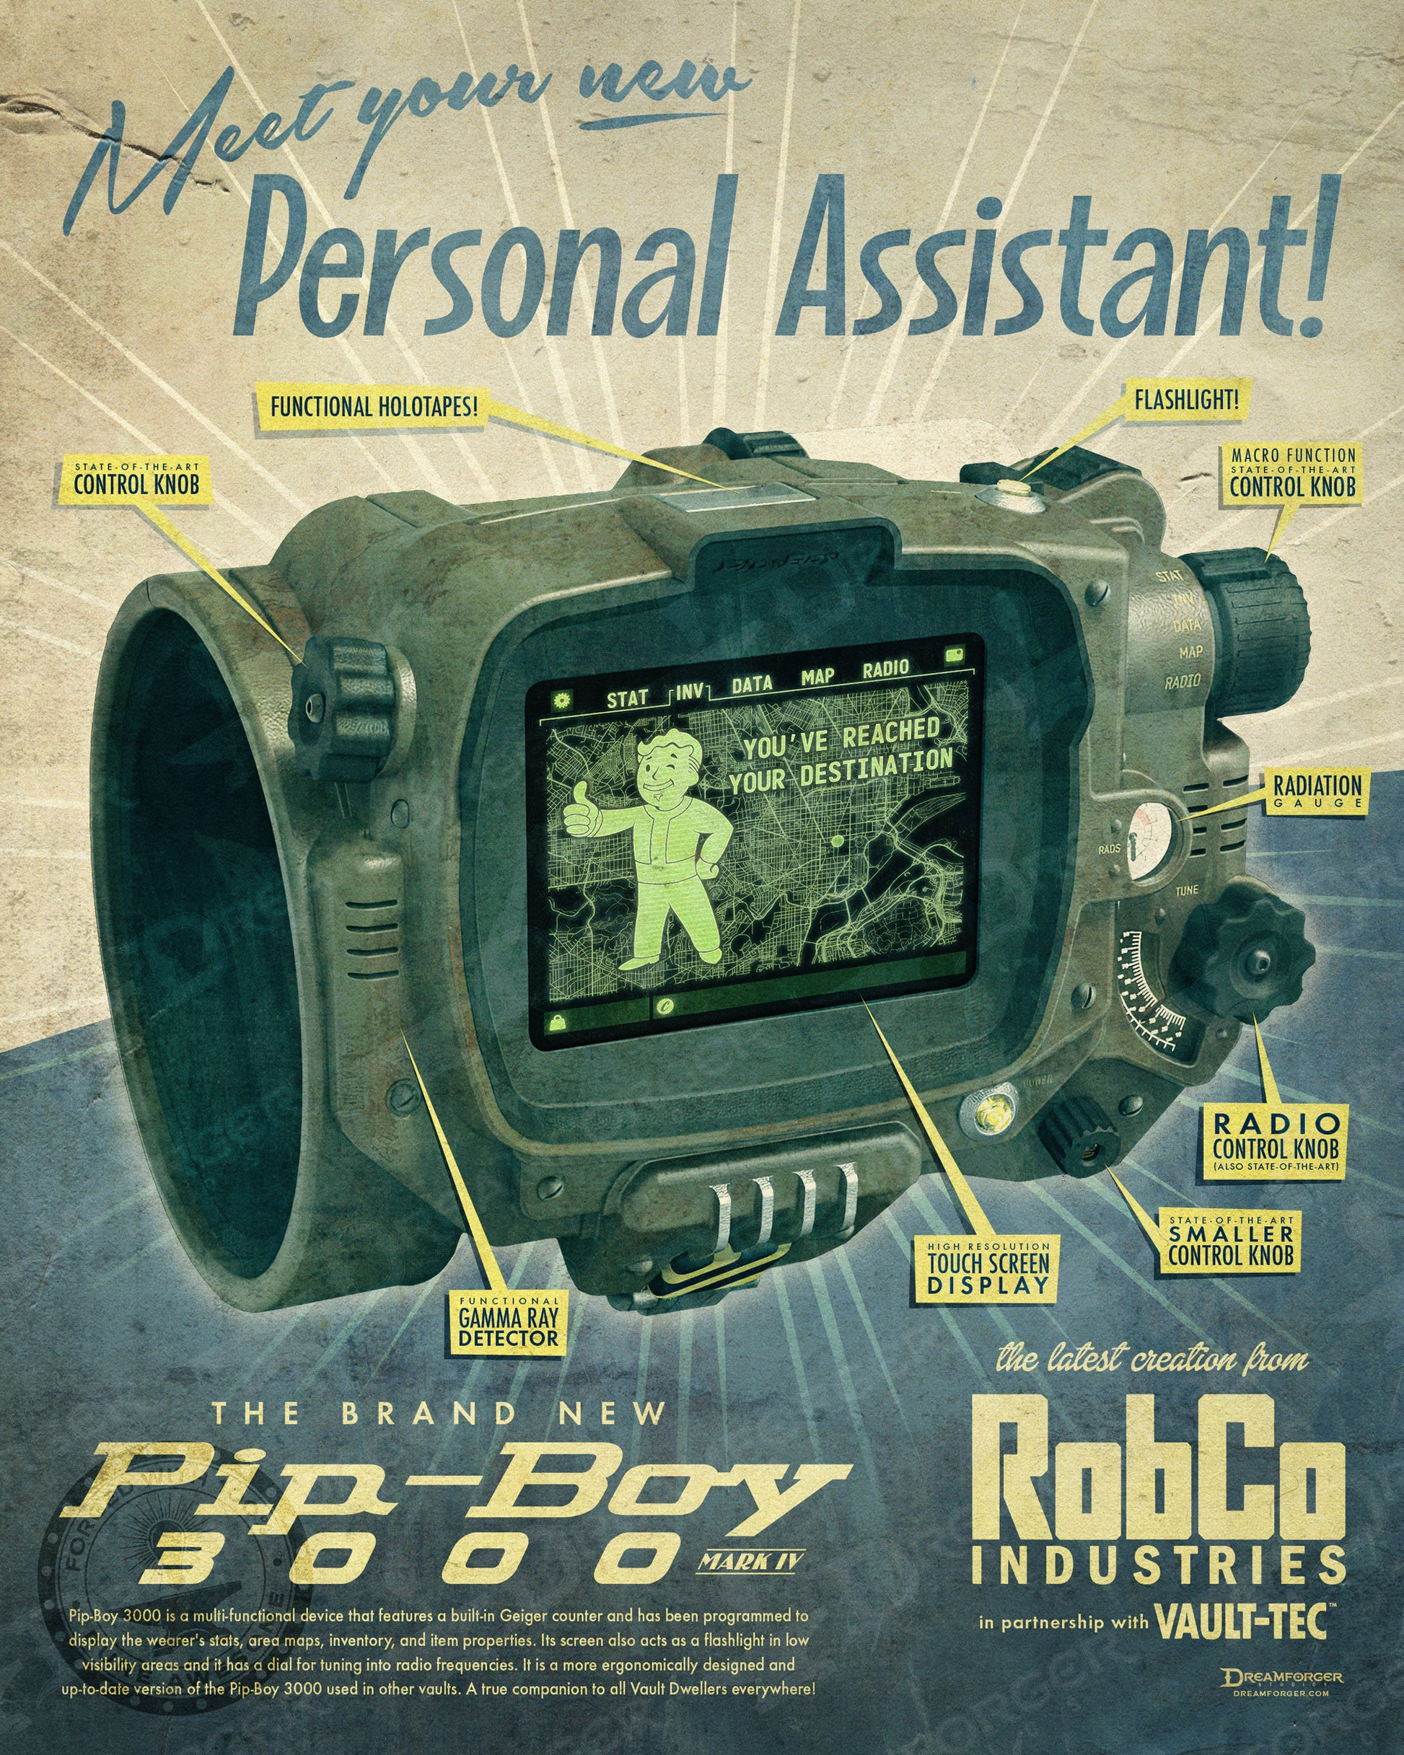

Inspiration
PIP-Boy (MARK IV) Features: - Player Inventory
Player Positions and Map
Radio & Holotape Player
Quest Logs
PIP-Boy (MARK I) Features: - Clock Display
Weather and Location
Music Player
https://fallout.fandom.com/wiki/Pip-Boy

Slide 3
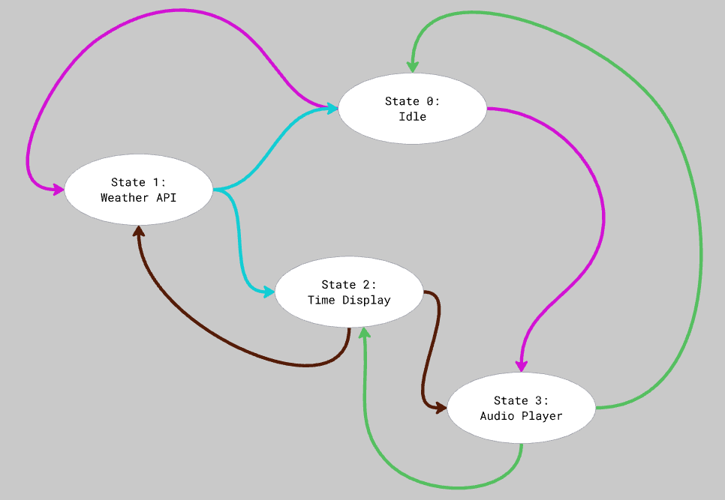


Slide 4

Code Sources
Provided lab files for PA5, PA6
Interfacing with DS1307 with I2C Protocol https://www.romn.io/2021/03/i2c-real-time-clock-rtc-ds1307-writeread.html

Slide 5

Work Distribution
Anika Roskowski
Mak Mckinney
Weather Driver
LCD Driver
RTC Driver
Audio Driver
Weather/LCD Integration
Circuit Construction
Finite State Machine
Audio Integration
Image Integration
LCD Displays
Presentation
(Attempted Radio API, failed horribly)

Slide 6


