Slide 1


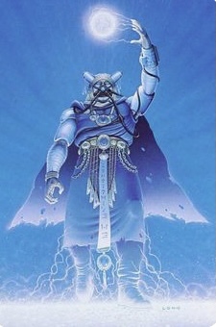
Team mystic
PRESENTING: Mentor ME

Slide 2
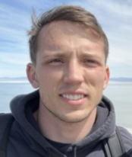
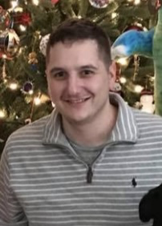
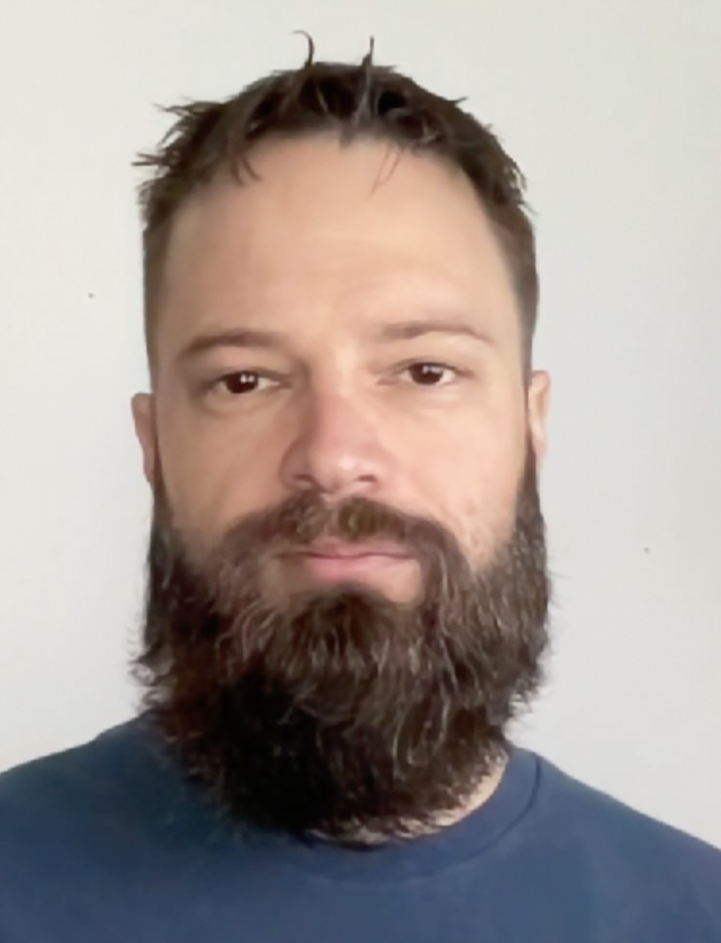
The developer team
Austin Borck, Scrum Master
Chad Rousseau, Repo Owner
Ken Pederson, Database Administrator

Slide 3
Overview
Application Demonstration
Talking About Code
Remaining Functionality
The README
Recap

Slide 4
Application Demonstration
MENTORME

Slide 5
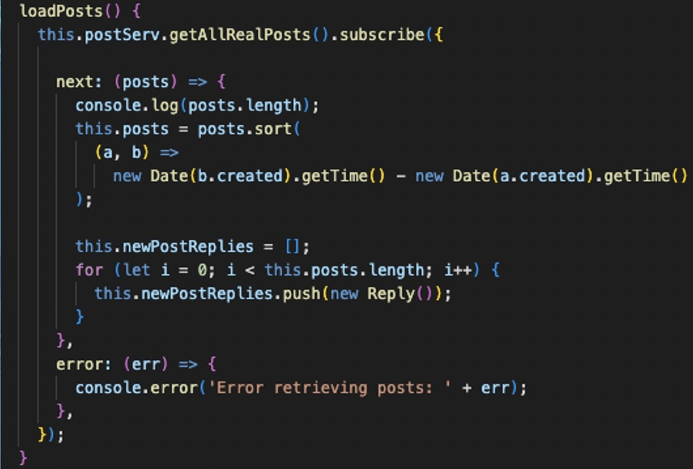
Talking About Code

Slide 6
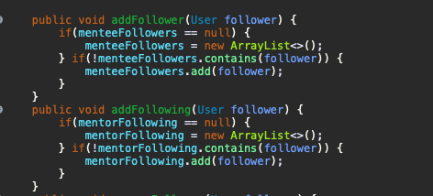
Talking About Code

Slide 7
Remaining Functionality
Sprint Timeline: ~10 days
Functionality Timeboxed at 2.5 days from presentation
- Instant messaging between users
A system for users to send messages to administrators for adding an unlisted bootcamp

Slide 8
The README
GitHub

Slide 9
recap
What we covered…
1. Application Demonstration
2. The code
3. Remaining Implementations
4. The README

Slide 10
Questions?

