Slide 1
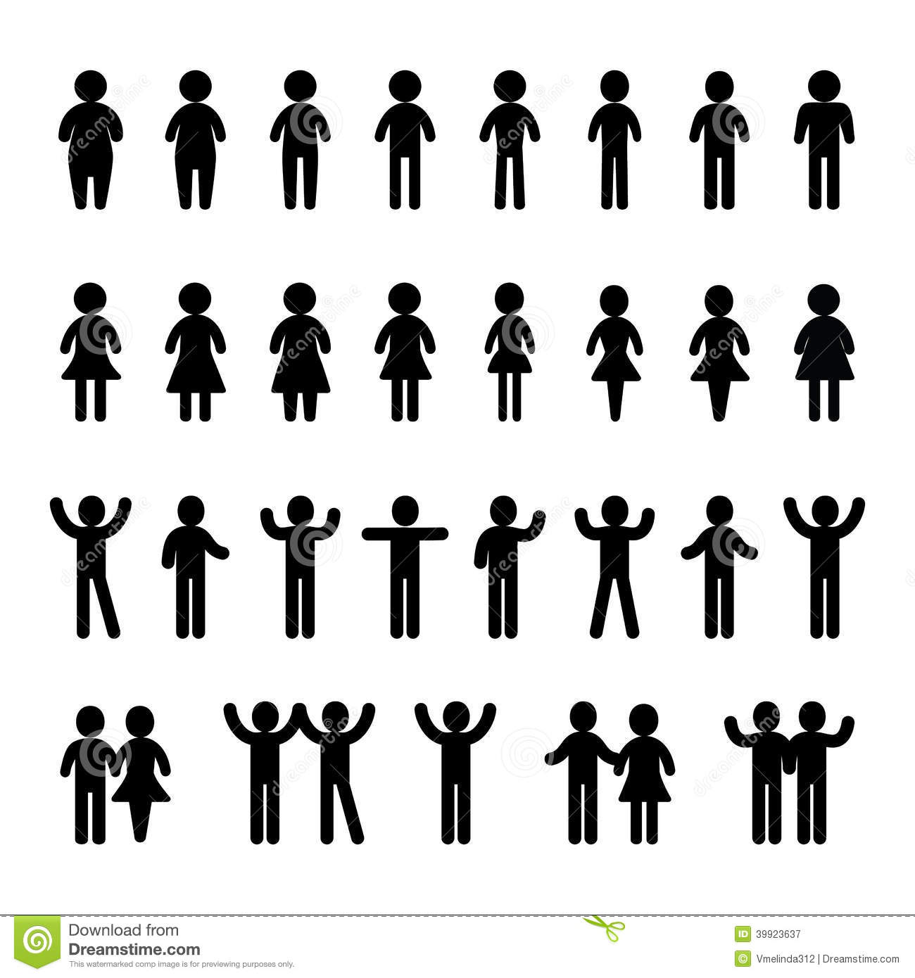


Exposed zone
4
Description
Values/effect
1
1
Self-distancing: reduction mean number of contacts per day and individual.
20%, 50%
2
2a
Self-isolation of symptomatic (!) in individual tents
Tents available:
10, 20, 50, 100, 250, 500, 1000, 2000
2b
!
2b
Number of carers ( )
1 per tent
2c
Self-isolation delay
12h, 24h, 48h
!
2c
3
Safety-zone for vulnerable population
Elderly only
Elderly+Adults w. comorb.
Elderly+Adults+kids
(up to 20%, 25%, 30% pop.)
3c
3b
3d
3b
Number of contacts
2, 10 (per week and individual in safety zone)
3
3c
Health checks
Exclude symptomatic from buffering zone if in place.
Safety zone
3d
Lockdown of buffering zone if one case is detected
Reduces values of 3b a 50%, or 90%
4
Evacuation of severely symptomatic
Evacuated individuals are no longer infectious, don’t receive health care
Buffering zones: open space, 2m distance, use of masks.
Probability of infection reduces an 80%

