Slide 1






A
S
E
I
R
Q
D

Slide 2











A_{i}
Jordan
R_{i}
I_{Ri}
S_{i}
E_{i}
P_{i}
I_{Hi}
H_{i}
R_{i}/D_{i}
I_{Ci}
D_{i}

Slide 3
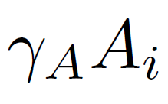
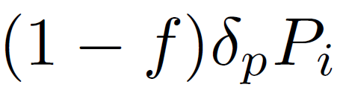
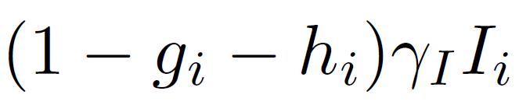
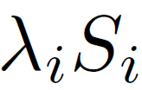
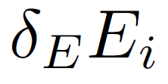
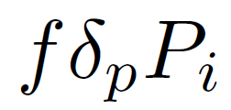
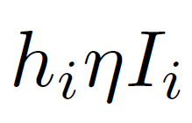
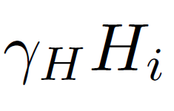
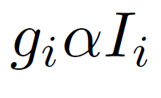
A_{i}
R_{i}
S_{i}
E_{i}
P_{i}
I_{i}
H_{i}
R_{i}/D_{i}
D_{i}

