Slide 1
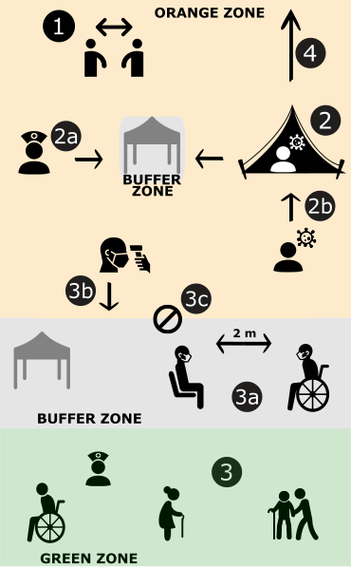

Intervention/Description | Levels/Effect
1. Self-distancing: reduction of mean number of contacts per day per individual | 10%, 20%, 30%, 40%, 50%
2. Self-isolation Isolation of symptomatic people in individual tents | Number of available tents: 10, 20, 50, 100, 250, 500, 1000, 2000
2a. Number of carers: number of healthy people that will take care of self-isolated people | 1 per tent
2b. Self-isolation delay: time from symptom onset to self-isolation | 12h, 24h, 48h
3. Safety zone Designated area for vulnerable population | Older adults only, Older adults + adults with comorbidities, Older adults + adults with comorbidities + healthy adults and kids, up to 20%, 25%, or 30% of the population
3a. Number of contacts people in the safety zone can have with people from the exposed zone (contacts always happen in the buffer zone) | 2 or 10 contacts per week per individual residing in the safety zone
3b. Health checks | Exclude symptomatic people from meeting with people from the safety zone
3c. Lockdown of safety zone if one case is detected in the exposed zone | Reduces value of 3a by 50%, or 90%
4. Evacuation of severely symptomatic | Evacuated individuals cannot infect other people from the camp, but they do not receive healthcare
Buffer zones Open space, 2m distancing, use of face cover | Reduces probability of infection by 80%

