Slide 1
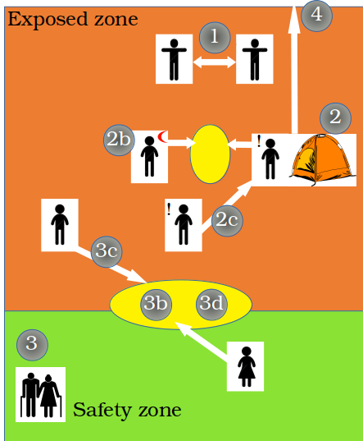










Intervention | Description | Levels
Self-distancing | Reduction of mean number of contacts per day per individual | 20%, 50%
Self-isolation | Isolation of symptomatic (!) people in individual tents | Number of available tents: 10, 20, 50, 100, 250, 500, 1000, 2000
Number of carers | Number of healthy people that will take care of self-isolated people ( ) | 1 per tent
Self-isolation delay | Time from symptom onset to self-isolation | 12h, 24h, 48h
Safety zone | Designated area for vulnerable population | Older adults only, Older adults + adults with comorbidities, Older adults + adults with comorbidities + healthy adults and kids, up to 20%, 25%, or 30% of the population
Number of contacts | Number of contacts people in the safety zone can have with people from the exposed zone (contacts always happen in the buffering zone) | 2 or 10 contacts per week per individual residing in the safety zone
Health checks | Exclude symptomatic (!) people from meeting with people from the safety zone
Lockdown of safety zone | Lockdown if one case is detected in the population | Reduces value of 3b by 50%, or 90%
Evacuation of severely symptomatic | Evacuated individuals cannot infect other people from the camp, but they do not receive healthcare
Buffering zones | Open space, 2m distancing, use of face cover | Reduces probability of infection by 80%

Slide 2
 | Description | Levels/ Effect
1 | Self-Distancing: reduction of mean number of contacts per day per individual | 20% , 50%
2 | Self-Isolation of symptomatic (!) people in individual tents | Number of available tents: 10, 20, 50, 100, 250, 500, 1000, 2000
2b | Number of carers ( ): healthy people that will take care of self-isolated people | 1 per tent
2c | Self-Isolation delay: time from symptom onset to self-isolation | 12h, 24h, 48h
3 | Safety zone: designated area for vulnerable population | Elderly only Elderly + Comorbid Adults Elderly + Comorbid Adults + Children (up to 20%, 25%, 30% population)
3b | Number of contacts people in the safety zone can have with people from the exposed zone (contacts always happen in the buffering zone) | 2 or 10 contacts (per week per individual residing in the safety zone)
3c | Health checks | Exclude symptomatic (!) people from meeting with people from the safety zone
3d | Lockdown of safety zone if one case is detected in the exposed zone | Reduces value of 3b at 50% or 90%
4 | Evacuation of severely symptomatic | Evacuated individuals cannot infect other people from the camp, but they do not receive healthcare
 | Buffering zones: open space, 2m distance, use of face cover | Reduces probability of infection by 80%

Slide 3
 | Description | Levels/ Effect
1 | Self-Distancing: reduction of mean number of contacts per day per individual | 20% , 50%
2 | Self-Isolation of symptomatic (!) people in individual tents | Number of available tents: 10, 20, 50, 100, 250, 500, 1000, 2000
2b | Number of carers ( ): healthy people that will take care of self-isolated people | 1 per tent
2c | Self-Isolation delay: time from symptom onset to self-isolation | 12h, 24h, 48h
3 | Safety zone: designated area for vulnerable population | Older adults only Older adults + Adults with comorbidities Older adults + Adults with comorbidities + Healthy adults & Children (up to 20%, 25%, 30% population)
3b | Number of contacts people in the safety zone can have with people from the exposed zone (contacts always happen in the buffer zone) | 2 or 10 contacts (per week per individual residing in the safety zone)
3c | Health checks | Exclude symptomatic (!) people from meeting with people from the safety zone
3d | Lockdown of safety zone if one case is detected in the exposed zone | Reduces value of 3b by 50% or 90%
4 | Evacuation of severely symptomatic | Evacuated individuals cannot infect other people from the camp, but they do not receive healthcare
 | Buffer zones: open space, 2m distance, use of face cover | Reduces probability of infection by 80%

Slide 4
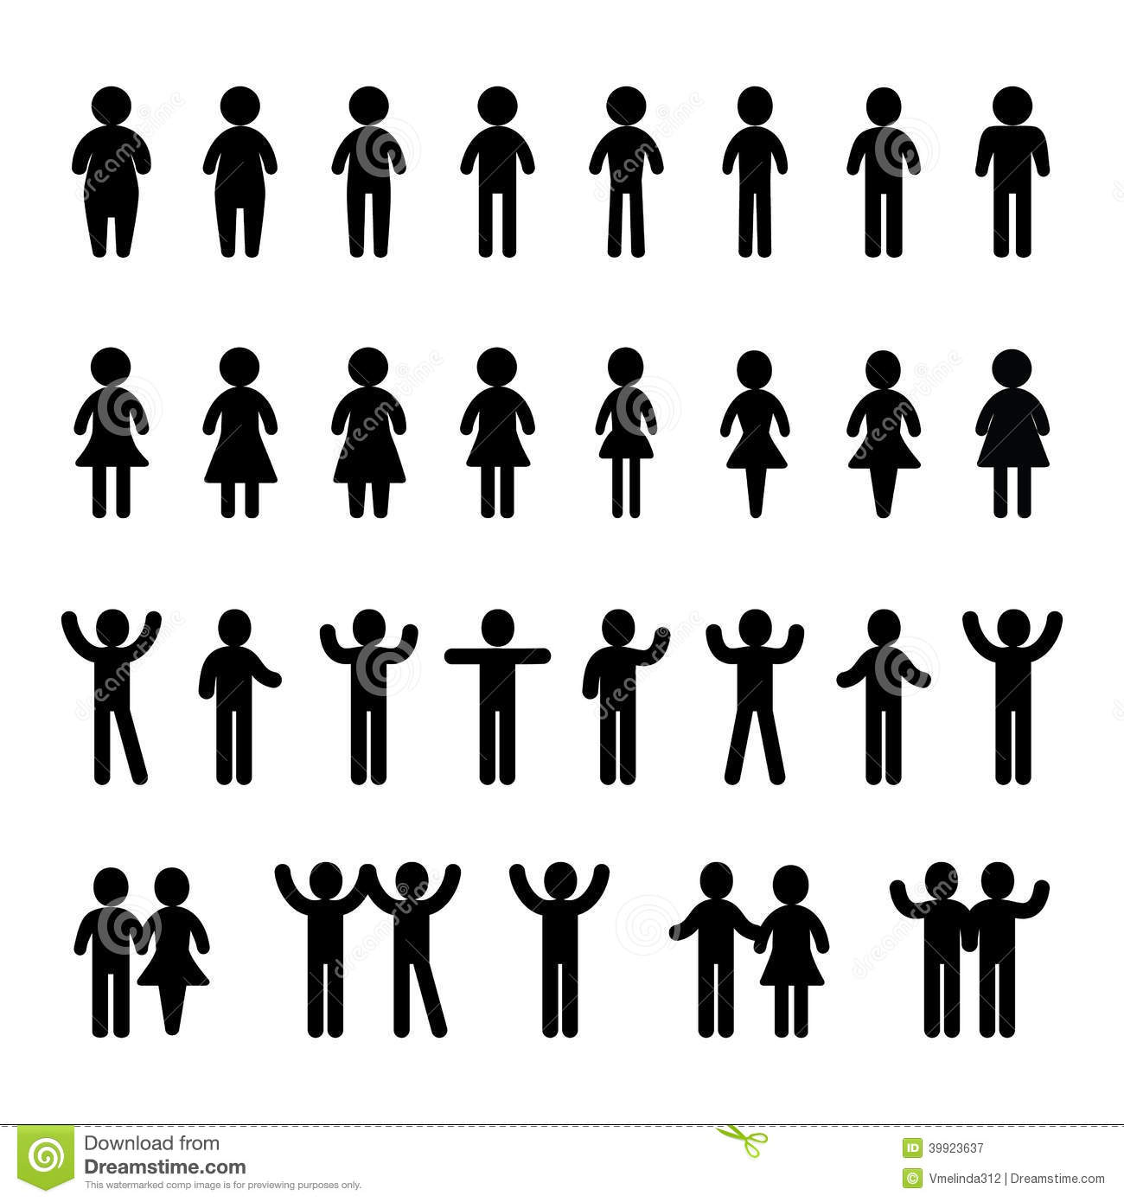
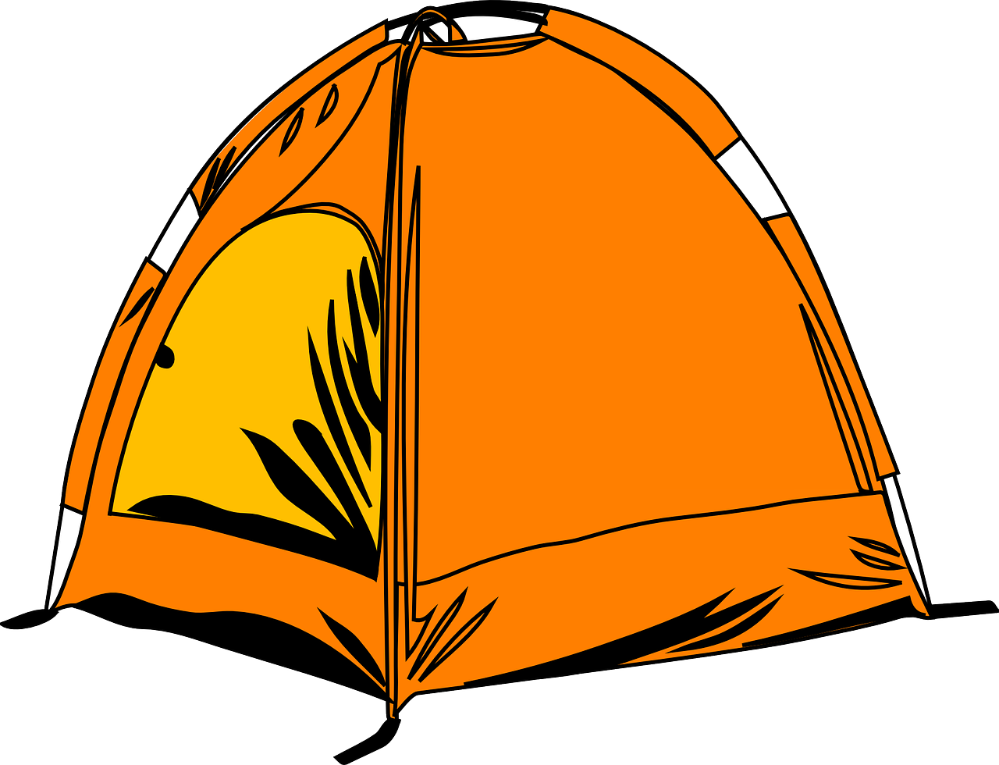
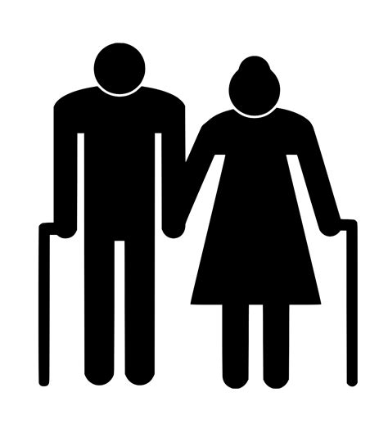
Intervention/Description | Levels/Effect
Self-distancing: reduction of mean number of contacts per day per individual | 20%, 50%
Self-isolation Isolation of symptomatic (!) people in individual tents | Number of available tents: 10, 20, 50, 100, 250, 500, 1000, 2000
Number of carers ( ): number of healthy people that will take care of self-isolated people | 1 per tent
Self-isolation delay: time from symptom onset to self-isolation | 12h, 24h, 48h
Safety zone Designated area for vulnerable population | Older adults only, Older adults + adults with comorbidities, Older adults + adults with comorbidities + healthy adults and kids (up to 20%, 25%, or 30% of the population)
Number of contacts people in the safety zone can have with people from the exposed zone (contacts always happen in the buffering zone) | 2 or 10 contacts per week per individual residing in the safety zone
Health checks | Exclude symptomatic (!) people from meeting with people from the safety zone
Lockdown of safety zone if one case is detected in the exposed zone | Reduces value of 3a by 50%, or 90%
Evacuation of severely symptomatic | Evacuated individuals cannot infect other people from the camp, but they do not receive healthcare
Buffer zones Open space, 2m distancing, use of face cover | Reduces probability of infection by 80%
1
Exposed zone
4
1
2
2a
2
2b
2a
!
3
!
2b
3b
3a
3a
3c
3b
3
3c
4
Safety zone

Slide 5
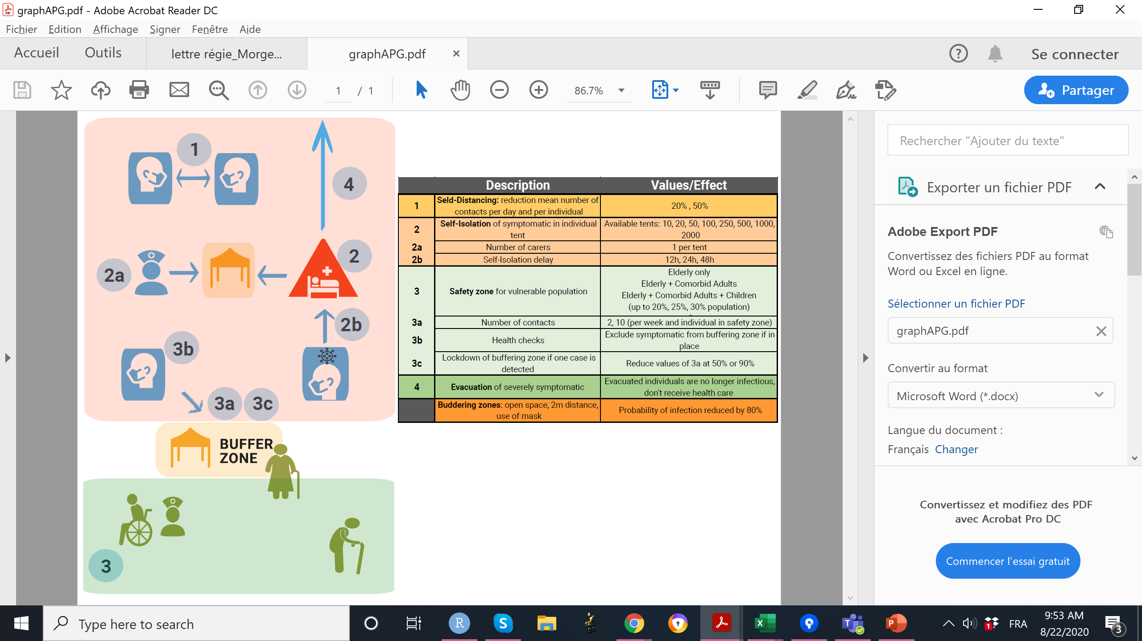
Intervention/Description | Levels/Effect
Self-distancing: reduction of mean number of contacts per day per individual | 20%, 50%
Self-isolation Isolation of symptomatic people in individual tents | Number of available tents: 10, 20, 50, 100, 250, 500, 1000, 2000
Number of carers: number of healthy people that will take care of self-isolated people | 1 per tent
Self-isolation delay: time from symptom onset to self-isolation | 12h, 24h, 48h
Safety zone Designated area for vulnerable population | Older adults only, Older adults + adults with comorbidities, Older adults + adults with comorbidities + healthy adults and kids, up to 20%, 25%, or 30% of the population
Number of contacts people in the safety zone can have with people from the exposed zone (contacts always happen in the buffering zone) | 2 or 10 contacts per week per individual residing in the safety zone
Health checks | Exclude symptomatic people from meeting with people from the safety zone
Lockdown of safety zone if one case is detected in the exposed zone | Reduces value of 3b by 50%, or 90%
Evacuation of severely symptomatic | Evacuated individuals cannot infect other people from the camp, but they do not receive healthcare
Buffer zones Open space, 2m distancing, use of face cover | Reduces probability of infection by 80%
1
2
2a
2b
3
3a
3b
3c
4

