Slide 1


Empowering the crowd: Feasible strategies
to minimize the spread of COVID-19
in IDP camps in NW Syria
Dr. Alberto Pascual-García, PhD, ETH-Zürich (Switzerland)
Dr. Eduard Campillo-Funollet, PhD, Univ. of Sussex (UK)
Jordan Klein, Mph, Princeton Univ. (USA)
Dr. Jennifer Villers, PhD, Princeton Univ. (USA)
Chamsy Sarkis, Pax Syriana Foundation
August 21th, 2020

Slide 3
Scientists

Slide 4
AIM
Identify feasible interventions:
– Immediate applicability
– No need of complex technical infrastructure
(e.g. testing, protection)
– Cost: as low as possible

Slide 5
The model

Slide 6
Outlook
Modelling
  Compartment models.
  Age-structured.
  Deterministic and stochastic simulations.
  Parameters estimated for IDPCs.

Slide 7
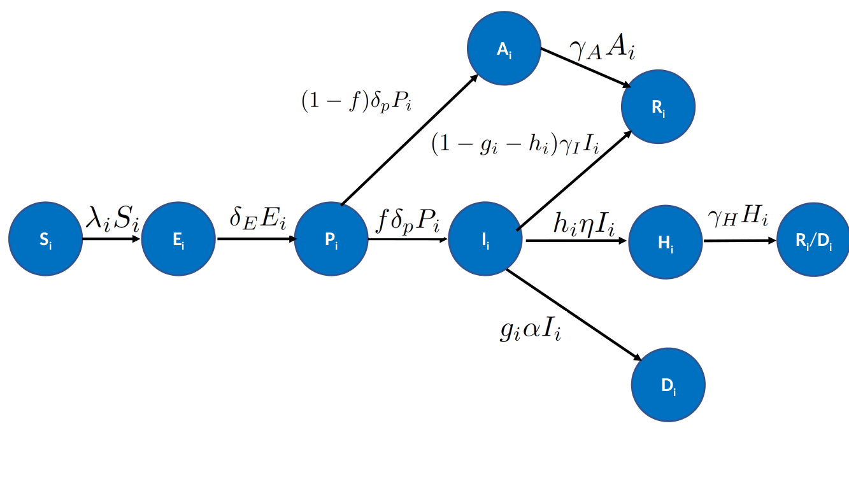
Model
Asymptomatic
Recovered
Presymptomatic
Symptomatic
Hospitalized
Susceptible
Exposed
Death

Slide 8
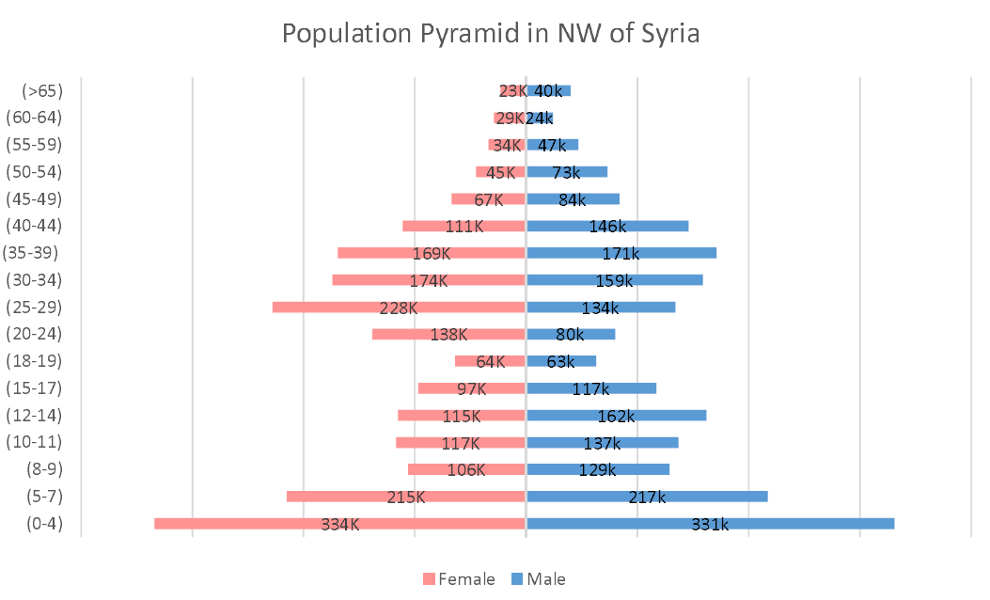

Slide 9
Age 3
Age 2
Age 1

Slide 10
Age 3
+ comorbidities
Age 2
+ comorbidities
Age 1

Slide 11
The results

Slide 12
Outlook
Modelling
  ~70 different interventions modelled
  ~100K different simulations.
Strategies
  Self-distancing
  Shielding, lockdown
  Self-isolation
  Evacuation
  Combined strategies

Slide 13
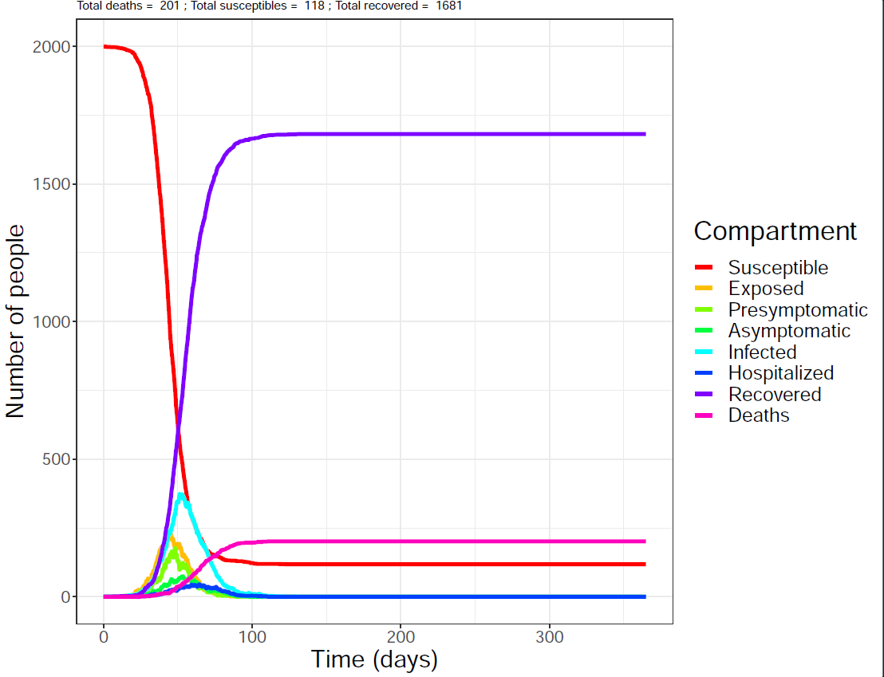
Model

Slide 14
Model
You can only gain time and protect vulnerable

Slide 15
No intervention: spread like wildfire
Probability of general outbreak in the camp 80%

Slide 16
No intervention: spread like wildfire
Probability of general outbreak in the camp 80%
10% of the population in the camp will die

Slide 17
No intervention: spread like wildfire
Probability of general outbreak in the camp 80%
10% of the population in the camp will die
For 1000 camps means 100K individuals dying

Slide 18
No intervention: spread like wildfire
Probability of general outbreak in the camp 80%
10% of the population in the camp will die
For 1000 camps means 100K individuals dying
Maximum of infections in 60 days

Slide 19
No intervention: spread like wildfire
Probability of general outbreak in the camp 80%
10% of the population in the camp will die
For 1000 camps means 100K individuals dying
Maximum of infections in 60 days
At that time, 60K people may have required healthcare.

Slide 20
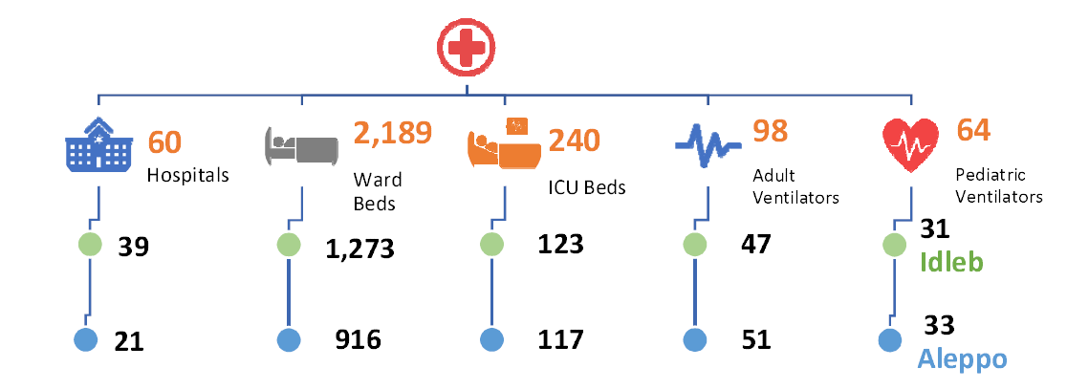
Hospitalization capacity
Hariri et al. The COVID-19 forecast in NW Syria. MedRxiv (2020)

Slide 21
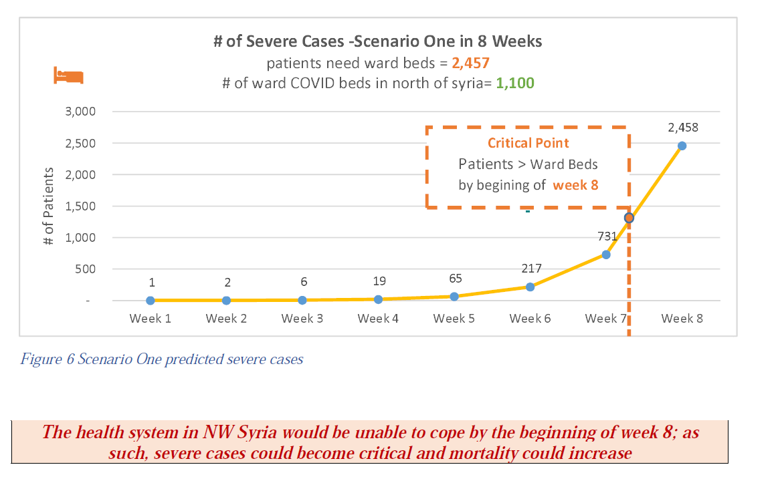
Hospitalization capacity
Hariri et al. The COVID-19 forecast in NW Syria. MedRxiv (2020)

Slide 22
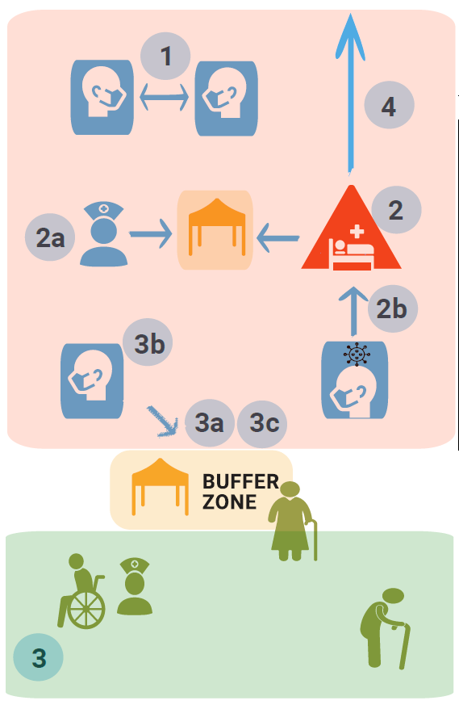
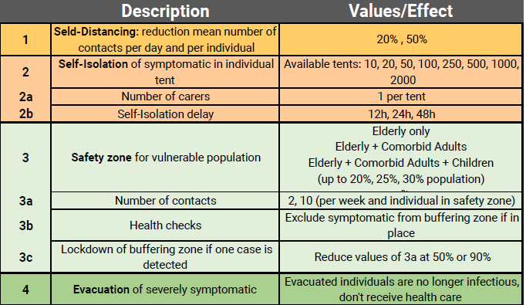
Interventions

Slide 23
Strategy 1: Self-distancing
Description
  Reduction of contacts between individuals.
Key-points
  Simple and rapid implementation.
  Educational-based, long-term benefit
  Starting investment
  then mouth-to-word

Slide 24
Strategy 1: Self-distancing
Description
  Reduction of contacts between individuals.
Key-points
  Simple and rapid implementation.
  Educational-based, long-term benefit
  Starting investment then mouth-to-word
Population class | Null model | Reduction 20% | Reduction 50%
Kids | 25 | 20 | 12.5
Adults | 15 | 11 | 7.5
Elderly | 10 | 8 | 5

Slide 25
Strategy 1: Self-distancing
Description
  Reduction of contacts between individuals.
Key-points
  Simple and rapid implementation.
  Educational-based, long-term benefit
  Starting investment then mouth-to-word
Population class | Null model | Reduction 20% | Reduction 50%
Kids | 25 | 20 | 12.5
Adults | 15 | 11 | 7.5
Elderly | 10 | 8 | 5

Slide 26
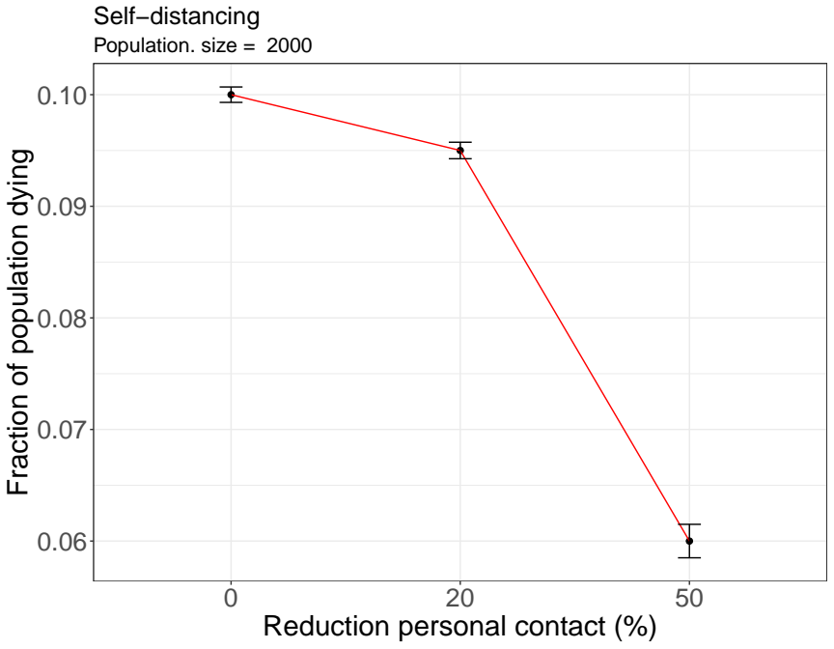
Strategy 1: Self-distancing

Slide 27
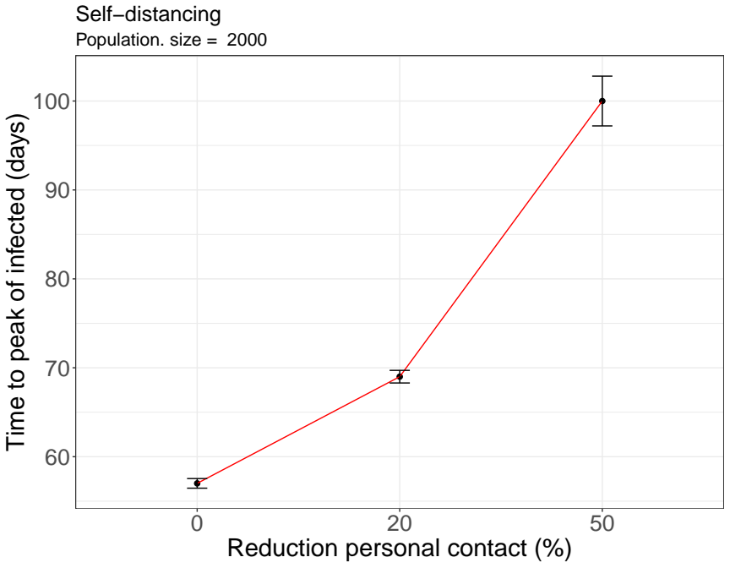
Strategy 1: Self-distancing

Slide 28
Strategy 1: Self-distancing
Up to 40% reduction in the the death tolls
Up to 40% delay in the peak of infected population

Slide 29
Interventions

Slide 30
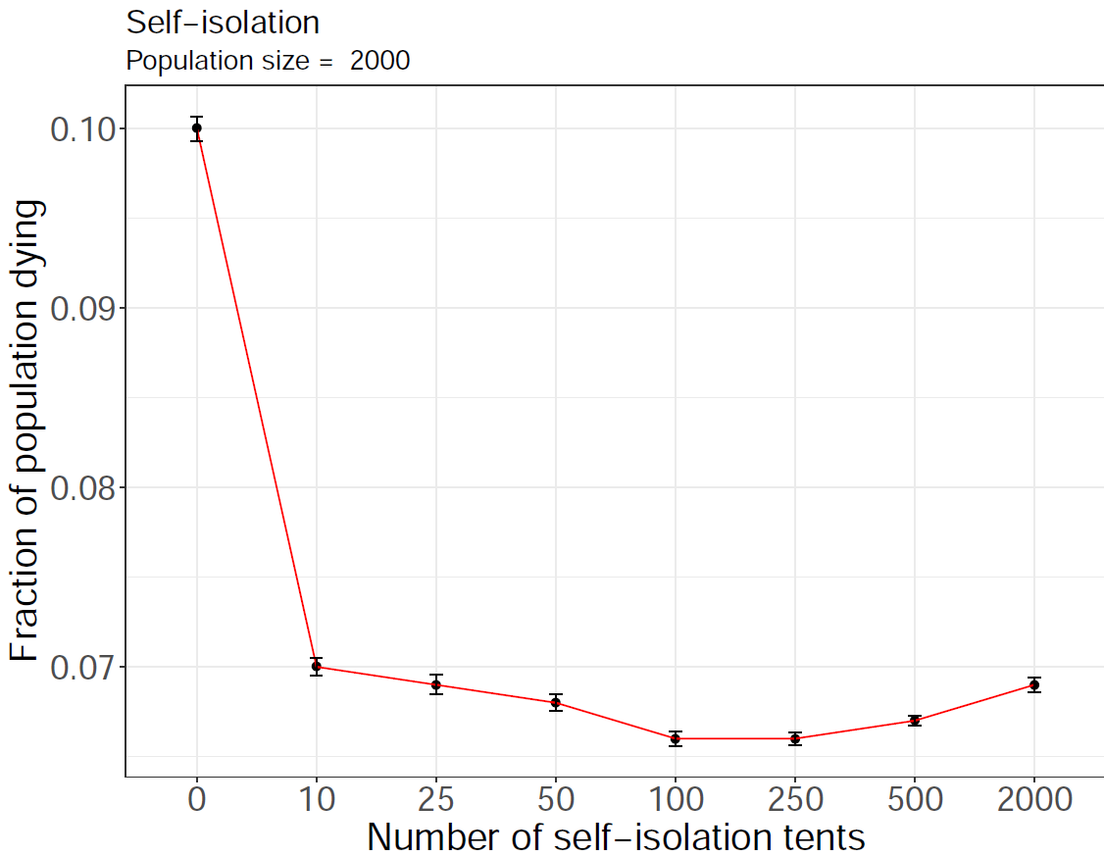
Strategy 3: Isolation

Slide 31
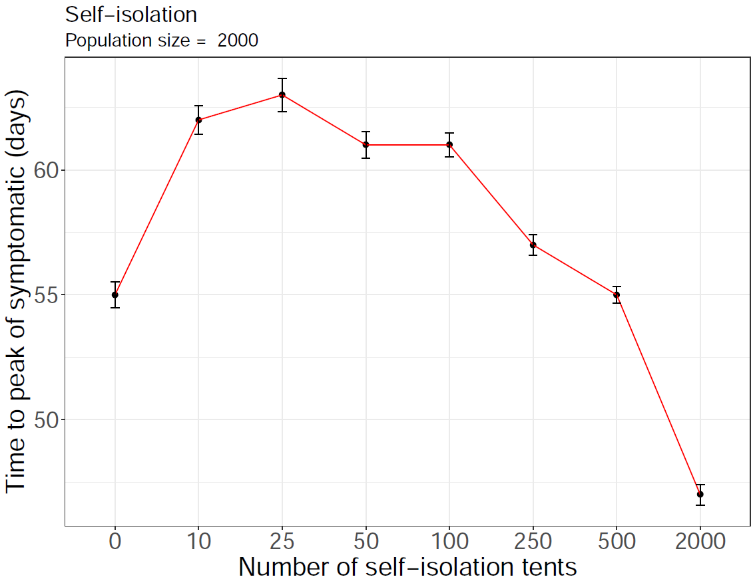
Strategy 3: Isolation

Slide 32
Interventions

Slide 33
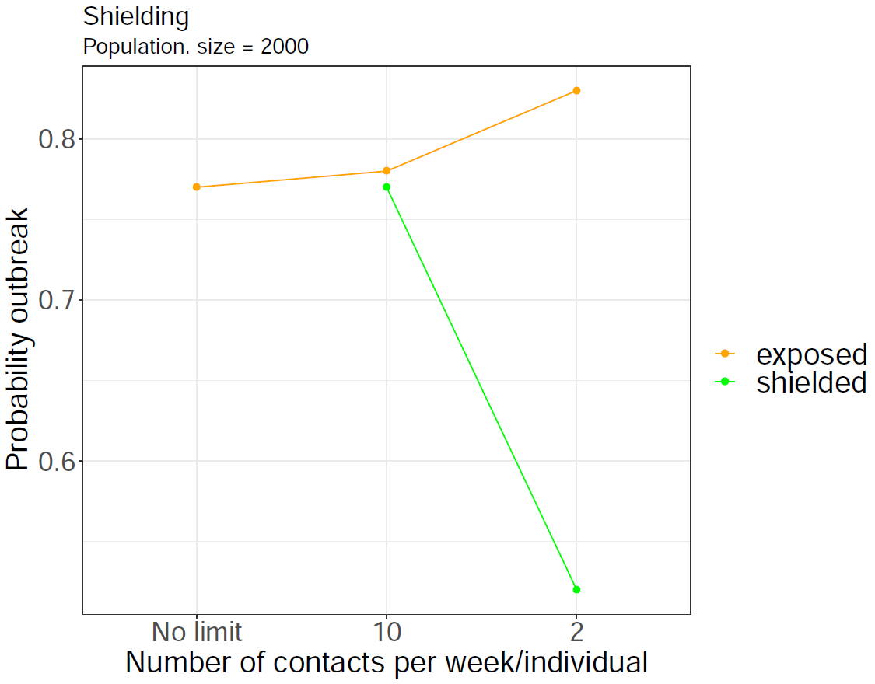
Strategy 2: Shielding only

Slide 34
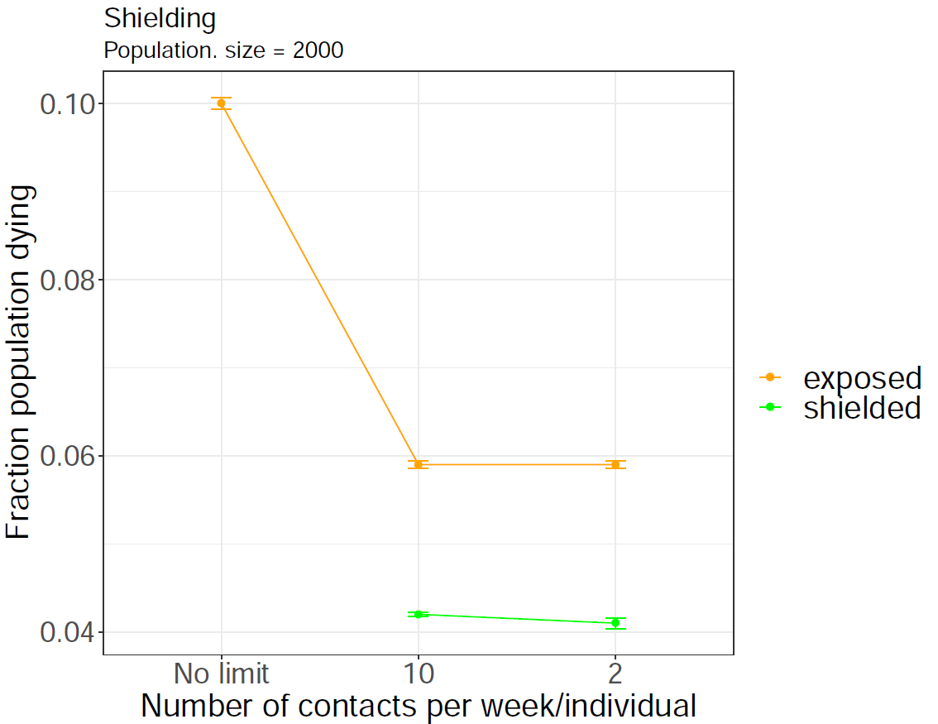
Strategy 2: Shielding only

Slide 35
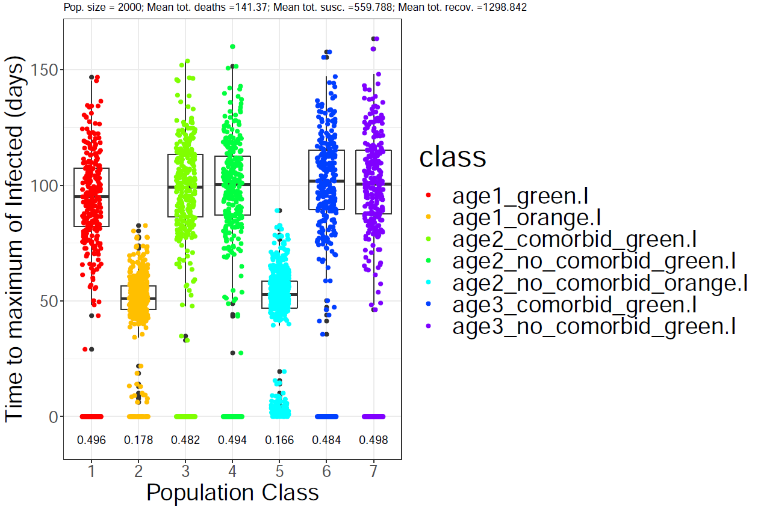
Strategy 2: Shielding only

Slide 36
Interventions

Slide 37
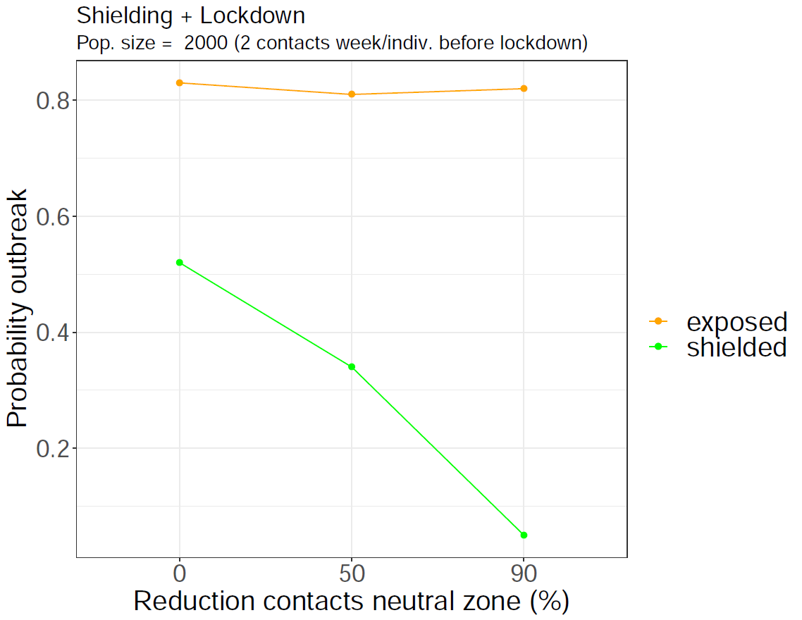
Strategy 2: Shielding and Lockdown

Slide 38
Combined strategies

Slide 39
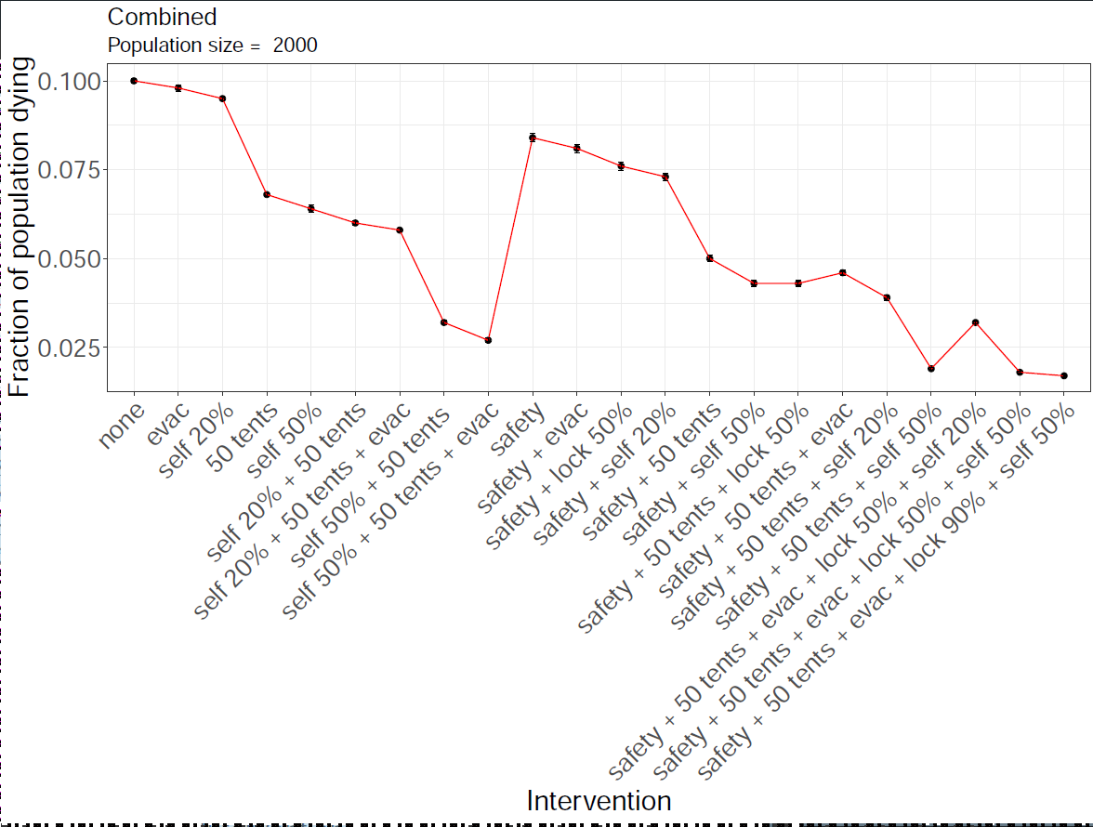
Combined strategies

Slide 40
Combined strategies

Slide 41
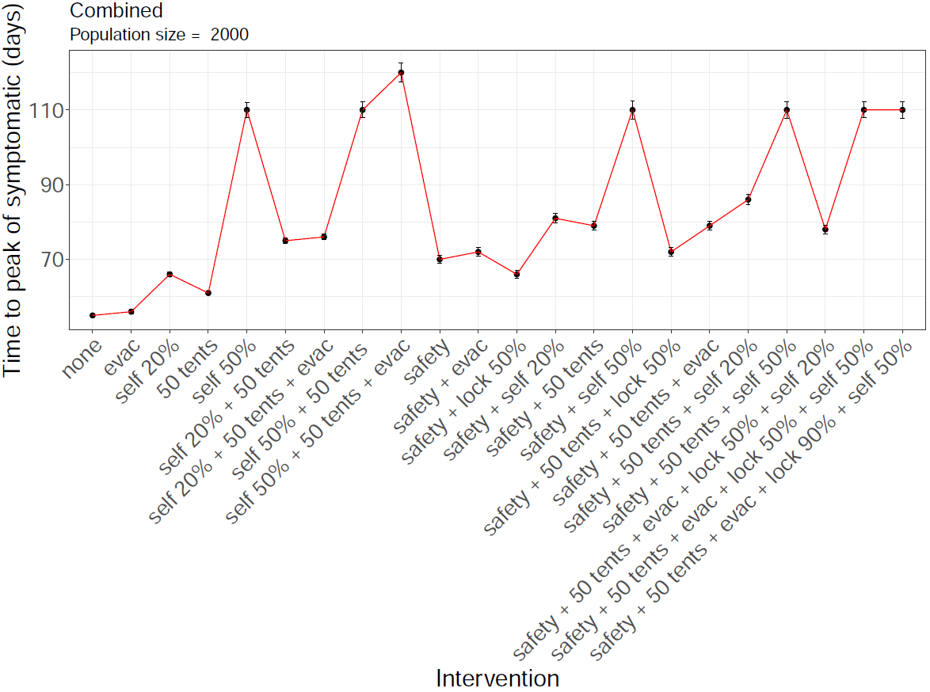
Combined strategies

Slide 42
Combined strategies

Slide 43
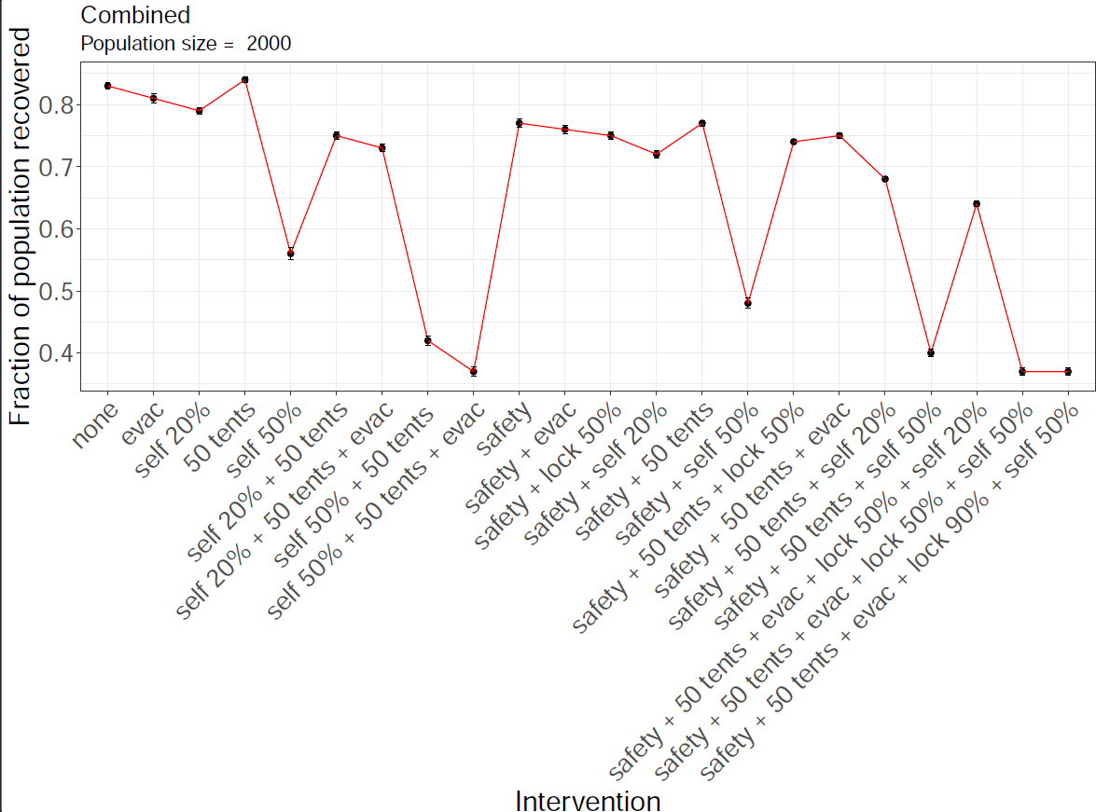
Combined strategies

Slide 44
Combined strategies

Slide 45
Conclusions
Empower communities to manage the spread of the virus or the consequences will be dramatic.

Slide 46
Conclusions
Empower communities to manage the spread of the virus or the consequences will be dramatic.
It is feasible and can be done immediately

Slide 47
Acknowledgements
Contributors:
Jordan Klein (Princeton University)
Jennifer Villers (Princeton University)
Eduard Campillo-Funollet, University of Sussex
Judith Bouman (ETH-Zürich)
Chamsy Sarkis (Pax Syriana Foundation)
Thanks for useful discussions:
Burcu Tepekule (ETH-Zürich)
Juan Poyatos (Spanish Research Council)

Slide 48
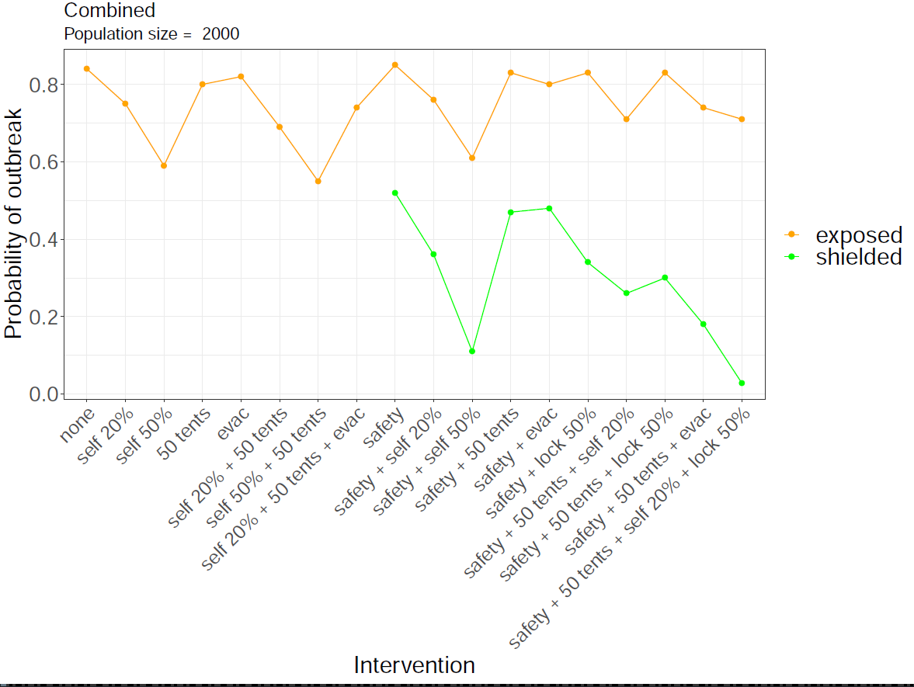
Combined strategies

Slide 49
Combined strategies

Slide 50
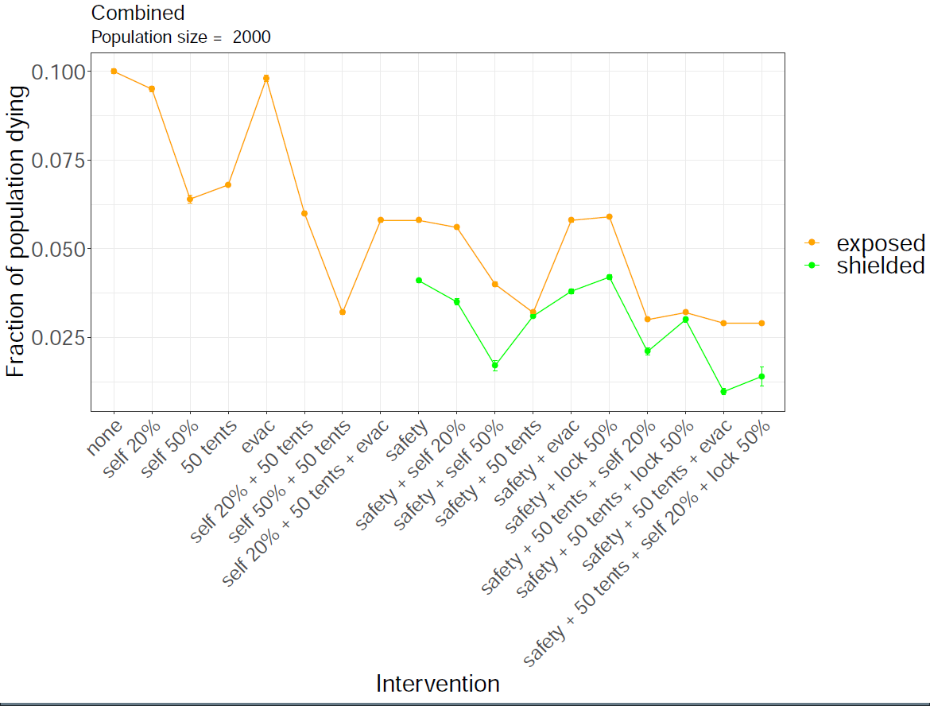
Combined strategies

Slide 51
Combined strategies

Slide 52
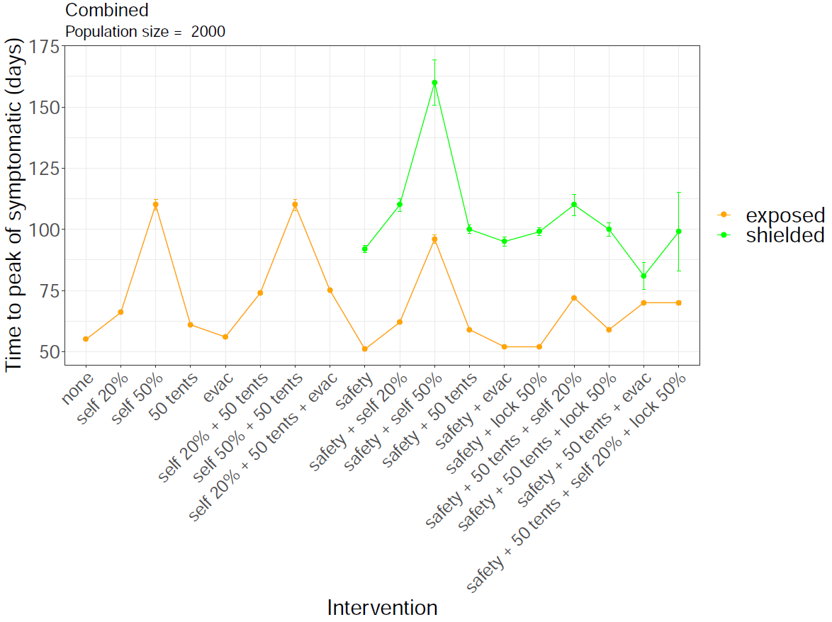
Combined strategies

