Slide 1


Modelling of COVID-19 epidemic and interventions within
IDP camps
Dr. Eduard Campillo-Funollet, PhD, Univ. of Sussex (UK)
Jordan Klein, Mph, Princeton Univ. (USA)
Dr. Alberto Pascual-García, PhD, ETH-Zürich (Switzerland)
Dr. Jennifer Villers, PhD, Princeton Univ. (USA)
Chamsy Sarkis, Pax Syriana Foundation
July 16th, 2020

Slide 2
Model preliminaries

Slide 3
Between December 2019 and March 2020, 1M new IDP → Informal settlements
HIGH DENSITY and no management
~700 camps with 600 person per camp on average (log-normal)
80% family-sized tents (~7 people)
Most of the informal camps have no management.
Source: UN- REACH report, January-March 2020

Slide 4
Between December 2019 and March 2020, 1M new IDP → Informal settlements
HIGH DENSITY and no management
~700 camps with 600 person per camp on average (log-normal)
80% family-sized tents (~7 people)
Most of the informal camps have no management.
NO POSSIBLE lockdown
50% no access to electricity
External water, with 25% not have enough drinking water
External letrines, and 10% households have 1 member disable/elderly.
360% drop of Syrian pound (no access to goods) → high motility to work
Source: UN- REACH report, January-March 2020

Slide 5
Between December 2019 and March 2020, 1M new IDP → Informal settlements
HIGH DENSITY and no management
~700 camps with 600 person per camp on average (log-normal)
80% family-sized tents (~7 people)
Most of the informal camps have no management.
NO POSSIBLE lockdown
50% no access to electricity
External water, with 25% not have enough drinking water
External letrines, and 10% households have 1 member disable/elderly.
360% drop of Syrian pound (no access to goods) → high motility to work
HIGH comorbidity
10% population has chronic diseases, 17% of them have no access to medicines.
Source: UN- REACH report, January-March 2020

Slide 6
AIM
Identify feasible interventions:
– Immediate applicability
– No need of complex technical infrastructure
(e.g. testing, protection)
– Cost: as low as possible

Slide 7
Outlook
Modelling
  Compartment models.
  Age-structured.
  Deterministic and stochastic simulations.
  Parameters estimated for IDPCs.
  Different camp sizes.
  ~50 different interventions modelled
  ~100K different simulations.
Strategies
  Self-distancing
  Shielding, lockdown
  Isolation
  Combined strategies

Slide 8
The model

Slide 9
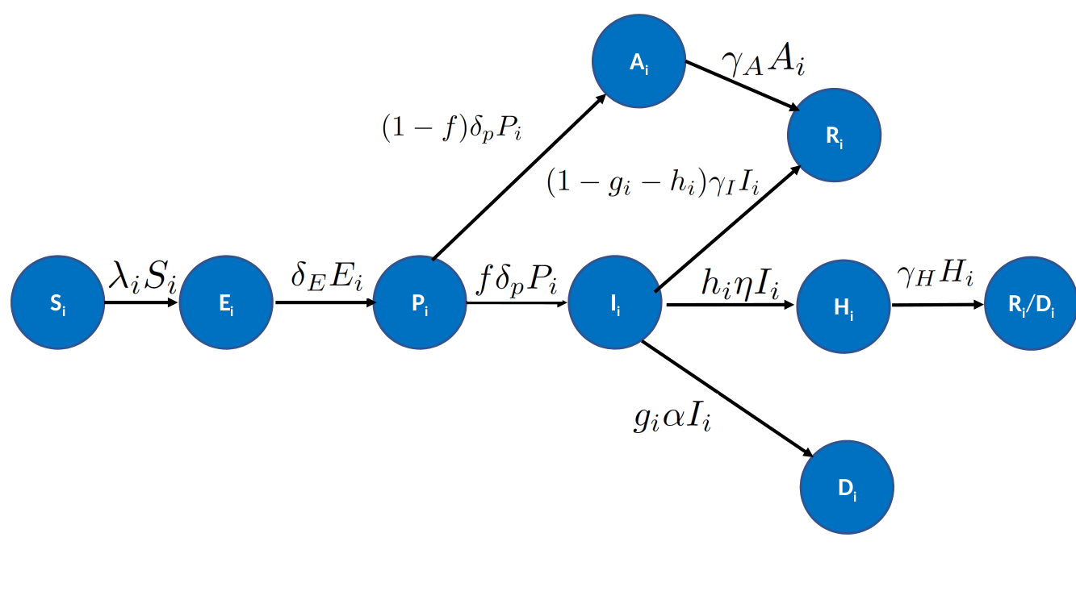
Model
Asymptomatic
Recovered
Presymptomatic
Symptomatic
Hospitalized
Susceptible
Exposed
Death

Slide 10
Model
Asymptomatic
Recovered
Presymptomatic
Symptomatic
Hospitalized
Susceptible
Exposed
Death

Slide 11
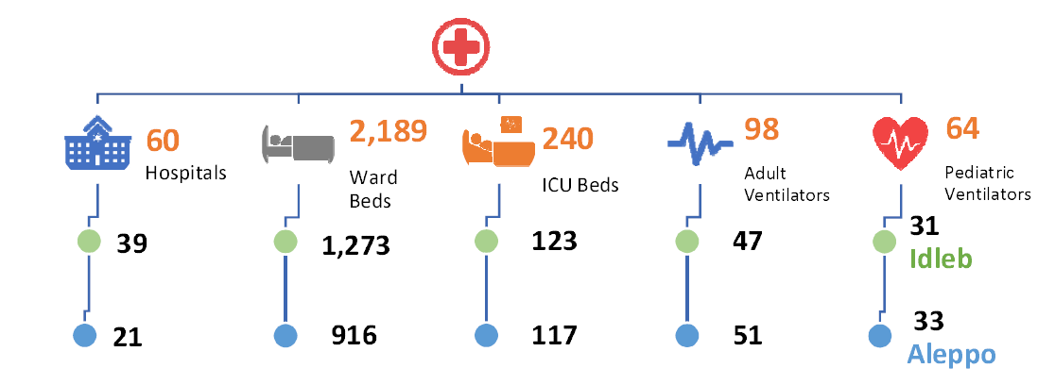
Hospitalization capacity
Hariri et al. The COVID-19 forecast in NW Syria. MedRxiv (2020)

Slide 12
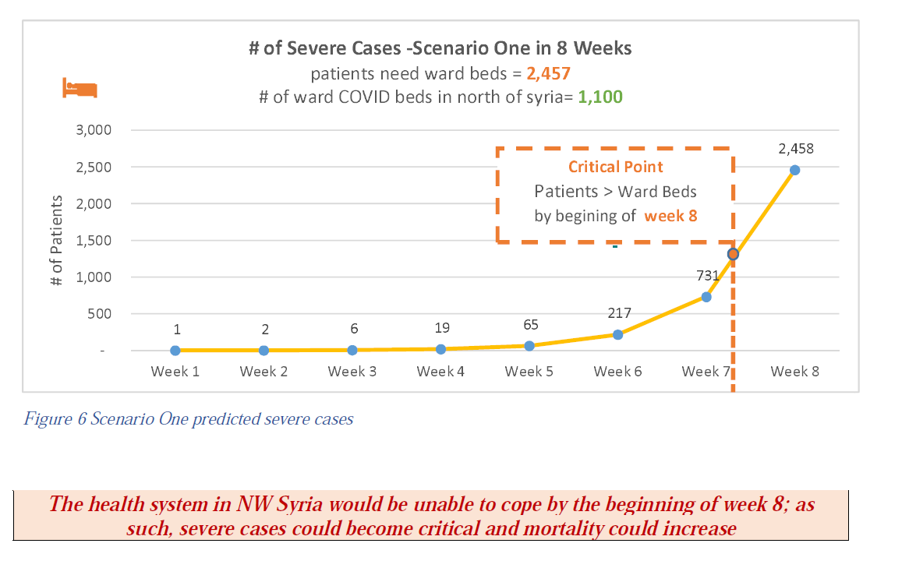
Hospitalization capacity
Hariri et al. The COVID-19 forecast in NW Syria. MedRxiv (2020)

Slide 13
Model
Asymptomatic
Recovered
Presymptomatic
Symptomatic
Hospitalized
Susceptible
Exposed
Death

Slide 14
Model
Asymptomatic
Recovered
Presymptomatic
Symptomatic
Hospitalized
Susceptible
Exposed
Death

Slide 15
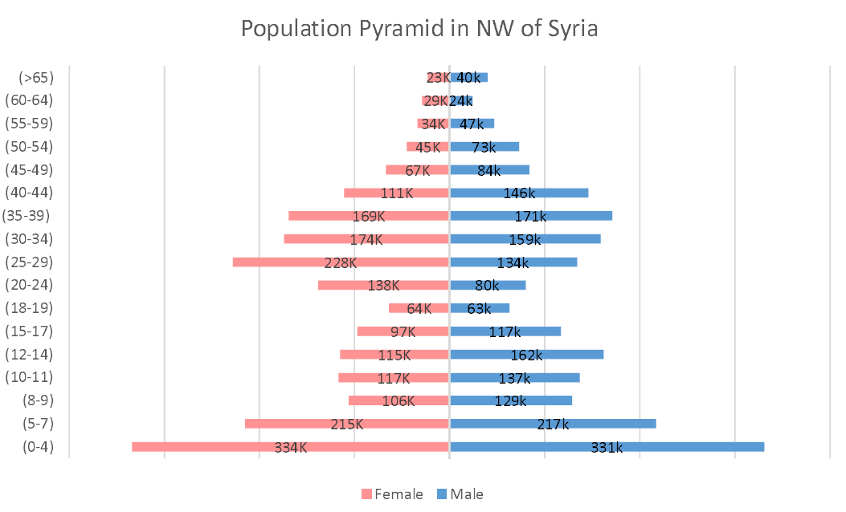

Slide 16
Age 3
Age 2
Age 1

Slide 17
Age 3
+ comorbidities
Age 2
+ comorbidities
Age 1

Slide 18
Model
Asymptomatic
Recovered
Presymptomatic
Symptomatic
Hospitalized
Susceptible
Exposed
Death

Slide 19
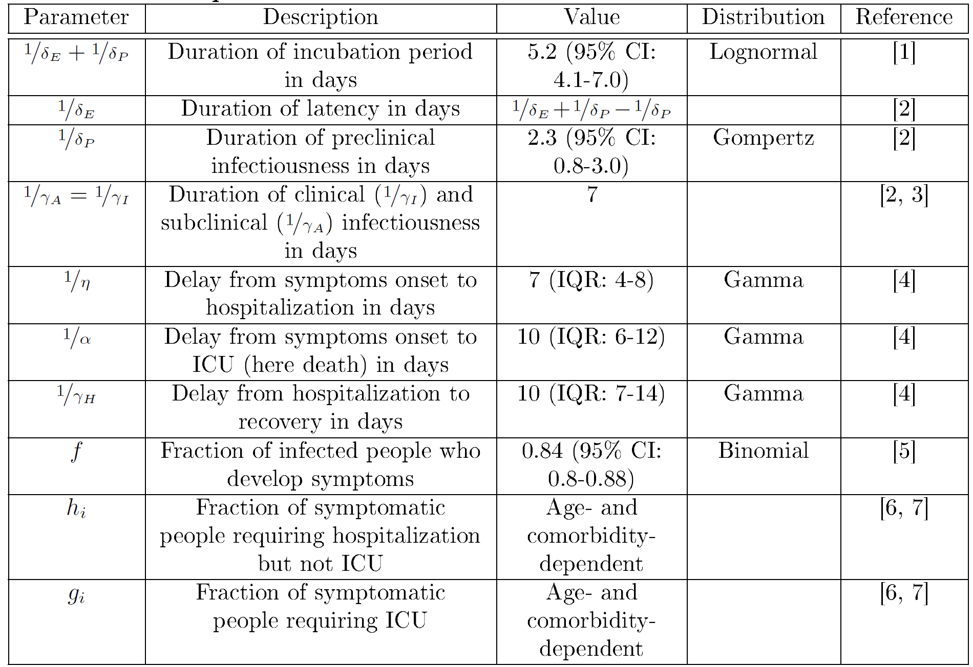

Slide 21
Values mapped
to individuals
10 years older
Values mapped
to individuals
10 years older

Slide 22
Model
Asymptomatic
Recovered
Presymptomatic
Symptomatic
Hospitalized
Susceptible
Exposed
Death

Slide 23
Model
Asymptomatic
Recovered
Presymptomatic
Symptomatic
Hospitalized
Susceptible
Exposed
Infectious individuals
Death

Slide 24
Model
Asymptomatic
Recovered
Presymptomatic
Symptomatic
Hospitalized
Susceptible
Exposed
Infectious individuals
Death

Slide 25
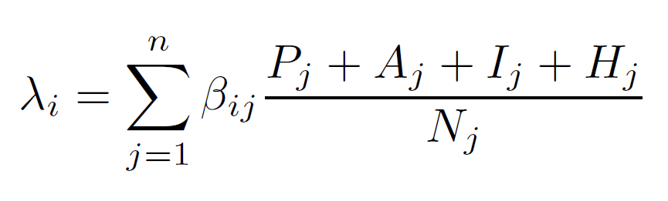

With:
τ is the probability of infection if there is a contact
C is the number of contacts between population classes i and j

Slide 26
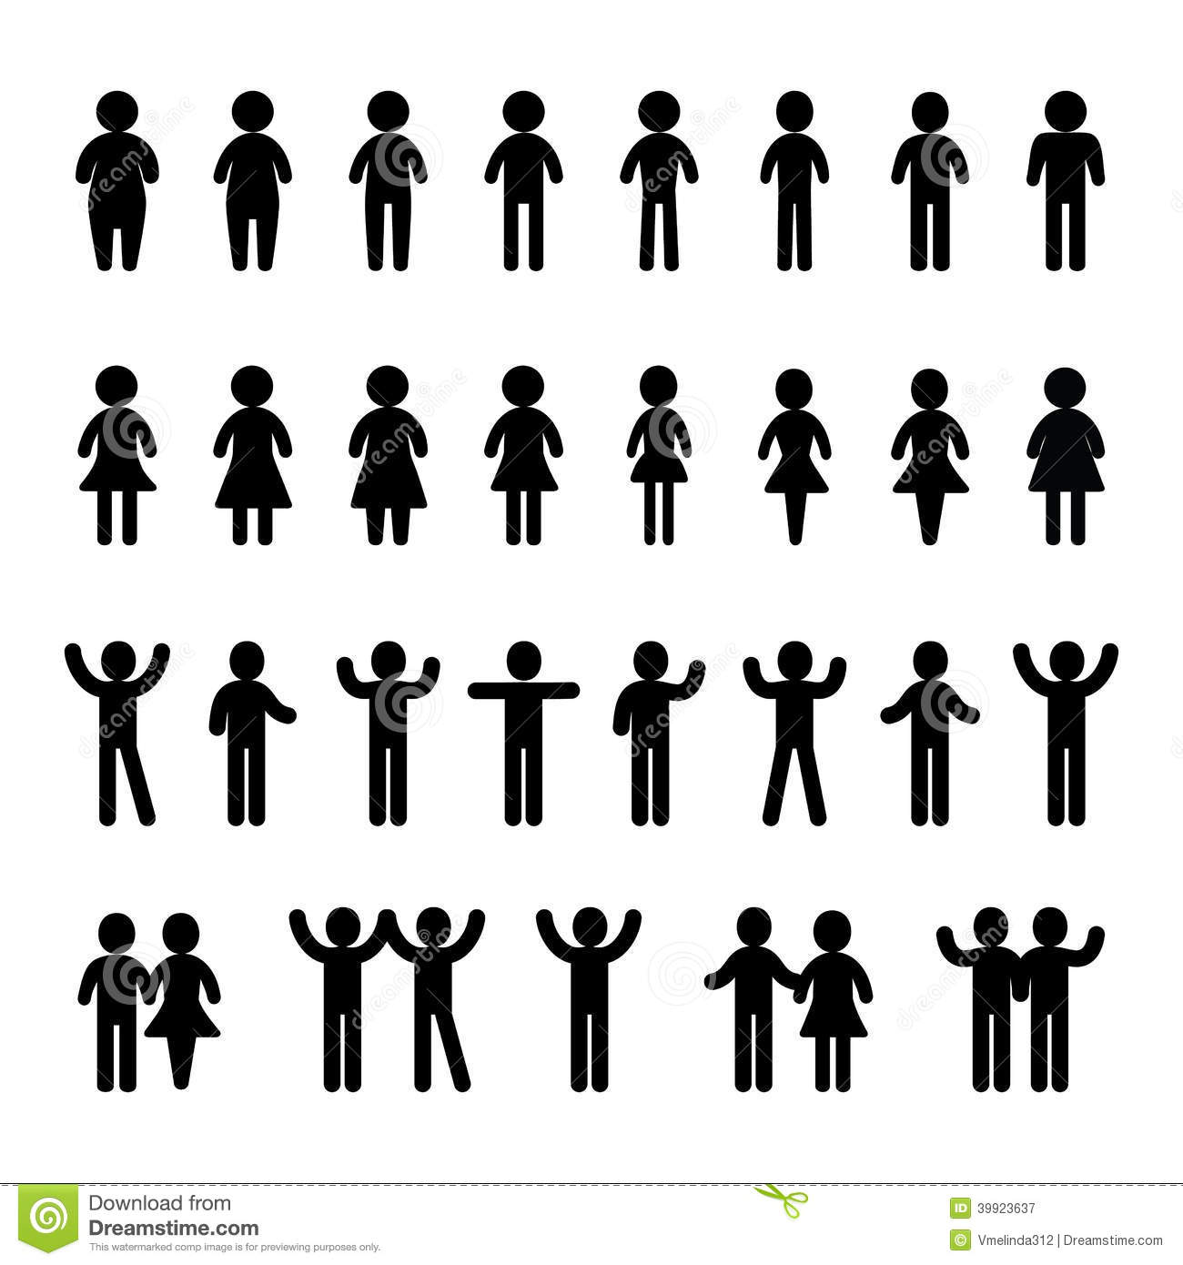
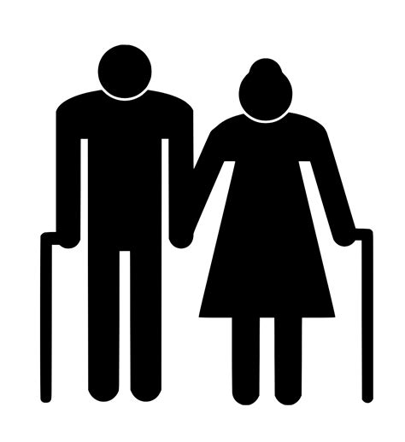
With:
τ is the probability of infection if there is a contact
C is the number of contacts between population classes i and j

Slide 27
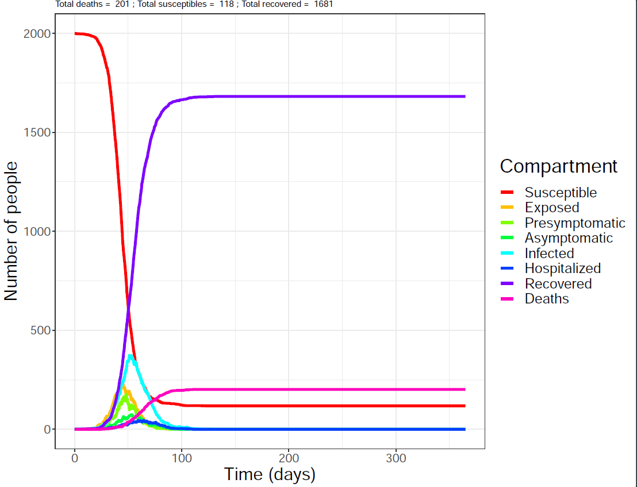
Model

Slide 28
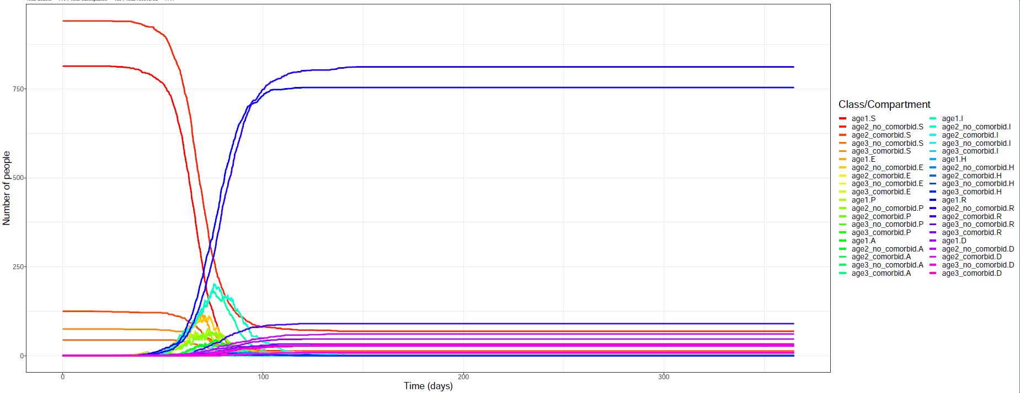
Model

Slide 29
The results

Slide 30
Strategy 1: Self-distancing
Description
  Reduction of contacts between individuals.
Key-points
  Simple and rapid implementation.
  Educational-based, long-term benefit
  Starting investment
  then mouth-to-word

Slide 31
Strategy 1: Self-distancing
Description
  Reduction of contacts between individuals.
Key-points
  Simple and rapid implementation.
  Educational-based, long-term benefit
  Starting investment then mouth-to-word
Population class | Null model | Reduction 20% | Reduction 50%
Kids | 25 | 20 | 12.5
Adults | 15 | 11 | 7.5
Elderly | 10 | 8 | 5

Slide 32
Strategy 1: Self-distancing
Description
  Reduction of contacts between individuals.
Key-points
  Simple and rapid implementation.
  Educational-based, long-term benefit
  Starting investment then mouth-to-word
Population class | Null model | Reduction 20% | Reduction 50%
Kids | 25 | 20 | 12.5
Adults | 15 | 11 | 7.5
Elderly | 10 | 8 | 5

Slide 33
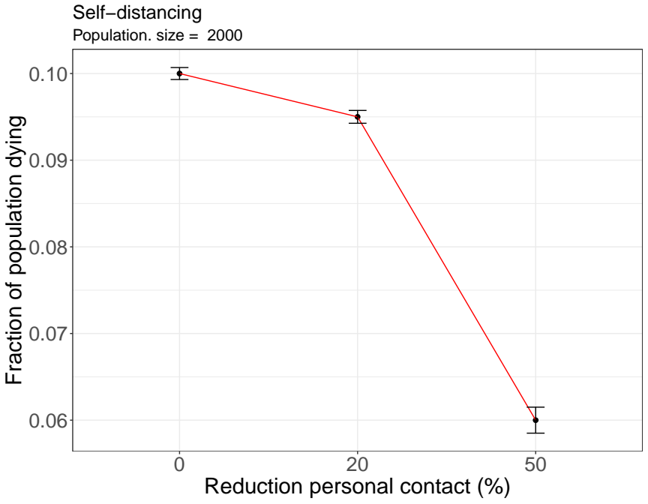
Strategy 1: Self-distancing

Slide 34
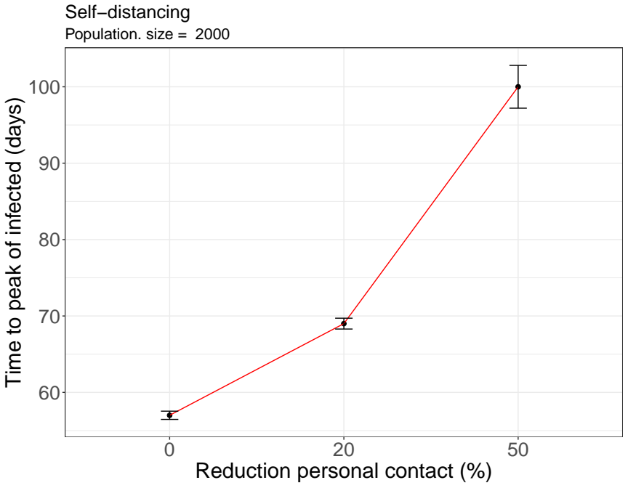
Strategy 1: Self-distancing

Slide 35
Strategy 1: Self-distancing
Up to 40% reduction in the the death tolls
Up to 40% delay in the peak of infected population

Slide 36
Strategy 2: Shielding and Lockdown
Description
  Shield of vulnerable population.
  Similar conditions in terms of tents occupancy and distance between tents were considered.
  Vulnerable:
    Elderly.
    People with co-morbidities.
    Carers/family.
  Lockdown when first symptom is detected.

Slide 37
Shielding vulnerable population within a “green” zone
80% of the population
For a total population of 100 persons
45 kids (0-18 yo)
35 adults
Meetings between orange and green in « neutral zone » (open tent), no more than 4 people at a time (mixed orange/green). No physical contact (mask and gloves, 1.5 meter distance).
Neutral zone
5 elderly (60+)
10 middle-aged NCD affected (mainly people 40-60 years old)
5 kids (<13 yrs)
Intra-green zone carers are among the 10 non-elderly NCD
No unprotected contact with orange zone or external world
In average, meeting in neutral zone once per week (2 to 10 contacts per week with orange zone)
20% of the population

Slide 38
Shielding vulnerable population within a “green” zone
80% of the population
Neutral zone
20% of the population

Slide 39
Shielding vulnerable population within a “green” zone
80% of the population
Neutral zone
Neutral zone
20% of the population

Slide 40
Shielding vulnerable population within a “green” zone
80% of the population
Neutral zone
Neutral zone
20% of the population

Slide 41
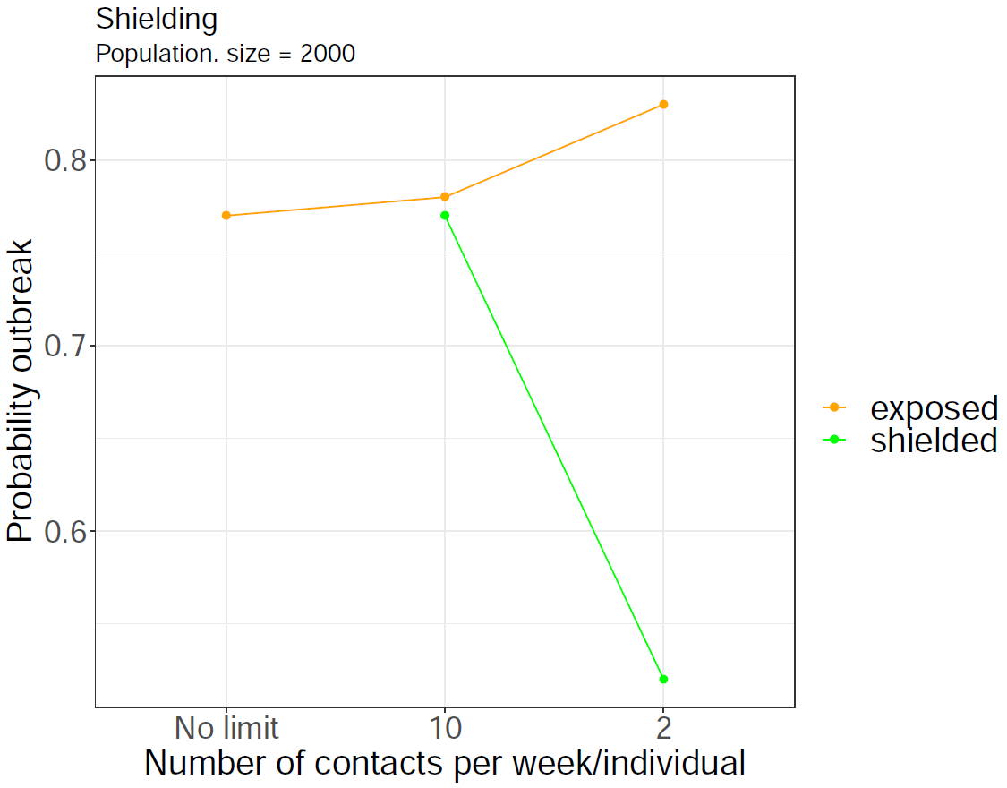
Strategy 2: Shielding only

Slide 42
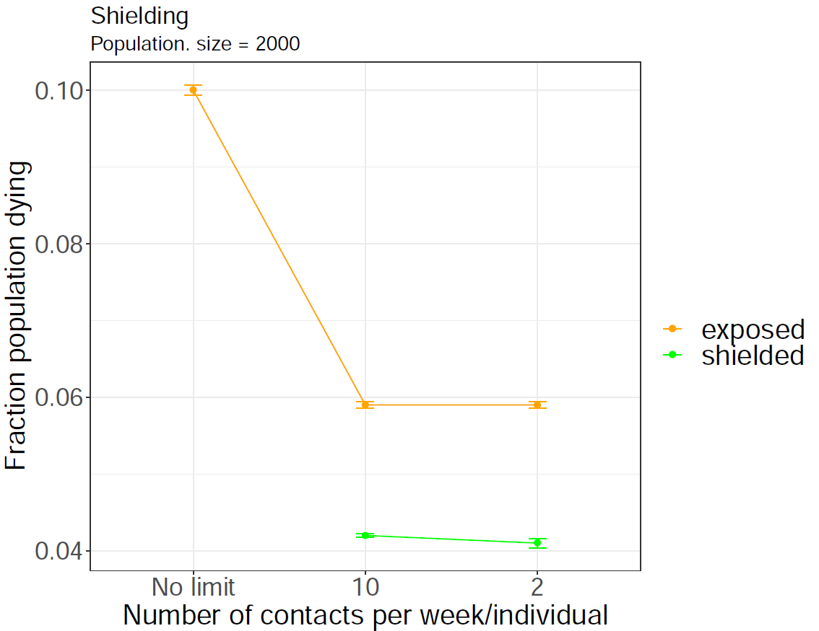
Strategy 2: Shielding only

Slide 43
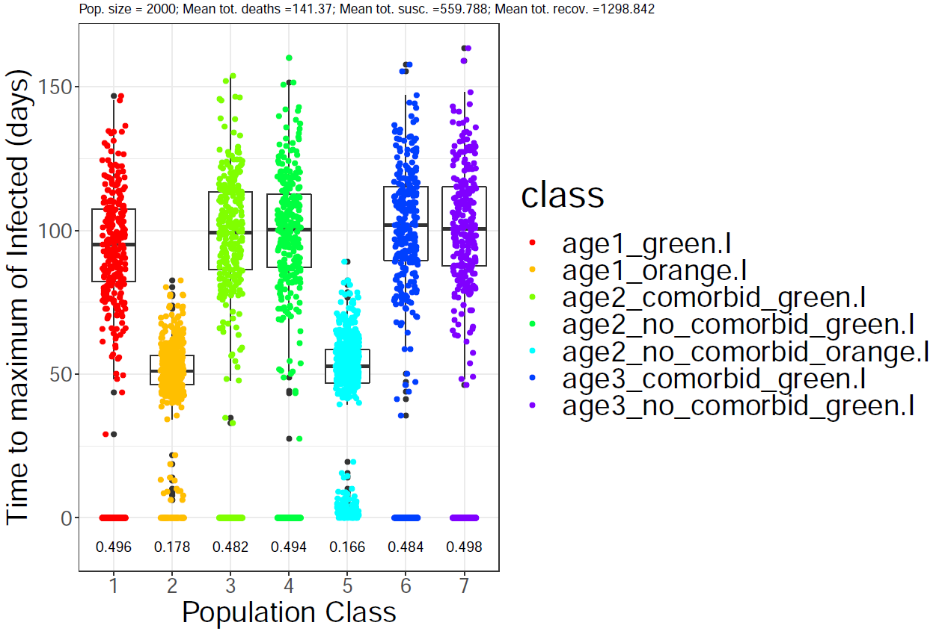
Strategy 2: Shielding only

Slide 44
Lockdown of the “green” zone after first symptomatic case
80% of the population
Neutral zone
Neutral zone
20% of the population

Slide 45

Lockdown of the “green” zone after first symptomatic case
80% of the population
Neutral zone
50% reduction
90% reduction
Neutral zone
20% of the population

Slide 46
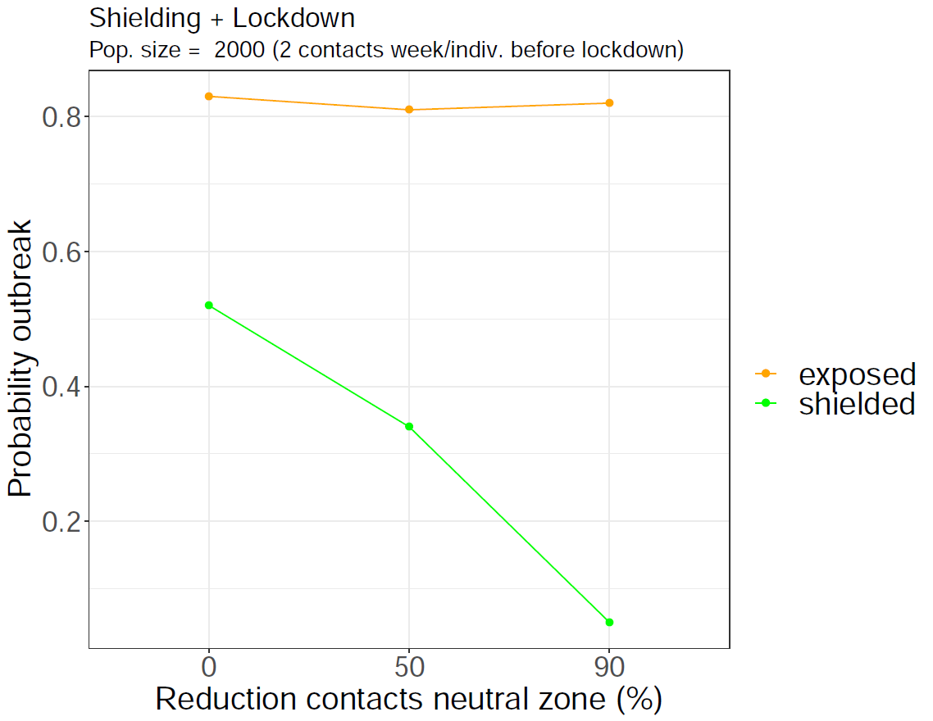
Strategy 2: Shielding and Lockdown

Slide 47
Strategy 3: Isolation
>80% of the population
Isolation
Description:
Symptomatic people is isolated.
The main question to address is which minimum capacity of isolation has a significant effect.
Neutral zone
Vulnerable <20%

Slide 48
Strategy 3: Isolation
>80% of the population
Isolation
Assumptions:
Symptomatic people are isolated “instantly”, what can only be achieved anticipating symptoms (testing and information)
The fate of the patients is not better nor worse than if staying in the camp → Discards isolating people together without testing.
We haven’t modelled the fate of “carers” which cannot be neglected, even less without an adequate protection.
Neutral zone
Vulnerable <20%

Slide 49
Model
Asymptomatic
Recovered
Presymptomatic
Symptomatic
Hospitalized
Susceptible
Exposed
Infectious individuals
Death

Slide 50
Model
Asymptomatic
Recovered
Presymptomatic
Symptomatic
Hospitalized
Susceptible
Exposed
Infectious individuals
Death

Slide 51
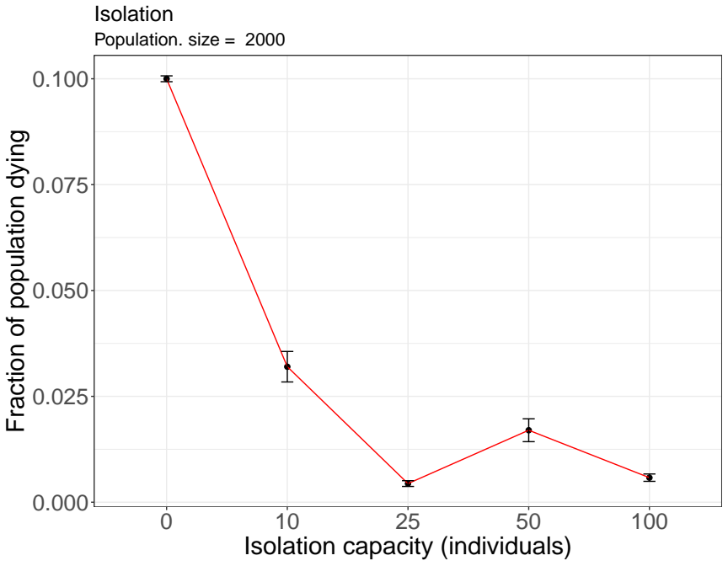
Strategy 3: Isolation

Slide 52
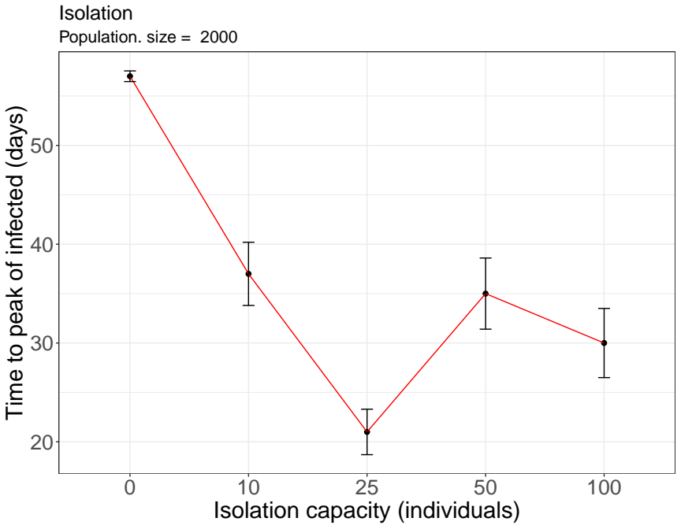
Strategy 3: Isolation

Slide 53
Combined strategies

Slide 54
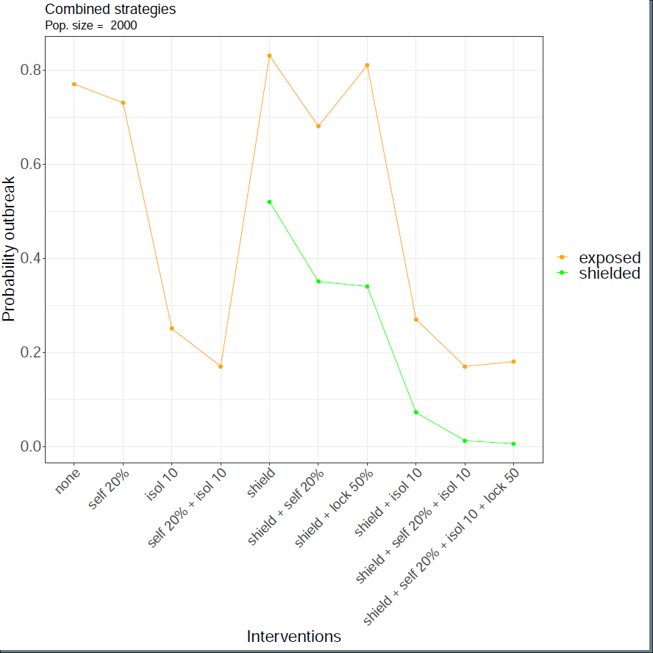
Combined strategies

Slide 55
Combined strategies

Slide 56
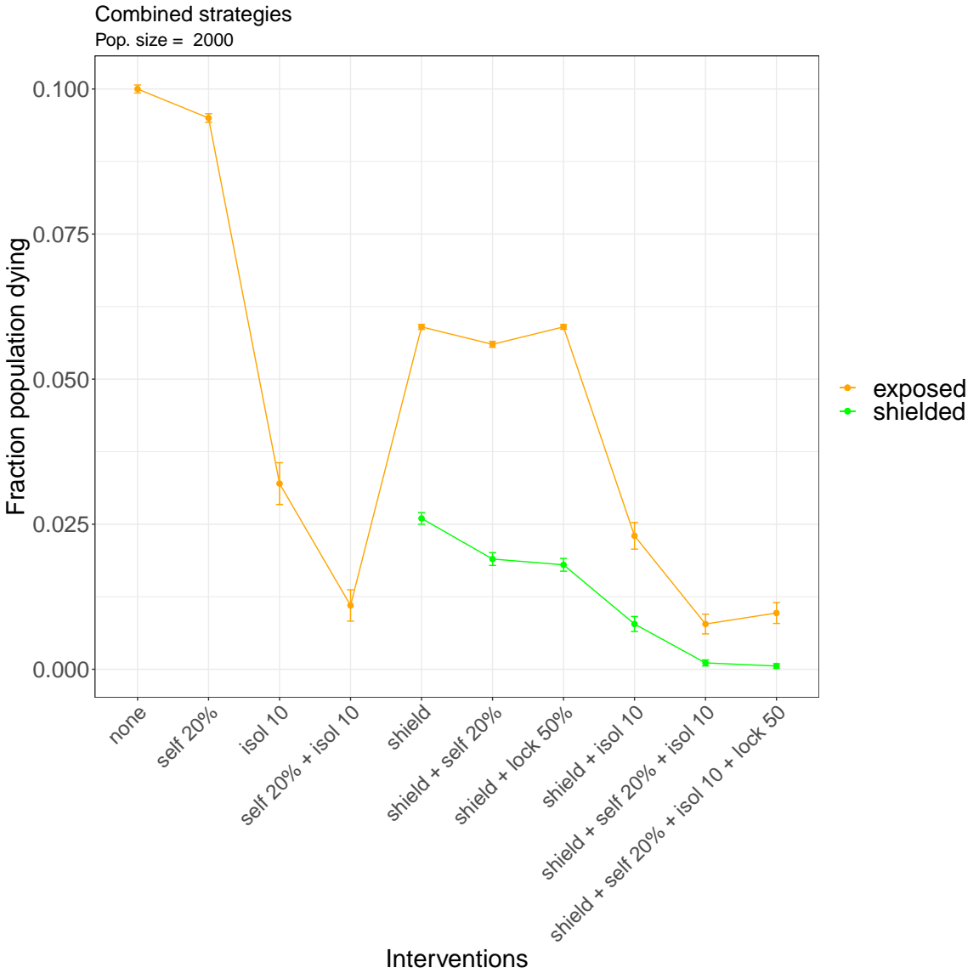
Combined strategies

Slide 57
Combined strategies

Slide 58
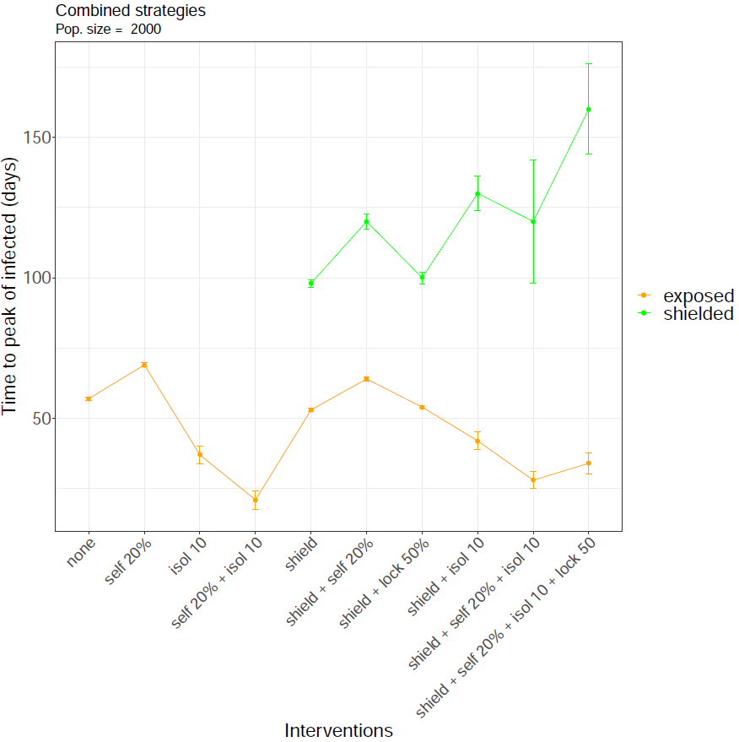
Combined strategies

Slide 59
Combined strategies

Slide 60
Conclusions
Simple interventions can reduce the probability of outbreak and death tolls.
Shielding under appropriate conditions has an overall positive effect. An increase in the probability of outbreak can be mitigated by self-distancing.
Isolation brings the stronger reduction in death tolls. However, it may accelerate the spread of the virus among the vulnerable population. Several technical caveats should be considered in its implementation.
The combination of interventions are very effective against the spread of the virus and its potential impact in the population.

Slide 61
Future work
Determine the optimal population fraction that should be shielded (simulations done, analysis required).
What can we expect in terms of herd immunity depending on the intervention, and estimate accurate times for e.g. lockdown.
More accurate extrapolation of the spread of the infection at a regional scale.
More realistic modelling of some interventions, e.g. introduction of carers if isolation.

Slide 62
Acknowledgements
Contributors:
Jordan Klein (Princeton University)
Jennifer Villers (Princeton University)
Eduard Campillo-Funollet, University of Sussex
Judith Bouman (ETH-Zürich)
Chamsy Sarkis (Pax Syriana Foundation)
Thanks for useful discussions:
Burcu Tepekule (ETH-Zürich)
Juan Poyatos (Spanish Research Council)

