Slide 1


Modelling of COVID-19 epidemic and interventions within
IDP camps
Dr. Eduard Campillo-Funollet, PhD, Univ. of Sussex (UK)
Jordan Klein, Mph, Princeton Univ. (USA)
Dr. Alberto Pascual-García, PhD, ETH-Zürich (Switzerland)
Dr. Jennifer Villers, PhD, Princeton Univ. (USA)
July 16th, 2020

Slide 2
Highlights
Modelling
  Comparmental models.
  Age-structured.
  Deterministic, stochastic.
  Parameters estimated for IDPCs.
Strategies
  Self-distancing
  Shielding, lockdown
  Isolation
  Combined strategies
Main conclusions
  Remark 1
  Remark 2
  Combined strategies have a greater effect.

Slide 3
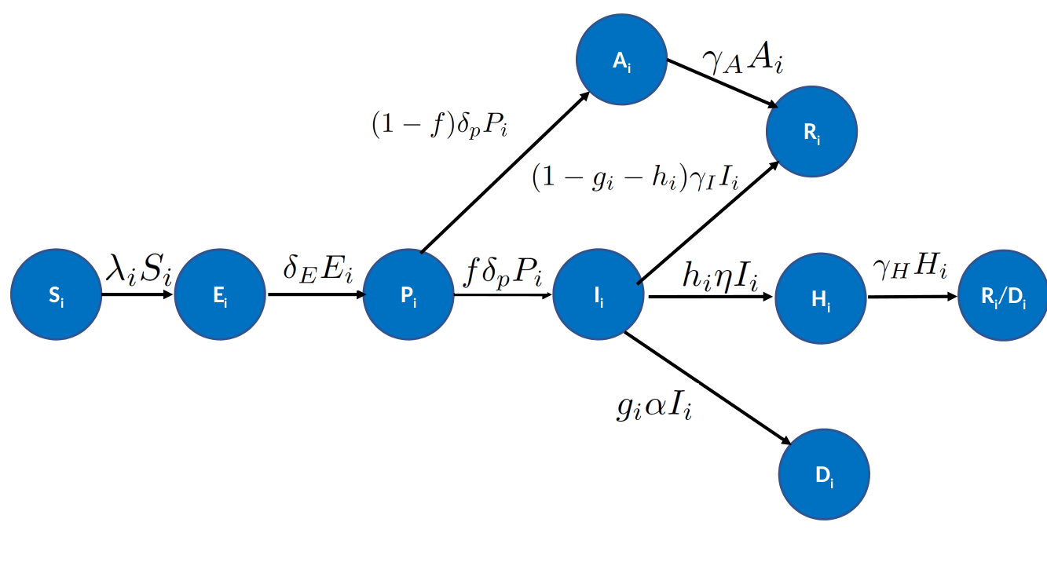
Model

Slide 4
Strategy 1: Self-distancing
Description
  Reduction of contacts between individuals.
  Example: instead of meeting 15 people/day, meet only 10.
Key-points
  Simple implementation.
  Relies on individuals following the advice.
  Remark 1.
  Remark 2.

Slide 5
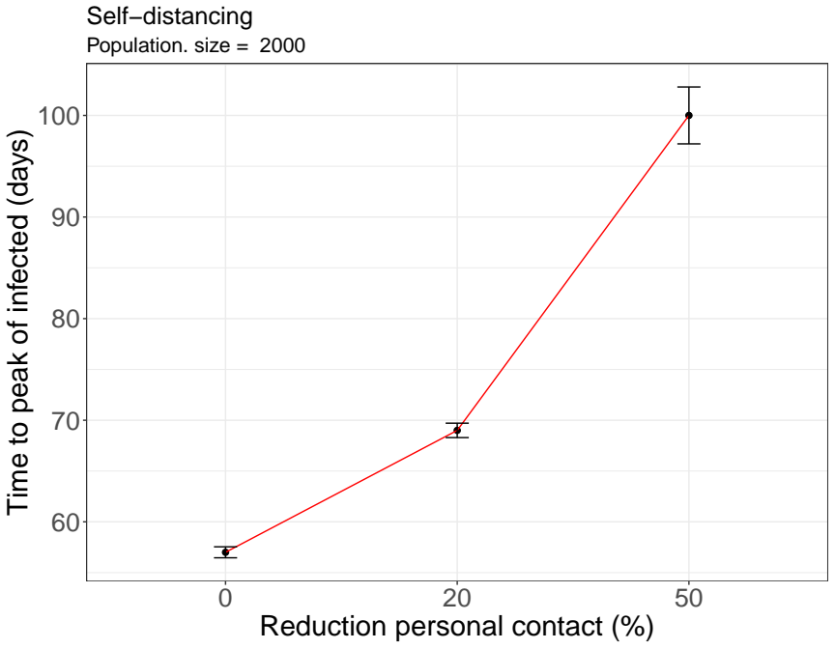
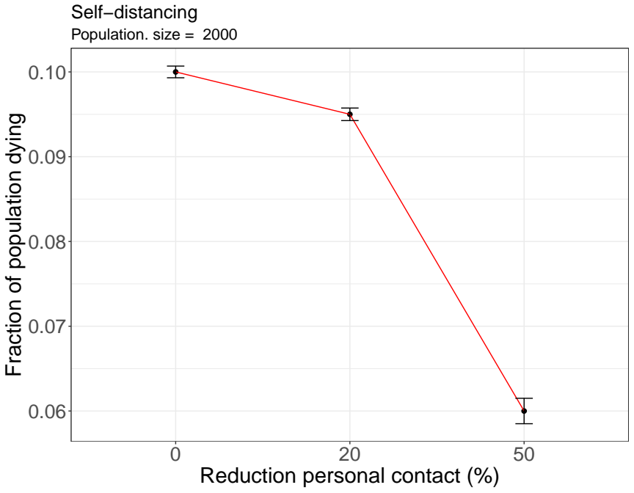
Strategy 1: Self-distancing

Slide 6
Strategy 2: Shielding, Lockdown
Description
  Shield the vulnerable population.
  Vulnerable:
    Elderly.
    People with co-morbidities.
    Carers/family.
  Lockdown when an outbreak begins.
Key-points
  Remark 1.
  Remark 2.
  Requires re-organization of the camp.

Slide 7
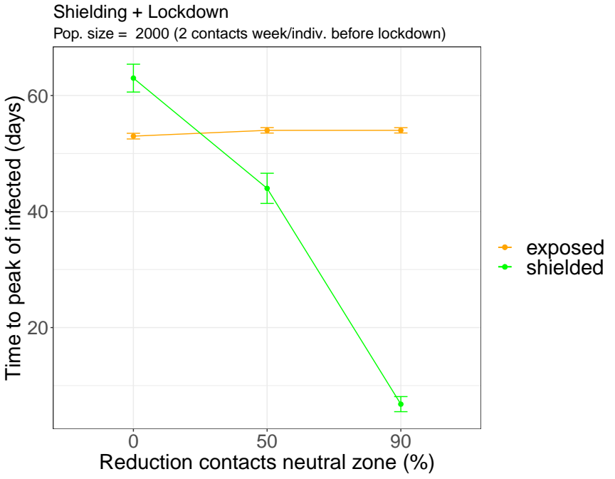
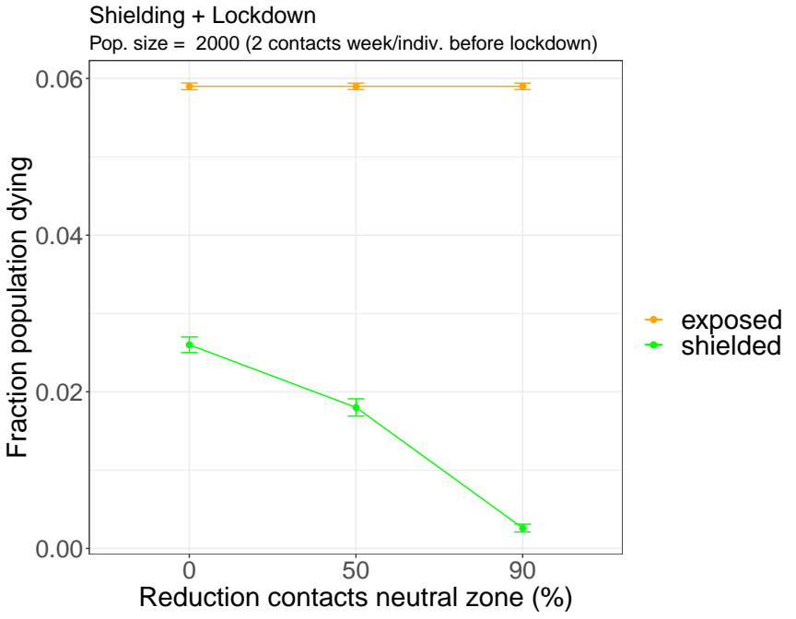
Strategy 2: Shielding, Lockdown

Slide 8
Strategy 3: Isolation
Description
  Isolation of infected individuals
Key-points
  Remark 1.
  Remark 2.
  Requires quick identification of infected individuals

Slide 9
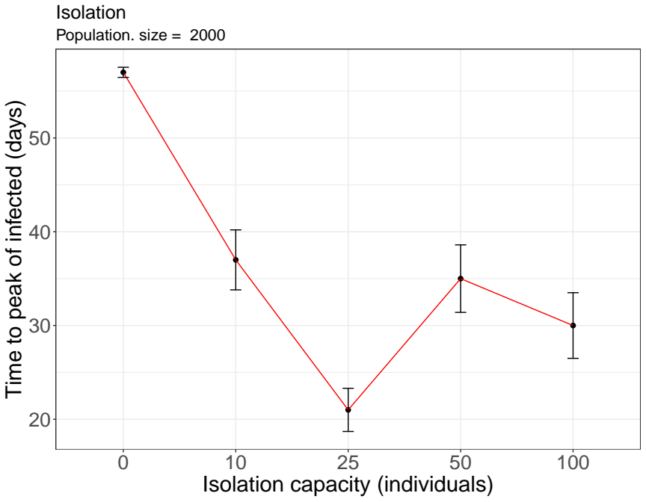
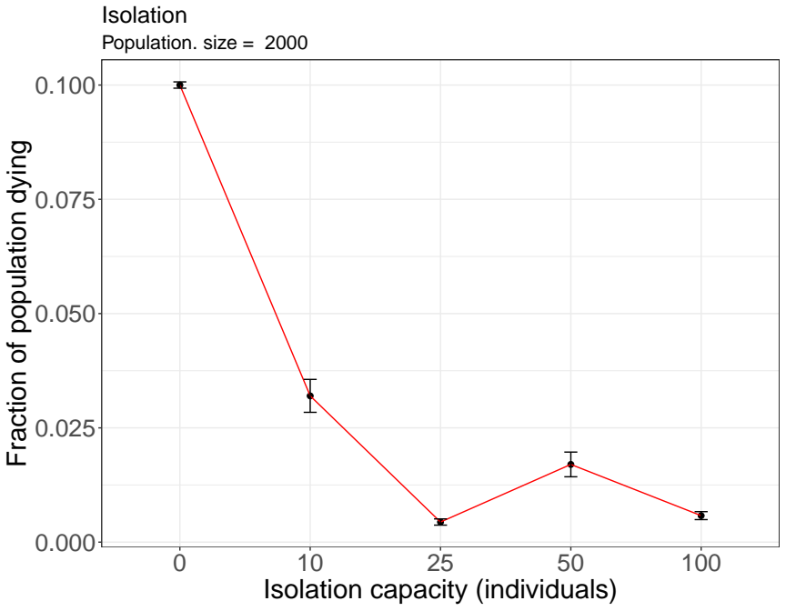
Strategy 3: Isolation

Slide 10
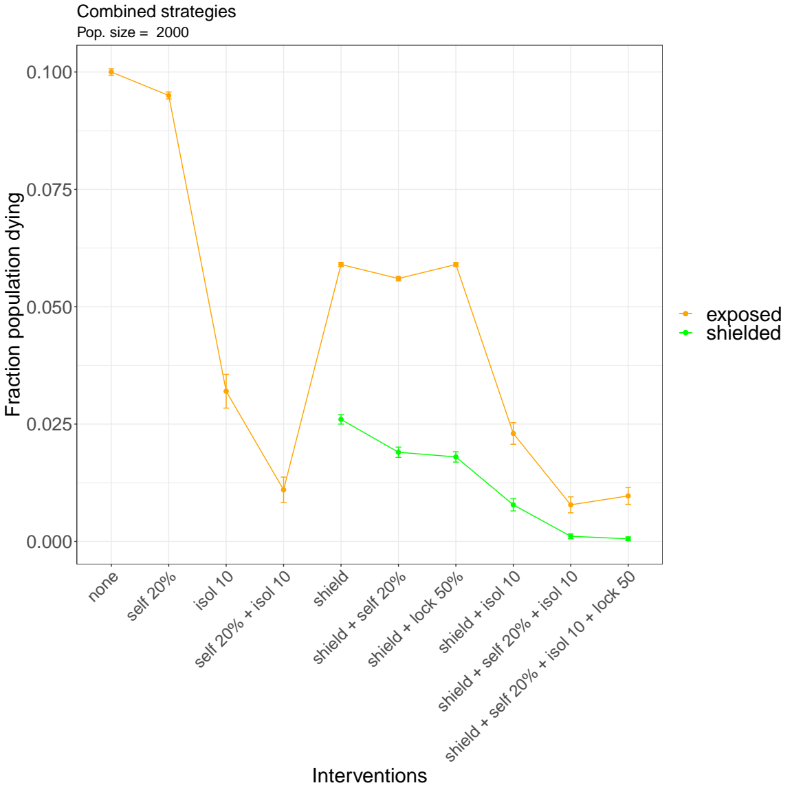
Combined strategies

Slide 11
Conclusions
Remark 1
Remark 2
Combined strategies have a greater effect.

