Slide 1
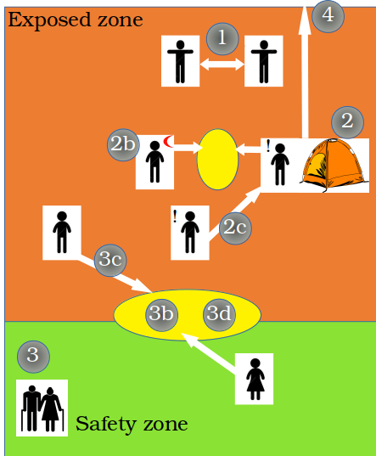










Intervention | Description | Levels
Self-distancing | Reduction of mean number of contacts per day and individual | 20%, 50%
Self-isolation | Isolation of symptomatic (!) people in individual tents | Available tents: 10, 20, 50, 100, 250, 500, 1000, 2000
Number of carers | Number of carers ( ) | 1 per tent
Self-isolation delay | Time from symptom onset to self-isolation | 12h, 24h, 48h
Safety zone | Designated area for vulnerable population | Elderly only, elderly + adults with comorbidities, elderly + adults with comorbidities + kids, up to 20%, 25%, 30% of the population
Number of contacts | In the buffering zone | 2, 10 contacts per week and individual in the safety zone
Health checks | Exclude symptomatic from buffering zone
Lockdown of buffering zone | Lockdown if one case is detected in the population | Reduces value of 3b by 50%, or 90%
Evacuation of severely symptomatic | Evacuated individuals cannot infect other people, but they do not receive healthcare
Buffering zones | Open space, 2m distancing, use of face cover | Reduces probability of infection by 80%

