Slide 1
Modelling the impact of shielding strategies
in the spread of COVID-19 within
informal refugees camps
NW – Syria as a case study
Alberto Pascual-García
ETH-Zürich
July 8th, 2020

Slide 2
The story
(why I ended up doing these models)

Slide 3

An initiative from the scientific community to put all available resources at the service of the fight against COVID-19

Slide 4

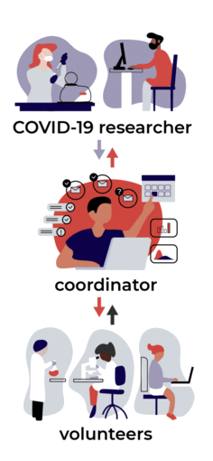
What we do
COVID-19 researchers can ask anything...
...we figure out if it's posible
Highly centralized (it's not a forum)
High-quality end product

Slide 5
Types of requests
Literature search & Translations (e.g. surveys)
Reagents & Protocol sharing
Compilation of datasets & statistical analysis/modelling
Access to clinical data and samples
Access to experimental facilities / techniques
Collaborations (~50%)

Slide 6
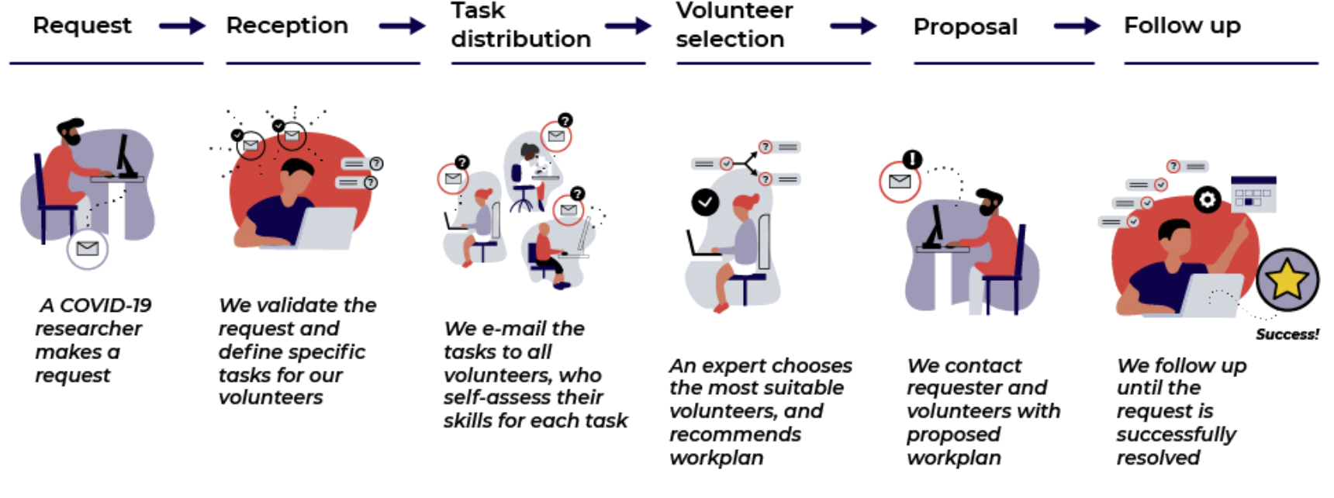
How we work
<24 hrs
~1 week
Indeterminate

Slide 7
How we work
– Claudia Igler
– Burcu Tepekule
– Nicola Criscuolo
– Marie Vasse
<24 hrs
~1 week
Indeterminate

Slide 8

Our statistics
>500 requests received
>45K scientists registered
~300 requests accepted
~150 successfully resolved
~100 ongoing requests

Slide 9
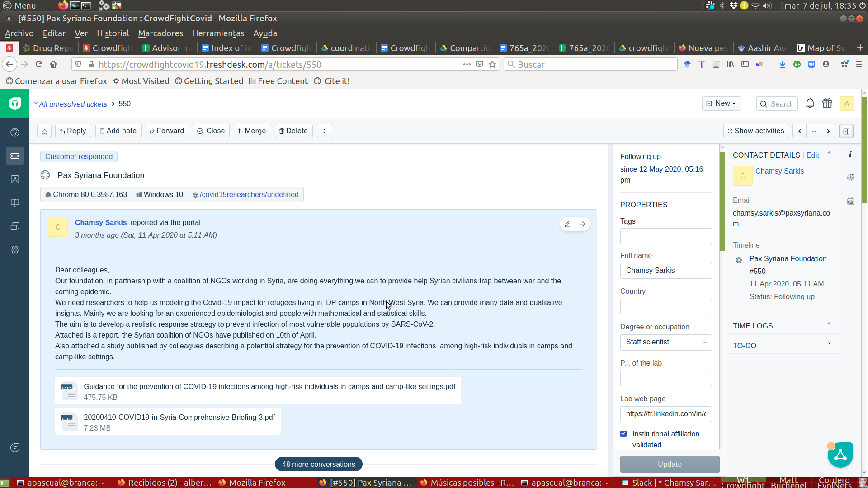
The request

Slide 10
The problem

Slide 11
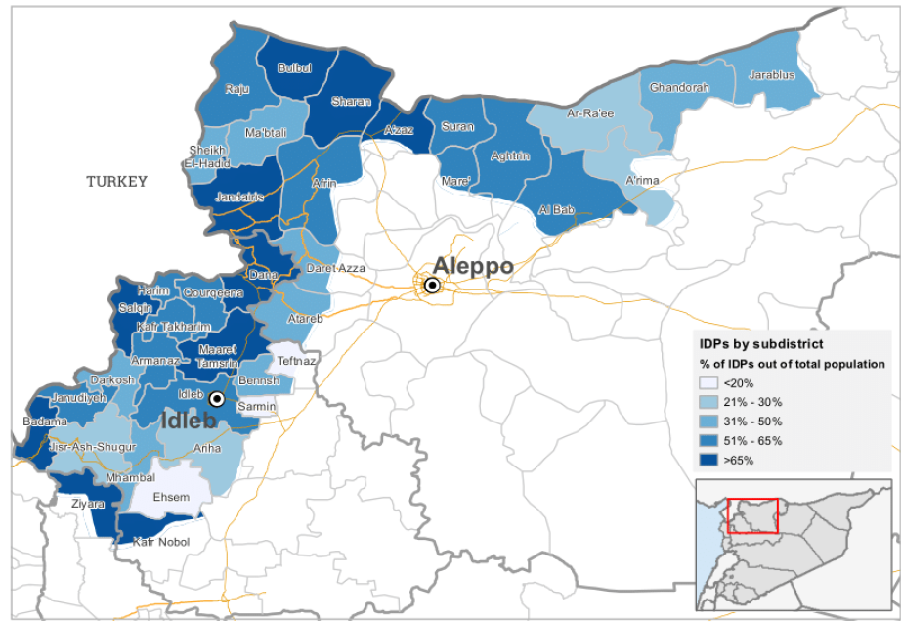
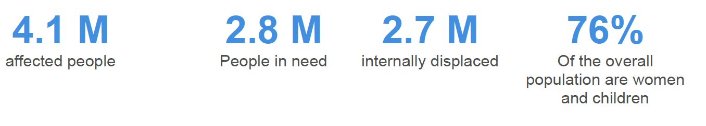

Slide 12
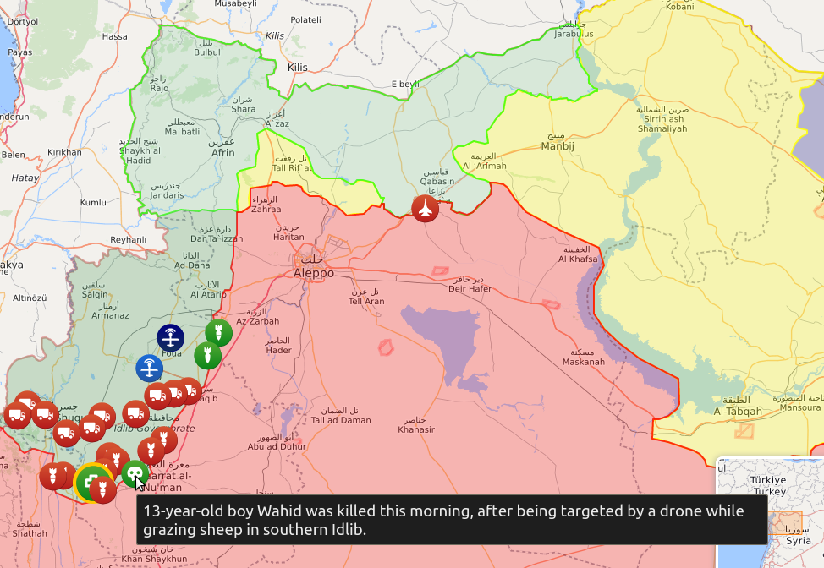

Slide 13
Between December 2019 and March 2020, 1M new IDP → Informal settlements

Slide 14
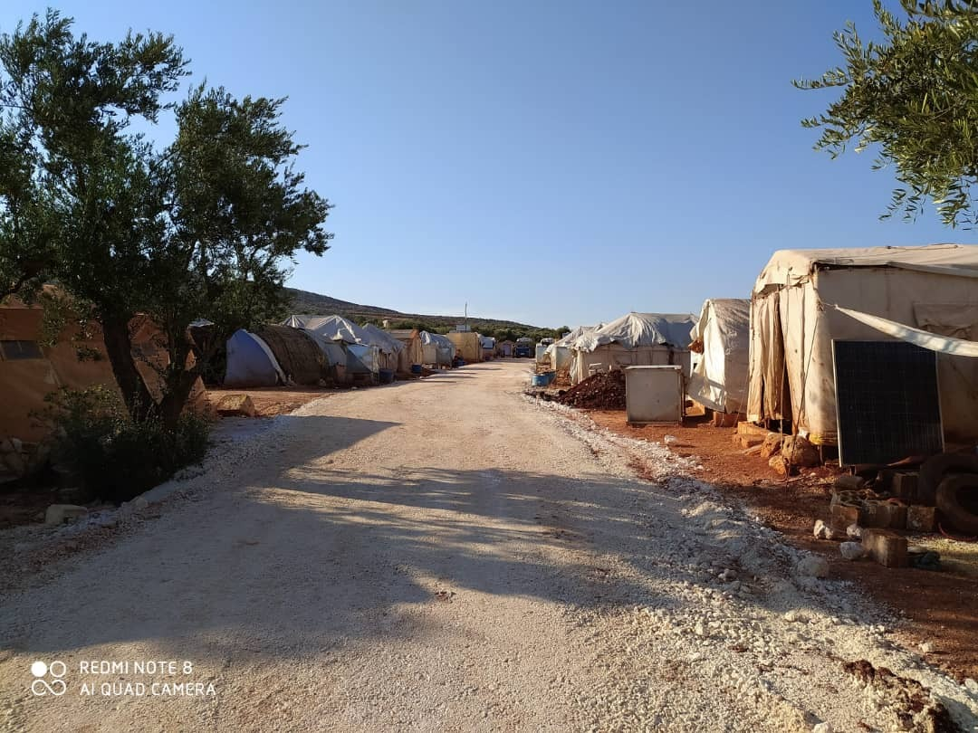

Slide 15
Between December 2019 and March 2020, 1M new IDP → Informal settlements
HIGH DENSITY and no management
~700 camps with 600 person per camp on average (log-normal)
80% family-sized tents (~7 people)
Most of the informal camps have no management → Role of Pax Syriana Foundation

Slide 16
Between December 2019 and March 2020, 1M new IDP → Informal settlements
HIGH DENSITY and no management
~700 camps with 600 person per camp on average (log-normal)
80% family-sized tents (~7 people)
Most of the informal camps have no management.
NO POSSIBLE lockdown
50% no access to electricity
External water, with 25% not have enough drinking water
External letrines, and 10% households have 1 member disable/elderly.
360% drop of Syrian pound (no access to goods) → high motility to work

Slide 17
Between December 2019 and March 2020, 1M new IDP → Informal settlements
HIGH DENSITY and no management
~700 camps with 600 person per camp on average (log-normal)
80% family-sized tents (~7 people)
Most of the informal camps have no management.
NO POSSIBLE lockdown
50% no access to electricity
External water, with 25% not have enough drinking water
External letrines, and 10% households have 1 member disable/elderly.
360% drop of Syrian pound (no access to goods) → high motility to work
HIGH comorbidity
10% population has chronic diseases, 17% of them have no access to medicines.

Slide 18
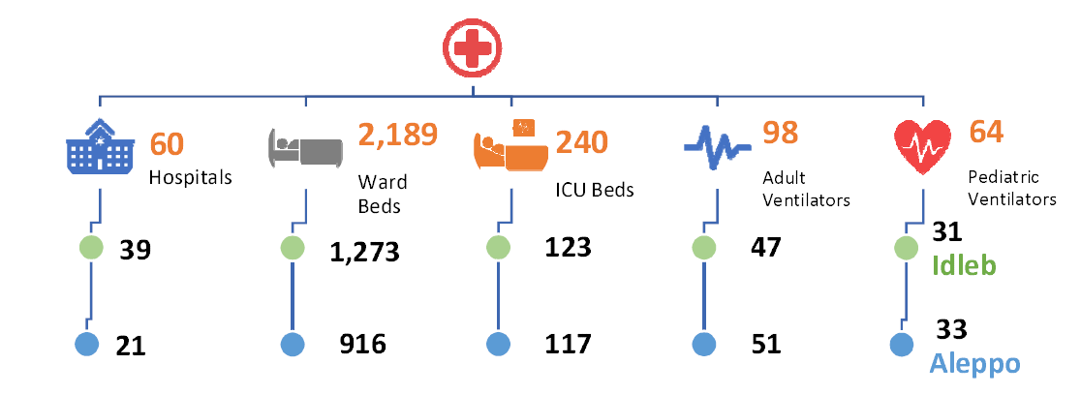
Hariri et al. The COVID-19 forecast in NW Syria. MedRxiv (2020)

Slide 19
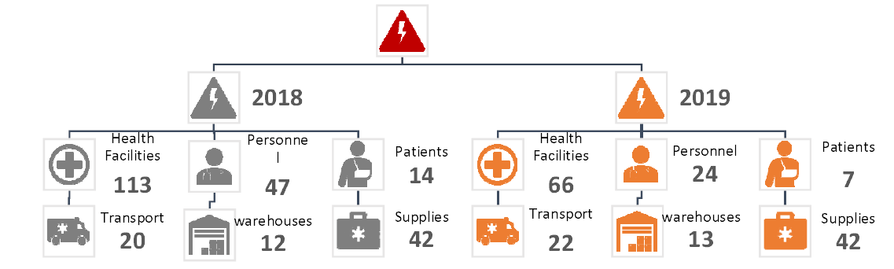
Hariri et al. The COVID-19 forecast in NW Syria. MedRxiv (2020)

Slide 20
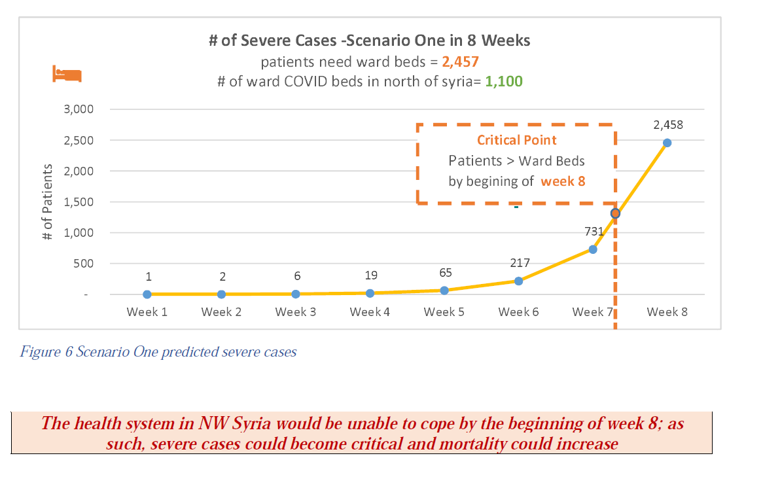
Hariri et al. The COVID-19 forecast in NW Syria. MedRxiv (2020)

Slide 21
The model

Slide 22
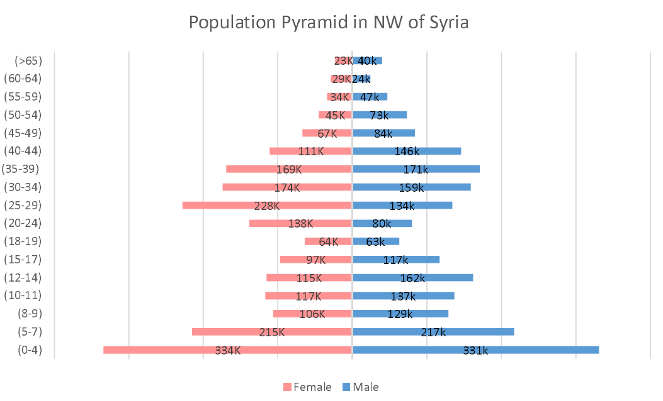

Slide 23
Age 3
Age 2
Age 1

Slide 24
Age 3
+ comorbidities
Age 2
+ comorbidities
Age 1

Slide 25
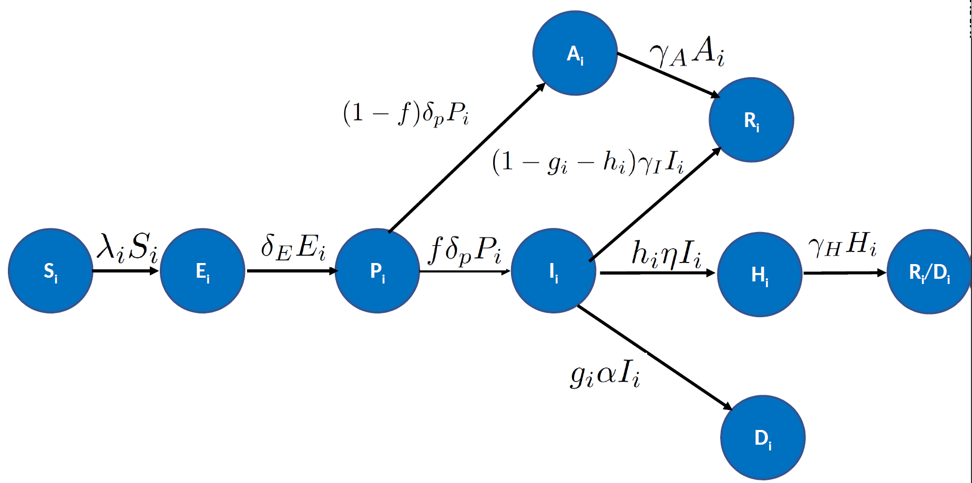

Slide 26
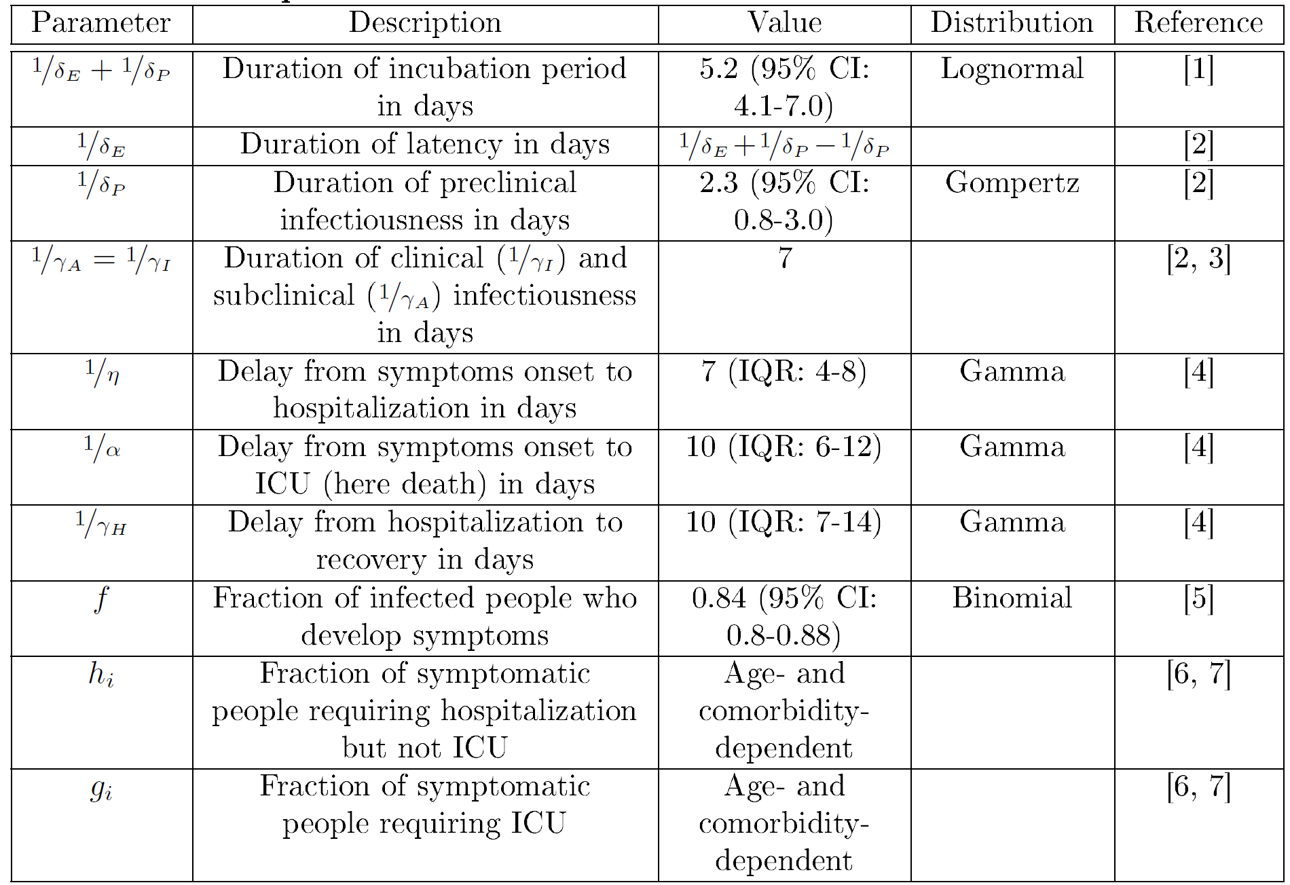

Slide 28
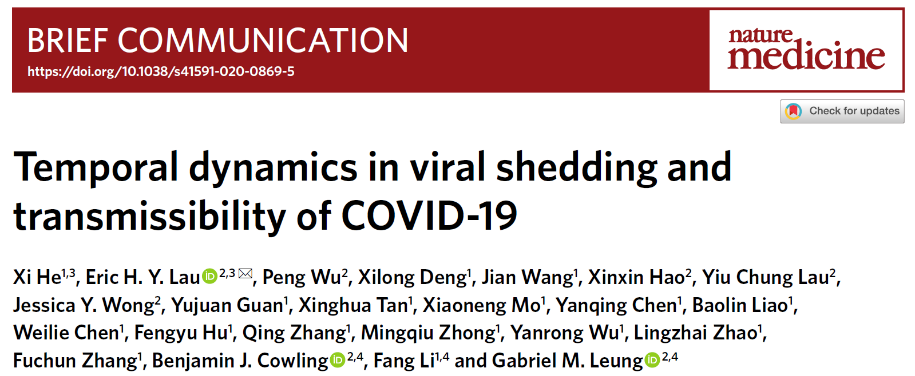

Slide 29
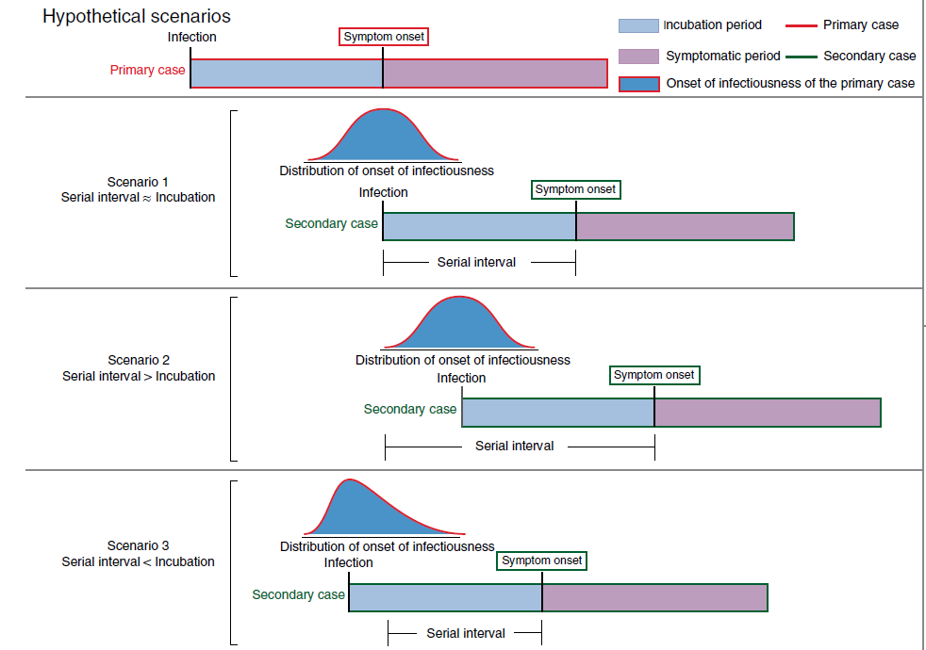

Slide 34
Presymptomatic
Mean 2.3 days
CI [0.8-3.0]

Slide 35
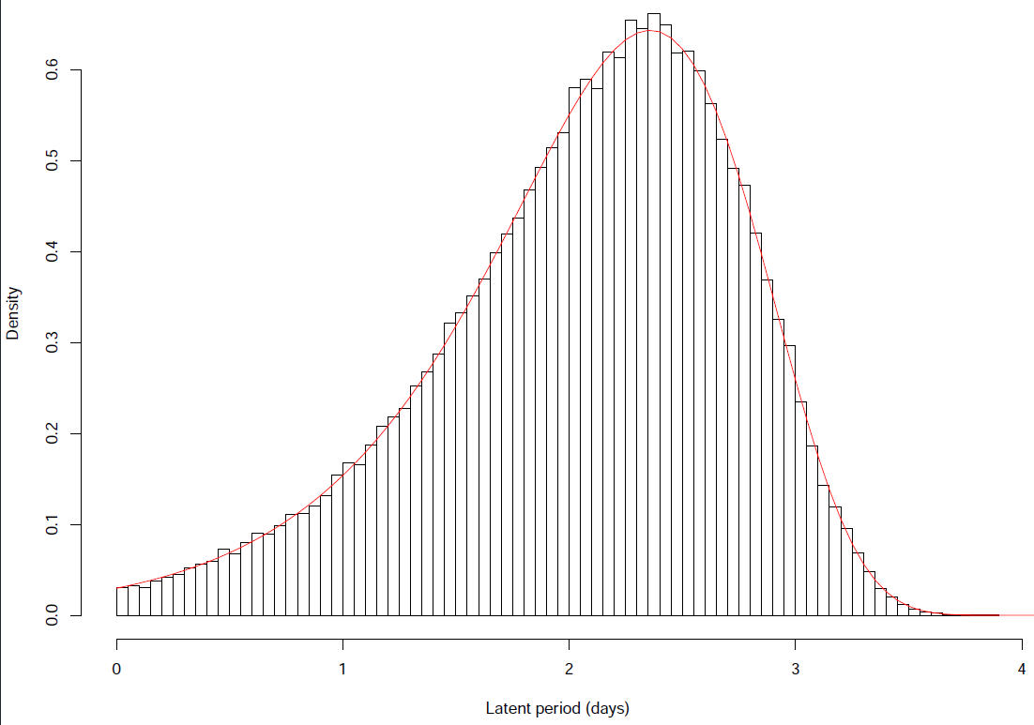
Presymptomatic
Mean 2.3 days
CI [0.8-3.0]
Gompertz distribution
Used in demography to predict lifespan.
While P(infectious) increases,
P=1-P(symptoms) decreases exponentially.

Slide 38
Values mapped
to individuals
10 years older
Values mapped
to individuals
10 years older

Slide 39
Shielding vulnerable population within a “green” zone
85% of the population
For a total population of 100 persons
50 kids (0-18 yo)
35 adults
Meetings between orange and green in « neutral zone » (open tent), no more than 4 people at a time (mixed orange/green). No physical contact (mask and gloves, 1.5 meter distance).
Neutral zone
0 kid
5 elderly (60+)
10 middle-aged NCD affected (mainly people 40-60 years old)
Intra-green zone carers are among the 10 non-elderly NCD
No unprotected contact with orange zone or external world
In average, meeting in neutral zone once per week
15% of the population

Slide 40
Modelling the contacts between population classes

Slide 41
Modelling the contacts between population classes

Slide 42
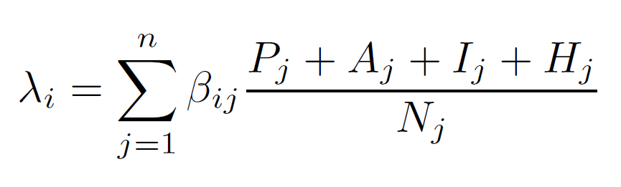

With:
τ is the probability of infection if there is a contact
C is the number of contacts between population classes i and j

Slide 43
With:
τ is the probability of infection if there is a contact
Cij is the number of contacts between population classes i and j
τ was estimated computing the small-domain Next Generation Matrix and estimating R0 from literature
(Rohinya refugee camps and Nigerian slums; R0 ~ 4)
Thanks to Judith Bouman for the help with this!

Slide 44
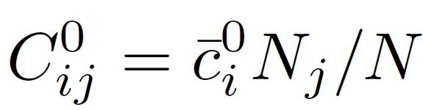
With:
τ is the probability of infection if there is a contact
Cij is the number of contacts between population classes i and j
Null model
ci = mean number of contacts class i per day
(Superscript 0 indicates null model)

Slide 45
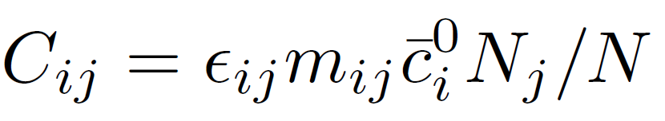
With:
τ is the probability of infection if there is a contact
Cij is the number of contacts between population classes i and j
Null model
ci = mean number of contacts class i per day
(Superscript 0 indicates null model)
Intervention
єij = reduction mean number contacts
mij = reduction “visibility” class j

Slide 46
The results

Slide 47
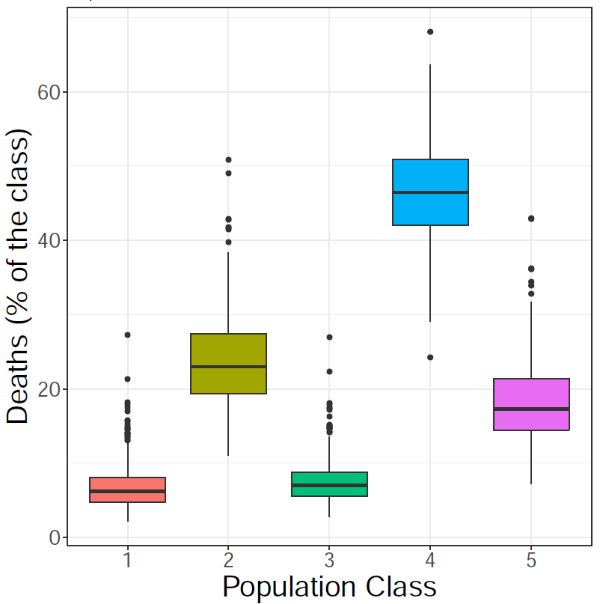
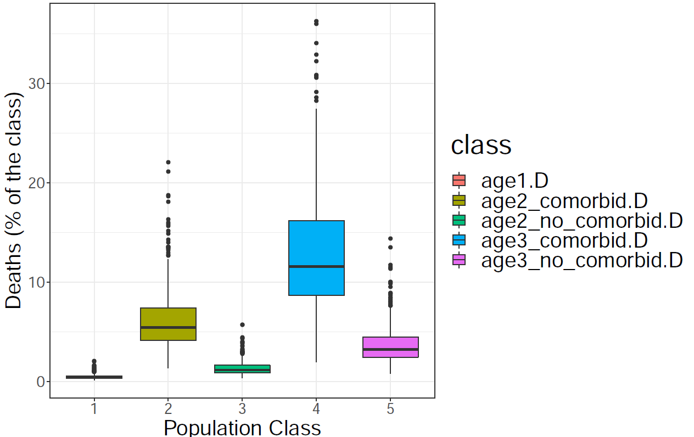
Testing upper and lower casualties boundaries
(Null model)
If H → D
Mean total deaths = 200

Slide 48
Testing upper and lower casualties boundaries
(Null model)
If H → D
Mean total deaths = 200
If H → R
Mean total deaths = 36

Slide 49
Shielding intervention, elderly only
>90% of the population
Neutral zone
Meeting in neutral zone once per week maximum two persons from orange zone.
No physical contact (mask and gloves, 1.5 meter distance)
Only elderly <10%

Slide 50
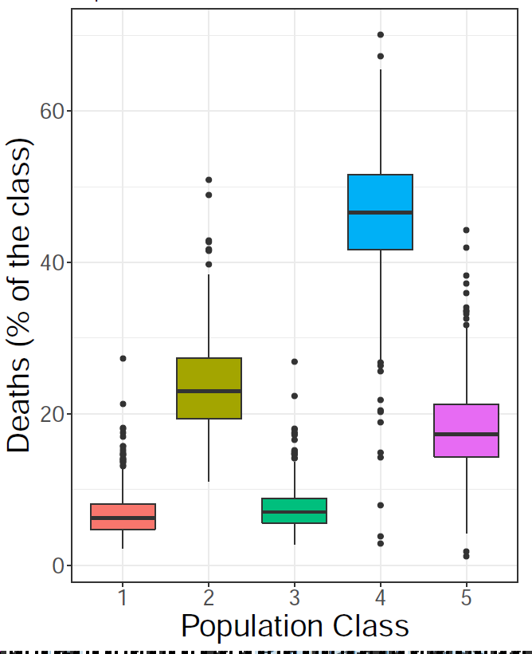
Testing null model vs shielding intervention
Null model
Shielding
Mean total deaths = 200
Mean total deaths = 200

Slide 51
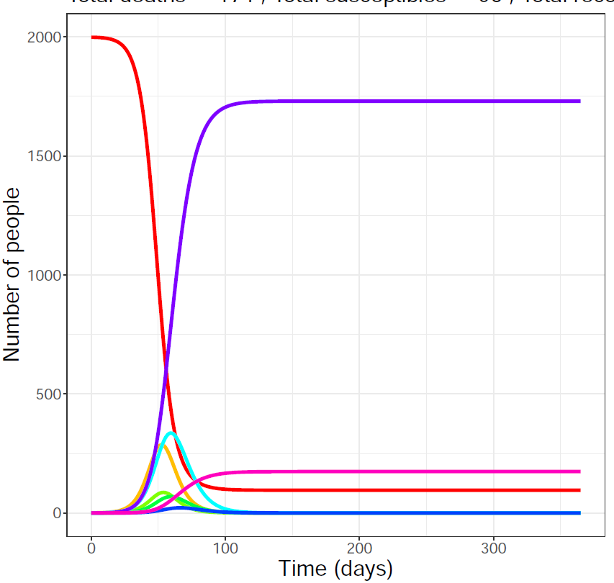
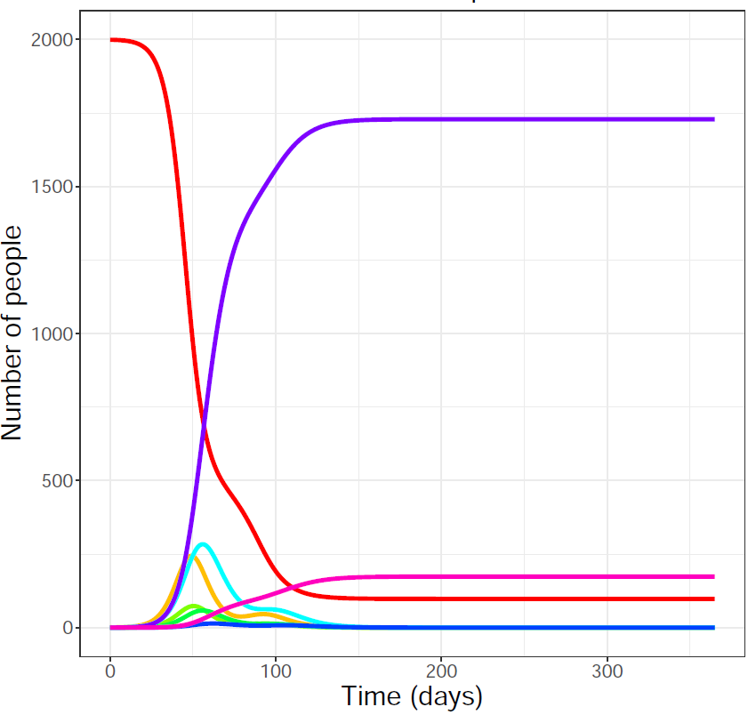
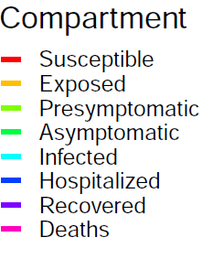
Testing null model vs shielding intervention
Null model
Shielding
Mean total deaths = 200
Mean total deaths = 200

Slide 52
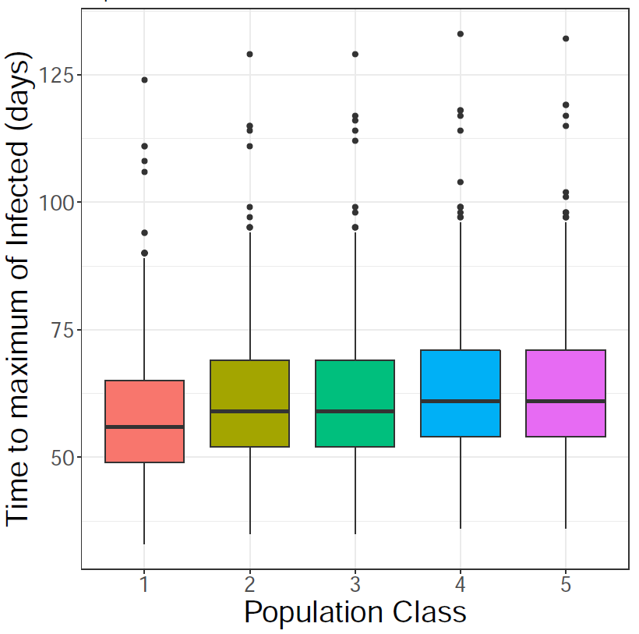
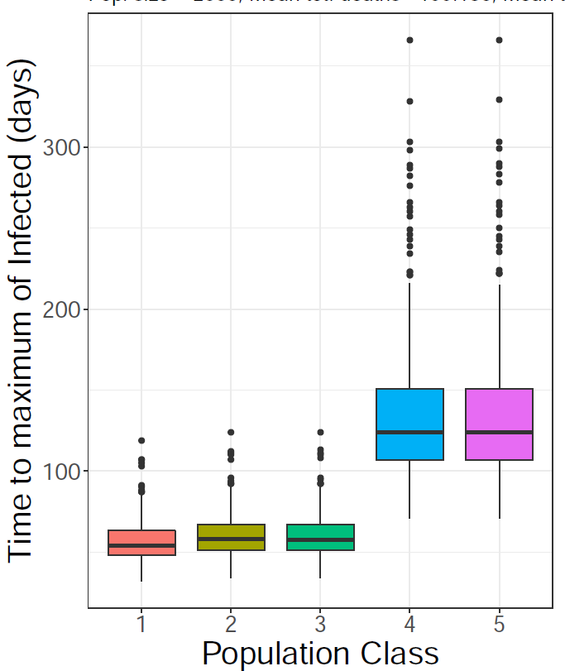
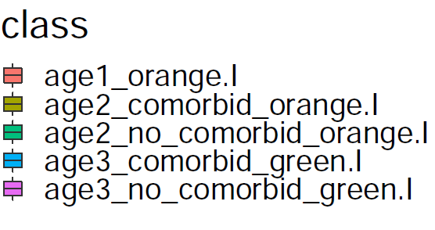
Testing null model vs shielding intervention
Null model
Shielding

Slide 53
Shielding intervention and evacuation
>90% of the population
Isolation centers
Capacity → Up to 10K people.
Managed from volunteers from cities
Support international organizations
Neutral zone
Only elderly <10%

Slide 54
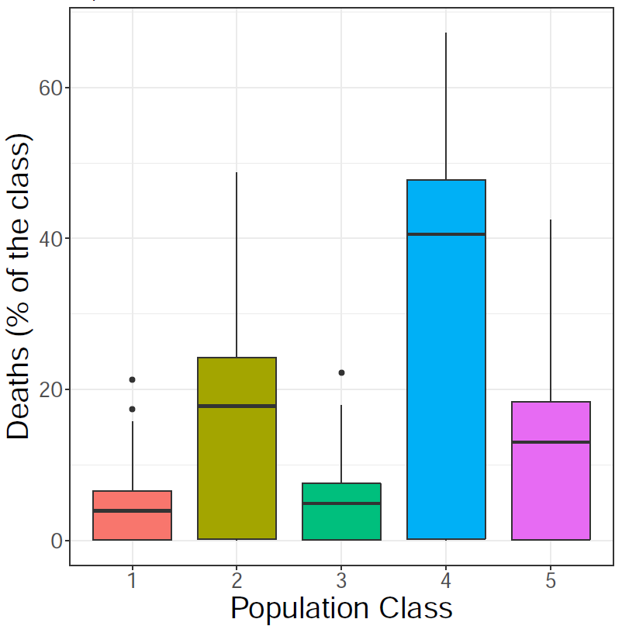
Testing evacuation strategy
(Null model)
No evacuation
Mean total deaths = 200
Evacuation, capacity 10 cap
Mean total deaths = 117

Slide 55
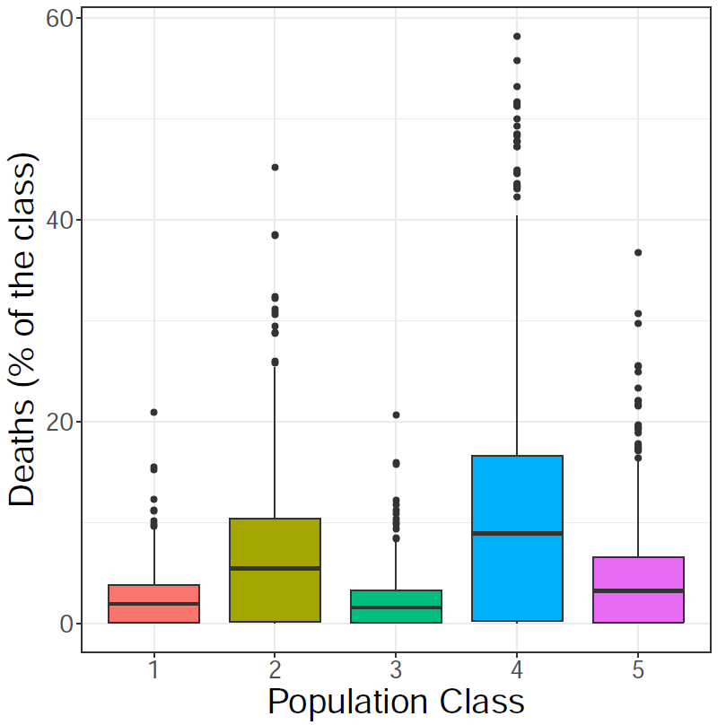
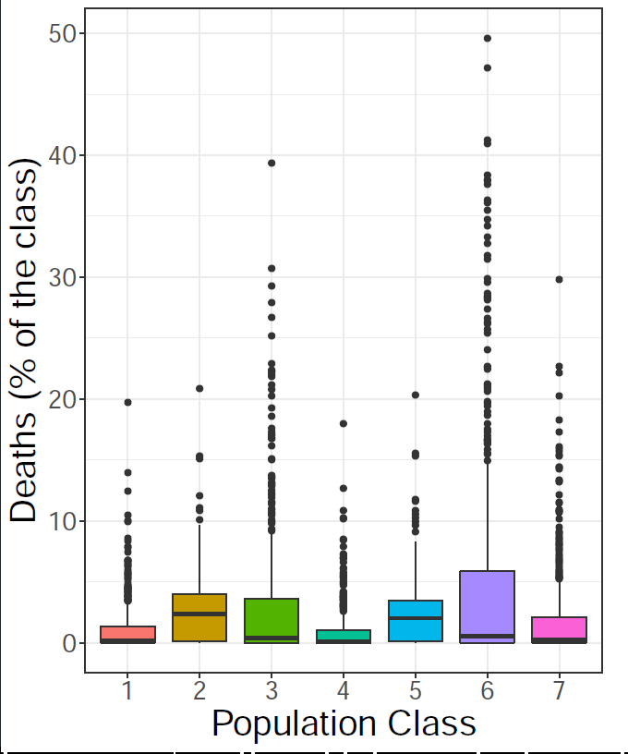
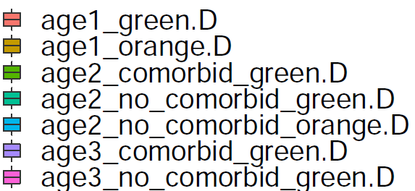
Testing evacuation strategy
Null model
Shielding
Mean total deaths = 59
Mean total deaths = 49
Evacuation capacity
100 cap

Slide 56
Conclusions
The consequences of COVID outbreak in these communities could be dramatic.
Shielding strategies alone are not sufficient and may even be detrimental.
Timely evacuation is fundamental, which require financial support for testing.
Lockdown of the shielding zone after the first symptoms appear should be tested.

Slide 57
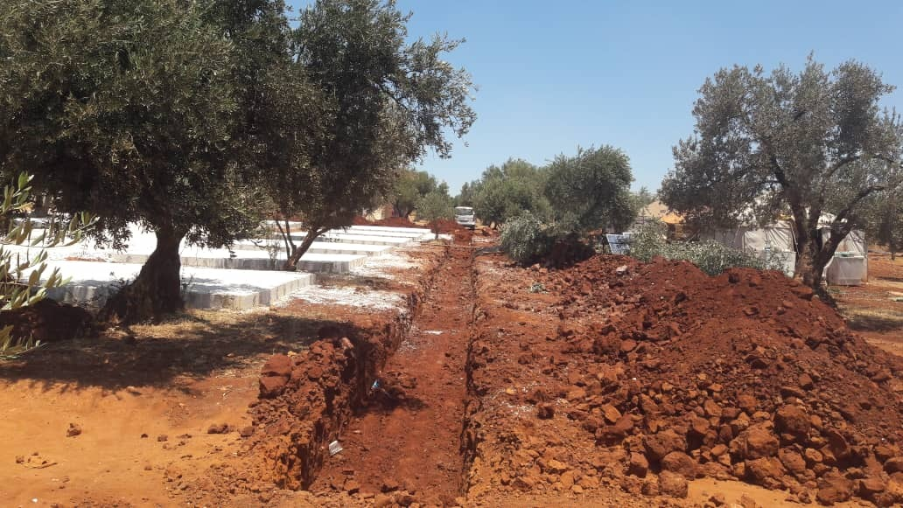

Slide 58
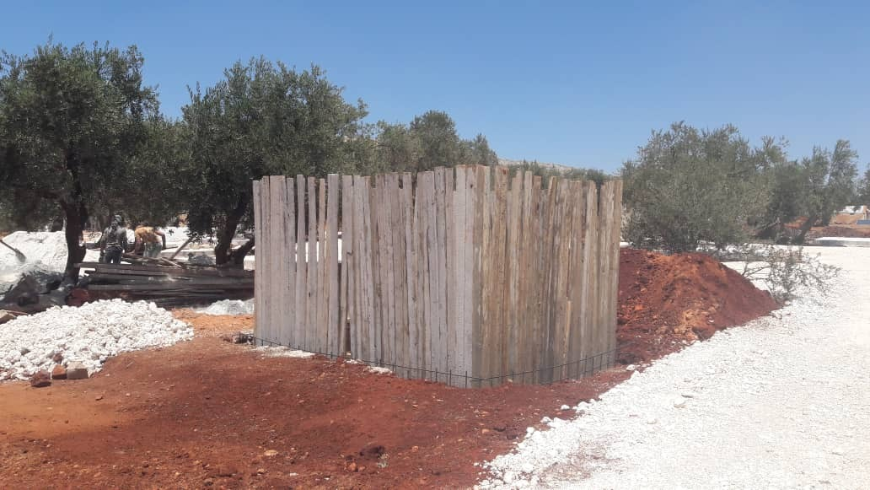

Slide 59
Take-home message
COVID showed us that a more cooperative and less competitive science is possible
(let’s crowdfight)

Slide 60
Acknowledgements
Contributors:
Jordan Klein (Princeton University)
Jennifer Villers (Princeton University)
Eduard Campillo-Funollet, University of Sussex
Judith Bouman (ETH-Zürich)
Chamsy Sarkis (Pax Syriana Foundation)
Thanks for useful discussions:
Burcu Tepekule (ETH-Zürich)
Juan Poyatos (Spanish Research Council)

