Slide 1
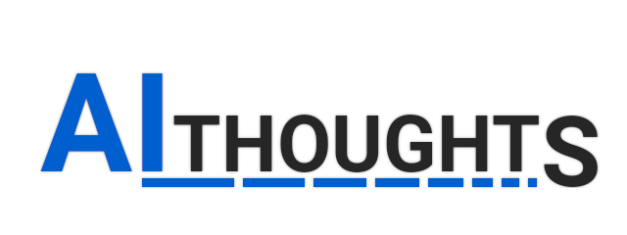


Vasileios Sakkas
Bachelor Student at the Department of Informatics and Telecommunications of the University of Athens
www.linkedin.com/in/vasileios-sakkas/
vasileios.sakkas96@gmail.com
Vasileios Papavasileiou
Bachelor Student at the Department of Informatics and Telecommunications
of the University of Athens
www.linkedin.com/in/vasileios-papavasileiou/
vpapav96@gmail.com

Slide 2

Chatbots - Benefits
Fast and easy to use: Can satisfy customer needs through simple commands and questions
Helps eliminate bureaucracy: reduces costs
Works 24/7: no humans required
Better accessibility through voice commands and
text-to-speech

Slide 3
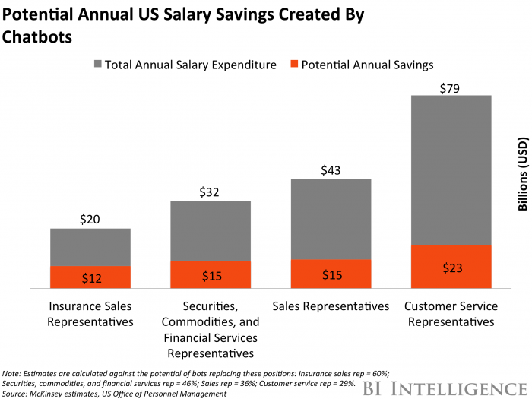

Slide 4
Our Solution
Greek support: Most current solutions only work in English.
Text-to-Speech and (in the future) Speech-to-Text: Easy and accessible for all customers.
Cross platform: Works with Android and iOS. Easy to be integrated with websites.
Interactivity and personalization: Easy to use with simple commands and questions. Can adjust to customer needs.
Security: Can be integrated with Authorization services.

Slide 5
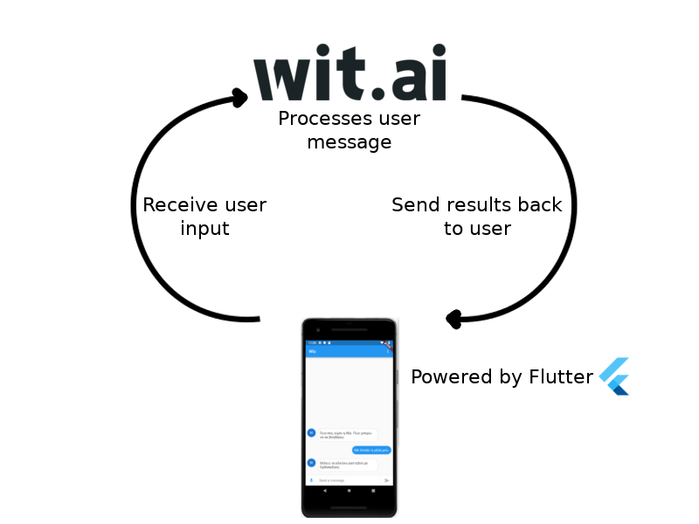

Slide 6
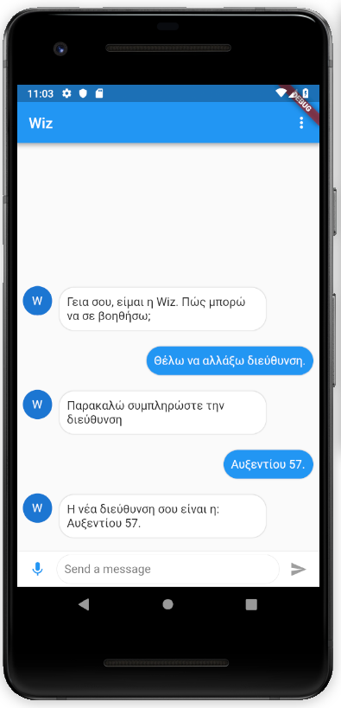
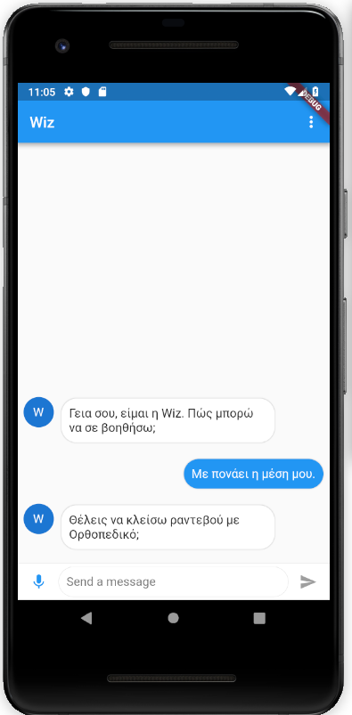
Screenshots

Slide 7
Use-case scenario: #1
User is a customer of an Insurance Company
User recently moved: needs to update his address
Traditional Way
User needs to call Insurance Company: long waiting times
Tedious process: Easy to make mistakes through a phone call
Long and bureaucratic process in order to update information: Costs time and money
Through a Chatbot
User simply opens Chatbot App: Instant access to services and support
Simple to use: Direct feedback in order to avoid any mistakes
Immediate results. Information is updated through internal APIs: Requires little to no human involvement.

Slide 8
Use-case scenario: #2
User is a customer of an Insurance Company
User feels sick: possibly requires medical help
Traditional Way
User calls doctor’s office: Several minutes wasted in order to schedule a check-in with doctor.
User visits doctor. Spends lots of time on waiting and check-in. Time and medical resources are potentially wasted.
Through a Chatbot
User open Chatbot app and describes current symptoms. Chatbot provides solutions based on user feedback and (if needed) suggests visiting a doctor and offers available hours.
User visits doctor that can assist him with his issue. Thanks to the chatbot’s suggestions, there is no need to burden specialized doctors and hospital staff without a reason.

Slide 9
Live Demostration
&
Questions

