Slide 1
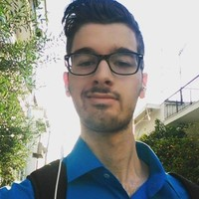
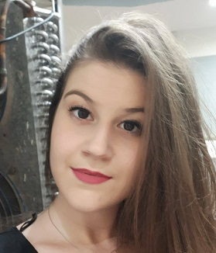
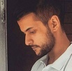
404 Not Found
ARISTOFANIS CHIONIS KOUFAKOS
Department of Informatics and Telecommunications UoA
aristofanischionis@gmail.com
KONSTANTINA STOIKOU
Department of Informatics and Telecommunications UoA
tinasto97@gmail.com
STEFANOS DIANELLOS
Department of Informatics and Telecommunications UoA
stefanos_dl97@hotmail.gr

Slide 2
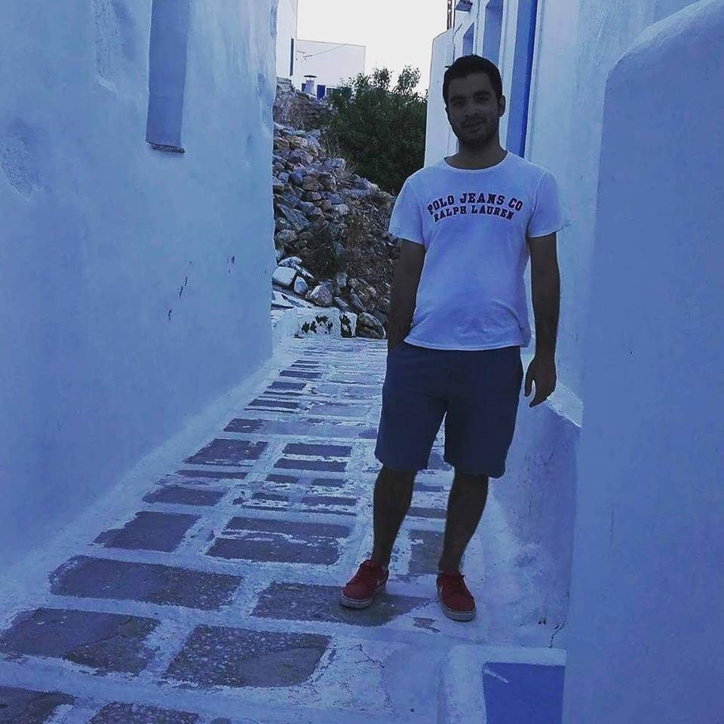
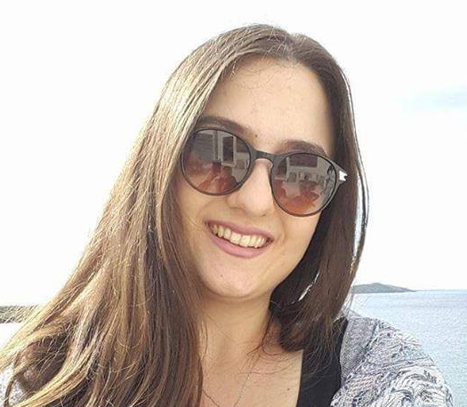
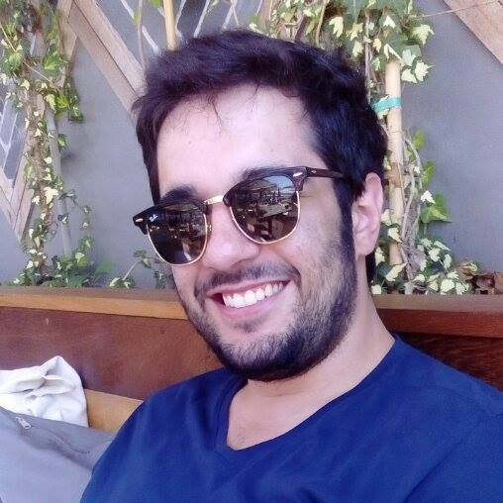
404 Not Found
STAVROS DAVARIS
Electrical Engineer NTUA
stavdav@gmail.com
ILIANA ROUSSOU
Insurance Consultant
roussouiliana@gmail.com
PANAGIOTIS PANAGIOTIDIS
Department of Informatics and Telecommunications UoA

Slide 3
InsuranceBot
A RoboAdvisor chatbot for clients
and professionals in the Insurance
Industry .

