Slide 1



Team: openCity
Lambros Pappas
Vas Giatilis
Georgia Alexopoulou
Gamification at public transport

Slide 2

Motivate people to use Public Transport
Application that gathers distance covered from a citizen by using public transport. Kilometeres/miles are reflected to points and added into user’s profile point system. Points are translated to real awards.
Calculates distance covered by using public transport and gathers ‘Smiles’ based on the distance
Grants rewards based on points (Smiles) obtained
Calculates CO2 emission based on user’s car
Calculates distance covered by using public transport and gathers ‘Smiles’ based on the distance
Grants rewards based on points (Smiles) obtained
Calculates CO2 emission based on user’s car
Who can use it?
All citizens (as users)
Public Transport services (as vendors)
Municipality (as providers of real awards)

Slide 3

Impact and Business Model
Energy Saving
Environment
Carbon footprint
Decrease Car Emission
A full bus can take 50 cars of the road
Reduce gas consumption
Use Green Buses
Transport
Increase profits to public transports
Incentives can be provided by municipalities or by cities
Citizens would get benefits from buying the app
Free ads for municipalities
More citizens use them – More frequent and quality services

Slide 4


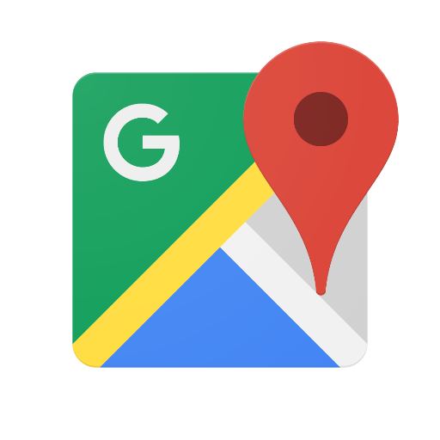

Architecture / Innovation
Provide incentives to citizens
Gather points
Calculate CO2 emission per user car
Electronic Ticket
(start & end of route)
Calculate distance in public transport
Get Traffic data
OASA API
CO2 emission API
Google Maps API

Slide 5
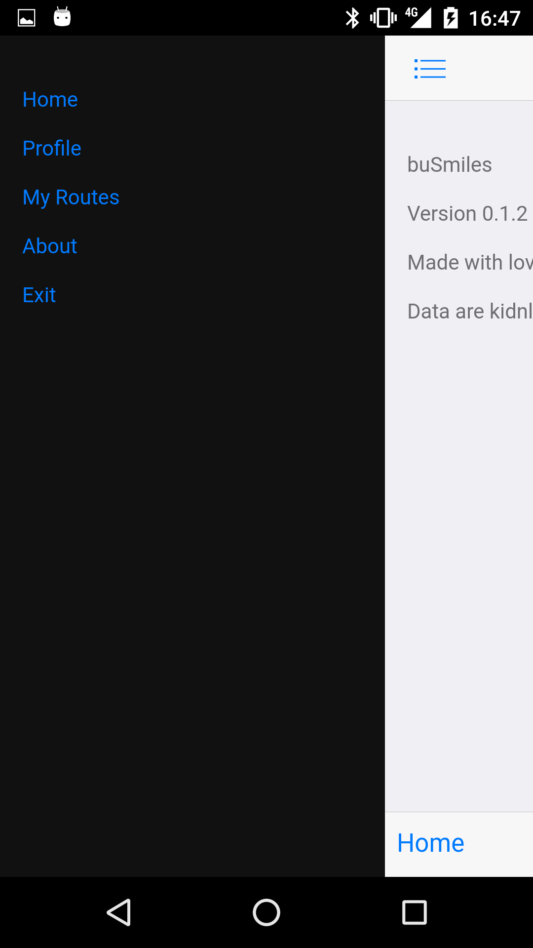
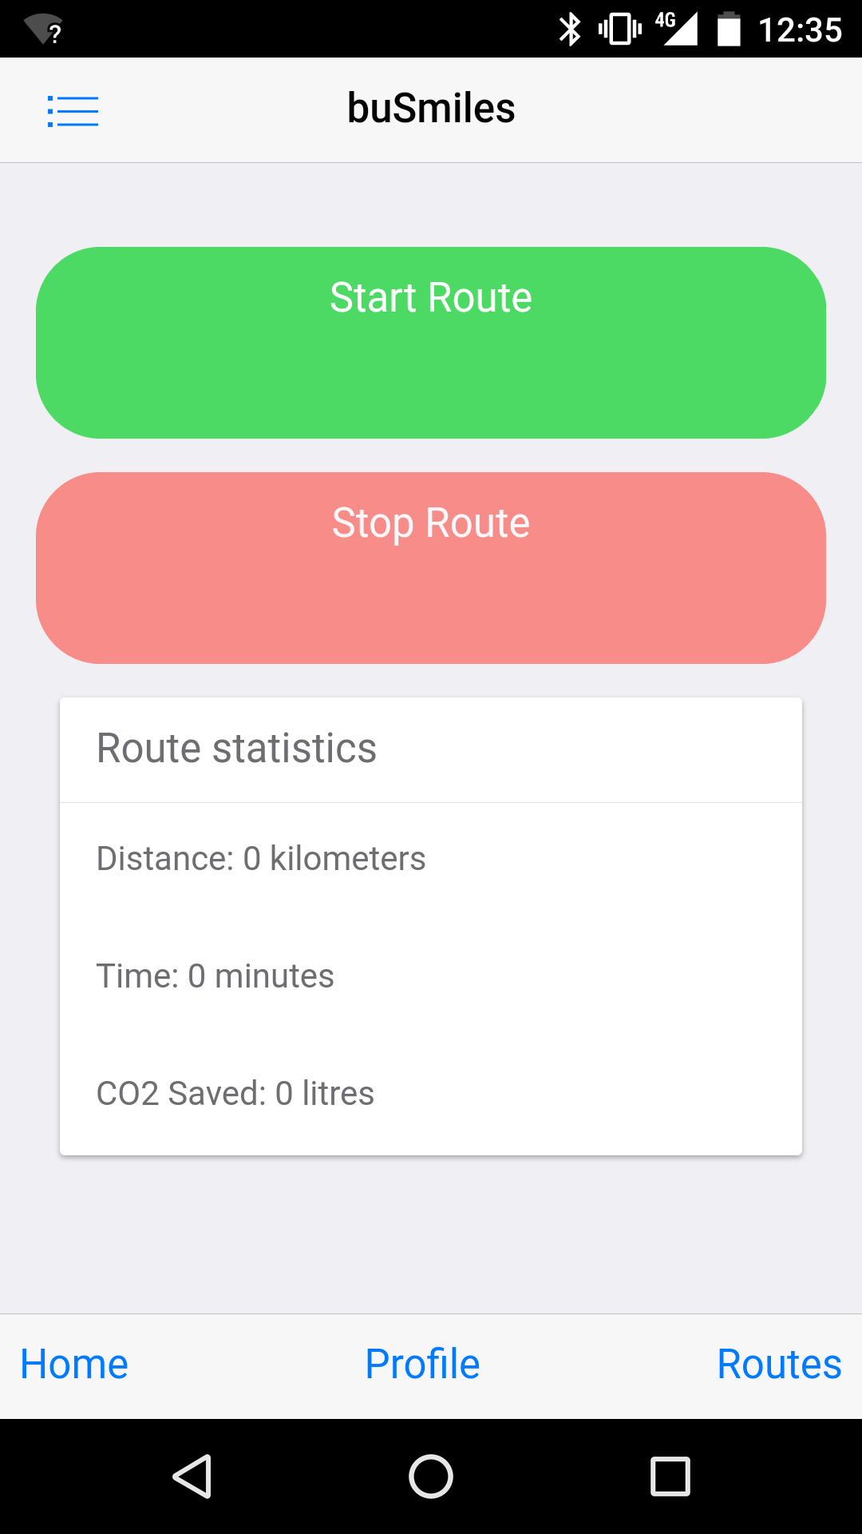
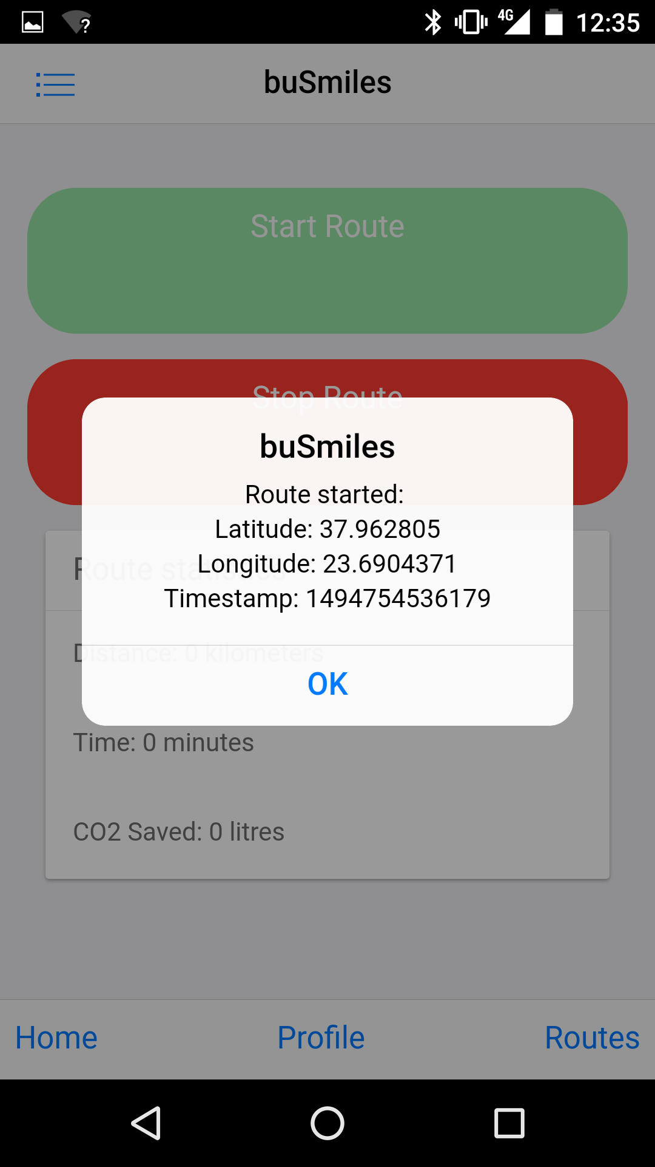
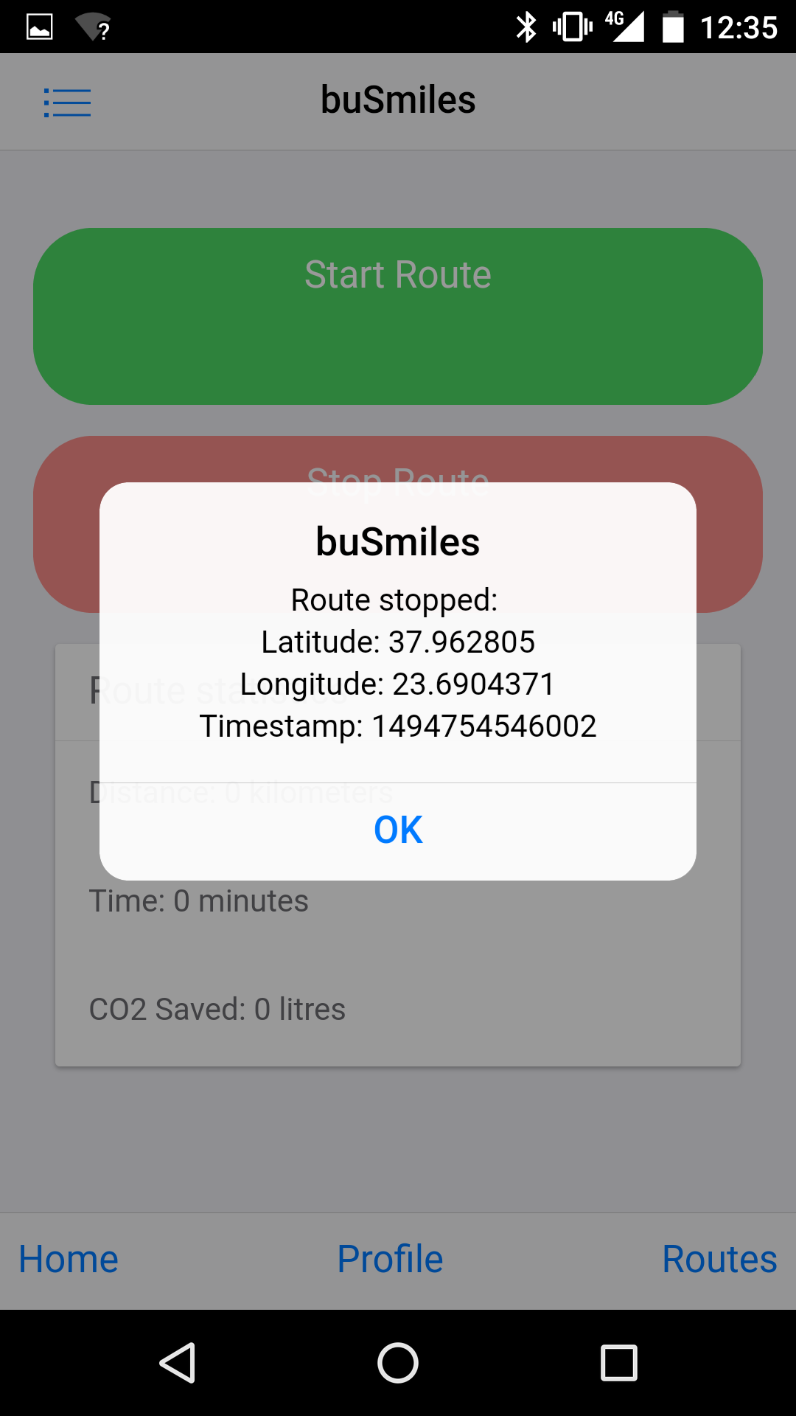
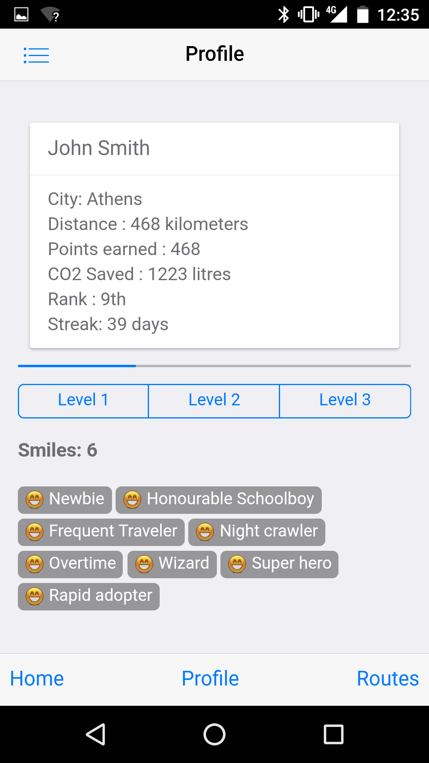
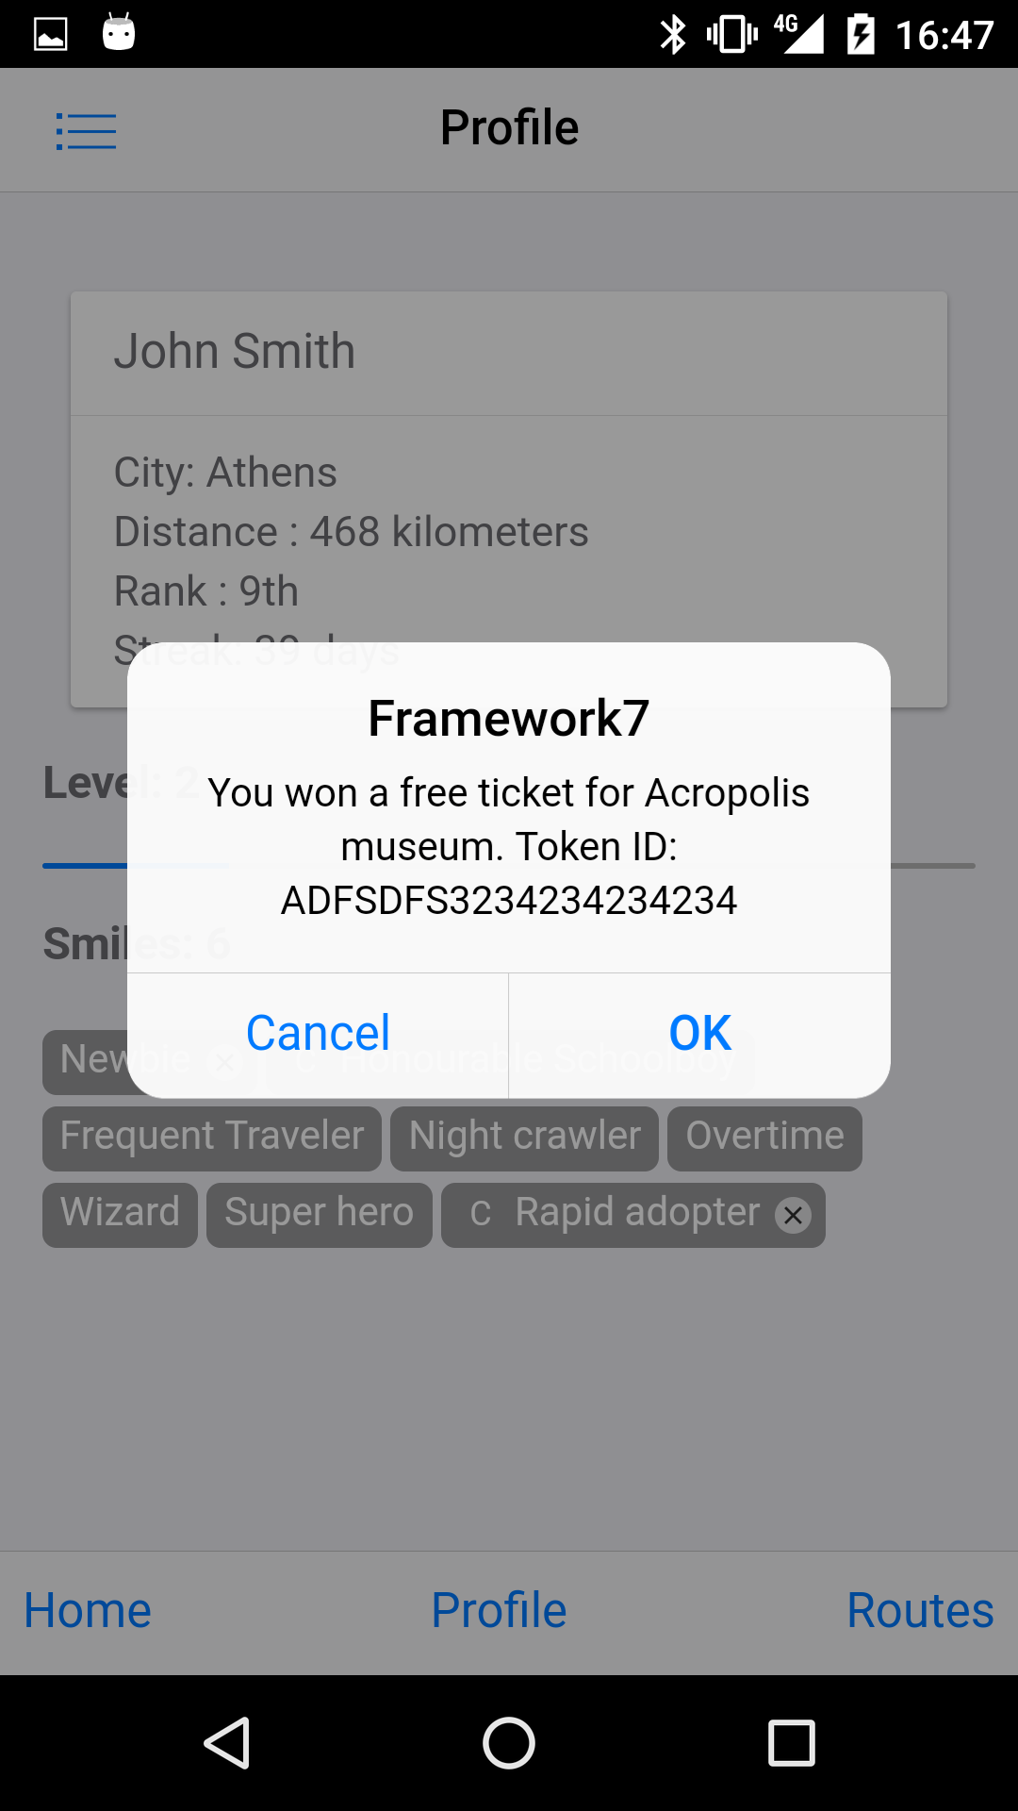
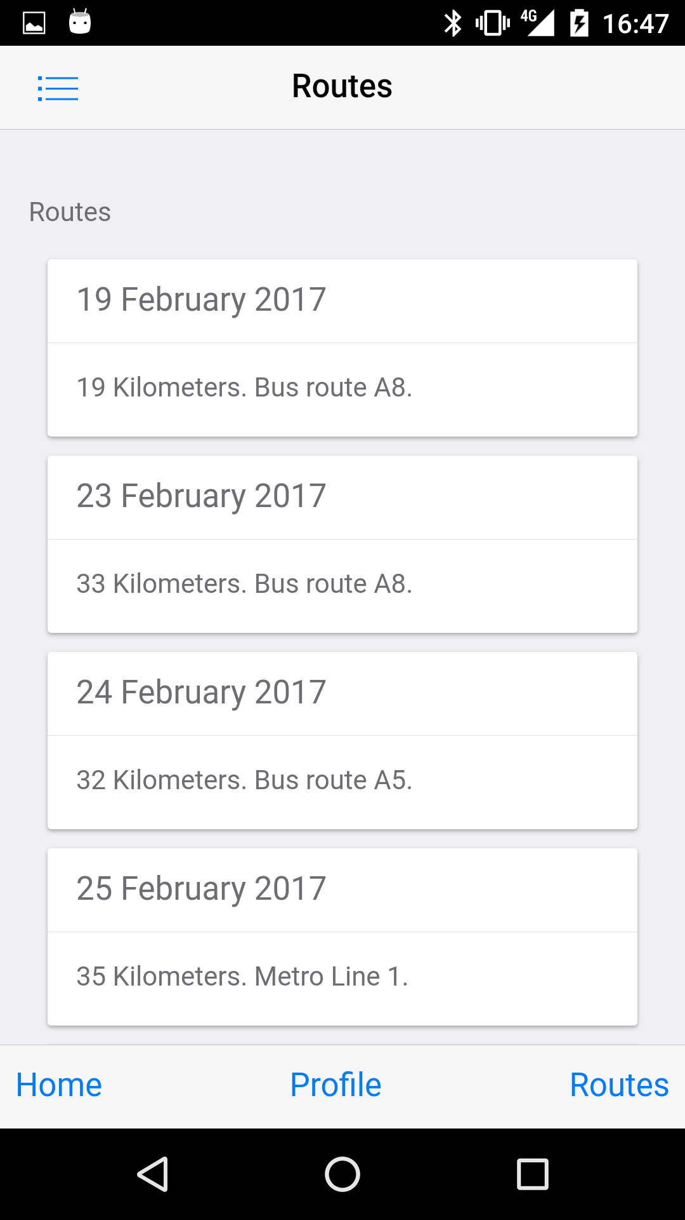

Android App

Slide 6
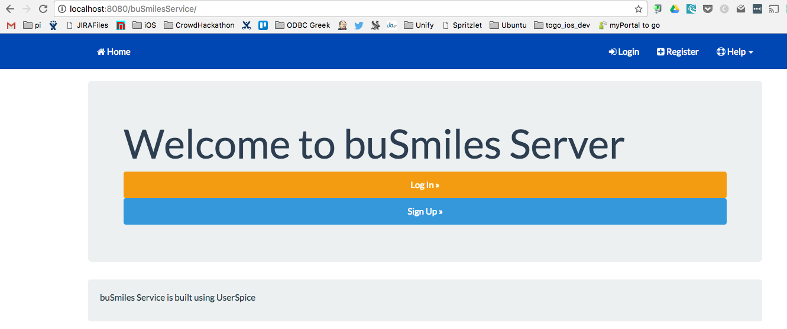
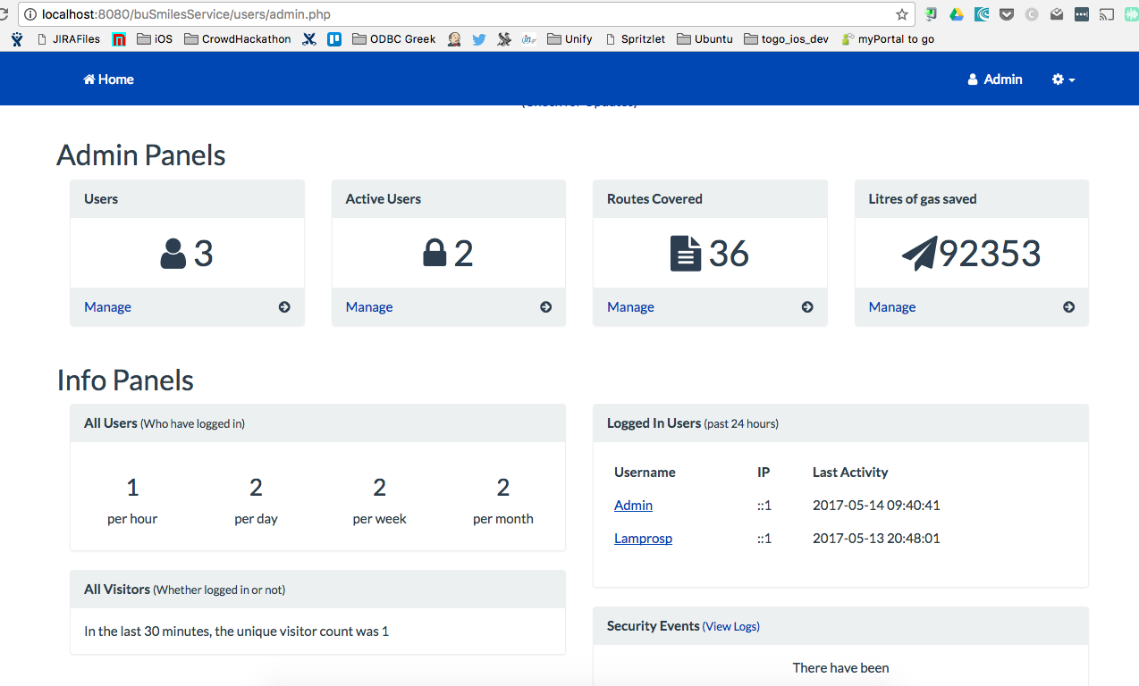
Server side

Slide 7

Thank you!

