Slide 1

Smart OnStreet Parking
An Open Parking Platform and API
that connects Cities with Service Providers-Developers.
May 14, 2017

Slide 2

30 % of traffic is caused by people looking for a parking space

Slide 3



Parking Problems in Cities accounts for:
10% of car’s greenhouse gas emission
Decreased revenue for cities & local merchants
46% of drivers give up on a planned activity

Slide 4
Smart OnStreet Parking is a Open Platform and API that connects Cities with Service Providers/Application Developers
to manage and monetize city parking
Smart OnStreet Parking, offers a standardized way for every Municipality to develop their controlled street parking offerings

Slide 5
Smart OnStreet Parking - Overview
City
Makes parking data available on Smart OnStreet Parking platform
Service Provider
Builds web or mobile app using Smart OnStreet Parking API to access city parking data.
Driver
Easily finds and pays for parking through Service Provider app.
Service
Provider
City
Smart OnStreet Parking
Driver

Slide 6
Smart OnStreet Parking Benefits
Openness & Interoperability - Common MARKETPLACE that allows easy discovery
Standardize & Structure City: Data – Specifications & Formats
Integration with Service Providers: One API for Developers
Cloud-based & Scalable
Innovation Ecosystem
Real-time data and accurate analytics that improve decision making.
Easily monitor activity and enforce parking.

Slide 7
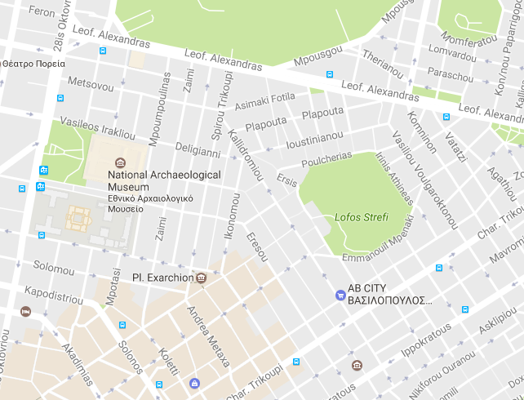
How does it work? (Cities)
1. Upload city parking data
or use interactive map to define parking zones
2. Enter price, duration etc.
3. Issue tickets
4. Publish data to marketplace
Zone 1
Zone 2

Slide 8
How does it work? (Service Provider)
1. Generate API Keys
2. Complete Verification
3. Start building apps

Slide 9
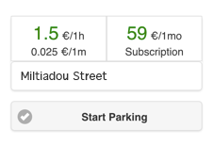
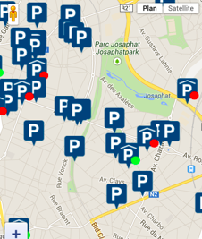
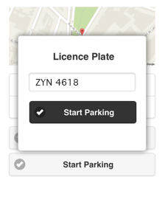
How does it work? (Driver)
1. Use a mobile phone to pay for parking in an easy and convenient way.
2. Easily extend parking time.
3. Receive parking receipts electronically.

Slide 10
Team
Ioannis Zarifis
Panagiotis Renztis
George Pipilakis
Evgenios Kontaxakis
Jim Papastogiannidis

