Slide 1
Parallel Programming in Matlab
-Tutorial-
Jeremy Kepner, Albert Reuther and Hahn Kim
MIT Lincoln Laboratory
This work is sponsored by the Defense Advanced Research Projects Administration under Air Force Contract FA8721-05-C-0002. Opinions, interpretations, conclusions, and recommendations are those of the author and are not necessarily endorsed by the United States Government.
Notes:
1
1
Title Slide: Talk describing Parallel Matlab Tutorial

Slide 2
Outline
Introduction
ZoomImage
Quickstart (MPI)
ZoomImage App
Walkthrough (MPI)
ZoomImage
Quickstart (pMatlab)
ZoomImage App
Walkthrough (pMatlab)
Beamfomer
Quickstart (pMatlab)
Beamformer App
Walkthrough (pMatlab)
Tutorial Goals
What is pMatlab
When should it be used
Notes:
Outline Slide: Introduction describes Tutorial goals

Slide 3
Tutorial Goals
Overall Goals
  Show how to use pMatlab Distributed MATrices (DMAT) to write parallel programs
  Present simplest known process for going from serial Matlab to parallel Matlab that provides good speedup
Section Goals
  Quickstart (for the really impatient)
    How to get up and running fast
  Application Walkthrough (for the somewhat impatient)
    Effective programming using pMatlab Constructs
    Four distinct phases of debugging a parallel program
  Advanced Topics (for the patient)
    Parallel performance analysis
    Alternate programming styles
    Exploiting different types of parallelism
  Example Programs (for those really into this stuff)
    descriptions of other pMatlab examples
Notes:
What the user can expect to get out of the tutorial.

Slide 4
pMatlab Description
Provides high level parallel data structures and functions
Parallel functionality can be added to existing serial programs with minor modifications
Distributed matrices/vectors are created by using “maps” that describe data distribution
“Automatic” parallel computation and data distribution is achieved via operator overloading (similar to Matlab*P)
“Pure” Matlab implementation
Uses MatlabMPI to perform message passing
  Offers subset of MPI functions using standard Matlab file I/O
  Publicly available: http://www.ll.mit.edu/MatlabMPI
Notes:
Our goals in implementing pMatlab.

Slide 5
pMatlab Maps and Distributed Matrices
Map Example
mapA = map([1 2], ... % Specifies that cols be dist. over 2 procs
{}, ... % Specifies distribution: defaults to block
[0:1]); % Specifies processors for distribution
mapB = map([1 2], {}, [2:3]);
A = rand(m,n, mapA); % Create random distributed matrix
B = zeros(m,n, mapB); % Create empty distributed matrix
B(:,:) = A; % Copy and redistribute data from A to B.
Grid and Resulting Distribution
A
Proc 0
Proc 1
Proc 0
Proc 1
Proc 2
Proc 3
Proc 2
B
Proc 3
Notes:
Maps: the core idea of pMatlab

Slide 6
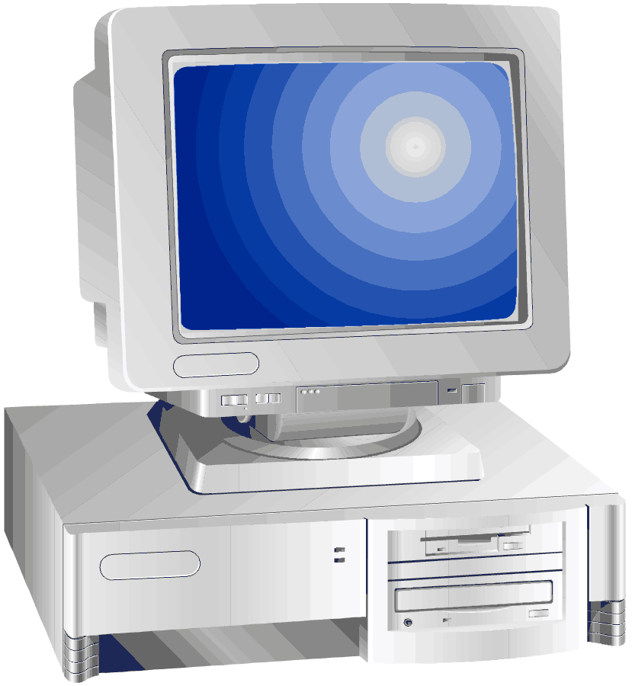
MatlabMPI & pMatlab Software Layers
Input
Analysis
Output
Application
Library Layer (pMatlab)
Vector/Matrix
Comp
Conduit
Task
User
Interface
Parallel
Library
Kernel Layer
Hardware
Interface
Messaging (MatlabMPI)
Math (Matlab)
Parallel
Hardware
Can build a parallel library with a few messaging primitives
MatlabMPI provides this messaging capability:
  MPI_Send(dest,comm,tag,X);
  X = MPI_Recv(source,comm,tag);
Can build a application with a few parallel structures and functions
pMatlab provides parallel arrays and functions
  X = ones(n,mapX);
  Y = zeros(n,mapY);
  Y(:,:) = fft(X);
Notes:
1
1
Layered design: MatlabMPI is communication kernel, pMatlab is library layer

Slide 7
MatlabMPI:
Point-to-point Communication
Any messaging system can be implemented using file I/O
File I/O provided by Matlab via load and save functions
  Takes care of complicated buffer packing/unpacking problem
  Allows basic functions to be implemented in ~250 lines of Matlab code
MPI_Send (dest, tag, comm, variable);
save
Data file
load
variable
variable
Sender
Shared File System
Receiver
create
Lock file
detect
variable = MPI_Recv (source, tag, comm);
Sender saves variable in Data file, then creates Lock file
Receiver detects Lock file, then loads Data file
Notes:
MatlabMPI exploits Matlab filei I/O. Eliminates most difficult part of implementing a messaging library

Slide 8
When to use? (Performance 101)
Why parallel, only 2 good reasons:
  Run faster (currently program takes hours)
    Diagnostic: tic, toc
  Not enough memory (GBytes)
    Diagnostic: whose or top
When to use
  Best case: entire program is trivially parallel (look for this)
  Worst case: no parallelism or lots of communication required (don’t bother)
  Not sure: find an expert and ask, this is the best time to get help!
Measuring success
  Goal is linear Speedup = Time(1 CPU) / Time(N CPU)
  (Will create a 1, 2, 4 CPU speedup curve using example)
Notes:
There are two primary situations for using parallel Matlab.

Slide 9
Parallel Speedup
Ratio of the time on 1 CPU divided by the time on N CPUs
  If no communication is required, then speedup scales linearly with N
  If communication is required, then the non-communicating part should scale linearly with N
Speedup typically plotted vs number of processors
  Linear (ideal)
  Superlinear (achievable in some circumstances)
  Sublinear (acceptable in most circumstances)
  Saturated (usually due to communication)
Speedup
Number of Processors
Notes:
Speedup is the primary metric for gauging how well an implementation is performing.

Slide 10
Speedup for Fixed and Scaled Problems
Fixed Problem Size
Scaled Problem Size
Parallel performance
Speedup
Gigaflops
Number of Processors
Number of Processors
Achieved “classic” super-linear speedup on fixed problem
Achieved speedup of ~300 on 304 processors on scaled problem
Notes:
Scaling results for an image filtering benchmark

Slide 11
Outline
Introduction
ZoomImage
Quickstart (MPI)
ZoomImage App
Walkthrough (MPI)
ZoomImage
Quickstart (pMatlab)
ZoomImage App
Walkthrough (pMatlab)
Beamfomer
Quickstart (pMatlab)
Beamformer App
Walkthrough (pMatlab)
Installation
Running
Timing
Notes:
Outline Slide: ZoomImage written in MPI

Slide 12
QuickStart - Installation [All users]
Download pMatlab & MatlabMPI & pMatlab Tutorial
  http://www.ll.mit.edu/MatlabMPI
  Unpack tar ball in home directory and add paths to ~/matlab/startup.m
    addpath ~/pMatlab/MatlabMPI/src
    addpath ~/pMatlab/src
[Note: home directory must be visible to all processors]
Validate installation and help
  start MATLAB
  cd pMatlabTutorial
  Type “help pMatlab” “help MatlabMPI”
Notes:
Insallting pMatlab from the web.

Slide 13
QuickStart - Installation [LLGrid users]
Copy tutorial
  Copy z:\tools\tutorials\ to z:\
Validate installation and help
  start MATLAB
  cd z:\tutorials\pMatlabTutorial
  Type “help pMatlab” and “help MatlabMPI”
Notes:
Installing pMatlab from grid.

Slide 14
QuickStart - Running
Run mpiZoomImage
  Edit RUN.m and set:
    m_file = ’mpiZoomimage’;
    Ncpus = 1;
    cpus = {};
  type “RUN”
  Record processing_time
Repeat with: Ncpus = 2; Record Time
Repeat with:
cpus ={’machine1’ ’machine2’}; [All users]
OR
cpus =’grid’; [LLGrid users]
Record Time
Repeat with: Ncpus = 4; Record Time
  Type “!type MatMPI\*.out” or “!more MatMPI/*.out” ;
  Examine processing_time
Congratulations!
You have just completed the 4 step process
Notes:
Running the mpi Zoomimage example.

Slide 15
QuickStart - Timing
Enter your data into mpiZoomImage_times.m
T1 = 15.9; % MPI_Run('mpiZoomimage',1,{})
T2a = 9.22; % MPI_Run('mpiZoomimage',2,{})
T2b = 8.08; % MPI_Run('mpiZoomimage',2,cpus))
T4 = 4.31; % MPI_Run('mpiZoomimage',4,cpus))
Run mpiZoomImage_times
Divide T(1 CPUs) by T(2 CPUs) and T(4 CPUs)
speedup = 1.0000 2.0297 3.8051
  Goal is linear speedup
Notes:
Timing the mpiZoomImage example.

Slide 16
Outline
Introduction
ZoomImage
Quickstart (MPI)
ZoomImage App
Walkthrough (MPI)
ZoomImage
Quickstart (pMatlab)
ZoomImage App
Walkthrough (pMatlab)
Beamfomer
Quickstart (pMatlab)
Beamformer App
Walkthrough (pMatlab)
Description
  Setup
  Scatter Indices
  Zoom and Gather
  Display Results
Notes:
Outline Slide: description of the mpiZoomImage implementation.

Slide 17
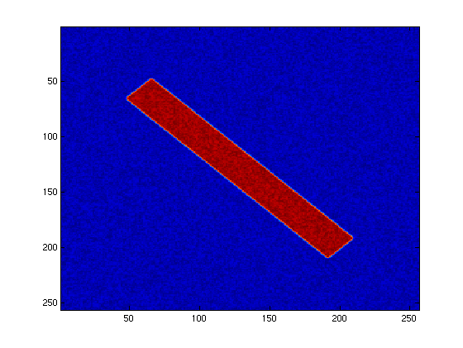
Application Description
Parallel image generation
  0. Create reference image
  1. Compute zoom factors
  2. Zoom images
  3. Display
2 Core dimensions
  N_image, numFrames
  Choose to parallelize along frames (embarassingly parallel)
Notes:
Application takes an image and progressively zooms in on it.

Slide 18
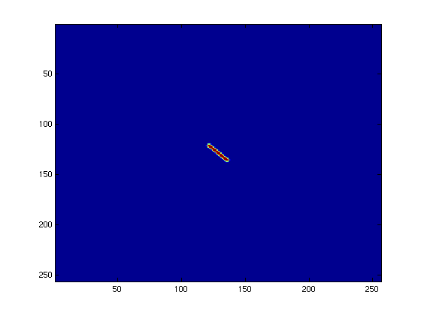

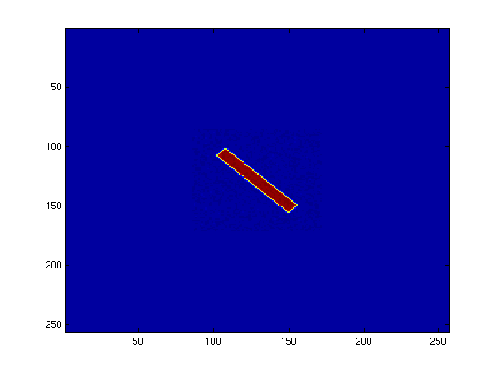
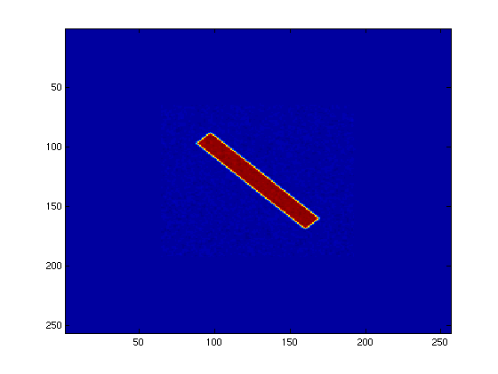
Application Output
Time
Notes:
Output is a sequence of zoomed images.

Slide 19
Setup Code
Implicitly Parallel Code
Required Change
% Setup the MPI world.
MPI_Init; % Initialize MPI.
comm = MPI_COMM_WORLD; % Create communicator.
% Get size and rank.
Ncpus = MPI_Comm_size(comm);
my_rank = MPI_Comm_rank(comm);
leader = 0; % Set who is the leader
% Create base message tags.
input_tag = 20000;
output_tag = 30000;
disp(['my_rank: ',num2str(my_rank)]); % Print rank.
Comments
MPI_COMM_WORLD stores info necessary to communicate
MPI_Comm_size() provides number of processors
MPI_Comm_rank() is the ID of the current processor
Tags are used to differentiate messages being sent between the same processors. Must be unique!
Notes:
Code for initializing data structures.

Slide 20
Things to try
Ncpus is the number of Matlab
sessions that were launched
>> Ncpus
Ncpus =
4
>> my_rank
my_rank =
0
Interactive Matlab session is
always rank = 0
Notes:
How to display the number of CPUS.

Slide 21
Scatter Index Code
Implicitly Parallel Code
Required Change
scaleFactor = linspace(startScale,endScale,numFrames); % Compute scale factor
frameIndex = 1:numFrames; % Compute indices for each image.
frameRank = mod(frameIndex,Ncpus); % Deal out indices to each processor.
if (my_rank == leader) % Leader does sends.
for dest_rank=0:Ncpus-1 % Loop over all processors.
dest_data = find(frameRank == dest_rank); % Find indices to send.
% Copy or send.
if (dest_rank == leader)
my_frameIndex = dest_data;
else
MPI_Send(dest_rank,input_tag,comm,dest_data);
end
end
end
if (my_rank ~= leader) % Everyone but leader receives the data.
my_frameIndex = MPI_Recv( leader, input_tag, comm ); % Receive data.
end
Comments
If (my_rank …) is used to differentiate processors
Frames are destributed in a cyclic manner
Leader distributes work to self via a simple copy
MPI_Send and MPI_Recv send and receive the indices.
Notes:
Code for scattering the indices amongst processors.

Slide 22
Things to try
>> my_frameIndex
my_frameIndex = 4 8 12 16 20 24 28 32
>> frameRank
frameRank = 1 2 3 0 1 2 3 0
1 2 3 0 1 2 3 0
1 2 3 0 1 2 3 0
1 2 3 0 1 2 3 0
my_frameIndex different on each processor
frameRank the same on each processor
Notes:
Displaying the indices.

Slide 23
Zoom Image and Gather Results
Implicitly Parallel Code
Required Change
% Create reference frame and zoom image.
refFrame = referenceFrame(n_image,0.1,0.8);
my_zoomedFrames = zoomFrames(refFrame,scaleFactor(my_frameIndex),blurSigma);
if (my_rank ~= leader) % Everyone but the leader sends the data back.
MPI_Send(leader,output_tag,comm,my_zoomedFrames); % Send images back.
end
if (my_rank == leader) % Leader receives data.
zoomedFrames = zeros(n_image,n_image,numFrames); % Allocate array
for send_rank=0:Ncpus-1 % Loop over all processors.
send_frameIndex = find(frameRank == send_rank); % Find frames to send.
if (send_rank == leader) % Copy or receive.
zoomedFrames(:,:,send_frameIndex) = my_zoomedFrames;
else
zoomedFrames(:,:,send_frameIndex) = MPI_Recv(send_rank,output_tag,comm);
end
end
end
Comments
zoomFrames computed for different scale factors on each processor
Everyone sends their images back to leader
Notes:
Code for gathering the results back on 1 processor.

Slide 24
Things to try
>> whos refFrame my_zoomedFrames zoomedFrames
Name Size Bytes Class
my_zoomedFrames 256x256x8 4194304 double array
refFrame 256x256 524288 double array
zoomedFrames 256x256x32 16777216 double array
-Size of global indices are the same dimensions of local part
-global indices shows those indices of DMAT that are local
-User function returns arrays consistent with local part of DMAT
Notes:
Displaying the sizes of the data structure.

Slide 25
Finalize and Display Results
Implicitly Parallel Code
Required Change
% Shut down everyone but leader.
MPI_Finalize;
If (my_rank ~= leader)
exit;
end
% Display simulated frames.
figure(1); clf;
set(gcf,'Name','Simulated Frames','DoubleBuffer','on','NumberTitle','off');
for frameIndex=[1:numFrames]
imagesc(squeeze(zoomedFrames(:,:,frameIndex)));
drawnow;
end
Comments
MPI_Finalize exits everyone but the leader
Can now do operations that make sense only on leader
  Display output
Notes:
Shutting down the other processors and showing graphical output.

Slide 26
Outline
Introduction
ZoomImage
Quickstart (MPI)
ZoomImage App
Walkthrough (MPI)
ZoomImage
Quickstart (pMatlab)
ZoomImage App
Walkthrough (pMatlab)
Beamfomer
Quickstart (pMatlab)
Beamformer App
Walkthrough (pMatlab)
Running
Timing
Notes:
Outline Slide: Running and timing pZoomImage

Slide 27
QuickStart - Running
Run pZoomImage
  Edit pZoomImage.m and set “PARALLEL = 0;”
  Edit RUN.m and set:
    m_file = ’pZoomImage’;
    Ncpus = 1;
    cpus = {};
  type “RUN”
  Record processing_time
Repeat with: PARALLEL = 1; Record Time
Repeat with: Ncpus = 2; Record Time
Repeat with:
cpus ={’machine1’ ’machine2’}; [All users]
OR
cpus =’grid’; [LLGrid users]
Record Time
Repeat with: Ncpus = 4; Record Time
  Type “!type MatMPI\*.out” or “!more MatMPI/*.out” ;
  Examine processing_time
Congratulations!
You have just completed the 4 step process
Notes:
Running the pZoomImage example.

Slide 28
QuickStart - Timing
Enter your data into pZoomImage_times.m
T1a = 16.4; % PARALLEL = 0, MPI_Run('pZoomImage',1,{})
T1b = 15.9; % PARALLEL = 1, MPI_Run('pZoomImage',1,{})
T2a = 9.22; % PARALLEL = 1, MPI_Run('pZoomImage',2,{})
T2b = 8.08; % PARALLEL = 1, MPI_Run('pZoomImage',2,cpus))
T4 = 4.31; % PARALLEL = 1, MPI_Run('pZoomImage',4,cpus))
Run pZoomImage_times
1st Comparison PARALLEL=0 vs PARALLEL=1
T1a/T1b = 1.03
  Overhead of using pMatlab, keep this small (few %) or we have already lost
Divide T(1 CPUs) by T(2 CPUs) and T(4 CPUs)
speedup = 1.0000 2.0297 3.8051
  Goal is linear speedup
Notes:
Timing the pZoomImage example.

Slide 29
Outline
Introduction
ZoomImage
Quickstart (MPI)
ZoomImage App
Walkthrough (MPI)
ZoomImage
Quickstart (pMatlab)
ZoomImage App
Walkthrough (pMatlab)
Beamfomer
Quickstart (pMatlab)
Beamformer App
Walkthrough (pMatlab)
Description
  Setup
  Scatter Indices
  Zoom and Gather
  Display Results
Debugging
Notes:
Outline Slide: Description of the pZoomImage implementation.

Slide 30
Setup Code
Implicitly Parallel Code
Required Change
PARALLEL = 1; % Turn pMatlab on or off. Can be 1 or 0.
pMatlab_Init; % Initialize pMatlab.
Ncpus = pMATLAB.comm_size; % Get number of cpus.
my_rank = pMATLAB.my_rank; % Get my rank.
Zmap = 1; % Initialize maps to 1 (i.e. no map).
if (PARALLEL)
% Create map that breaks up array along 3rd dimension.
Zmap = map([1 1 Ncpus], {}, 0:Ncpus-1 );
end
Comments
PARALLEL=1 flag allows library to be turned on an off
Setting Zmap=1 will create regular Matlab arrays
Zmap = map([1 1 Ncpus],{},0:Ncpus-1);
Map Object
Processor Grid
(chops 3rd dimension
into Ncpus pieces)
Use default
block distribution
Processor list
(begins at 0!)
Notes:
Initializing the pZoomImage application.

Slide 31
Things to try
Ncpus is the number of Matlab
sessions that were launched
>> Ncpus
Ncpus =
4
>> my_rank
my_rank =
0
>> Zmap
Map object, Dimension: 3
Grid:
(:,:,1) = 0
(:,:,2) = 1
(:,:,3) = 2
(:,:,4) = 3
Overlap:
Distribution: Dim1:b Dim2:b Dim3:b
Interactive Matlab session is
always my_rank = 0
Map object contains number
of dimensions, grid of processors,
and distribution in each dimension,
b=block, c=cyclic, bc=block-cyclic
Notes:
Looking at the maps.

Slide 32
Scatter Index Code
Implicitly Parallel Code
Required Change
% Allocate distributed array to hold images.
zoomedFrames = zeros(n_image,n_image,numFrames,Zmap);
% Compute which frames are local along 3rd dimension.
my_frameIndex = global_ind(zoomedFrames,3);
Comments
zeros() overloaded and returns a DMAT
  Matlab knows to call a pMatlab function
  Most functions aren’t overloaded
global_ind() returns those indices that are local to the processor
  Use these indices to select which indices to process locally
Notes:
Scatter index code using pMatlab.

Slide 33
Things to try
>> whos zoomedFrames
Name Size Bytes Class
zoomedFrames 256x256x32 4200104 dmat object
Grand total is 524416 elements using 4200104 bytes
>> z0 = local(zoomedFrames);
>> whos z0
Name Size Bytes Class
z0 256x256x8 4194304 double array
Grand total is 524288 elements using 4194304 bytes
>> my_frameIndex
my_frameIndex = 1 2 3 4 5 6 7 8
zoomedFrames is a dmat object
Size of local part of zoomedFames is 2nd dimension divided by Ncpus
Local part of zoomedFrames is a regular double array
my_frameIndex is a block of indices
Notes:
Looking at the dmat objects.

Slide 34
Zoom Image and Gather Results
Implicitly Parallel Code
Required Change
% Compute scale factor
scaleFactor = linspace(startScale,endScale,numFrames);
% Create reference frame and zoom image.
refFrame = referenceFrame(n_image,0.1,0.8);
my_zoomedFrames = zoomFrames(refFrame,scaleFactor(my_frameIndex),blurSigma);
% Copy back into global array.
zoomedFrames = put_local(zoomedFrames,my_zoomedFrames);
% Aggregate on leader.
aggFrames = agg(zoomedFrames);
Comments
zoomFrames computed for different scale factors on each processor
Everyone sends their images back to leader
agg() collects a DMAT onto leader (rank=0)
  Returns regular Matlab array
  Remember only exists on leader
Notes:
Collecting the data.

Slide 35
Finalize and Display Results
Implicitly Parallel Code
Required Change
% Exit on all but the leader.
pMatlab_Finalize;
% Display simulated frames.
figure(1); clf;
set(gcf,'Name','Simulated Frames','DoubleBuffer','on','NumberTitle','off');
for frameIndex=[1:numFrames]
imagesc(squeeze(aggFrames(:,:,frameIndex)));
drawnow;
end
Comments
pMatlab_Finalize exits everyone but the leader
Can now do operations that make sense only on leader
  Display output
Notes:
Ending the session and displaying graphics.

Slide 36
Outline
Introduction
ZoomImage
Quickstart (MPI)
ZoomImage App
Walkthrough (MPI)
ZoomImage
Quickstart (pMatlab)
ZoomImage App
Walkthrough (pMatlab)
Beamfomer
Quickstart (pMatlab)
Beamformer App
Walkthrough (pMatlab)
Running
Timing
Notes:
Outline Slide: Running and timing the pBeamformer example.

Slide 37
QuickStart - Running
Run pBeamformer
  Edit pBeamformer.m and set “PARALLEL = 0;”
  Edit RUN.m and set:
    m_file = ’pBeamformer’;
    Ncpus = 1;
    cpus = {};
  type “RUN”
  Record processing_time
Repeat with: PARALLEL = 1; Record Time
Repeat with: Ncpus = 2; Record Time
Repeat with:
cpus ={’machine1’ ’machine2’}; [All users]
OR
cpus =’grid’; [LLGrid users]
Record Time
Repeat with: Ncpus = 4; Record Time
  Type “!type MatMPI\*.out” or “!more MatMPI/*.out” ;
  E_x0013_xamine processing_time
Congratulations!
You have just completed the 4 step process
Notes:
Running the pBeamformer example.

Slide 38
QuickStart - Timing
Enter your data into pBeamformer_times.m
T1a = 16.4; % PARALLEL = 0, MPI_Run('pBeamformer',1,{})
T1b = 15.9; % PARALLEL = 1, MPI_Run('pBeamformer',1,{})
T2a = 9.22; % PARALLEL = 1, MPI_Run('pBeamformer',2,{})
T2b = 8.08; % PARALLEL = 1, MPI_Run('pBeamformer',2,cpus)
T4 = 4.31; % PARALLEL = 1, MPI_Run('pBeamformer',4,cpus)
1st Comparison PARALLEL=0 vs PARALLEL=1
T1a/T1b = 1.03
  Overhead of using pMatlab, keep this small (few %) or we have already lost
Divide T(1 CPUs) by T(4 CPU2) and T(2 CPUs)
speedup = 1.0000 2.0297 3.8051
  Goal is linear speedup
Notes:
Timing the pBeamformer example.

Slide 39
Outline
Introduction
ZoomImage
Quickstart (MPI)
ZoomImage App
Walkthrough (MPI)
ZoomImage
Quickstart (pMatlab)
ZoomImage App
Walkthrough (pMatlab)
Beamfomer
Quickstart (pMatlab)
Beamformer App
Walkthrough (pMatlab)
Goals and Description
  Setup
  Allocate DMATs
  Create steering vectors
  Create targets
  Create sensor input
  Form Beams
  Sum Frequencies
  Display results
Debugging
Notes:
Outline Slide: pBeamformer code walk through.

Slide 40
Application Description
Parallel beamformer for a uniform linear array)
  0. Create targets
  1. Create synthetic sensor returns
  2. Form beams and save results
  3. Display Time/Beam plot
4 Core dimensions
  Nsensors, Nsnapshots, Nfrequencies, Nbeams
  Choose to parallelize along frequency (embarrasingly parallel)
Linear
Array
Source₁
Source₂
Notes:
Code simulates forming beams from data received on a linear array of receivers.

Slide 41
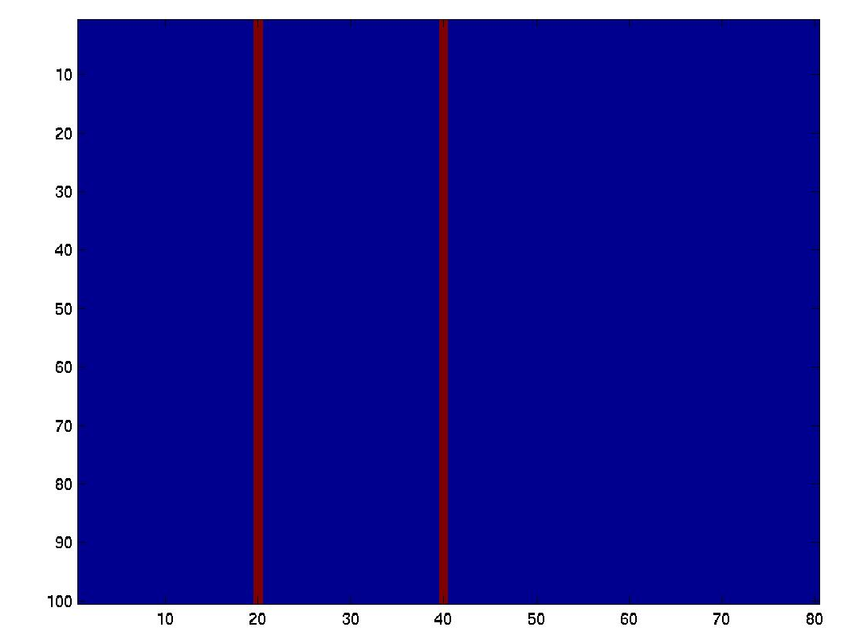
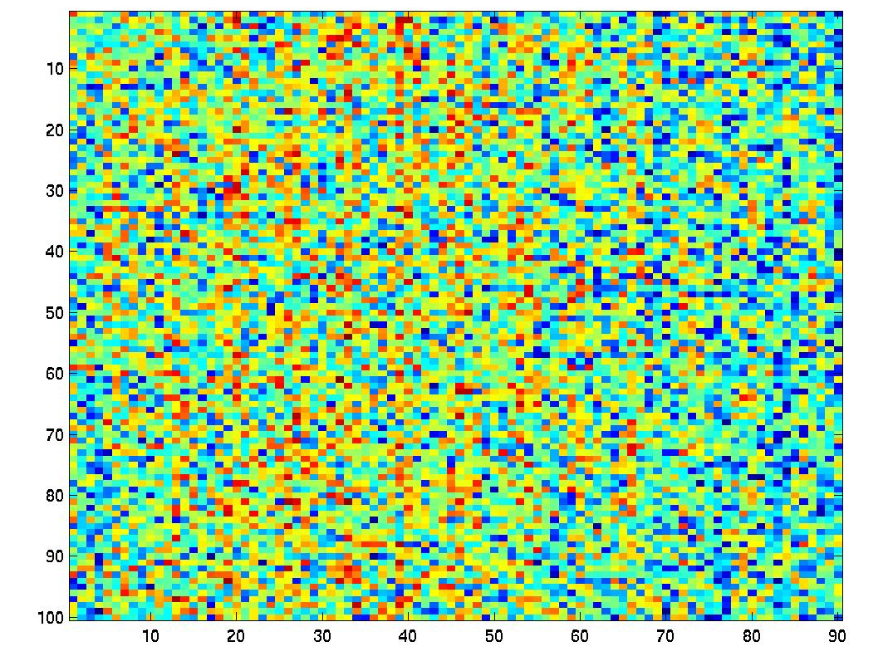

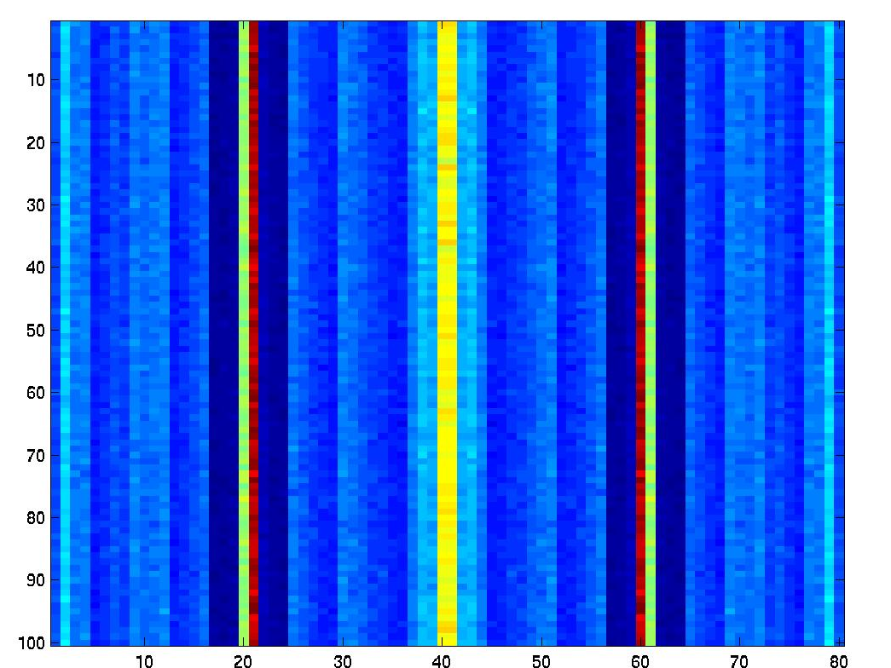
Application Output
Input targets
Synthetic sensor response
Beamformed output
Summed output
Notes:
pBeamformer output at different stages in the computation.

Slide 42
Setup Code
Implicitly Parallel Code
Required Change
% pMATLAB SETUP ---------------------
tic; % Start timer.
PARALLEL = 1; % Turn pMatlab on or off. Can be 1 or 0.
pMatlab_Init; % Initialize pMatlab.
Ncpus = pMATLAB.comm_size; % Get number of cpus.
my_rank = pMATLAB.my_rank; % Get my rank.
Xmap = 1; % Initialize maps to 1 (i.e. no map).
if (PARALLEL)
% Create map that breaks up array along 2nd dimension.
Xmap = map([1 Ncpus 1], {}, 0:Ncpus-1 );
end
Comments
PARALLEL=1 flag allows library to be turned on an off
Setting Xmap=1 will create regular Matlab arrays
Xmap = map([1 Ncpus 1],{},0:Ncpus-1);
Map Object
Processor Grid
(chops 2nd dimension
into Ncpus pieces)
Use default
block distribution
Processor list
(begins at 0!)
Notes:
Setting up the data structures.

Slide 43
Things to try
Ncpus is the number of Matlab
sessions that were launched
>> Ncpus
Ncpus =
4
>> my_rank
my_rank =
0
>> Xmap
Map object
Dimension: 3
Grid:
0 1 2 3
Overlap:
Distribution:
Dim1:b
Dim2:b
Dim3:b
Interactive Matlab session is
always rank = 0
Map object contains number
of dimensions, grid of processors,
and distribution in each dimension,
b=block, c=cyclic, bc=block-cyclic
Notes:
Looking at the number of processors and the maps.

Slide 44
Allocate Distributed Arrays (DMATs)
Implicitly Parallel Code
Required Change
% ALLOCATE PARALLEL DATA STRUCTURES ---------------------
% Set array dimensions (always test on small problems first).
Nsensors = 90; Nfreqs = 50; Nsnapshots = 100; Nbeams = 80;
% Initial array of sources.
X0 = zeros(Nsnapshots,Nfreqs,Nbeams,Xmap);
% Synthetic sensor input data.
X1 = complex(zeros(Nsnapshots,Nfreqs,Nsensors,Xmap));
% Beamformed output data.
X2 = zeros(Nsnapshots,Nfreqs,Nbeams,Xmap);
% Intermediate summed image.
X3 = zeros(Nsnapshots,Ncpus,Nbeams,Xmap);
Comments
Write parameterized code, and test on small problems first.
Can reuse Xmap on all arrays because
  All arrays are 3D
  Want to break along 2nd dimension
zeros() and complex() are overloaded and return DMATs
  Matlab knows to call a pMatlab function
  Most functions aren’t overloaded
Notes:
Creating the distributed arrays.

Slide 45
Things to try
>> whos X0 X1 X2 X3
Name Size Bytes Class
X0 100x200x80 3206136 dmat object
X1 100x200x90 7206136 dmat object
X2 100x200x80 3206136 dmat object
X3 100x4x80 69744 dmat object
>> x0 = local(X0);
>> whos x0
Name Size Bytes Class
x0 100x50x80 3200000 double array
>> x1 = local(X1);
>> whos x1
Name Size Bytes Class
x1 100x50x90 7200000 double array (complex)
-Size of X3 is Ncpus in 2nd dimension
-Size of local part of X0 is 2nd dimension divided by Ncpus
-Local part of X1 is a regular complex matrix
Notes:
Looking at the dmats.

Slide 46
Create Steering Vectors
Implicitly Parallel Code
Required Change
% CREATE STEERING VECTORS ---------------------
% Pick an arbitrary set of frequencies.
freq0 = 10; frequencies = freq0 + (0:Nfreqs-1);
% Get frequencies local to this processor.
[myI_snapshot myI_freq myI_sensor] = global_ind(X1);
myFreqs = frequencies(myI_freq);
% Create local steering vectors by passing local frequencies.
myV = squeeze(pBeamformer_vectors(Nsensors,Nbeams,myFreqs));
Comments
global_ind() returns those indices that are local to the processor
  Use these indices to select which values to use from a larger table
User function written to return array based on the size of the input
  Result is consistent with local part of DMATs
  Be careful of squeeze function, can eliminate needed dimensions
Notes:
Using global_ind() function to get indices.

Slide 47
Things to try
>> whos myI_snapshot myI_freq myI_sensor
Name Size Bytes Class
myI_freq 1x50 400 double array
myI_sensor 1x90 720 double array
myI_snapshot 1x100 800 double array
>> myI_freq
myI_freq =
1 2 3 4 5 6 7 8 9 10 11 12 13 14 15 16 17 18 19 20
21 22 23 24 25 26 27 28 29 30 31 32 33 34 35 36 37 38 39 40
41 42 43 44 45 46 47 48 49 50
>> whos myV
Name Size Bytes Class
myV 90x80x50 5760000 double array (complex)
-Size of global indices are the same dimensions of local part
-global indices shows those indices of DMAT that are local
-User function returns arrays consistent with local part of DMAT
Notes:
Size of distributed data structures.

Slide 48
Create Targets
Implicitly Parallel Code
Required Change
% STEP 0: Insert targets ---------------------
% Get local data.
X0_local = local(X0);
% Insert two targets at different angles.
X0_local(:,:,round(0.25*Nbeams)) = 1;
X0_local(:,:,round(0.5*Nbeams)) = 1;
Comments
local() returns piece of DMAT store locally
Always try to work on local part of data
  Regular Matlab arrays, all Matlab functions work
  Performance guaranteed to be same at Matlab
  Impossible to do accidental communication
If can’t work locally, can do some things directly on DMAT, e.g.
  X0(i,j,k) = 1;
Notes:
Using the local() function.

Slide 49
Create Sensor Input
Implicitly Parallel Code
Required Change
% STEP 1: CREATE SYNTHETIC DATA. ---------------------
% Get the local arrays.
X1_local = local(X1);
% Loop over snapshots, then the local frequencies
for i_snapshot=1:Nsnapshots
for i_freq=1:length(myI_freq)
% Convert from beams to sensors.
X1_local(i_snapshot,i_freq,:) = ...
squeeze(myV(:,:,i_freq)) * squeeze(X0_local(i_snapshot,i_freq,:));
end
end
% Put local array back.
X1 = put_local(X1,X1_local);
% Add some noise,
X1 = X1 + complex(rand(Nsnapshots,Nfreqs,Nsensors,Xmap), ...
rand(Nsnapshots,Nfreqs,Nsensors,Xmap) );
Comments
Looping only done over length of global indices that are local
put_local() replaces local part of DMAT with argument (no checking!)
plus(), complex(), and rand() all overloaded to work with DMATs
  rand may produce values in different order
Notes:
How to deal with for loops.

Slide 50
Beamform and Save Data
Implicitly Parallel Code
Required Change
% STEP 2: BEAMFORM AND SAVE DATA. ---------------------
X1_local = local(X1); % Get the local arrays.
X2_local = local(X2);
% Loop over snapshots, loop over the local fequencies.
for i_snapshot=1:Nsnapshots
for i_freq=1:length(myI_freq)
% Convert from sensors to beams.
X2_local(i_snapshot,i_freq,:) = abs(squeeze(myV(:,:,i_freq))' * …
squeeze(X1_local(i_snapshot,i_freq,:))).^2;
end
end
processing_time = toc
% Save data (1 file per freq).
for i_freq=1:length(myI_freq)
X_i_freq = squeeze(X2_local(:,i_freq,:)); % Get the beamformed data.
i_global_freq = myI_freq(i_freq); % Get the global index of this frequency.
filename = ['dat/pBeamformer_freq.' num2str(i_global_freq) '.mat'];
save(filename,'X_i_freq'); % Save to a file.
end
Comments
Similar to previous step
Save files based on physical dimensions (not my_rank)
  Independent of how many processors are used
Notes:
Saving data in a scalable way.

Slide 51
Sum Frequencies
Implicitly Parallel Code
Required Change
% STEP 3: SUM ACROSS FREQUNCY. ---------------------
% Sum local part across fequency.
X2_local_sum = sum(X2_local,2);
% Put into global array.
X3 = put_local(X3,X2_local_sum);
% Aggregate X3 back to the leader for display.
x3 = agg(X3);
Comments
Sum not supported, so need to do in steps.
  Sum local part
  Put into a global array
agg() collects a DMAT onto leader (rank=0)
  Returns regular Matlab array
  Remember only exists on leader
Notes:
Aggregating results.

Slide 52
Finalize and Display Results
Implicitly Parallel Code
Required Change
% STEP 4: Finalize and display. ---------------------
disp('SUCCESS'); % Print success.
% Exit on all but the leader.
pMatlab_Finalize;
% Complete local sum.
x3_sum = squeeze(sum(x3,2));
% Display results
imagesc( abs(squeeze(X0_local(:,1,:))) );
pause(1.0);
imagesc( abs(squeeze(X1_local(:,1,:))) );
pause(1.0);
imagesc( abs(squeeze(X2_local(:,1,:))) );
pause(1.0);
imagesc(x3_sum)
Comments
pMatlab_Finalize exits everyone but the leader
Can now do operations that make sense only on leader
  Final sum of aggregated array
  Display output
Notes:
Exiting on the other processors and displaying graphics.

Slide 53
Application Debugging
Simple four step process for debugging a parallel program
Step 1: Add distributed matrices without maps, verify functional correctness
    PARALLEL=0; eval( MPI_Run(‘pZoomImage’,1,{}) );
Step 2: Add maps, run on 1 CPU, verify pMatlab correctness, compare performance with Step 1
    PARALLEL=1; eval( MPI_Run(‘pZoomImage’,1,{}) );
Step 3: Run with more processes (ranks), verify parallel correctness
    PARALLEL=1; eval( MPI_Run(‘pZoomImage’,2,{}) );
Step 4: Run with more CPUs, compare performance with Step 2
    PARALLEL=1; eval( MPI_Run(‘pZoomImage’,4,cpus) );
Step 1
Step 2
Step 3
Step 4
Serial
Matlab
Serial
pMatlab
Mapped
pMatlab
Parallel
pMatlab
Optimized
pMatlab
Add DMATs
Add Maps
Add Ranks
Add CPUs
Functional correctness
pMatlab correctness
Parallel correctness
Performance
Always debug at lowest numbered step possible
Notes:
Methodology for debugging applications.

Slide 54
Different Access Styles
Implicit global access
    Y(:,:) = X;
    Y(i,j) = X(k,l);
Most elegant; performance issues; accidental communication
Explicit local access
    x = local(X);
    x(i,j) = 1;
    X = put_local(X,x);
A little clumsy; guaranteed performance; controlled communication
Implicit local access
    [I J] = global_ind(X);
    for i=1:length(I)
    for j=1:length(I)
    X_ij = X(I(i),J(I));
    end
    end
Notes:
Different ways to access data on distributed arrays.

Slide 55
Summary
Tutorial has introduced
  Using MatlabMPI
  Using pMatlab Distributed MATtrices (DMAT)
  Four step process for writing a parallel Matlab program
Provided hands on experience with
  Running MatlabMPI and pMatlab
  Using distributed matrices
  Using four step process
  Measuring and evaluating performance
Step 1
Step 2
Step 3
Step 4
Serial
Matlab
Serial
pMatlab
Mapped
pMatlab
Parallel
pMatlab
Optimized
pMatlab
Add DMATs
Add Maps
Add Ranks
Add CPUs
Functional correctness
pMatlab correctness
Parallel correctness
Performance
Get It Right
Make It Fast
Notes:
Summary.

Slide 56
Advanced Examples
Notes:
The following are more advanced examples.

Slide 57
Clutter Simulation Example
(see pMatlab/examples/ClutterSim.m)
Fixed Problem Size (Linux Cluster)
PARALLEL = 1;
mapX = 1; mapY = 1;
% Initialize
% Map X to first half and Y to second half.
if (PARALLEL)
pMatlab_Init; Ncpus=comm_vars.comm_size;
mapX=map([1 Ncpus/2],{},[1:Ncpus/2])
mapY=map([Ncpus/2 1],{},[Ncpus/2+1:Ncpus]);
end
% Create arrays.
X = complex(rand(N,M,mapX),rand(N,M,mapX));
Y = complex(zeros(N,M,mapY);
% Initialize coefficents
coefs = ...
weights = ...
% Parallel filter + corner turn.
Y(:,:) = conv2(coefs,X);
% Parallel matrix multiply.
Y(:,:) = weights*Y;
% Finalize pMATLAB and exit.
if (PARALLEL) pMatlab_Finalize;
Parallel performance
Speedup
Number of Processors
Achieved “classic” super-linear speedup on fixed problem
Serial and Parallel code “identical”
Notes:
Simple clutter simulation program: performance and code

Slide 58
Eight Stage Simulator Pipeline
(see pMatlab/examples/GeneratorProcessor.m)
Parallel Data Generator
Parallel Signal Processor
Channel response
Detect targets
Initialize
Inject targets
Convolve with pulse
Pulse compress
Beamform
Matlab Map Code
map3 = map([2 1], {}, 0:1);
map2 = map([1 2], {}, 2:3);
map1 = map([2 1], {}, 4:5);
map0 = map([1 2], {}, 6:7);
Example Processor Distribution
- 0, 1
- 2, 3
- 4, 5
- 6, 7
- all
Goal: create simulated data and use to test signal processing
parallelize all stages; requires 3 “corner turns”
pMatlab allows serial and parallel code to be nearly identical
Easy to change parallel mapping; set map=1 to get serial code
Notes:
Multi stage simulator connected to multi stage signal processor

Slide 59
pMatlab Code
(see pMatlab/examples/GeneratorProcessor.m)
pMATLAB_Init; SetParameters; SetMaps; %Initialize.
Xrand = 0.01*squeeze(complex(rand(Ns,Nb, map0),rand(Ns,Nb, map0)));
X0 = squeeze(complex(zeros(Ns,Nb, map0)));
X1 = squeeze(complex(zeros(Ns,Nb, map1)));
X2 = squeeze(complex(zeros(Ns,Nc, map2)));
X3 = squeeze(complex(zeros(Ns,Nc, map3)));
X4 = squeeze(complex(zeros(Ns,Nb, map3)));
...
for i_time=1:NUM_TIME % Loop over time steps.
X0(:,:) = Xrand; % Initialize data
for i_target=1:NUM_TARGETS
[i_s i_c] = targets(i_time,i_target,:);
X0(i_s,i_c) = 1; % Insert targets.
end
X1(:,:) = conv2(X0,pulse_shape,'same'); % Convolve and corner turn.
X2(:,:) = X1*steering_vectors; % Channelize and corner turn.
X3(:,:) = conv2(X2,kernel,'same'); % Pulse compress and corner turn.
X4(:,:) = X3*steering_vectors’; % Beamform.
[i_range,i_beam] = find(abs(X4) > DET); % Detect targets
end
pMATLAB_Finalize; % Finalize.
Implicitly Parallel Code
Required Change
Notes:
pMatlab code for multi-stage simulator/signal processor

Slide 60
Parallel Image Processing
(see pMatlab/examples/pBlurimage.m)
mapX = map([Ncpus/2 2],{},[0:Ncpus-1],[N_k M_k]); % Create map with overlap
X = zeros(N,M,mapX); % Create starting images.
[myI myJ] = global_ind(X); % Get local indices.
% Assign values to image.
X = put_local(X, …
(myI.' * ones(1,length(myJ))) + (ones(1,length(myI)).' * myJ) );
X_local = local(X); % Get local data.
% Perform convolution.
X_local(1:end-N_k+1,1:end-M_k+1) = conv2(X_local,kernel,'valid');
X = put_local(X,X_local); % Put local back in global.
X = synch(X); % Copy overlap.
Implicitly Parallel Code
Required Change
Notes:
pMatlab code for a parallel image processing code.

