Slide 1


The Venture Devils course is designed to support and advance early-stage ventures via dedicated mentorship and asynchronous online coursework and modules based on proven startup methods and tactics.

Slide 2
week one

Slide 3
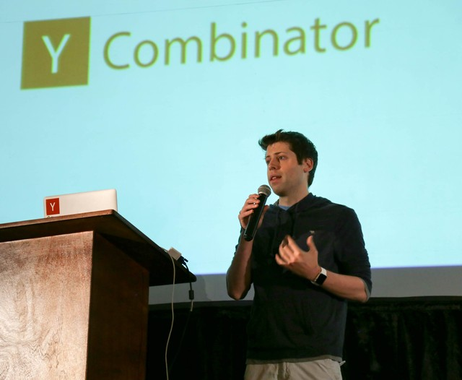
The Startup Playbook
If you’re really serious about launching a startup, read this.
Don’t skim it. Read it.
http://playbook.samaltman.com/

Slide 4
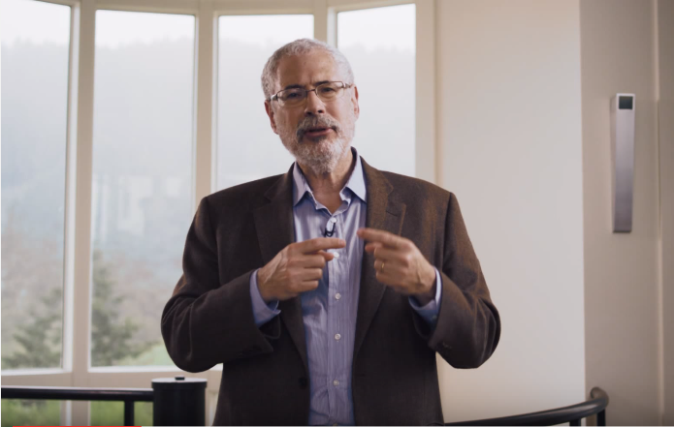
Customer Development
Let’s watch Steve Blank’s introduction to customer development.
How might your venture leverage this methodology?
https://www.youtube.com/watch?v=lLEebbiYIkI

Slide 5
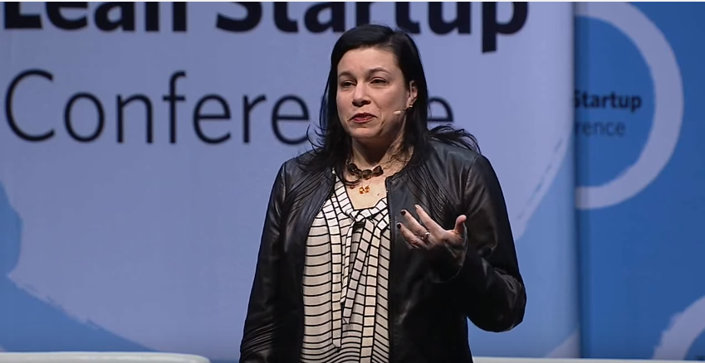
Customer First, Product Second
A case study on customer development, NOT product development.
How might your team leverage this story to be more successful?
https://www.youtube.com/watch?v=0wujokikyWo

Slide 6
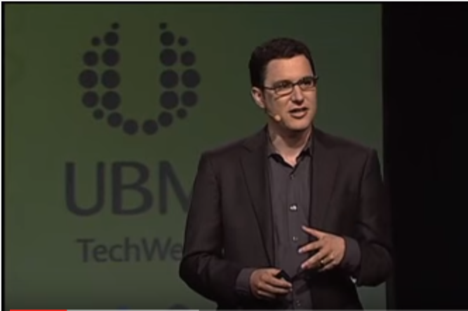
The Lean Startup
Learn about the genesis of the lean startup innovation methodology.
Stop wasting people’s time and build something people actually want and need. How will you do so?
https://www.youtube.com/watch?v=i65PaoTlVKg

Slide 7
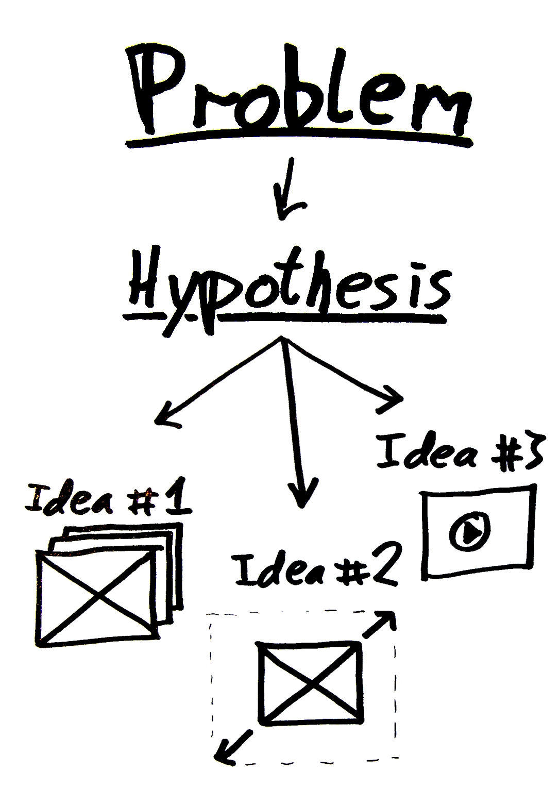
Inspiration & Creativity
Inspiration will help you find a problem.
Creativity will allow you to brainstorm potential solutions.
The scientific method will guide you toward which of these solutions will actually solve your customer’s problem.
Repeat
http://blog.ycombinator.com/the-scientific-method-for-startups/

Slide 8
find + post your own
Do you have an impactful innovation management tutorial that you’d like to post and comment on?
Go ahead and we’ll give you credit. Plus, if you think other early-stage ventures could benefit from learning about the resource as well, please email the link to fsestartup@asu.edu and we will add it to our Venture Devils module offerings.

Slide 9
week two

Slide 10
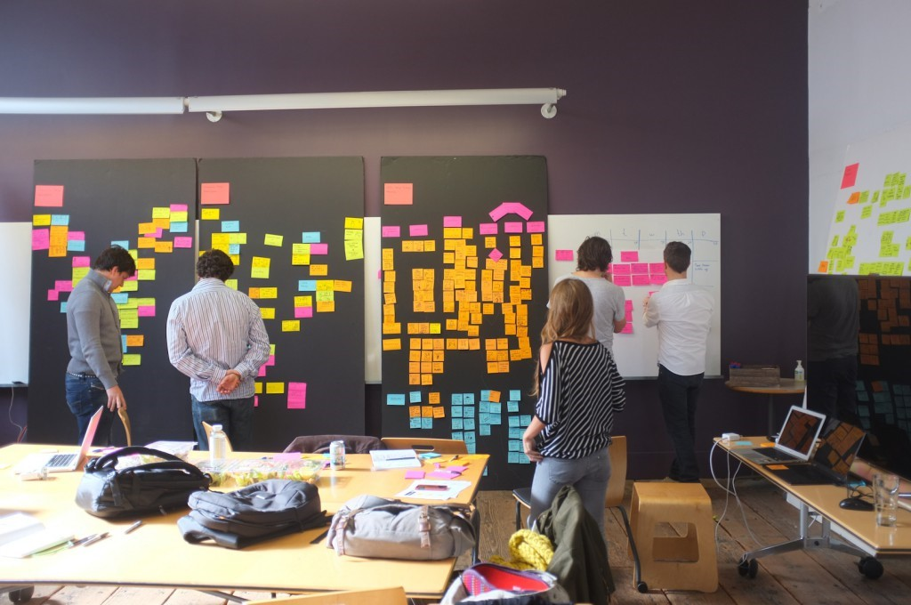
Design Thinking
What is design thinking?
How might this approach help you develop your product or service?
https://www.youtube.com/watch?v=_9TIspgTbLM

Slide 11

Experimentation
What are the key principles of good experimentation?
How might your founding team practice these methods?
http://www.huffingtonpost.com/peter-diamandis/how-x-google-experiments_b_9796408.html

Slide 12
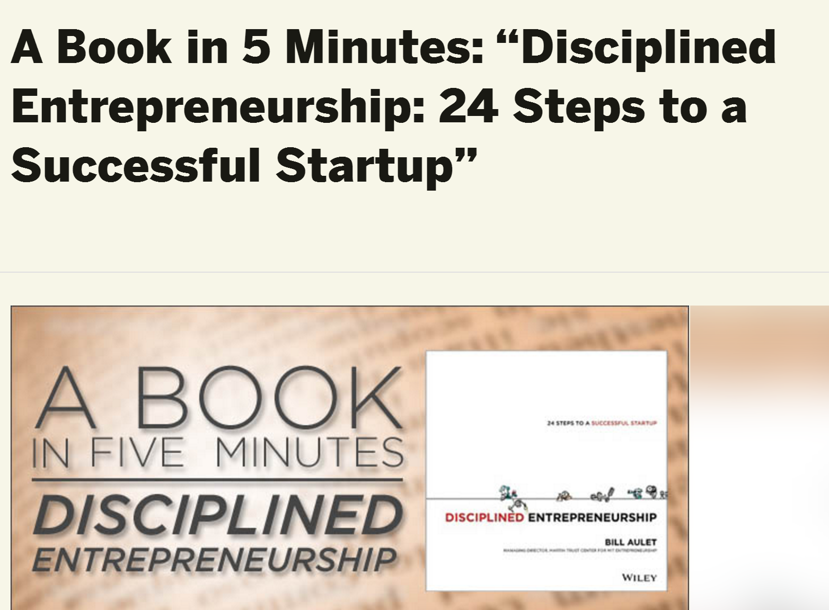
Disciplined Entrepreneurship
We encourage you to buy the hard copy of this book, but if you need to share the salient points with your co-founders and mentors in five minutes, this article will help.
http://tech.co/disciplined-entrepreneurship-bill-aulet-2013-08

Slide 13
find + post your own
Do you have an impactful innovation management tutorial that you’d like to post and comment on?
Go ahead and we’ll give you credit. Plus, if you think other early-stage ventures could benefit from learning about the resource as well, please email the link to fsestartup@asu.edu and we will add it to our Venture Devils module offerings.

Slide 14
week three

Slide 15

Customer Interviews
How might you gain relevant insights via potential customer/user interviews?
http://links.asu.edu/customerinterviews

Slide 16
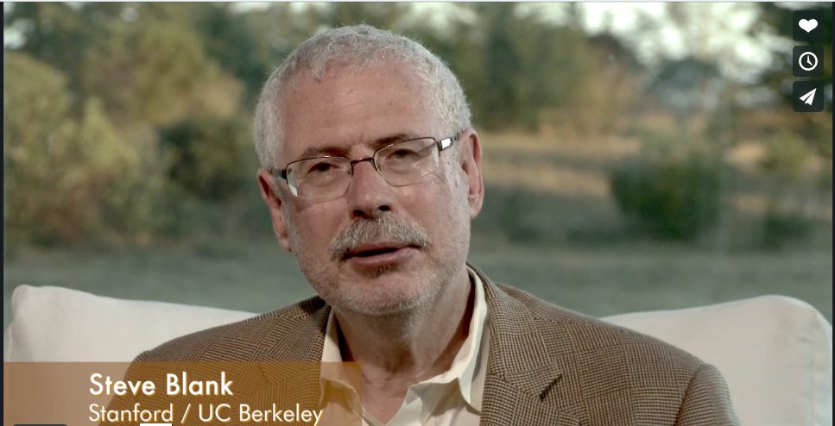
Customer Discovery
Why should you not assume that you understand the problem completely?
https://vimeo.com/groups/204136/videos/76175907

Slide 17
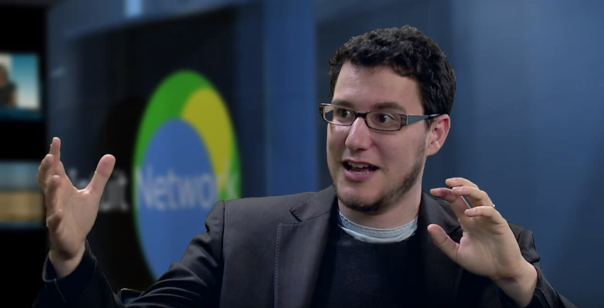
Experimentation
Let’s Learn how to “Test before you build” from Eric Ries.
Are your potential customers/users willing to:
Prepay for your solution?
Put down a deposit?
Provide a letter of intent?
Agree to a pilot?
Use the MVP?
https://www.youtube.com/watch?v=KqtVWzwIfso

Slide 18
find + post your own
Do you have an impactful innovation management tutorial that you’d like to post and comment on?
Go ahead and we’ll give you credit. Plus, if you think other early-stage ventures could benefit from learning about the resource as well, please email the link to fsestartup@asu.edu and we will add it to our Venture Devils module offerings.

Slide 19
week four

Slide 20

Customer Archetypes
Let’s watch Steve Blank’s introduction
to customer archetypes. What do your
customers REALLY need? How do you know?
Step one: you need to know who THEY are. How will you find out?
https://www.youtube.com/watch?v=StAeA16gNPY

Slide 21
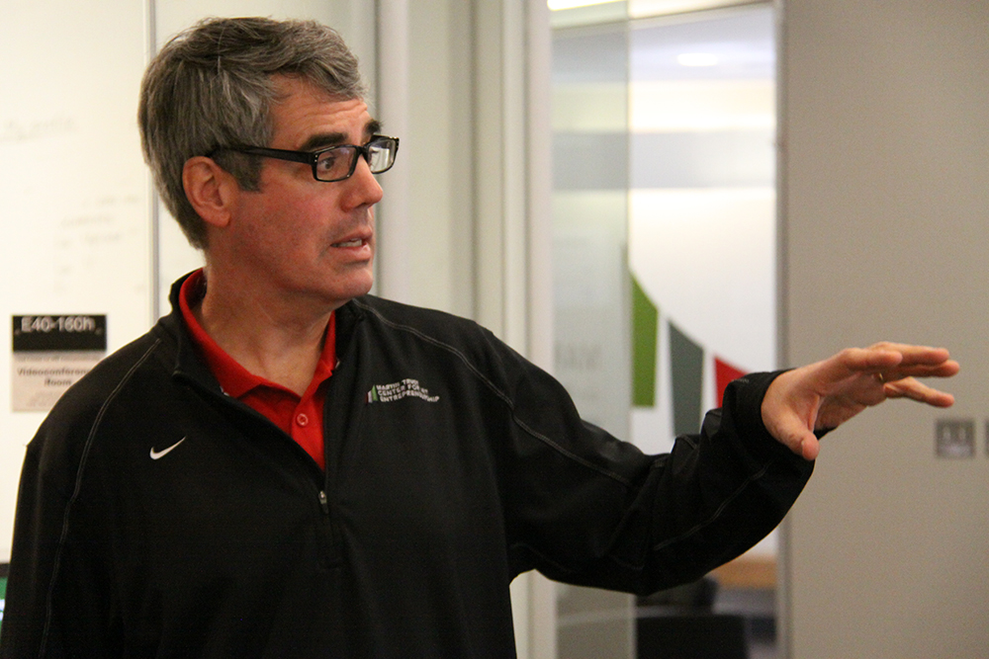
Beachhead Market
Let’s watch Bill Aulet’s introduction to beachhead market strategy.
Why might this be important to your startup?
https://www.youtube.com/watch?v=2KpOZ9N2QOQ

Slide 22

Customer Development Interviews
What are a few best practices for conducting customer/user interviews?
Why do these tactics matter?
http://links.asu.edu/customerinterviews2

Slide 23
find + post your own
Do you have an impactful innovation management tutorial that you’d like to post and comment on?
Go ahead and we’ll give you credit. Plus, if you think other early-stage ventures could benefit from learning about the resource as well, please email the link to fsestartup@asu.edu and we will add it to our Venture Devils module offerings.

Slide 24
week five

Slide 25
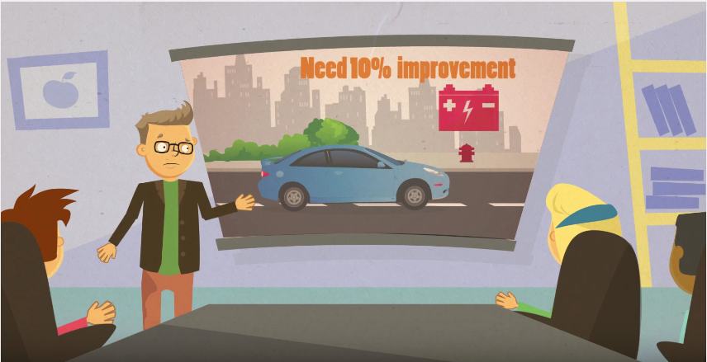
Entrepreneurial vs Traditional Engineering
Do you understand traditional vs. entrepreneurial engineering?
As an innovator, regardless of your major, how might this new approach be leveraged?
https://www.youtube.com/watch?v=ufdgKZ_3Zco

Slide 26
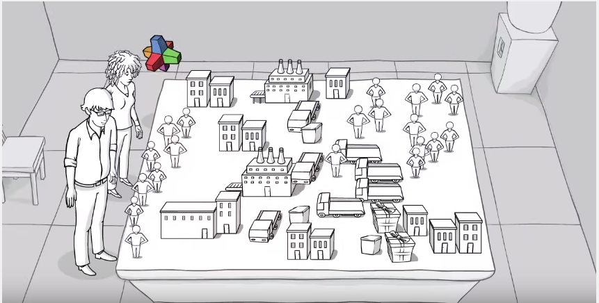
From Business Idea to Business Model
How might a value proposition canvas help you manage the chaos of understanding the interplay between your customer segment(s) (and their bugs/pains/wants) and your hypothesized value propositions (solutions)?
https://www.youtube.com/watch?v=wwShFsSFb-Y

Slide 27
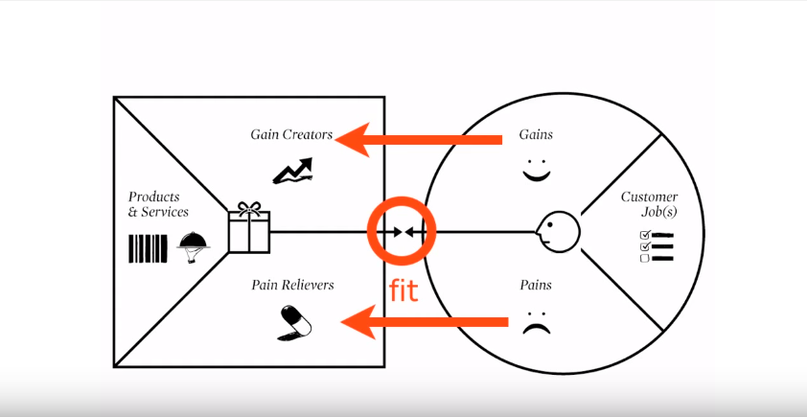
Value Proposition Canvas
How might your team leverage a value proposition canvas?
Give it a try and share it with your networks for feedback.
https://www.youtube.com/watch?v=aN36EcTE54Q

Slide 28
find + post your own
Do you have an impactful innovation management tutorial that you’d like to post and comment on?
Go ahead and we’ll give you credit. Plus, if you think other early-stage ventures could benefit from learning about the resource as well, please email the link to fsestartup@asu.edu and we will add it to our Venture Devils module offerings.

Slide 29
week six

Slide 30
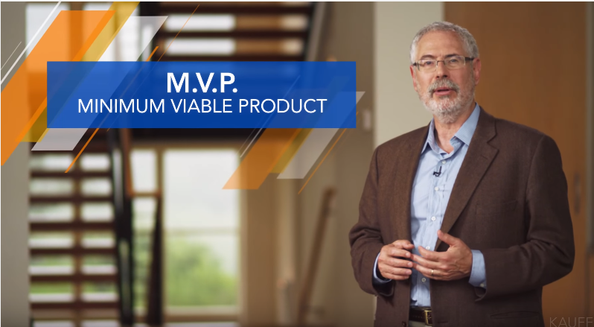
MVPs
Let’s watch another valuable overview of Minimum Viable Products (MVPs) as a shortcut toward learning.
Remember: Gaining INSIGHT is the primary objective of an innovator.
https://www.youtube.com/watch?v=xxjbxk8dUqI

Slide 31
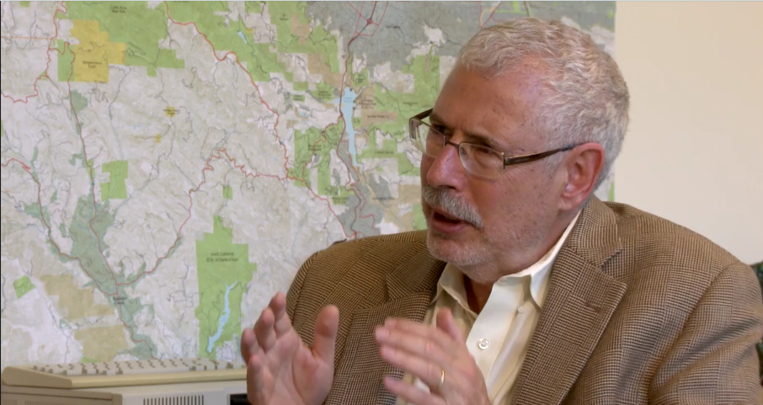
All About Insights
Getting the MVP right: An example.
Have you made similar mistakes?
https://vimeo.com/groups/204136/videos/73713162

Slide 32
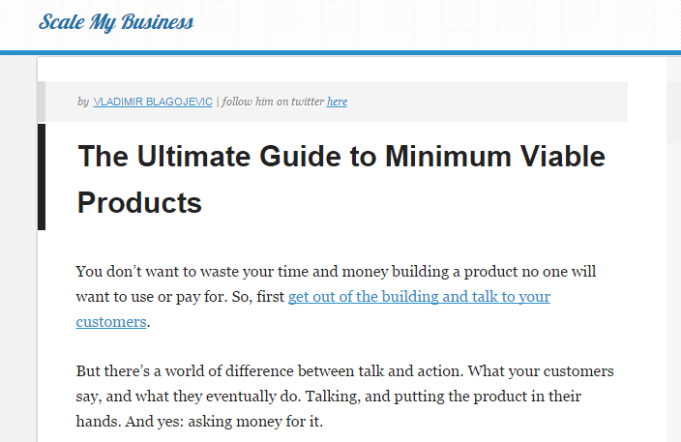
MVP examples
Read this to learn about other cool MVP examples.
Which ones might you employ?
http://scalemybusiness.com/the-ultimate-guide-to-minimum-viable-products/

Slide 33
find + post your own
Do you have an impactful innovation management tutorial that you’d like to post and comment on?
Go ahead and we’ll give you credit. Plus, if you think other early-stage ventures could benefit from learning about the resource as well, please email the link to fsestartup@asu.edu and we will add it to our Venture Devils module offerings.

Slide 34
week seven

Slide 35
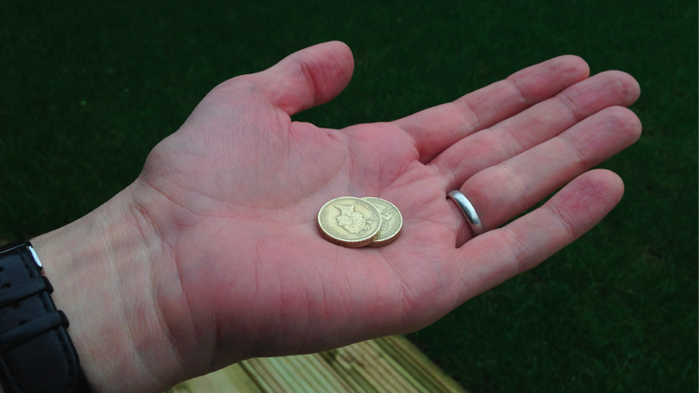
Pricing
An optimal price is one that is accepted, but not without some initial resistance.
Do you agree? Prove it.
https://medium.com/fluxx-studio-notes/the-first-rule-of-pricing-is-you-do-not-talk-about-pricing-1875caa39b89#.5hgch79fq

Slide 36
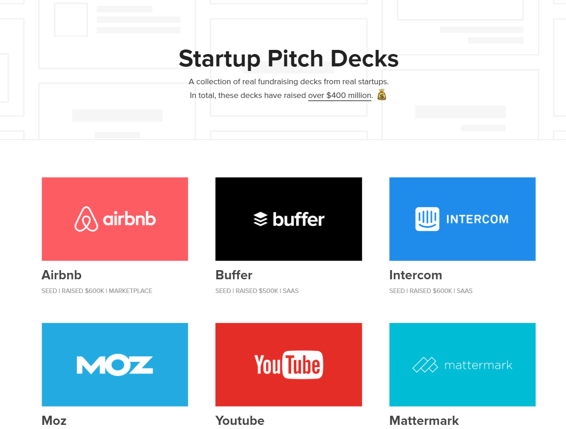
Startup Pitch Decks
Check out these well-known company’s pitch decks.
How might your founding team leverage these examples?
https://attach.io/startup-pitch-decks/

Slide 37
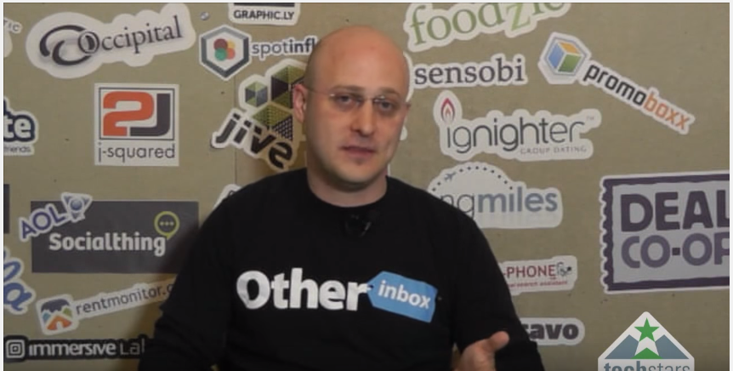
Perfecting your Evidence-Based Pitches
Do think you might be able to leverage these tactics within your entrepreneurial career?
How so?
https://www.youtube.com/watch?v=7XmXo-haKG8

Slide 38
find + post your own
Do you have an impactful innovation management tutorial that you’d like to post and comment on?
Go ahead and we’ll give you credit. Plus, if you think other early-stage ventures could benefit from learning about the resource as well, please email the link to fsestartup@asu.edu and we will add it to our Venture Devils module offerings.

Slide 39
supplemental material
All supplemental venture training material may be accessed here: http://links.asu.edu/VentureDevils-SupplementalModules

Slide 40
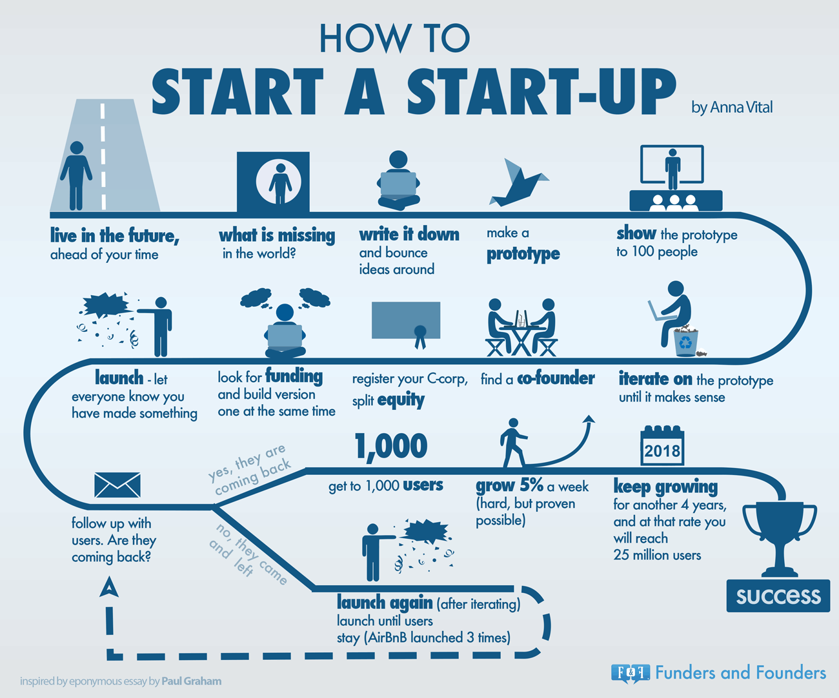
How to Start a Startup
Check this out. Do you agree with the order of these steps? Why or why not?
Which steps have you completed already?
http://fundersandfounders.com/how-to-start-a-startup/

Slide 41
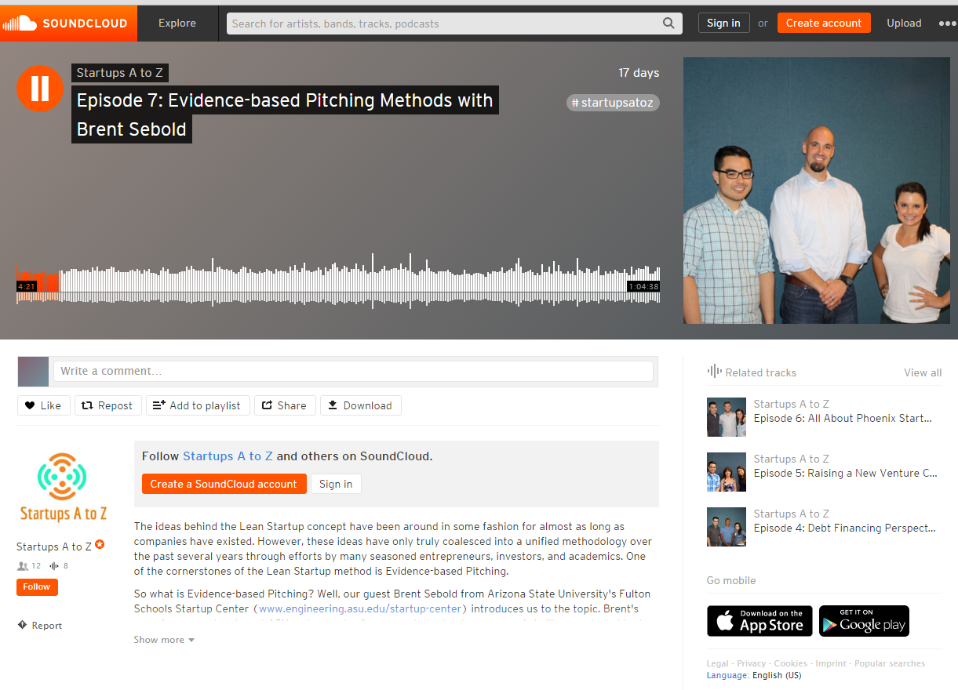
Evidence-Based Pitching
I know it’s long, but I think you’ll find it worthwhile to listen to this interview.
It provides a lot of context that will be helpful as you progress.
https://soundcloud.com/startupsatoz/episode-7-evidence-based-pitching-methods-with-brent-sebold

Slide 42

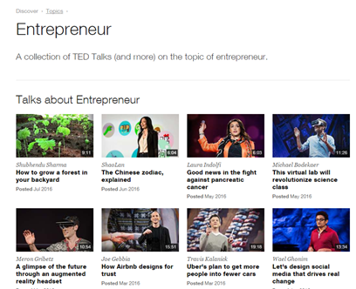
Top Entrepreneurship TED-Talks
#1 How To Start A Movement – Derek Sivers
#2 The Single Biggest Reason Why Startups Succeed – Bill Gross
#3 How To Get Your Ideas To Spread – Seth Godin
#4 How Great Leaders Inspire Action – Simon Sinek
#5 The Happy Secret To Better Work – Shawn Achor
http://magazine.startus.cc/5-ted-talks-entrepreneur-needs-watch/

