Slide 1




How do you like
working for a
start up?
It's better than working for a shut down

Slide 2

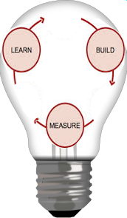



THE FUTURE IS...

Slide 3


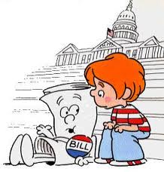



MANY EMPLOYERS
FREELANCE
WORK FOR OTHER'S PROJECTS

Slide 4
MANY EMPLOYERS
1/3 JOURNALISTS INDEPENDENT (Washington Post)
1995 – 2005: INDEPENDENT CONTRACTORS UP 27% (NYT Magazine)
30% WORKERS ARE INDEPENDENT (FREELANCERS' UNION)
2020: > 40% US WORKFORCE = FREELANCE, CONTRACT, TEMP (Intuit)

Slide 5





MANY EMPLOYERS

Slide 6
MANY EMPLOYERS
HEALTHCARE
1973 HEALTH MAINTENANCE ORGANIZATION ACT
FREELANCERS' UNION
SELF-EMPLOYMENT TAX

Slide 7
MANY EMPLOYERS
DON'T PUT ALL YOUR EGGS IN 1 COMPANY'S BASKET
EXPERTS CAN CHARGE MORE
LESS COMMITMENT

Slide 8
MANY EMPLOYERS
Employees don't quit jobs. They quit bosses.
65% EMPLOYEES DISSATISFIED (MANPOWER)
78% DISENGAGED (GALLUP)
44% WITH FLEX TIME REPORT HIGHER WELLBEING THAN THOSE WITH PERKS (GALLUP)
REASON FOR DISSATISFACTION:
- 49% SUPERVISOR
- 33% SENIOR MANAGEMENT (CUSTOM INSIGHT)

Slide 9

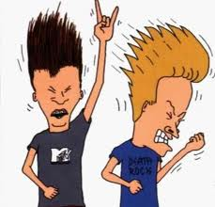
AD HOC PROJECTS
STARTUP
CREATE YOUR OWN PRODUCTS & GOALS

Slide 10
AD HOC PROJECTS
SINCE 1982: # OF US SMALL BUSINESSES ↑ 49%
SINCE 1990: BIG BUSINESS ↓ 4 MILLION JOBS
SMALL BUSINESS ↑ 8 MILLION JOBS (SBA)
3.7% US ADULTS START BUSINESS EVERY YEAR
= 6.2 MILLION BUSINESSES/YR (KAUFFMAN)

Slide 11
AD HOC PROJECTS
BANDWIDTH
REMOTE COMMUNICATION: SKYPE, SOCIAL MEDIA
REMOTE COLLABORATION: GITHUB
MATCHMAKERS: COFOUNDERSLAB, FOUNDERDATING
PREFUNDING: KICKSTARTER, GOFUNDME, INDIEGOGO

Slide 12
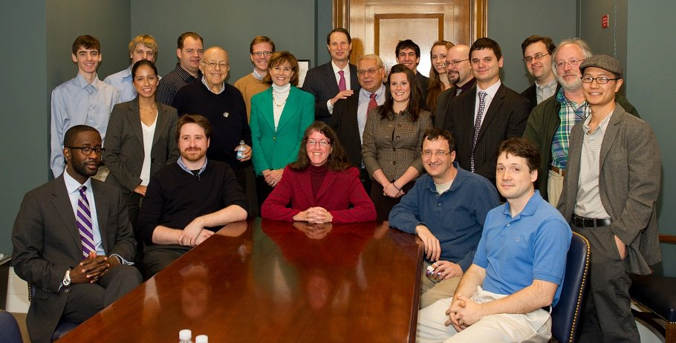
AD HOC PROJECTS
SEC: SMALL INVESTMENTS
PATENT TROLLS
SOPA: COPYRIGHT
HEALTHCARE

Slide 13
AD HOC PROJECTS
CREATE FOR A NICHE:
SEE A NEED, CREATE WHAT CUSTOMERS WANT
LAYERS OF MANAGEMENT INEFFICIENT
OWN THE PRODUCT
LOCAL COMMUNITY

Slide 14
AD HOC PROJECTS
MILLENIALS: 75%OF WORKFORCE IN 11.5 YRS
COOL: MEETUPS = COMMUNITY
FUTURE: FUN & FULL OF OPTIONS
MAKE A DIFFERENCE

Slide 15


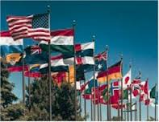

YOU WILL BE GLOBAL

Slide 16
YOU WILL BE GLOBAL
3.2% WORLD POPULATION LIVE ABROAD
EMAIL CONNECTS 85%OF WORLD
SOCIAL MEDIA CONNECTS 62%
10% IN US, 36% IN RUSSIA USE VOIP
(Ipsos/Reuters)

Slide 17
YOU WILL BE GLOBAL
OUTSOURCING BY ALL
CHAT ROOMS
FRIENDS & COWORKERS MOVE

Slide 18
YOU WILL BE GLOBAL
MUST BE A CITIZEN TO BE EMPLOYEE
EU HAS MERGED THEIR CURRENCY

Slide 19
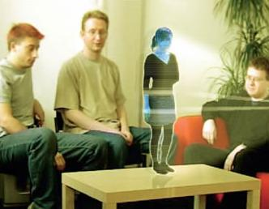
YOU WILL BE GLOBAL

Slide 20
YOU WILL BE GLOBAL
WORK IS A GOAL, NOT A PLACE
NOT DEPENDENT UPON WHAT YOU LIVE NEAR
DIVERSITY: EXPAND YOUR MARKET

Slide 21
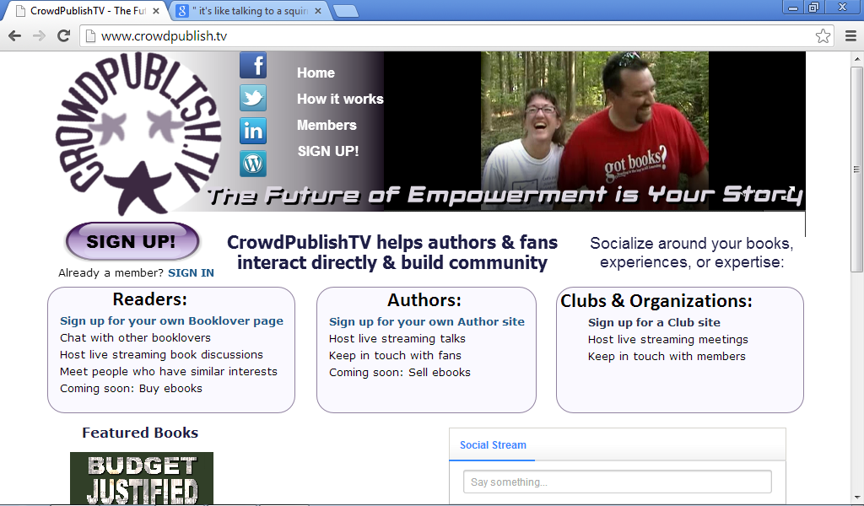

Slide 22
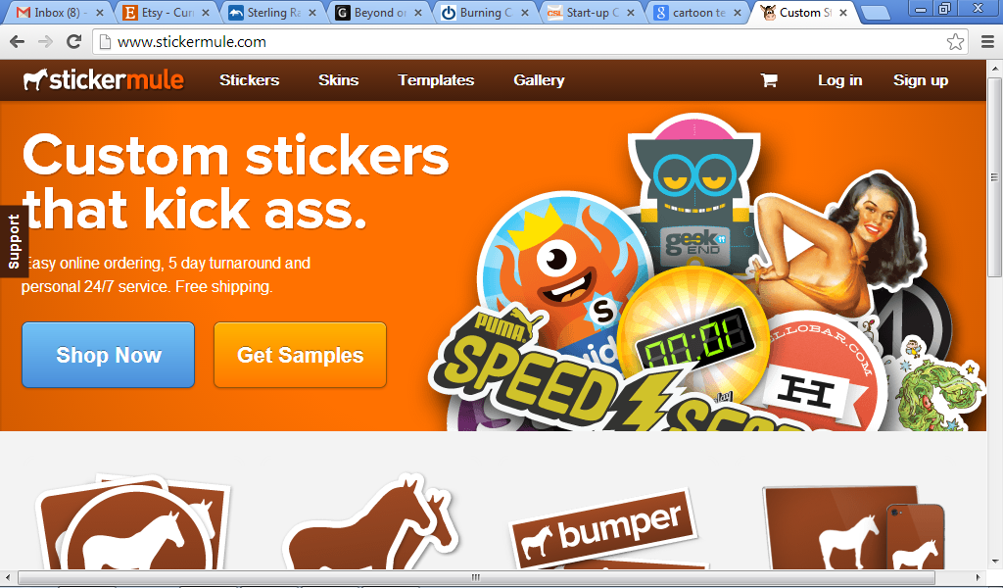
SEXISM WILL BE A THING OF THE PAST

Slide 23
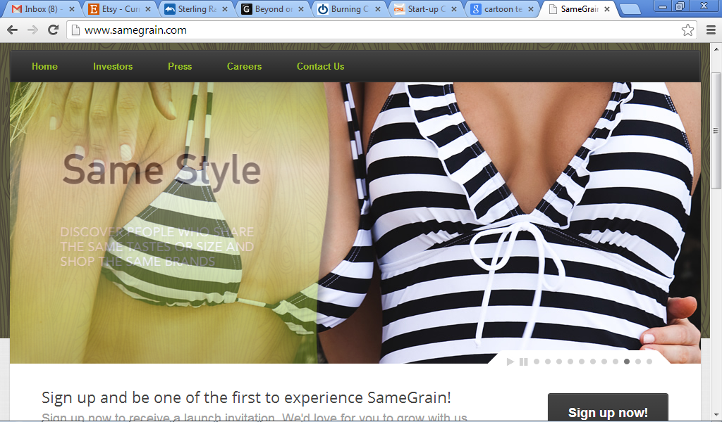
SEXISM WILL BE A THING OF THE PAST

Slide 24
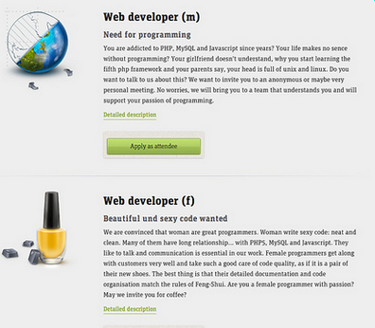

Slide 25
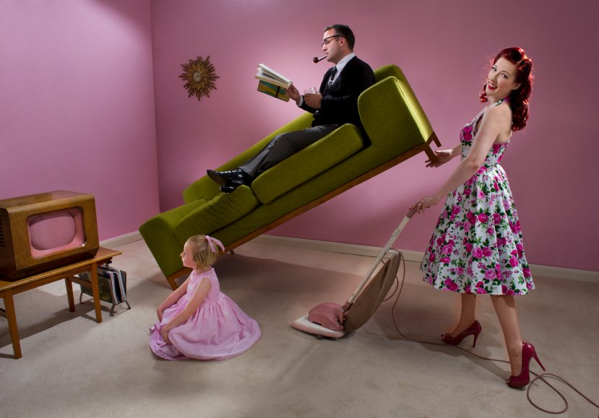
SEXISM WILL BE A THING OF THE PAST

Slide 26
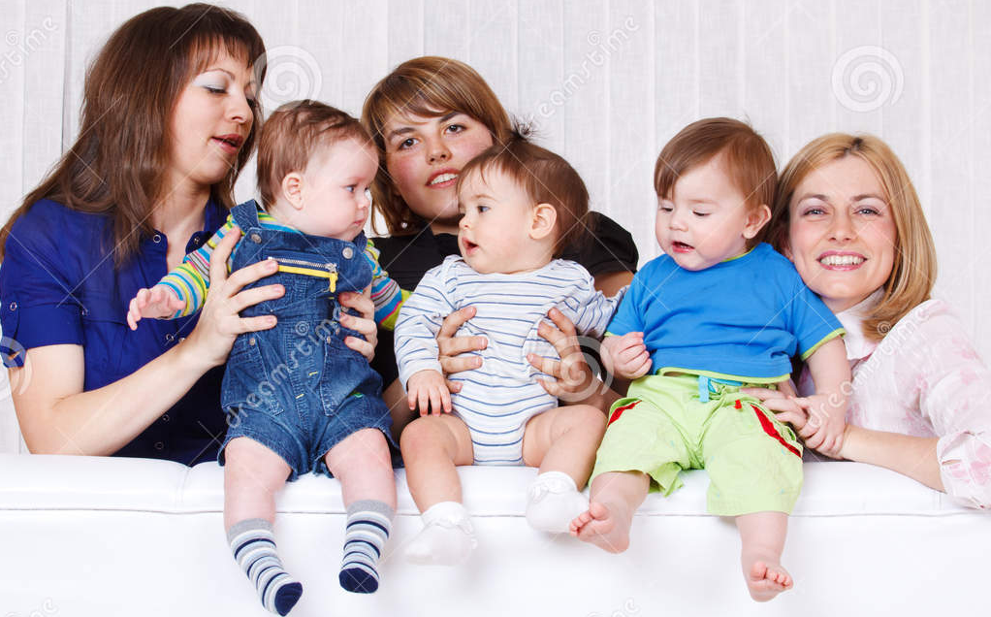
SEXISM WILL BE A THING OF THE PAST

Slide 27
MORE SOCIAL
MORE OPPORTUNITIES TO BE ENTREPRENEURIAL
GLOBAL COLLABORATION MORE FREQUENT
WOMEN WILL BE LEADERS
ACTIVISM

