Slide 1
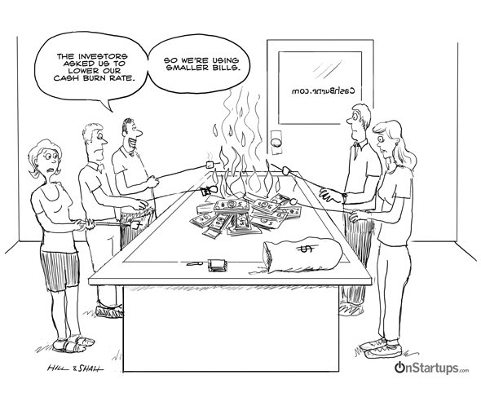


The Future of Empowerment is Your Story
Myth 1
1. Most startups make millions $$$

Slide 2
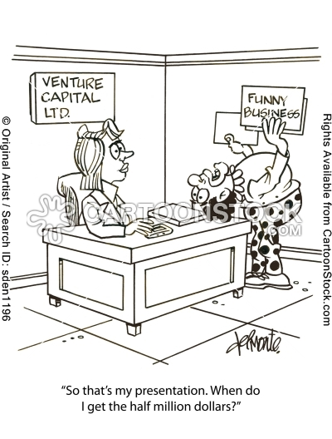
Myth 8
8. Investors know what they're doing
Venture capitalists own you
Angel
A good investor will help with expertise, connections

Slide 3
The Future of Empowerment is Your Story
1 3 Myths
1. Most startups make millions $$$
2. If you build it, they will come
3. If they come, they will use it
4. If they use it, advertisers will pay
5. We need more sites to help 20 year olds find people to hang out with
6. Running a startup is a big party
7. Startup founders are 30 year old frat boys
8. Investors know what they're doing
9. The first thing you do is pitch investors
10. Web developers are free
11. We don't need Subject Matter Experts
12. It's best to do your project in stealth
13. Sexism is a thing of the past

