Slide 1
Learn Ruby With a Context
Lisa Schaefer

Slide 2
I had a brainstorm
It became a ruby platform
Now you can use it as your live learning community

Slide 3
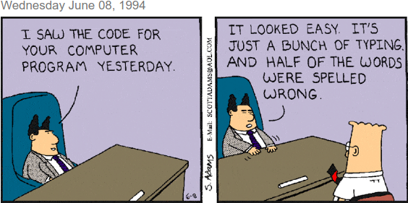
.

Slide 4
Books
Reviews
Groups
Events
Rsvps
Relation-ships
Users
Campaigns
Movies
Movie roles
Agree- ments
Purchases
Merch

Slide 5
one:
author_id: >
<%= User.first.id %>
user: two
book: two
stripe_customer_token: MyString
pricesold: 20.5
authorcut: 18.1
Error:
UsersControllerTest#test_should_get_manageaccounts:
NoMethodError: undefined method `id' for nil:NilClass
test/fixtures/purchases.yml:5:in `get_binding'

Slide 6
mysales = Purchase.where('purchases.author_id = ?', self.id).order('created_at DESC')
mysales.each do |sale|
if sale.book_id.present?
booksold = Book.find(sale.book_id)
customer = User.find(sale.user_id)
….
end
end
Error:
UsersControllerTest#test_should_get_dashboard:
ActiveRecord::RecordNotFound: Couldn't find User with 'id'=298486374
app/models/user.rb:340:in `block in calcdashboard'

Slide 7
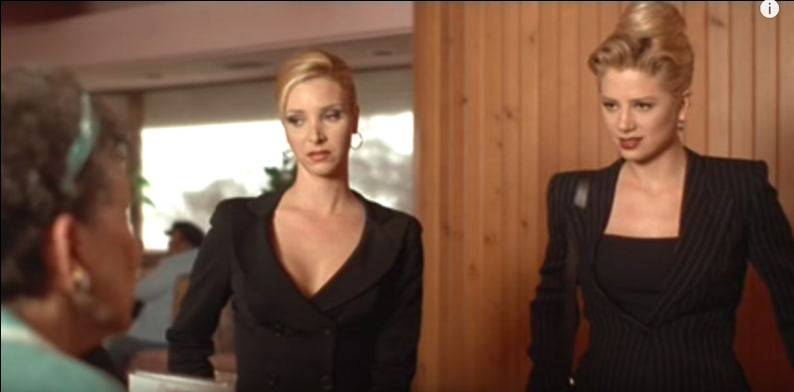
What kind of business are you in

