Slide 1
Phish Finders
Crowd-powered RE for anti-phishing training tools
Holly Rosser, Maylene Mayor, Adam Stemmler, Vinod Ahuja, Andrea Grover, Matthew Hale

Slide 2
How much do you know?
Let’s find out…
How much spam lands in our mail accounts everyday?
Answer…Close to 15 Billion!
How many of those emails are opened by people?
Answer…nearly a third!
How many organizations offer formal anti-phishing training?
Answer…only about 60%!

Slide 3
Why your answers matter…
Phishing attacks aren’t going anywhere
Most common type of data breach (GOV.UK, 2020)
Attacks are on the rise (Proofpoint, 2019a)
Wider range of industries are being targeted (Statista, 2022)
Troubling decline in awareness! (Proofpoint, 2021)

Slide 4
What are the issues?
Current process
Involves hand labeling by experts
Making it very expensive
A lot of time to generate
Content recency requirements perpetuate costs
Sustainable approaches are needed

Slide 5
What are the Issues?
Process is only partly supported by ML
Good for well-established cues
Novel cues bring us back to hand labeling by experts
Crowdsourcing can reduce cost while improving quality and recency of content in training tools

Slide 6
What we know about…
Phishing and anti-phishing campaigns
Current training efforts rely heavily on labeled phishing content
Content recency influences phishing susceptibility
Tools need to provide recent, varied phishing samples
Content generation for phishing tool support not yet automated

Slide 7
What we know about…
Crowdsourcing
Wisdom of the Crowd
Aggregate is more accurate than sum of individual solutions
Increasingly used in RE
Software requirements constantly evolving
Stakeholder/Trainee differences emulated by the crowd

Slide 8
What we’ve done so far…
Prior Related Work
Taxonomy
Top-down, literature driven approach
Does not take everyday user into account
Phish Finders
Crowd tasked with identifying phishing cues based off taxonomy
Crowd does a good job identifying known cues

Slide 9
RESEARCH QUESTION
How can we use crowd-generated data to better satisfy content labeling requirements for anti-phishing training tools?
Notes:
Novel approach for requirements gathering
Bottom-up rather than top-down
Broadens the base of participation in phishing cue identification
Gathers unique insights and perspectives most likely missed by experts

Slide 10
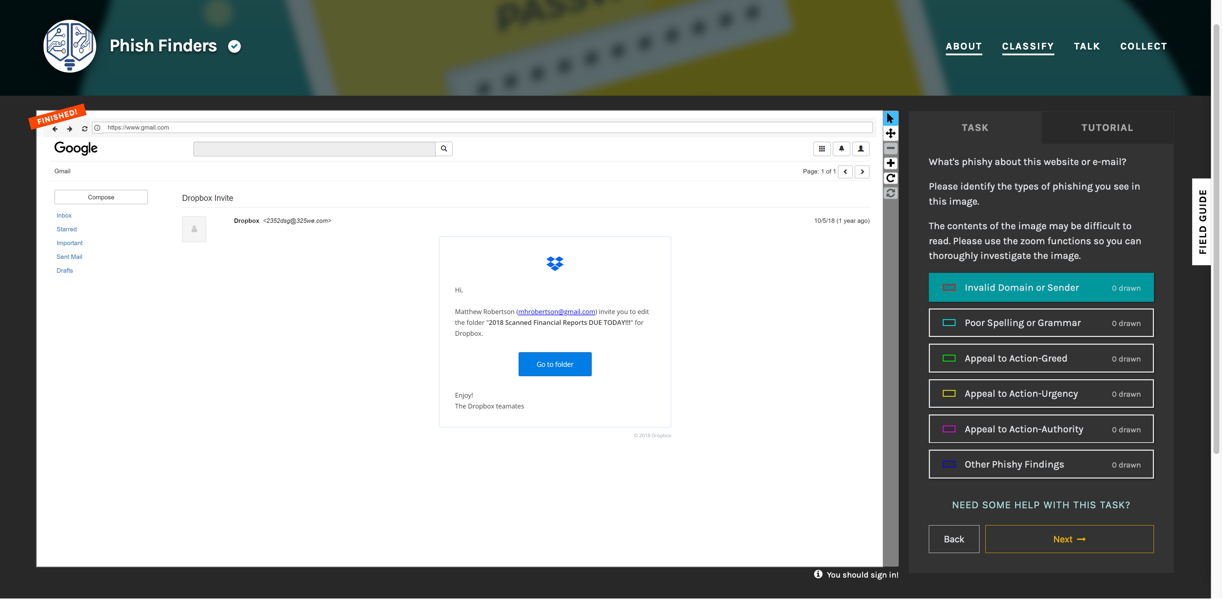

Slide 11
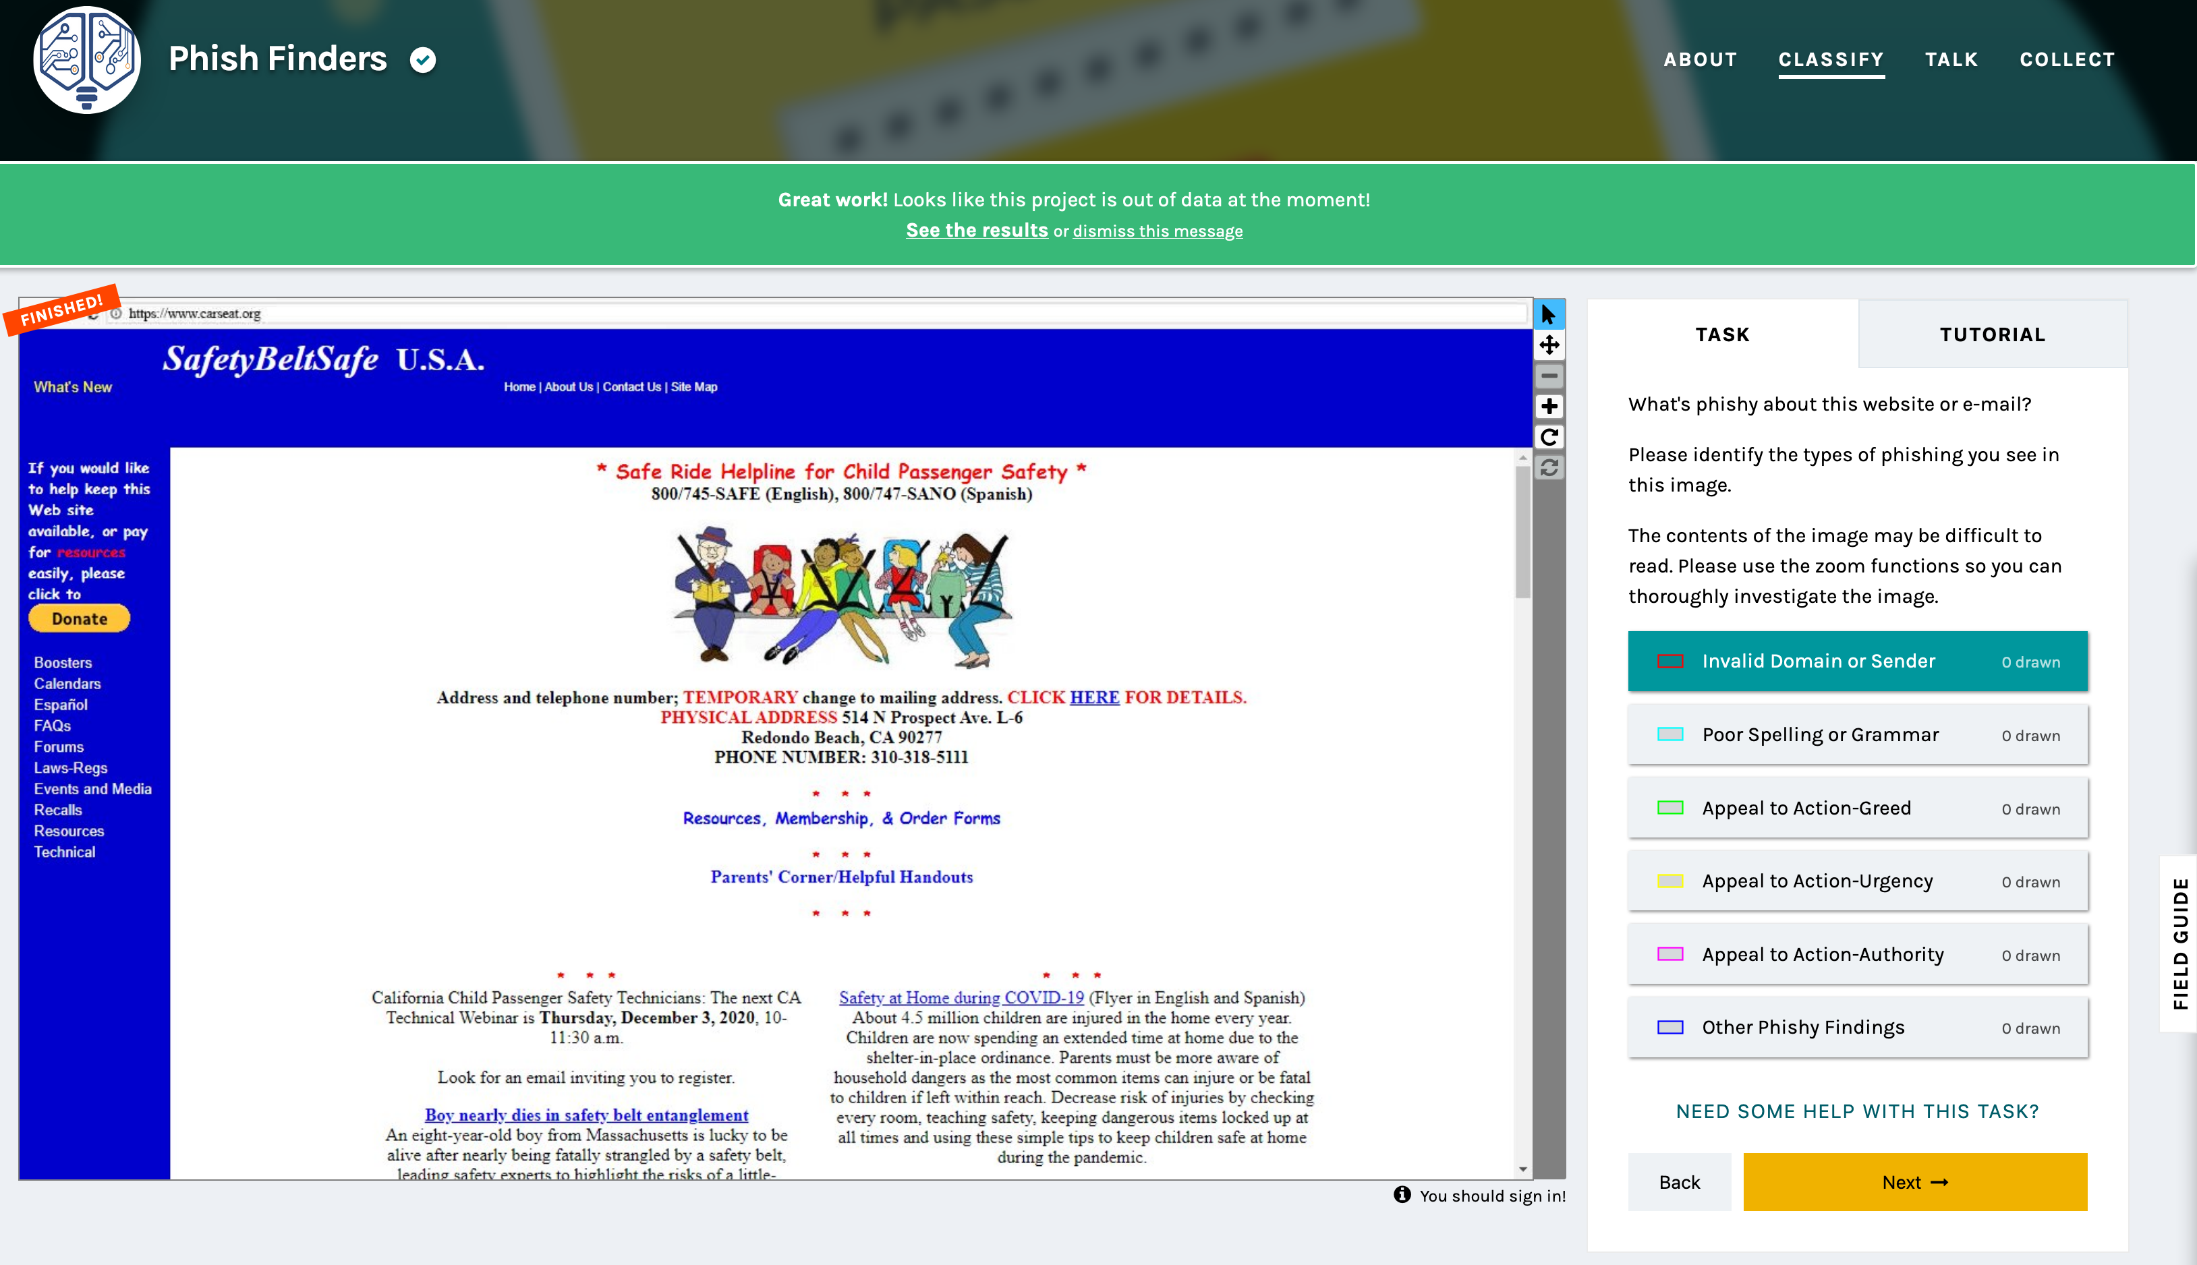
“Phone numbers aren’t usually printed like this in the US”

Slide 12
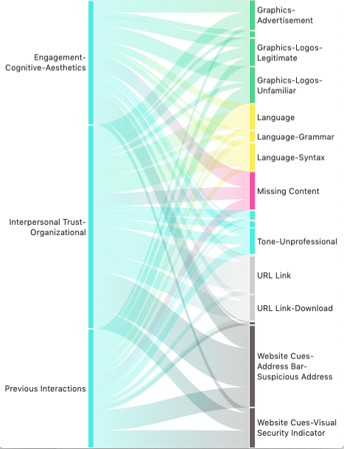
How we analyzed the data…
Coding Process
Initial coding: Deductive content analysis
Summer 2021, 3 researchers
5,735 “Other Phishy Findings” comments
Secondary coding: Inductive content analysis
Fall 2021 & Spring 2022, 3 researchers
3 codes disproportionately applied

Slide 13
What we found in…
General Findings
1,393 volunteers
28,425 individual annotations
1,922 images
5 days to fully annotate all images

Slide 14
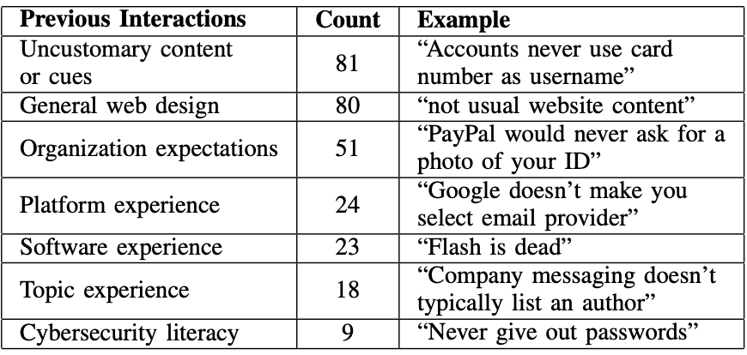
What we found in…
Previous Interactions
The perceived irregularities based on participants’ prior knowledge and experiences

Slide 15
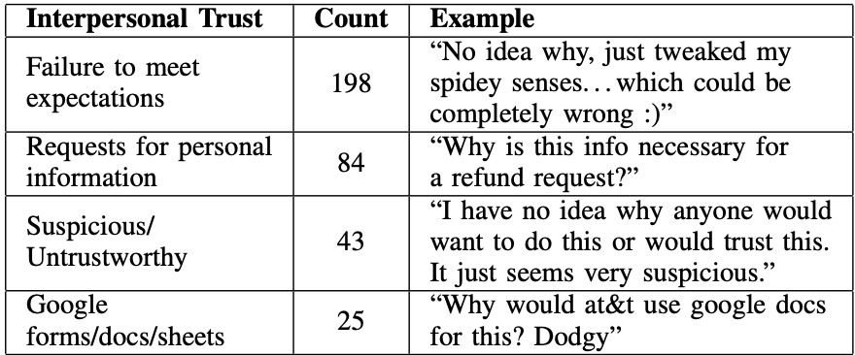
What we found in…
Interpersonal Trust
The perceived level of trust and willingness to accept risk based on that level of trust

Slide 16
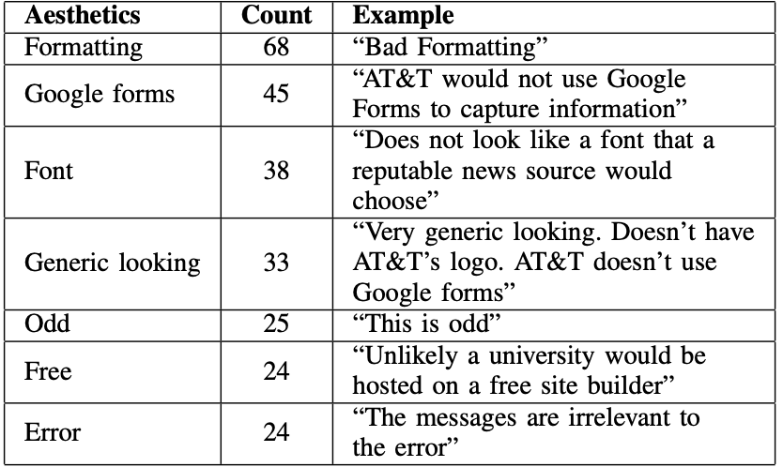
What we found in…
Aesthetics
The interface features related to content attractiveness and sensory appeal

Slide 17
Putting it all together…
New Theme: Failure to meet expectations
Specifically encompasses the mismatch between expectations and execution
”This brand would not use a Google Form”
“Google forms”
”Why would AT&T have a google forms login page?"

Slide 18
Putting it all together…
Effectiveness of Crowdsourcing
Content is as accurate as expert-identified cues
Can identify cues in greater detail than anticipated
Impact to Content Recency in Training Tools
Scalable approach to keep content fresh and relevant
Can help pinpoint signals of new phishing strategies
Cost would be significantly less than current process
Incredible speed in labeling content surpassed expectations

Slide 19
Concluding thoughts
Our intent
Dedicate research to phishing awareness training development
Give attention to experiences of participants & the phishy signals they see in online content
Test whether wisdom of the crowd can be applied
Results support additional research and exploration

Slide 20
Thank You!
We look forward to your questions, comments, and feedback!

