Slide 1
Speech Transcription with Crowdsourcing
Crowdsourcing and Human Computation
Instructor: Chris Callison-Burch
Thanks to Scott Novotney for today’s slides!

Slide 2
Mismatched Transcription
Can you transcribe Amharic?
http://audiomedia-sbs.akamaized.net/amharic_140901_358057.mp3
"amharic_140901_358057-10" : { "amharic" : [ "የቆየ ታሪክ ትምህርት ዘመናዊ ትምህርት ብሎ በኢትዮጲያ ውስጥ ከተጀመረ ጊዜ ጀምሮ በምእራባውያኑ" ] },
"amharic_140901_358057-10_part-2" : { "english" : [ "itsamastbilibo", "itsamostcabiloban", "indamutsseyinlokeawtsoa", "ifadisimmilakof", "itumahtutaloboal", "innamakinyalopa", "itsdamostabillobam", "itsahmobe", "itsdamoalbigoldbag", "ittumastabilobam" ]
Notes:
http://audiomedia-sbs.akamaized.net/amharic_140901_358057.mp3
http://isle.illinois.edu/sst/data/sbs_transcripts/mismatched/amharic/transcripts.txt

Slide 3
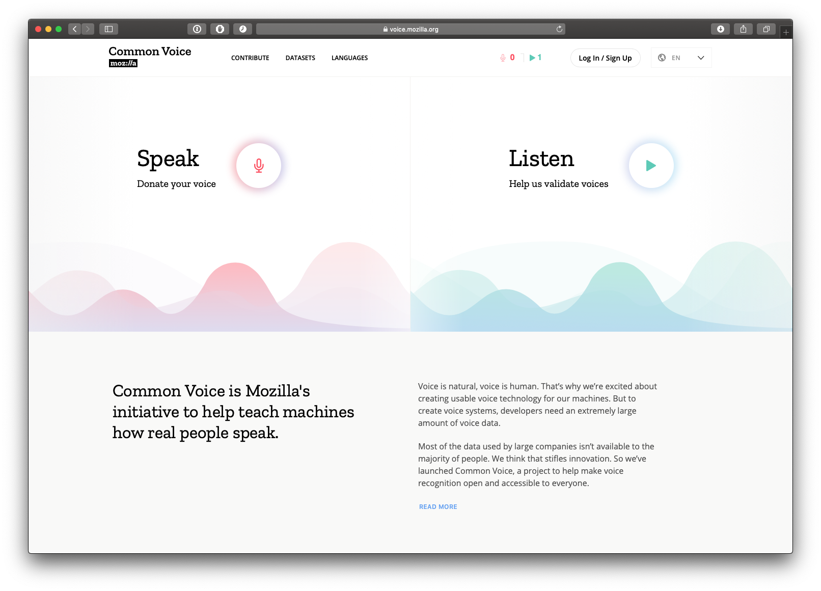

Slide 4
Whole book on the subject

Slide 5
Lecture Takeaways
Get more data, not better data
Use other Turkers to do QC for you
Non-English crowdsourcing is not easy

Slide 6
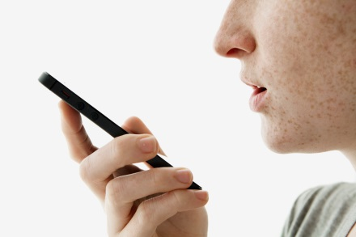
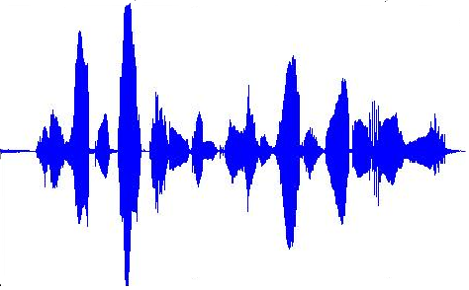
Siri in Five Minutes
Should I bring
an umbrella
Yes, it will
rain today

Slide 7
Siri in Five Minutes
Should I bring
an umbrella
Yes, it will
rain today
Automatic Speech Recognition

Slide 8
Digit Recognition

Slide 9
Digit Recognition

Slide 10
Digit Recognition
P(one| ) =

Slide 11
Digit Recognition
P(one| ) = P( |one) P(one)
P( )

Slide 12
Digit Recognition
P(one| ) = P( |one) P(one)
Acoustic Model
Language
Model

Slide 13
Digit Recognition
P(one| ) = P( |one) P(one)
P( )
P(two| ) = P( |two) P(two)
P( )

Slide 14
Digit Recognition
P(one| ) = P( |one) P(one)
P( )
P(two| ) = P( |two) P(two)
P( )
.
.
.
P(zero| ) = P( |zero) P(zero)
P( )

Slide 15
Digit Recognition
P(one| ) = P( |one) P(one)
P( )
P(two| ) = P( |two) P(two)
P( )
.
.
.
P(zero| ) = P( |zero) P(zero)
P( )

Slide 16
Evaluating Performance
Reference | THIS | IS | AN | EXAMPLE | SENTENCE

Slide 17
Evaluating Performance
Reference | THIS | IS | AN | EXAMPLE | SENTENCE
Hypothesis | THIS | IS |  | EXAMPLE | CENT | TENSE

Slide 18
Evaluating Performance
Reference | THIS | IS | AN | EXAMPLE | SENTENCE
Hypothesis | THIS | IS |  | EXAMPLE | CENT | TENSE
Score |  |  | Del. |  | Subs. | Insert.

Slide 19
Evaluating Performance
Reference | THIS | IS | AN | EXAMPLE | SENTENCE
Hypothesis | THIS | IS |  | EXAMPLE | CENT | TENSE
Score |  |  | Del. |  | Subs. | Insert.

Slide 20
Evaluating Performance
Some Examples (lower is better)
Youtube: ~50%
Automatic closed captions for news: ~12%
Siri/Google voice: ~5%
Reference | THIS | IS | AN | EXAMPLE | SENTENCE
Hypothesis | THIS | IS |  | EXAMPLE | CENT | TENSE
Score |  |  | Del. |  | Subs. | Insert.

Slide 21
Probabilistic Modeling
Both models are statistical
I’m going to completely skip over how they work
Need training data
Audio of people saying “one three zero four”
Matching transcript “one three zero four”
arg max P( |W) P(W)
W
Acoustic
Model
Language
Model

Slide 22
Why do we need data?

Slide 23
Motivation
Speech recognition models are hungry for data
ASR requires thousands of hours of transcribed audio
In-domain data needed to overcome mismatches like language, speaking style, acoustic channel, noise, etc…
Conversational telephone speech transcription is difficult
Spontaneous speech between intimates
Rapid speech, phonetic reductions and varied speaking style
Expensive and time consuming
$150 / hour of transcription
50 hours of effort / hour of transcription
Deploying to new domains is slow and expensive

Slide 24
Evaluating Mechanical Turk
Prior work judged quality by comparing Turkers to experts
10 Turkers match expert for many NLP tasks (Snow et al 2008)
Other Mechanical Turk speech transcription had low WER
Robot Instructions ~3% WER (Marge 2010)
Street addresses, travel dialogue ~6% WER (McGraw 2010)
Right metric depends on the data consumer
Humans: WER on transcribed data
Systems: WER on test data decoded with a trained system

Slide 25
English Speech Corpus
English Switchboard corpus
Ten minute conversations about an assigned topic
Two existing transcriptions for a twenty hour subset:
LDC – high quality, ~50xRT transcription time
Fisher ‘QuickTrans’ effort – 6xRT transcription time
Callfriend language-identification corpora
Korean, Hindi, Tamil, Farsi, and Vietnamese
Conversations from U.S. to home country between friends
Mixture of English and native language
Only Korean has existing LDC transcriptions

Slide 26
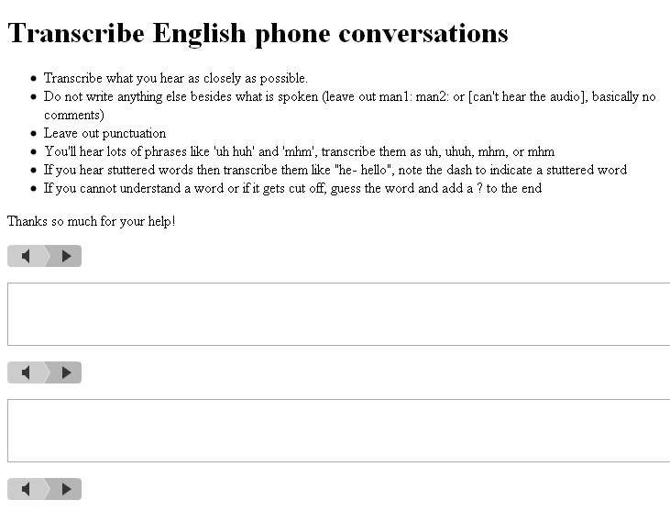
Transcription Task
Pay:
OH WELL I GUESS RETIREMENT THAT KIND OF THING WHICH I DON'T WORRY MUCH ABOUT
UH AND WE HAVE A SOCCER TEAM THAT COMES AND GOES WE DON'T EVEN HAVE THAT PRETTY

Slide 27
Speech Transcription for $5/hour
Paid $300 to transcribe 20 hours of Switchboard three times
$5 per hour of transcription ($0.05 per utterance)
1089 Turkers completed the task in six days
30 utterances transcribed on average (earning 15 cents)
63 Turkers completed more than 100 utterances
Some people rightfully complained about the cost
“wow that's a lot of dialogue for $.05”
“this stuff is really hard. pay per hit should be higher”
Many enjoyed the task and found it interesting
“Very interesting exercise. would welcome more hits.”
“You don't grow pickles they are cucumbers!!!!”

Slide 28
Turker Transcription Rate
Fisher QuickTrans – 6xRT
Historical Estimates – 50xRT
Number of Turkers
Transcription Time / Utterance Length (xRT)
Notes:
The quality degrades

Slide 29
Dealing with Real World Data
Every word in the transcripts needs a pronunciation
Misspellings, new proper name spellings, jeez vs. geez
Inconsistent hesitation markings, myriad of ‘uh-huh’ spellings
26% of utterances contained OOVs (10% of the vocabulary)
Lots of elbow grease to prepare phonetic dictionary
Turkers found creative ways not to follow instructions
Comments like “hard to hear” or “did the best I could :)”
Enter transcriptions into wrong text box
But very few typed in gibberish
We did not explicitly filter comments, etc…

Slide 30
Disagreement with Experts
23% mean disagreement
Transcription | WER
well ITS been nice talking to you again | 12%
well it's been [DEL] A NICE PARTY JENGA | 71%
well it's been nice talking to you again | 0%
Normalized Density
Average Turker Disagreement
Notes:
Cleaner transition to previous slides
Very few good, long tail of bad workers, but most are average
23% error might seem high compared to previous work which used simpler data sets with cleaner audio
Can we do quality control without having the gold standard LDC transcriptions?

Slide 31
Estimation of Turker Skill
Estimated disagreement of 25%
True disagreement of 23%
Transcription | WER | Est. WER
well ITS been nice talking to you again | 12% | 43%
well it's been [DEL] A NICE PARTY JENGA | 71% | 78%
well it's been nice talking to you again | 0% | 37%
Normalized Density
Average Turker Disagreement

Slide 32
Rating Turkers: Expert vs. Non-Expert
Disagreement Against Other Turkers
Disagreement Against Expert
Notes:
Correlation: 86%

Slide 33
Selecting Turkers by Estimated Skill
Disagreement Against Other Turkers
Disagreement Against Expert
Notes:
GREEN are CORRECTLY ACCEPTED (true positives).
BLUE are INCORRECTLY REJECTED (false negatives): using their transcripts would have helped, but they don’t hurt system performance, just waste money.
RED are CORRECTLY REJECTED (true negatives) for having high disagreement.
BLCK are INCORRECTLY ACCPTED (false positives). They are the trouble- some false positives that are included in training but actually may hurt performance. Luckily, the ratio of false negatives to false positives is usually much larger.

Slide 34
Selecting Turkers by Estimated Skill
12%
25%
Disagreement Against Other Turkers
57%
4.5%
Disagreement Against Expert
Notes:
GREEN are CORRECTLY ACCEPTED (true positives).
BLUE are INCORRECTLY REJECTED (false negatives): using their transcripts would have helped, but they don’t hurt system performance, just waste money.
RED are CORRECTLY REJECTED (true negatives) for having high disagreement.
BLCK are INCORRECTLY ACCPTED (false positives). They are the trouble- some false positives that are included in training but actually may hurt performance. Luckily, the ratio of false negatives to false positives is usually much larger.

Slide 35
Selecting Turkers by Estimated Skill
Disagreement Against Other Turkers
Disagreement Against Expert

Slide 36
Selecting Turkers by Estimated Skill
Disagreement Against Other Turkers
Disagreement Against Expert

Slide 37
Selecting Turkers by Estimated Skill
Disagreement Against Other Turkers
Disagreement Against Expert

Slide 38
Finding the Right Turkers
Mean disagreement of 23%
F-Score
WER Selection Threshold

Slide 39
Finding the Right Turkers
Mean disagreement of 23%
Easy to reject bad workers
F-Score
Mean Disagreement: 23%
Hard to find good workers
WER Selection Threshold

Slide 40
Selecting Turkers by Estimated Skill
1%
4%
Disagreement Against Other Turkers
92%
2%
Disagreement Against Expert

Slide 41
Reducing Disagreement
Selection | LDC Disagreement
None | 23%
System Combination | 21%
Estimated Best Turker | 20%
Oracle Best Turker | 18%
Oracle Best Utterance | 13%

Slide 42
Mechanical Turk for ASR Training
Ultimate test is system performance
Build acoustic and language models
Decode test set and compute WER
Compare to systems trained on equivalent expert transcription
23% professional disagreement might seem worrying
How does it effect system performance?
Do reductions in disagreement transfer to system gains?
What are best practices for improving ASR performance?

Slide 43
Breaking Down The Degradation
Measured test WER degradation from 1 to 16 hours
3% relative degradation for acoustic model
2% relative degradation for language model
5% relative degradation for both
Despite 23% transcription disagreement with LDC
Acoustic Models
Language Models

Slide 44
Value of Repeated Transcription
Each utterance was transcribed three times
What is the value of this duplicate effort?
Instead of dreaming up a better combination method, use oracle error rate as upper bound on system combination
Cutting disagreement in half reduced degradation by half
System combination has at most 2.5% WER to recover
Transcription | LDC Disagreement | ASR WER
Random | 23% | 42.0%
Oracle | 13% | 40.9%
LDC | - | 39.5%
Notes:
Should we transcribe every hour three times or transcribe three times as much data

Slide 45
How to Best Spend Resources?
Given a fixed transcription budget, either:
Transcribe as much audio as possible
Improve quality by redundantly transcribing
With a 60 hour transcription budget,
42.0% 20 hours transcribed once
40.9% Oracle selection from 20 hours transcribed three times
37.6% 60 hours transcribed once
39.5% 20 hours professionally transcribed
Get more data, not better data
Compare 37.6% WER versus 40.9% WER
Even expert data is outperformed by more lower quality data
Compare 39.5% WER to 37.6% WER
Transcription | Hours | Cost | ASR WER
Mturk | 20 | $100 | 42.0%
Oracle Mturk | 20 | $300 | 40.9%
MTurk | 60 | $300 | 37.6%
LDC | 20 |  | 39.5%
Notes:
This changed our thinking when using mechanical turk
We’re no longer as worried about QC as we initially thought

Slide 46
How to Best Spend Resources?
Given a fixed transcription budget, either:
Transcribe as much audio as possible
Improve quality by redundantly transcribing
With a 60 hour transcription budget,
42.0% 20 hours transcribed once
40.9% Oracle selection from 20 hours transcribed three times
37.6% 60 hours transcribed once
39.5% 20 hours professionally transcribed
Get more data, not better data
Compare 37.6% WER versus 40.9% WER
Even expert data is outperformed by more lower quality data
Compare 39.5% WER to 37.6% WER
Transcription | Hours | Cost | ASR WER
Mturk | 20 | $100 | 42.0%
Oracle Mturk | 20 | $300 | 40.9%
MTurk | 60 | $300 | 37.6%
LDC | 20 | ~$3000 | 39.5%
Notes:
This changed our thinking when using mechanical turk
We’re no longer as worried about QC as we initially thought

Slide 47
Comparing Cost of Reducing WER
Notes:
Draw red and blue lines, fix legend (casting words wrong color)

Slide 48
Comparing Cost of Reducing WER
Notes:
Bring up VOA, could we do 1000 hours in 30 languages for 5*100*30 for $150k

Slide 49
Korean
Tiny labor pool (initially two Turkers versus 1089 for English)
Posted separate ‘Pyramid Scheme’ HIT
Paid referrer 25% of what referred earns transcribing
Transcription costs $25/hour instead of $20/hour
80% of transcriptions came from referrals
Transcribed three hours in five weeks
Paid 8 Turkers $113 at a transcription rate of 10xRT
Despite 17% CER, test CER only goes down by 1.5% relative
from 51.3% CER to 52.1% CER
Reinforces English conclusions about the usefulness of noisy data for training an ASR system
Notes:
Even with a high disagreement, system performance isn’t as impacted
Tried $5/hour got nothing, bumped it to $20 hour
If this seems high, 27 hours of LDC has 41.2% CER – say it if it comes up
But it’s not a magicaly mystery box

Slide 50
Tamil and Hindi
Collected one hour of transcripts
Much larger labor pool – how many?
Paid $20/hour, finished in 8 days
Difficult to accurately convey instructions
Many translated Hindi audio to English
No clear conclusions
A private contractor provided transcriptions
Very high disagreement (80%+) for both languages
Reference transcripts inaccurate
Colloquial speech, poor audio quality
English speech irregularly transliterated into Devanagari
Lax gender agreement both for speaking and transcribing
Hindi ASR might be a hard task
Notes:
Say thanks to Nagendra

Slide 51
English Conclusions
Mechanical Turk can quickly and cheaply transcribe difficult audio like English CTS
10 hours a day for $5 / hour
Can reasonably predict Turker skill w/out gold standard data
But this turns out not to be as important as we thought
Oracle selection still only cuts disagreement in half
Trained models show little degradation despite 23% professional disagreement
Even perfect expert agreement has small impact on system performance (2.5% reduction in WER)
Resources better spent getting more data than better data
Notes:
QC isn’t worth the effort

Slide 52
Foreign Language Conclusions
Non-English Turkers are on Mechanical Turk
But not a field of dreams
“If you post it, they will come”
Korean results reinforce English conclusions
0.8% system degradation despite 17% disagreement
$20/hour (still very cheap)
Small amounts of errorful data is useful
Poor models can still produce useable systems
90% topic classification accuracy possible despite 80%+ WER
Semi-supervised methods can bootstrap initial models
51% WER reduced to 27% with a one hour acoustic model
Noisy data is much more useful than you think

Slide 53
Swahili and Amharic (Gelas, 2011)
Two under-resourced African languages
17M speak Amharic in Ethiopia
50M speak Swahili in East Africa (Kenya, Congo, etc…)
Not many workers on Mturk
12 Amharic, 3 Swahili
And they generated data very slowly
0.75hrs after 73 days, 1.5hrs after 12 days
But despite being worse than professionals
16% WER, 27.7% WER
ASR systems performed as well as professionals
At the end of the day, researchers paid grad students at $103/hr of transcription to get 12 hours vs. $37/hr on MTurk

Slide 54
Other Speech Tasks
Use MTurk to elicit speech for the target domain
Data collected on microphone, so point them to an app instead
Use Turkers to perform verification and correction
Listen to <audio, transcript> pairs and verify right or wrong
Correct automatic speech output
Speech Science
How sensitive are humans to noise?
Can they detect accent, fluency, etc…
System Evaluation
Synthesized Speech (but again non-English was tough)
Spoken Dialog Systems a.k.a. Siri

Slide 55
If You’re Curious
Praat - http://www.fon.hum.uva.nl/praat/
Speech analysis
Kaldi - Open Source State of the Art Recognizer
http://kaldi-asr.org
Linguistic Data Consortium
Based right here at Penn!
Creates almost all of the speech corpora used in research

Slide 56
BACKUP

Slide 57
Cheaply Estimating Turker Skill
Difference from Professional Estimate
Number of Utterances to Estimate Disagreement

