Slide 1
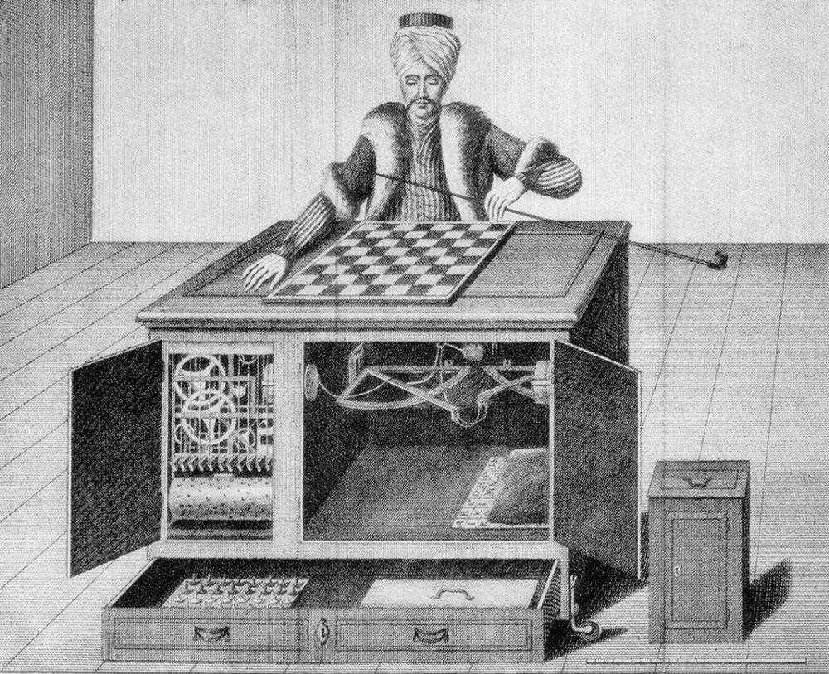
The Best Practices of the Best Requesters
Kristy Milland
Ryerson University
kmilland@ryerson.ca

Slide 2
Who We Are Not
Only from developing countries, non-native English speakers, uneducated, unskilled
Isolated
Cheaters, lazy, satisficers, inattentive
Work for $1/hour, doing it for fun in our PJs, unemployed
Anti-social
About Me | About Us | Amazon Changes | About You

Slide 3
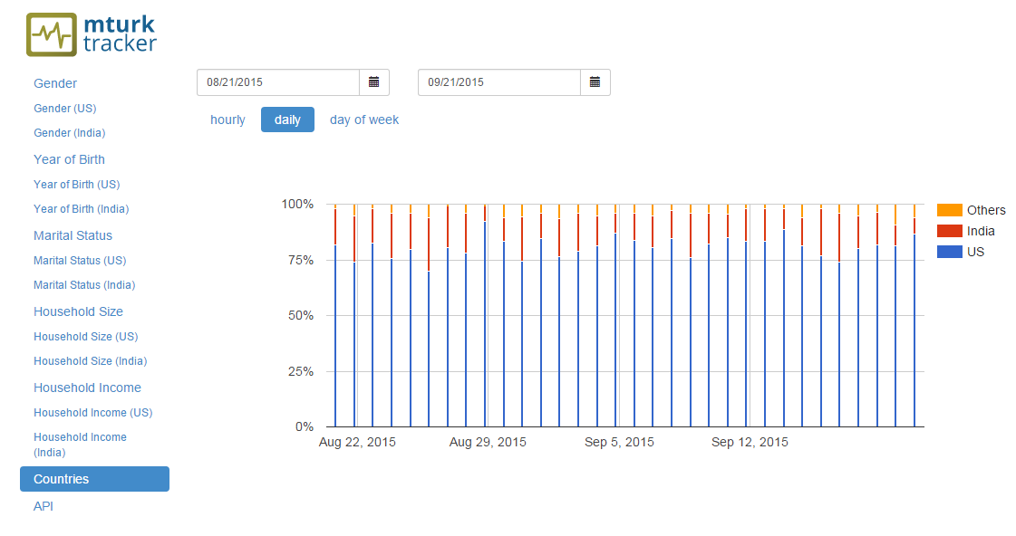
Who We Actually Are
Demographics (mTurk-Tracker.com, my data)
About Me | About Us | Amazon Changes | About You

Slide 4
How We Work
Turkopticon
Communities
  Turker Nation
  Reddit
  Facebook
Scripts
  IndiaTurkers
  GreasyFork
  HitDB / TurkMaster / HIT Scraper
Websites/tools
  Turk Alert / mTurk List
About Me | About Us | Amazon Changes | About You

Slide 5
How We Work
The Queue
Batches vs. Surveys
Mobile vs. stationary devices
10-20% of all workers do 80% of the work
  Musthag, M., & Ganesan, D. (2013). Labor dynamics in a mobile micro-task market. Proceedings of the SIGCHI Conference on …, 641. http://doi.org/10.1145/2470654.2470745
  Chandler, J., Mueller, P. A., & Paolacci, G. (2014). Nonnaïveté among Amazon Mechanical Turk workers: consequences and solutions for behavioral researchers. Behavior Research Methods, 46, 112–130. http://doi.org/10.3758/s13428-013-0365-7
About Me | About Us | Amazon Changes | About You

Slide 6
Bias
Same amount of bias as offline, but different kinds
  You do not know who they really are (geographically, duplicate accounts, demographics)
  They can run robots to spam, or scripts to autoanswer
  Share completion codes, ACs
  They have done CRT and other measures before (practice, information bias)
  And the same old: rushing, satisficing
About Me | About Us | Amazon Changes | About You

Slide 7
Ethical Behaviour
Using a fake Requester name
Give us context and be honest
Informed consent
Wage theft
Rejecting/blocking
Worker IDs are not anonymous
Turkopticon!
About Me | About Us | Amazon Changes | About You

Slide 8
Best Practices - Communication
Check your Requester email
Watch Turkopticon, forums
Ask for help and feedback before, during and after you post HITs
About Me | About Us | Amazon Changes | About You

Slide 9
Best Practices – HIT Design
Learn about creating attractive HITs (see Chilton et al. 2010)
  Use the right keywords (and be honest)
  Write a clear title and description
  Be upfront about bad content (beyond the adult qualification, but use it, too!)
About Me | About Us | Amazon Changes | About You

Slide 10
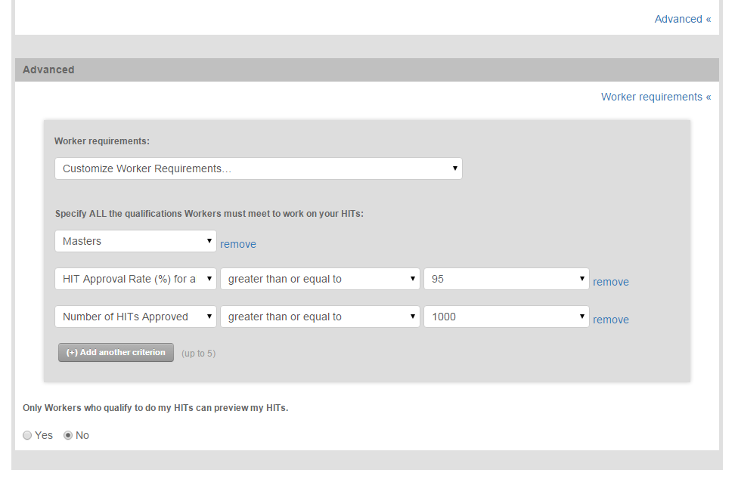
Best Practices – HIT Design
Use the right qualifications
About Me | About Us | Amazon Changes | About You

Slide 11
Best Practices – HIT Design
Masters is no better than 99% approval / 10k HITs approved
Do not go below 98%
Private/curated qualifications = higher accuracy
If you want English speakers, use the “Location is one of” comparator
  Australia, Canada, Ireland, New Zealand, United Kingdom, United States
About Me | About Us | Amazon Changes | About You

Slide 12
Best Practices – Test Your HITs
Use the sandbox to test
Design: collapsible, one screen, easy tabbing
Instructions: clear, examples, link to Turkopticon, explain purpose
Time allotted: add a buffer
Best times to post: depends on the work
About Me | About Us | Amazon Changes | About You

Slide 13
Best Practices – Test Your HITs
Pay: test pay points, be fair, pay DOES affect data quality/speed & bias/motivation
  Play with bonuses
  AMT is a LABOUR platform
  If you need to underpay, use undergrads
  If you cannot pay more, make your HITs more efficient (we can help!)
About Me | About Us | Amazon Changes | About You

Slide 14
Best Practices – The Results
List what you paid in your paper
Thank Turkers for their participation
Mention the actions you took to be ethical – asking for help on forums, commenting on your Turkopticon ratings, replying to email, how you calculated fair pay, etc.
About Me | About Us | Amazon Changes | About You

Slide 15
References
To see this list online, visit http://KristyMilland.com/ and click Speaking
What "myths" about Turkers would you like to bust?
Hauser, D. J., & Schwarz, N. (2015). Attentive Turkers: MTurk participants perform better on online attention checks than do subject pool participants. Behavior research methods, pp. 1-8.
Adult Swim. (2014, January 24). Infomercial: For-Profit Online University | Adult Swim [Video file]. Retrieved from https://www.youtube.com/watch?v=XQLdhVpLBVE
Mechanical Turk Tracker v2.0
Pavlick, E., Post, M., Irvine, A., Kachaev, D., & Callison-Burch, C. (2014). The language demographics of amazon mechanical turk. Transactions of the Association for Computational Linguistics, 2, pp. 79-92.
Callison-Burch, C. (2014, May). Crowd-Workers: Aggregating information across Turkers to help them find higher paying work. In Second AAAI Conference on Human Computation and Crowdsourcing.
Hanrahan, B. V., Willamowski, J. K., Swaminathan, S., & Martin, D. B. (2015, April). TurkBench: Rendering the Market for Turkers. In Proceedings of the 33rd Annual ACM Conference on Human Factors in Computing Systems (pp. 1613-1616). ACM.
Guidelines for Academic Requesters
Salehi, N., Irani, L. C., & Bernstein, M. S. (2015, April). We Are Dynamo: Overcoming Stalling and Friction in Collective Action for Crowd Workers. In Proceedings of the 33rd Annual ACM Conference on Human Factors in Computing Systems (pp. 1621-1630). ACM.
Turking for a Living
Les petites mains derrière les ordinateurs
Why Mechanical Turk Allows Only US-based Requesters?
The Reasons Why Amazon Mechanical Turk No Longer Accepts International Turkers
Requirements for Purchasing Prepaid HITs
GUI 40% HIT fee workaround
Externally hosted workaround
PHP/API workaround
Third party HIT hosting workaround
Chilton, L. B., Horton, J. J., Miller, R. C., & Azenkot, S. (2010, July). Task search in a human computation market. In Proceedings of the ACM SIGKDD workshop on human computation (pp. 1-9). ACM.
Workersandbox.amazon.com & requestersandbox.amazon.com
Ho, C. J., Slivkins, A., Suri, S., & Vaughan, J. W. (2015, May). Incentivizing High Quality Crowdwork. In Proceedings of the 24th International Conference on World Wide Web (pp. 419-429). International World Wide Web Conferences Steering Committee.
More questions and answers for Requesters are found on Turker Nation (registration required)

