Slide 1

CoderDojo Bray
Introduction to HTML
Session #5 : My First JavaScript Programs

Slide 2
Wi-Fi Network
Join wireless network: coderdojo<x> where <x> is your table number
Have you got: - Google Chrome - Komodo Edit Installed on your laptop?

Slide 3
Session #5 What will you do today?
Write your first JavaScript program to do simple animation on a web page
JavaScript and Animation are the basis for lots of Browser based games
Build on last week’s work

Slide 4
JavaScript!
JavaScript is a programming language
HTML/CSS are “descriptive”: they describe what your web page looks like
JavaScript lets you write programs that do things and these will run inside a web browser
JavaScript is:
A “scripting” language, not a “compiled” one
Supported by all web browsers
In the top 5 most used languages worldwide

Slide 5
Learning Programming
Mastering Programming is hard
Beginning Programming is easy
Today we are not going to become experts in JavaScript
If you want, we will run a complete block of JavaScript sessions in future

Slide 6
What can you do with JavaScript?
In your web pages, you can use JavaScript to:
React when the user does something
Access anything on the web page and change its content, or style, or attributes
Create new elements and insert them into the page anywhere you want, with any style
… and lots more complicated stuff like talking to web servers and getting data
In other words, your web page can change on the fly

Slide 7
Let’s get started
Download the samples that we have provided
http://goo.gl/eovdi
Extract to Desktop>CoderDojo
Open “button0.html”
Always open HTML files in both Chrome and Komodo
In Komodo
Note the <div> called “demo”
And the “<button>” for visitors to click

Slide 8
Now type and save this JavaScript file: start1.js
function myFunction()
{
element=document.getElementById("demo");
element.innerHTML="Hello World";
};
Your Document (web page) contains Elements with IDs
The Element whose ID is “demo” contains innerHTML
The content (or “value”) of this innerHTML will be changed to “Hello World”
i.e. Document.”demo”.innerHTML=“Hello World”
It’s like saying You.Arms.Endof=“Hands”

Slide 9

Adding JavaScript from external file
In the page <head>, type in the JavaScript reference: <script type="text/javascript" src=“start1.js"></script>
Change the button to:
<button onclick="myFunction()">Try it</button>
Save the HTML and reload the page
Now this works one time only:

Slide 10
Now add this “if statement” to improve the page
function myFunction()
{
element=document.getElementById("demo");
If (element.innerHTML.match(/Click/))
{
element.innerHTML="Hello World";
}
else
{
element.innerHTML="Click the button to change the text in this paragraph";
}
};
Save the Script and reload the page
Now this works all the time:

Slide 11


JavaScript working with images
Open “Lights.html” (Chrome and Komodo)
Open “start3.js” (Komodo)
How would you change i) the HTML and ii) the JavaScript to make the second bulb work?
HTML: you need: id="myimage2" onclick="changeImage2()”
JavaScript: you need: function changeImage2() … and element=document.getElementById('myimage2') …

Slide 12
Understanding JavaScript
JavaScript works using the DOM
Document Object Model
The DOM is a “tree” structure representing
The window displayed by the browser
The document in that window
The elements (HTML tags) inside that document

Slide 13
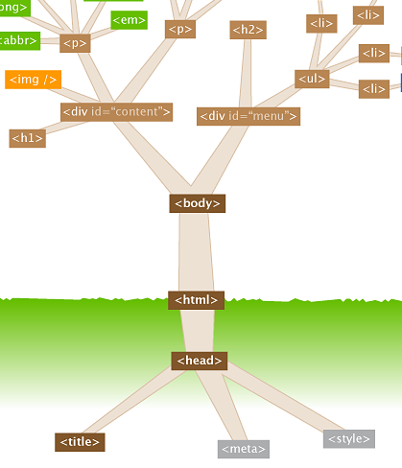
The DOM: it’s like a tree
We have already used many of these elements

Slide 14
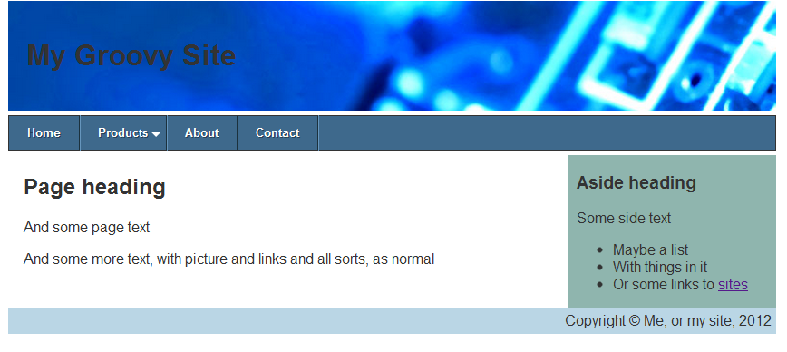
Last week @ CoderDojo
We used CSS to layout a page nicely
You can use many of these ideas in your own sites
Notes:
Mentors should identify new attendees, and run through the standard setup with them: check that all laptops are up and running, are on the wireless network, can see the internet (google.ie, https://thimble.webmaker.org, dojo.hallamor.org)
We would also like to have a decent editor (komodo edit is good: is saves on errors) and ideally Chrome as the browser installed.
This time we want to use the Developer Tools in Chrome to play with CSS.

Slide 15
JavaScript working with colours
Open “session5_noscript.html” (in Chrome and Komodo)
It’s where we finished last week
Styles
Menu
Divs
We will link in a more advanced script now
<script type="text/javascript" src="colours.js"></script>

Slide 16
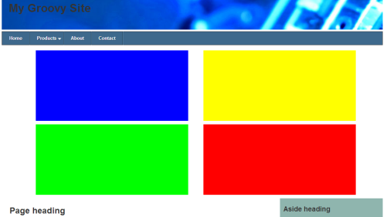
JavaScript working with colours
You should now have rectangles on screen
Click any letter on your keyboard
Where did the colours come from?
Not the HTML source code
Not the CSS
The JavaScript code set the background colour
It also created the boxes, moves the colours from box to box and reacts when you press keys
Open colours.js (in Komodo) for a quick look
It takes time and practice to understand every line of code

Slide 17
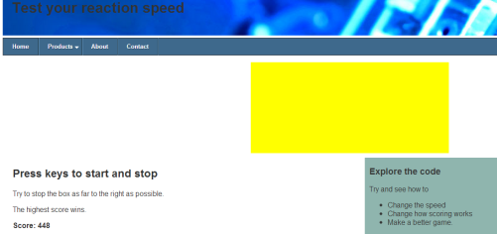
With a bit of editing, you can make a basic game
Open “session5_game.html”
The JavaScript game.js is based on colours.js
With some lines ‘commented out’
And a few extra lines for movement
Use the keys to get a high score
Which section of code creates movement?
Edit the code to improve the game

Slide 18
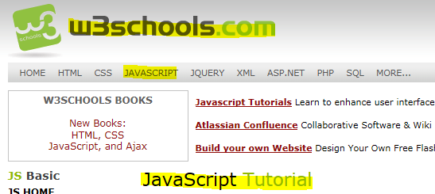

How to explore JavaScript on your own
Go to http://www.w3schools.com/js/default.asp
Try Google as well: copy code / tips from other sites

Slide 19
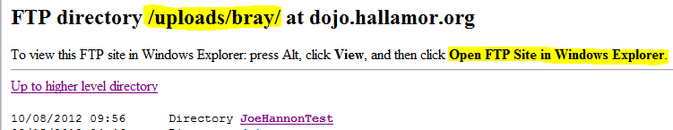
Now Practice Some More!
At home, practice what you learned this week
Upload your work to ftp://dojo.hallamor.org/uploads/bray/
View it at http://dojo.hallamor.org/eden/bray/
Send us the URLs of your websites to look at, to bray@coderdojo.com

Slide 20
Next Week @ CoderDojo
Next week is the last week of this session
We’re not going to introduce any new HTML/CSS or JavaScript next week
We’ll be looking inside some computers and electronics
…and we can go over anything not clear from any of the earlier sessions …

