Slide 1

CoderDojo Bray
Introduction to HTML
Session #5 : My First Javascript Program

Slide 2
WiFi Network
Join wireless network: coderdojo<x> where <x> is your table number
Have you got: - Google Chrome - Komodo Edit Installed on your laptop?

Slide 3
Session #5 What will you do today?
Review last week’s work
Write your first Javascript program to do simple animation on a web page
Javascript and Animation are the basis for lots of Browser based games

Slide 4
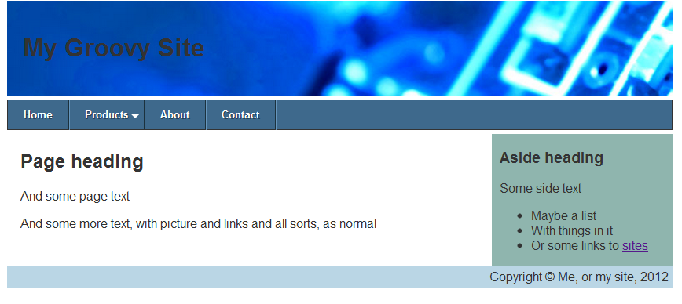
Last week @ CoderDojo
We used CSS to layout a page nicely
You can use some of these ideas in your own sites
Notes:
Mentors should identify new attendees, and run through the standard setup with them: check that all laptops are up and running, are on the wireless network, can see the internet (google.ie, https://thimble.webmaker.org, dojo.hallamor.org)
We would also like to have a decent editor (komodo edit is good: is saves on errors) and ideally Chrome as the browser installed.
This time we want to use the Developer Tools in Chrome to play with CSS.

Slide 5
Javascript!
Javascript is a programming language
HTML/CSS are “descriptive”: they describe what your web page looks like
Javascript lets you write progams that do things and these will run inside a web browser
Javascript is:
A “scripting” language, not a “compiled” one
Supported by all web browsers
In the top 5 most used languages worldwide

Slide 6
Learning Programming
Mastering Programming is hard
Anyone who tells you it is not is either:
Not very good at programming
Does not understand what programming is
Beginning Programming, though, is easy
Today we are not going to become experts in Javascript
But we will have a quick peek at it
If you want, we will run a complete block of Javascript sessions in future

Slide 7
What can I do with Javascript?
In your web pages, you can use Javascript to:
React when the user does something (like presses a key or clicks the mouse)
Access anything on the web page and change its content, or style, or attributes
Create new elements and insert them into the page anywhere you want, with any style
… and lots more complicated stuff like talking to web servers and getting data
In other words, your web page can change on the fly

Slide 8
For the time remaining …
Try to …do stuff …

Slide 9
Now Practice Some More!
At home, practice what you learned this week
Upload your work to dojo.hallamor.org
Look at www.w3schools.com and online for more Javascript tutorials
Send us the URLs of your websites to look at, to bray@coderdojo.com

Slide 10
Next Week @ CoderDojo
Next week is the last week of this session
We’re not going to introduce any new HTML/CSS or Javascript next week
We’ll be looking inside some computers and electronics
…and we can go over anything not clear from any of the earlier sessions …

