Slide 1

CoderDojo Bray
Introduction to HTML
Session #5 : My First Javascript Program

Slide 2
WiFi Network
Join wireless network: coderdojo<x> where <x> is your table number
Have you got: - Google Chrome - Komodo Edit Installed on your laptop?

Slide 3
Session #5 What will you do today?
Review last week’s work
Write your first Javascript program to do simple animation on a web page
Javascript and Animation is the basis for lots of Browser based games

Slide 4
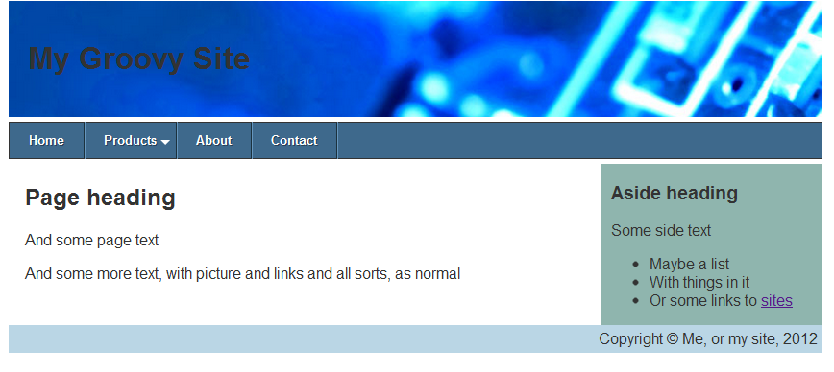
Last week @ CoderDojo
We used CSS to layout a page nicely
You can use some of these ideas in your own sites
Notes:
Mentors should identify new attendees, and run through the standard setup with them: check that all laptops are up and running, are on the wireless network, can see the internet (google.ie, https://thimble.webmaker.org, dojo.hallamor.org)
We would also like to have a decent editor (komodo edit is good: is saves on errors) and ideally Chrome as the browser installed.
This time we want to use the Developer Tools in Chrome to play with CSS.

Slide 5
Javascript!
Javascript is …

Slide 6
For the time remaining …
Try to …do stuff …

Slide 7
Now Practice Some More!
At home, practice what you learned this week
Upload your work to dojo.hallamor.org
Look at www.w3schools.com and online for more Javascript tutorials
Send us the URLs of your websites to look at, to bray@coderdojo.com

Slide 8
Next Week @ CoderDojo
Next week is the last week of this session
We’re not going to introduce any new HTML/CSS or Javascript next week
We’ll be looking inside some computers and electronics
…and you can work on your web projects …

