Slide 1

CoderDojo Bray
Introduction to HTML
Session #3 : Fancy Menus using CSS

Slide 2
WiFi Network
Join wireless network: coderdojo<x> where <x> is your table number
Have you got: - Google Chrome - Komodo Edit Installed on your laptop?

Slide 3
Session #3 What will you do today?
Review last week’s work
All about CSS Menus: you’ll make a super professional looking menu for your website
You’ll learn about using Chrome to experiment with CSS
We’ll publish your website to dojo.hallamor.org

Slide 4
Last week @ CoderDojo
We looked at lists and tables
We turned a list into a menu using CSS
But this menu was … super ugly
Because I am an engineer, not a graphic designer
However all is not lost
Because I know how to copy good graphic designers and today I will show you how
Today we will make a very professional looking menu using CSS
Notes:
Mentors should identify new attendees, and run through the standard setup with them: check that all laptops are up and running, are on the wireless network, can see the internet (google.ie, https://thimble.webmaker.org, dojo.hallamor.org)
We would also like to have a decent editor (komodo edit is good: is saves on errors) and ideally Chrome as the browser installed.
This time we want to use the Developer Tools in Chrome to play with CSS.

Slide 5
A new HTML tag, <div>
Like last week, we’re going to turn a <ul> into a menu using CSS
To change a <ul> into a menu, we need to
Identify the <ul> on the page … because we don’t want to change all <ul>’s
Attach a particular style to that <ul>
We use the <div> tag as the identifier
A <div> does not display, it’s just for us to organise the HTML document

Slide 6
How to identify an item
<div id=‘mymenu_a’>
<ul class = ‘abcdef’>
<li>…</li>
<li>…</li>
</ul>
</div>
Notes:
There are two ways of easily identifying parts of your HTML document, so that you can attach styles to them
id= is used when you want to uniquely identify one item on a page and apply a particular style to it
class= is used when you want to apply the same style to multiple things on the page.

Slide 7
Applying A Style
If you use id=abcd then use #abcd{ …} in the CSS file to identify the style
If you use class=xyz then use .xyz{…} in the CSS file to identify the style
Notes:
There are two ways of easily identifying parts of your HTML document, so that you can attach styles to them
id= is used when you want to uniquely identify one item on a page and apply a particular style to it
class= is used when you want to apply the same style to multiple things on the page.

Slide 8
OK, Let’s Start …
Make a new empty file with two <ul> lists in it
Use <link> to reference a CSS file
Wrap one of the <ul> tags inside a <div>
<div> is just a way of defining a section in the HTML document
It doesn’t display, but you can attach styles to it
… and this is how we make a menu …

Slide 9
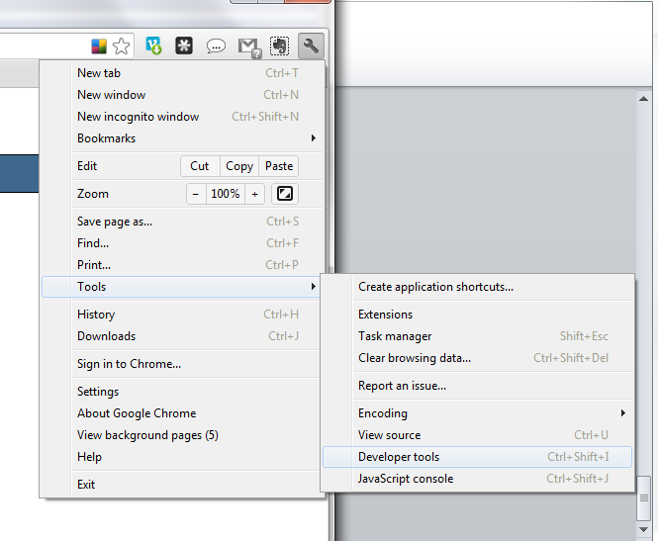
Using Chrome DevTools
Exploring CSS with Chrome is easy
Click Wrench Icon->Tools->Developer Tools

Slide 10
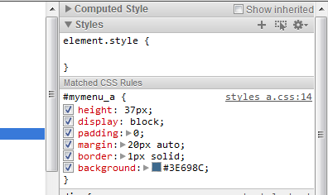
Using Chrome DevTools
You can explore your page
… see which parts of the HTML show on the page
… see which CSS styles apply
… see what happens when you turn off parts of the CSS
Cool!

Slide 11
Menu CSS code
<div id=‘mymenu_a’>
<ul>
<li><a href=“#”>Home</a></li>
<li><a href=“#”>Stuff</a></li>
<li><a href=“#”>More Stuff</a></li>
<li><a href=“#”>Less Stuff</a></li>
<li><a href=“#”>Help</a></li>
</ul>
</div>
Notes:
We just wrap our <ul> inside a <div>
And we give this <div> a specific id, “mymenu_a”
And in our CSS file, we have styles which apply to this <div>

Slide 12
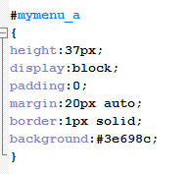
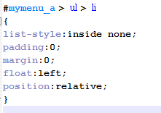
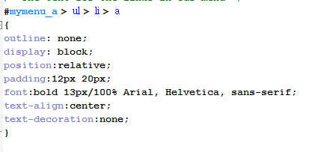
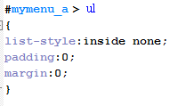
Basic CSS for our menu
Notes:
This block of CSS will turn our <ul> into a menu

Slide 13
Hmm. Still not great.
The text colour is hard to read
The menu bar looks a bit … square …
Easily fixed:
#mymenu { border-radius: 10px; } #mymenu > ul > li > a { text-shadow:1px 1px 0 rgba(0,0,0, 0.4);
border-right:1px solid #1b313d;
color:#fff;
}

Slide 14
Experiment with Chrome Developer Tools
See how you can use Developer Tools to
Explore which styles make which changes
Find the code for a displayed part of the page
You can also view the source code for any web page you visit
And … borrow … their good ideas
Notes:
Show the kids how to do this
Using their own pages, and some pages from the internet

Slide 15
Now back to the menus
We’ll add a menu hover colour
A similar colour to the main colour often looks quite good
We’ll make fancy menu dividers
3D “trick”
Two lines close together, but of different colours
There are lots of computer graphics “tricks” like this

Slide 16
Adding a sub-menu
We’ll use a class called submenu to identify the sub-menu
We embed another <ul> inside a <li> and style it …
<li class='submenu'><a href='#'>Products</a> <ul>
<li><a href='#'>Product 1</a></li> <li><a href='#'>Product 2</a></li> </ul>
</li>
Notes:
Now we’ll show the CSS code for the submenu class
Best to do this using the two sample code files

Slide 17
Making a website
The Dublin Dojos share a site you can use to publish your work: http://dojo.hallamor.org
Instructions for Komodo Edit are here:
http://dojo.hallamor.org/mentor-resources/hosting-your-files-dojo-hallamor-org
Make a directory for yourself and upload your files

Slide 18
So, CSS Styles Then …
All that menu CSS styles: how did I figure that out?
I didn’t. I used a tool. Everybody uses a tool.
But understanding how the CSS works makes the tools more useful
I used http://cssmenumaker.com/css-drop-down-menu
Now you understand how this works, you can use it to make a completely different menu

Slide 19
Now Practice Some More!
Make a new website, or upload the one you’ve worked on to dojo.hallamor.org
At home, practice what you learned this week
Look at www.w3schools.com for examples of other CSS styles
Look for other CSS tools, tips and tricks online
Send us the URLs of your websites to look at, to bray@coderdojo.com

Slide 20
Next Week …
Next week:
We’ll look at how to layout a full page using CSS for a stylish website
You’ll be able to customise this for your own websites with your own colour scheme and layout

