Slide 1
Project 4
Mu Li, Connor crowley, and Chelsea Sumba

Slide 2
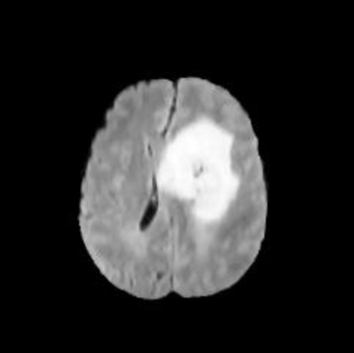
1. Intro of Project and its Aim
The main focus of this project revolved around healthcare and brain tumors.
The dataset used provided information that indicted whether there was a brain tumor present or not, following with various factors of measure.
The project’s aim was to identify which factor or factors can possibly contribute to having a brain tumor present, as well as vice versa, not having a brain tumor present.
Using various machine learning algorithms and models

Slide 3
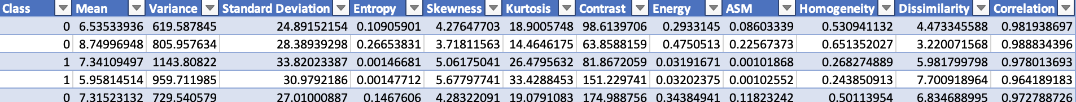
2. Intro to Dataset
The first column of the dataset is “Class,” which indicated whether its row information had resulted in 0 or 1.
0 – No Tumor
1- Tumor
The dataset included five first-order features:
Mean: the average, the sum of all values
Variance: measures spread or dispersion from the mean value
Standard Deviation: measure of average distance of between data point and mean
Skewness: the asymmetry of distribution of values
Kurtosis: measure how much the tails of the distribution differ from a normal distribution.

Slide 4
The rest of the dataset included seven texture features:
Contrast: measures variations in intensity
Energy: uniformity of pixel intensities
ASM: measures orderliness or regularity
Entropy: measures randomness or uncertainty of pixel intensities.
Homogeneity: measures closeness of the distribution of elements
Dissimilarity: average absolute difference in intensity between pairs of pixels
Correlation: measures direction and strength of a linear relationship between two variable
For reference, our dataset included images for each of the entries and a column of coarseness. Those two factors were cleaned out of the dataset.

Slide 5
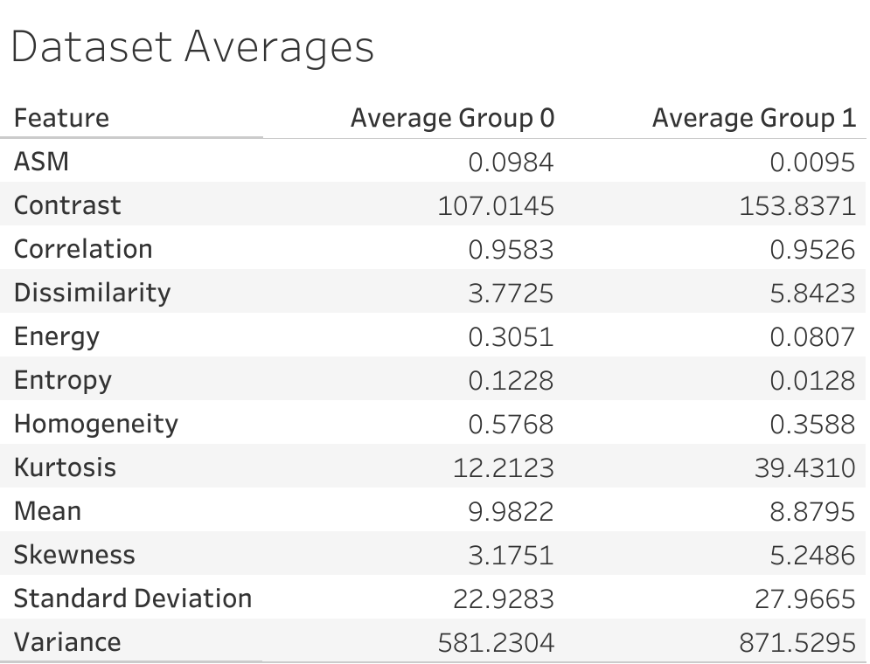
Statistical Breakdown of Dataset

Slide 6
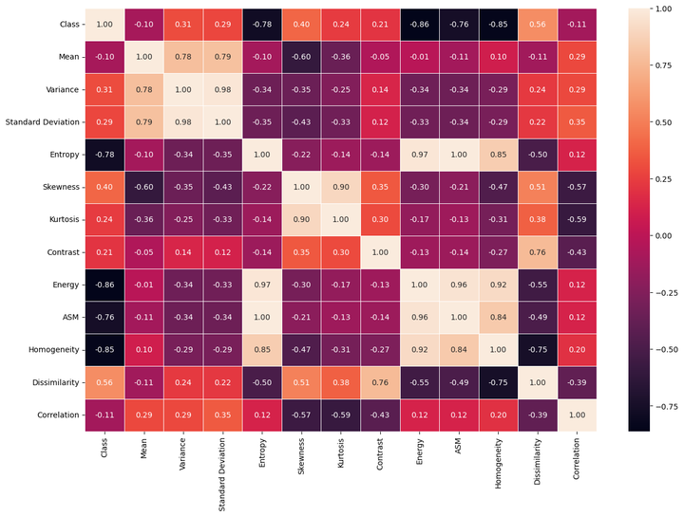
Correlation Matrix

Slide 7
Correlations with Class (Tumor Presence):
Negative Relationships:
Energy and Class (-0.86): As energy decreases, the likelihood of a tumor being present tends to increase.
ASM and Class (-0.76): As ASM decreases, the likelihood of a tumor being present tends to increase.
Homogeneity and Class (-0.85): As homogeneity decreases, the likelihood of a tumor being present tends to increase.
Entropy and Class (-0.78): As entropy decreases, the likelihood of a tumor being present tends to increase.
Positive Relationships:
Dissimilarity and Class (0.56): As dissimilarity increases, the likelihood of a tumor being present tends to increase.

Slide 8
Correlations between variables
Strongest Negative Relationships:
Homogeneity and Dissimilarity: (-0.75)
Correlation and Kurtosis: -(0.59)
Correlation and Skewness: -(0.57)
Strongest Positive Relationships:
Energy and Entropy: (0.97)
Standard Deviation and Variance: (0.98)
Skewness and Kurtosis: (0.90)
Energy and ASM: (0.96)
Entropy and ASM: (1.00)

Slide 9
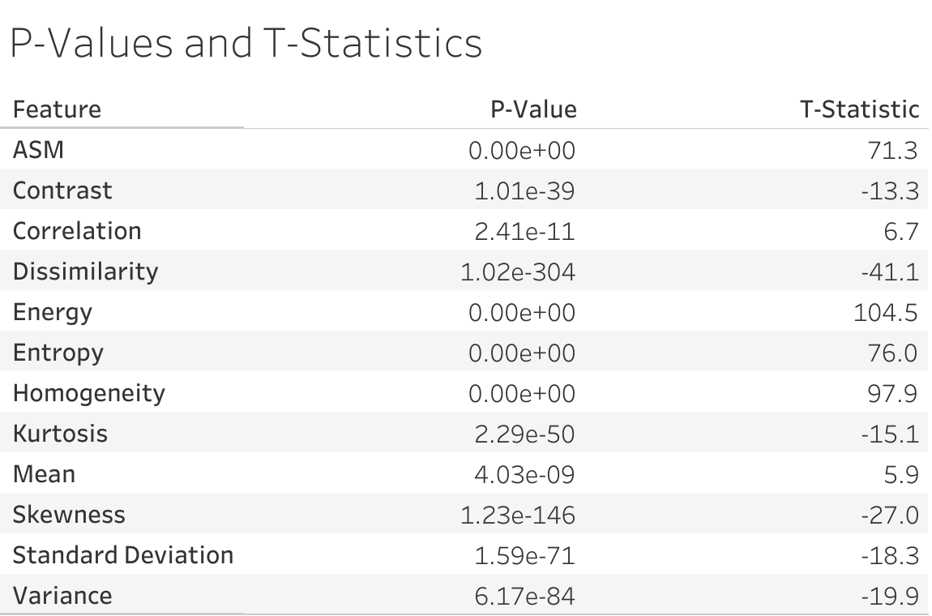
T-Test Results

Slide 10
Key Takeaways from data analysis
Group 1 tends to exhibit higher variability (variance, standard deviation) compared to Group 0.
Features related to texture (contrast, energy, ASM, homogeneity) show substantial differences between the groups.
The low p-values across the variables indicate both statistical and practical significance, and tell us they are likely meaningful in a real-world context.

Slide 11
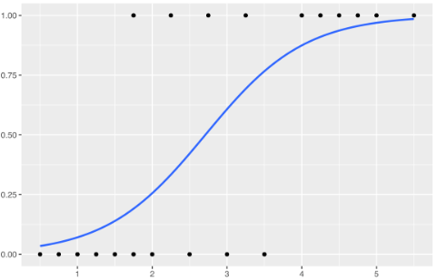


4. Intro to different models
(1) Logistic Regression
Logistic regression is a statistical method used for binary classification problems, predicting the probability of an observation belonging to a certain class. It’s a classification algorithm.
Purpose: It's employed when the dependent variable is categorical and binary in nature (e.g., yes/no, true/false), aiming to predict the probability of an event occurrence based on given independent variables or features.
Model Principle: The model uses the logistic function (sigmoid function) to map input features onto a binary outcome. It estimates the probability that a given input belongs to a certain class, using a linear combination of input features and their respective coefficients.
Training and Interpretation: Logistic regression coefficients represent the relationship between the independent variables and the likelihood of a particular outcome. The model is trained through an optimization process to minimize the error between predicted and actual outcomes.

Slide 12


4. Intro to different models
(2) Naive Bayes Classifier
Naive Bayes classifiers, a type of linear probabilistic classifiers in statistics, operate on Bayes' theorem with assumed feature independence. They are straightforward Bayesian network models known for their simplicity. With kernel density estimation, they exhibit notably high accuracy. These classifiers boast high scalability, demanding a parameter count linearly related to the number of features in a learning problem. Their maximum-likelihood training involves a linear-time evaluation of a closed-form expression, differing from the iterative approximations in other classifiers.
Purpose: Naive Bayes is employed in supervised learning for classification tasks. It predicts the probability of a given sample belonging to a certain class based on the presence of certain features.
Model Principle: It utilizes Bayes' theorem to compute the conditional probability of a class given a set of features. The "naive" assumption refers to the assumption that the features are conditionally independent of each other, which is often not entirely true in practice but simplifies the computation.
Training and Interpretation: The model learns the prior and conditional probabilities from the training data. It estimates the probabilities for each class and makes predictions based on the class with the highest probability.

Slide 13
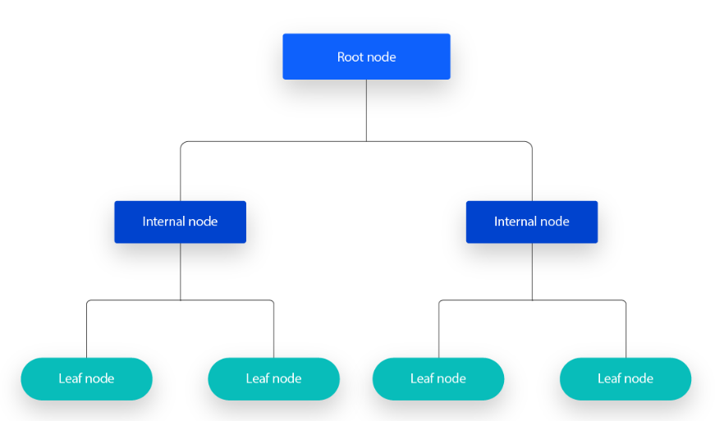
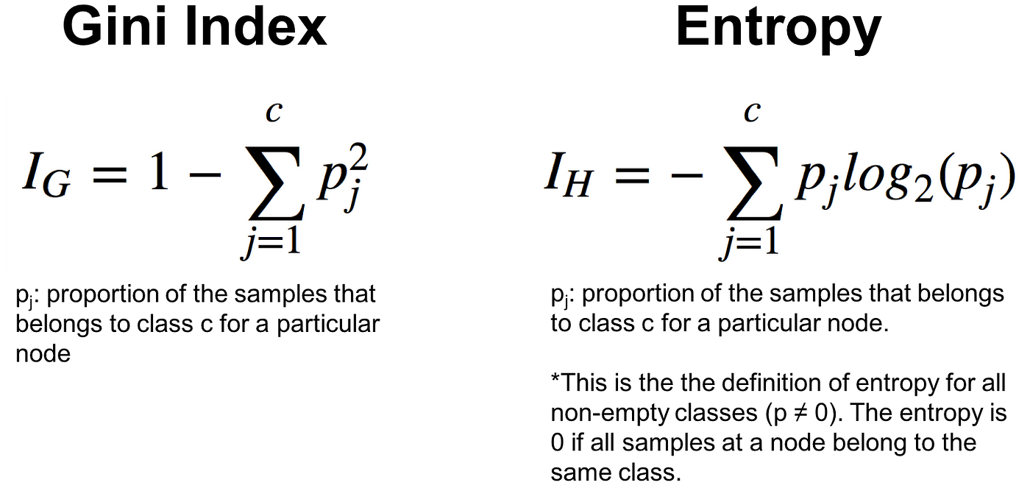
4. Intro to different models
(3) Decision Tree
Purpose: The decision tree model serves as a versatile algorithm used for both classification and regression tasks. Its primary goal is to create a predictive model that maps features (or attributes) to target values by following a set of decision rules.
Model Principle: Decision trees operate by recursively partitioning the input space into subsets, based on the features, to make decisions. Each internal node represents a feature, and each branch emanating from a node represents a decision rule or outcome. The leaves of the tree represent the final decision or prediction.
Training and Interpretation: The model is trained through a process of selecting the best features to create decision nodes that most effectively split the data. This selection process aims to maximize information gain or minimize impurity at each node. To interpret the model, one can visualize the tree structure, inspecting how decisions are made at each node based on feature thresholds.
During the construction process of a decision tree, the objective is to minimize the impurity or entropy of nodes by selecting features for node splitting, aiming to obtain purer subsets. The lower the Gini impurity or entropy, the purer and more ordered the dataset is perceived to be.

Slide 14
4. Intro to different models
(4) Random Forest
Purpose: Random Forest is an ensemble model consisting of multiple decision trees. It operates by aggregating predictions from numerous decision trees to make final predictions. It is an ensemble learning method used for classification and regression tasks. It aims to improve predictive accuracy and control overfitting compared to individual decision trees by aggregating predictions from multiple trees.
Model Principle: Random Forest consists of an ensemble of decision trees. Each tree is constructed by bootstrapping the dataset (randomly sampling with replacement) and selecting random subsets of features for node splitting. The final prediction is the aggregation (e.g., averaging or voting) of predictions made by individual trees.
Training and Interpretation: The model is trained by building numerous decision trees on different subsets of the data. During training, each tree is grown independently, and the final prediction is the aggregate of predictions from all trees. Interpretation involves analyzing feature importance, examining the impact of different features on predictions across multiple trees.
Methods: Random Forest doesn’t have a specific mathematical formula for predictions but relies on bagging and random feature selection. It uses methods like bootstrapping and decision tree algorithms for training individual trees. The feature importance can be determined by measuring the average decrease in impurity (Gini or entropy) across all trees when a particular feature is used for splitting.

Slide 15
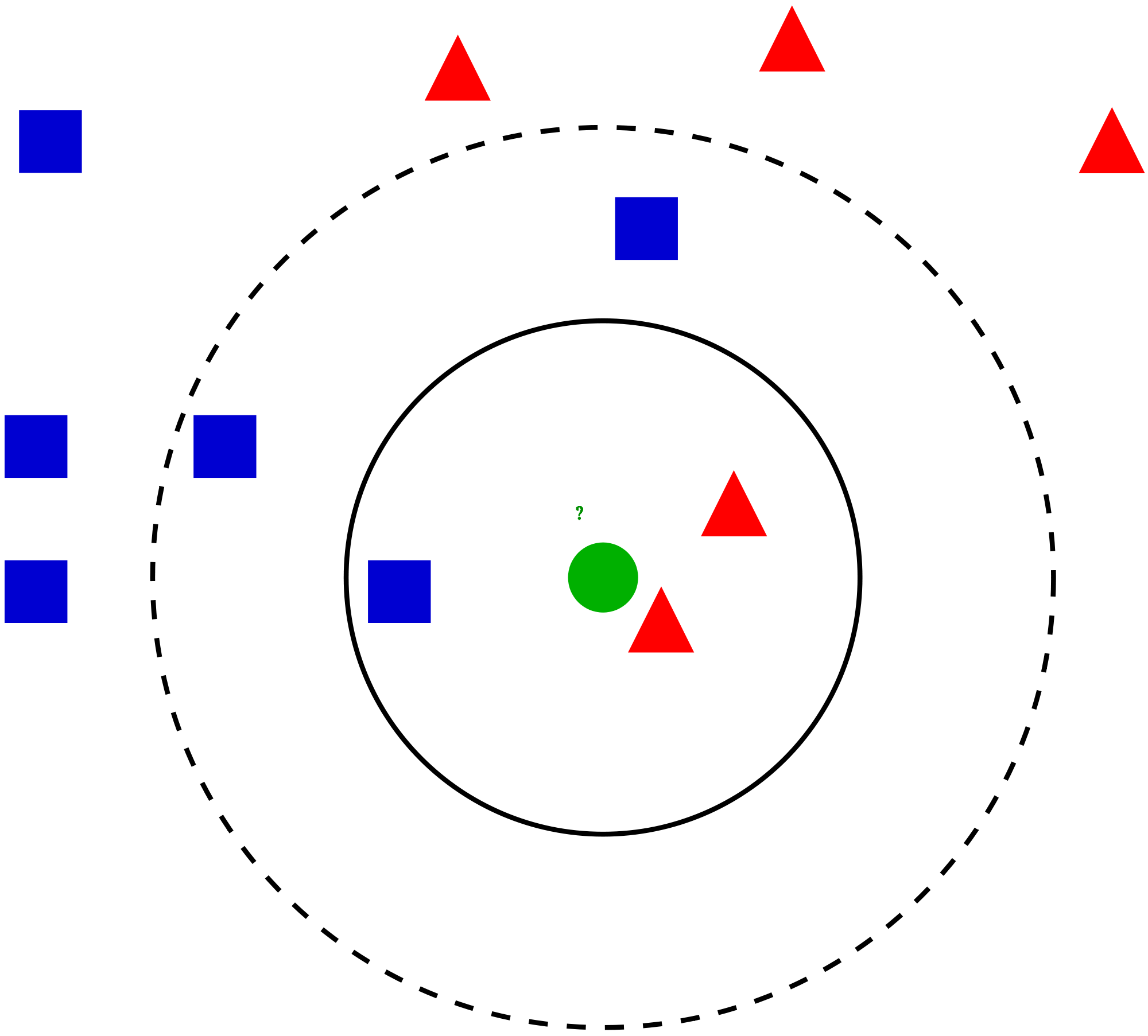

4. Intro to different models
(5) K-Nearest Neighbors
Purpose: K-Nearest Neighbors (KNN) is a simple yet effective algorithm used for both classification and regression tasks. It aims to predict the classification or value of a new data point based on its proximity to known data points in the feature space.
Model Principle: The KNN algorithm operates on the principle of similarity. It assumes that data points with similar features tend to belong to similar classes or have similar values. When predicting the label or value for a new data point, KNN identifies the 'K' closest data points (neighbors) in the feature space and assigns the most common class label (for classification) or the average value (for regression) among those neighbors to the new data point.
Training and Interpretation: KNN does not involve a training phase in the traditional sense. Instead, it stores the entire training dataset and utilizes it during the prediction phase. The model's interpretation involves understanding how the decision boundary or prediction is influenced by the selection of the number of neighbors (K) and the distance metric used for measuring proximity.
Methods and Formula: The main method in KNN is the calculation of distances between data points to determine the 'K' nearest neighbors. The most commonly used distance metrics include Euclidean distance, Manhattan distance, or other similarity measures. The formula for Euclidean distance between two points (p and q) in a multidimensional space is:
Where p_{i} and q_{i} represent the features of data points p and q in the 'i'th dimension, and 'n' is the total number of dimensions (features).

Slide 16
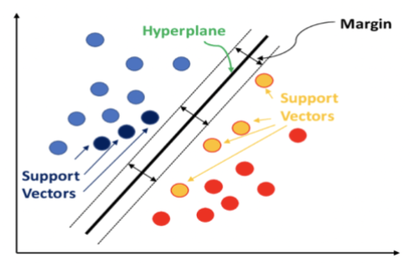

4. Intro to different models
(6) Support Vector Machine
Purpose: Support Vector Machine (SVM) is a versatile supervised learning algorithm used for both classification and regression tasks. Its primary goal is to find the optimal hyperplane that best separates classes in a high-dimensional space.
Model Principle: SVM operates on the principle of finding the hyperplane that maximizes the margin (distance) between different classes while minimizing classification errors. It aims to create a decision boundary that effectively separates different classes in the feature space.
Training and Interpretation: During training, SVM learns the optimal hyperplane by identifying support vectors, which are data points closest to the decision boundary. It handles complex decision boundaries using kernels that transform the input features into higher-dimensional space.
Methods and Formula: The main objective of SVM is to find the hyperplane equation that maximizes the margin between different classes. For linearly separable data, the equation of the hyperplane is , where w represents the weights, x denotes the input features, and b is the bias term. The decision boundary is defined by , and the distance between the hyperplane and the support vectors is maximized.

Slide 17
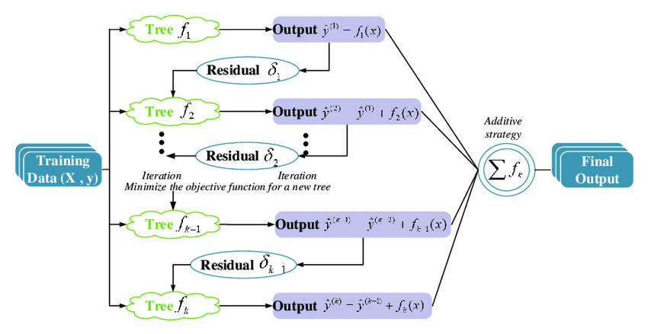

4. Intro to different models
(7) eXtreme Gradient Boosting
Purpose: XGBoost (eXtreme Gradient Boosting) is a powerful and efficient ensemble learning method used for both regression and classification tasks. Its primary goal is to sequentially build multiple decision trees and correct the errors of the previous trees by boosting (combining) their predictions.
Model Principle: XGBoost operates on the principle of boosting, where it combines weak learners (decision trees) to create a stronger ensemble model. It minimizes a predefined loss function by iteratively adding new trees, each one targeting the residuals (errors) of the preceding trees.
Training and Interpretation: During training, XGBoost optimizes the model by employing a gradient descent optimization technique, minimizing the loss function, and adding new trees that address the shortcomings of previous ones. The interpretation involves understanding how each tree contributes to the final predictions and the overall model's performance.

Slide 18
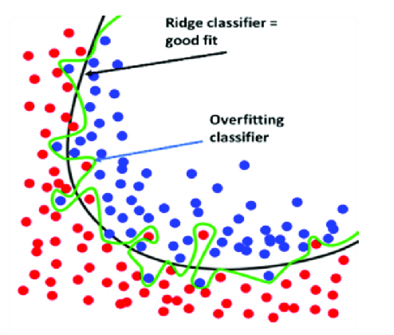



4. Intro to different models
(8) Ridge Classifier
Purpose: The Ridge Classifier is a linear classification model primarily used for solving binary and multiclass classification problems. It aims to classify data into different categories by finding the best hyperplane that separates the classes while minimizing the complexity of the model.
Model Principle: The Ridge Classifier is an extension of linear regression that includes regularization to prevent overfitting. It adds a regularization term (L2 norm penalty) to the standard linear regression objective, aiming to reduce the coefficients' magnitudes to prevent overemphasis on certain features.
Training and Interpretation: Training a Ridge Classifier involves fitting the model to the training data using a modified loss function that includes the regularization term. The model aims to minimize this modified objective function while considering both the accuracy in prediction and the complexity of the coefficients. Interpretation involves understanding the impact of regularization on the coefficients, as larger coefficients are penalized more, leading to a simpler model.
Methods and Formula: The Ridge Classifier minimizes a cost function that includes the sum of squared errors and a regularization term. The formula for the Ridge regression cost function is:
represents the ordinary least squares (OLS) loss, and represents the regularization term. α is the regularization parameter controlling the strength of regularization, and β_{j} are the coefficients being estimated.
Notes:
The Ridge Classifier uses a penalty term (α) to regularize the model, preventing extreme coefficient values. The regularization parameter helps balance the trade-off between fitting the training data well and keeping the model simple.

Slide 19
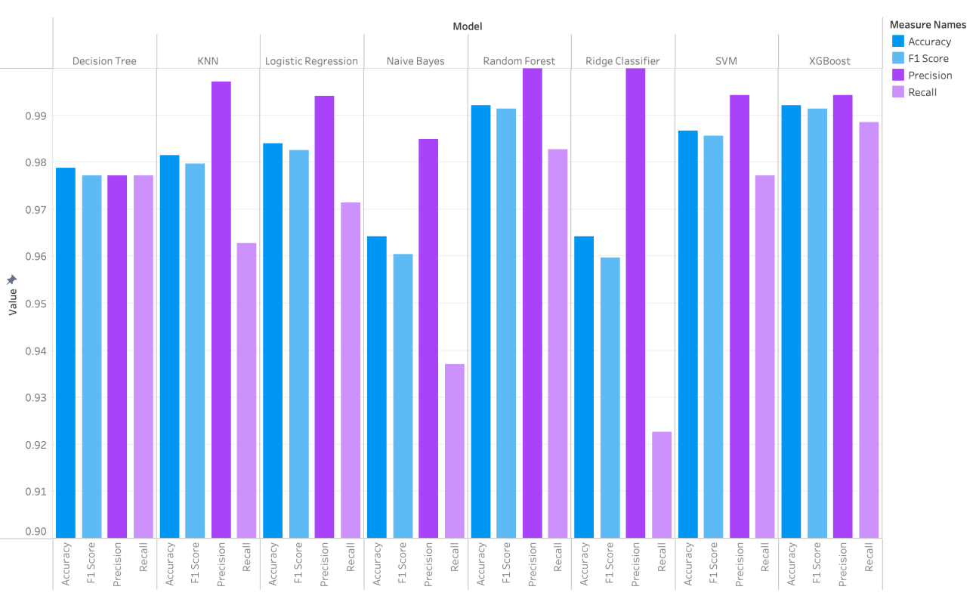
5. Models Performance

Slide 20
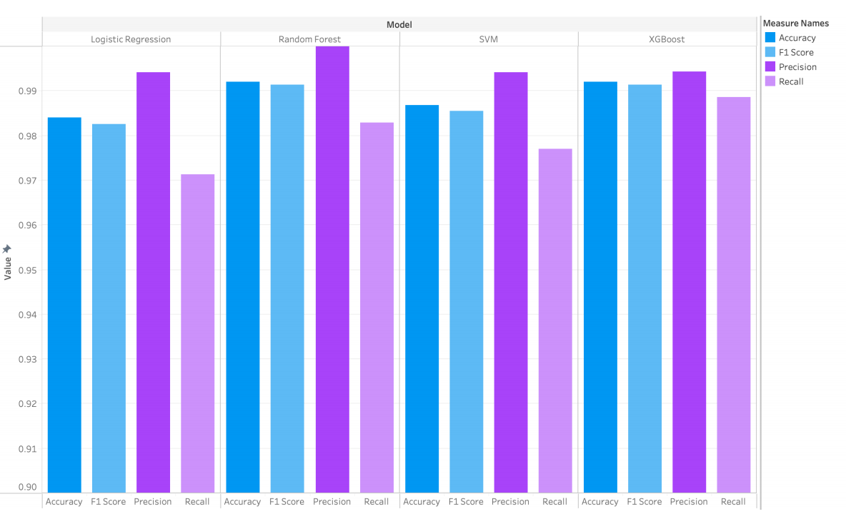
5. Models Performance

Slide 21
Conclusions
The dataset showcases large differences in the variables between Group 0 and Group 1, indicating statistical and practical relevance.
The 4 models we found most successful with our algorithm were Logistic Regression, Random Forest, SVM, and XGBoost.

Slide 22
Possibilities Moving Forward
Some possible ideas for building upon and adding to our algorithm:
Find more datasets with similar or the same data points to add to and improve our models
Create a webpage that allows the user to input their own data points and have our algorithm provide a likely result.
Increase the functionality of our algorithm by repeating this process with datasets for different kinds of diseases or conditions, allowing it to have more real-world uses.

Slide 23
Thank You!

