Slide 1
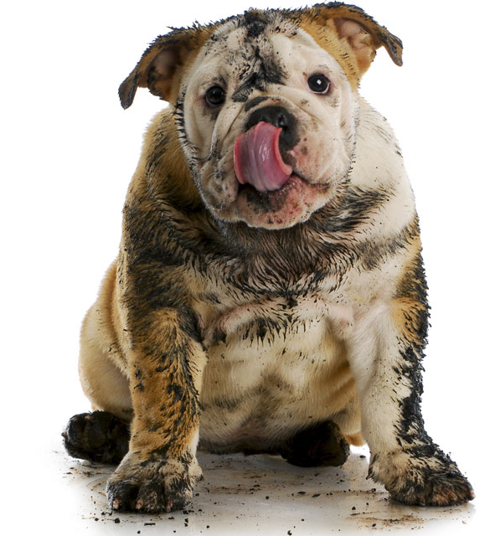
Project 3: Dirty Dog Finders Presented By: Craig Taylor Nathan Roberts Edgar Sanchez

Slide 2
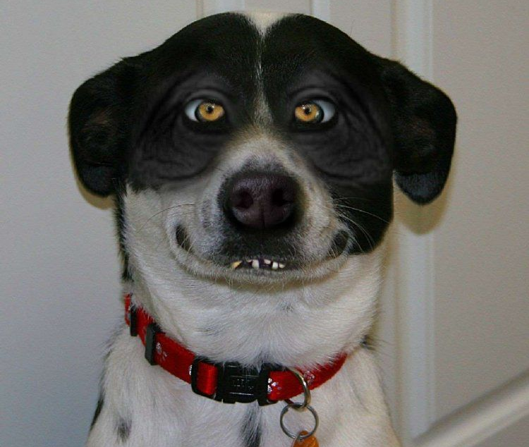
What is Dirty Dog Finder?
A sophisticated and easy to use application that helps you answer the age old question of “What the heck kind of dog is THAT?!”

Slide 3
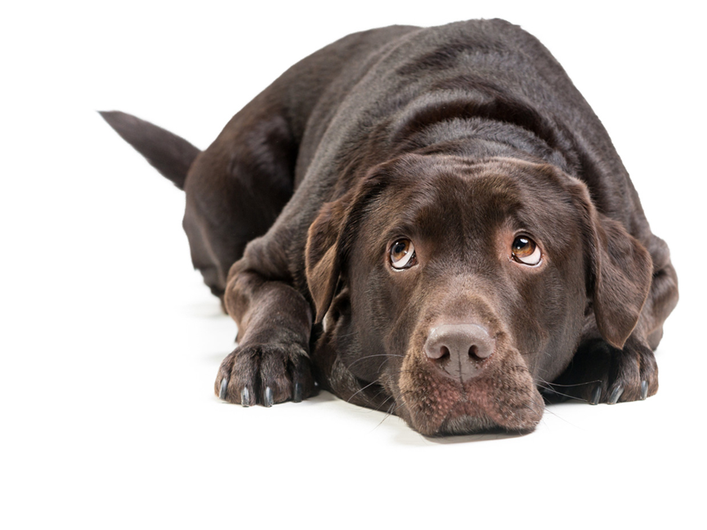
How it Works:
Simply snap a pic or upload an image and our deep neural network (magic) will identify the dogs breed and also give you info on where to buy your pooch.
Fun Facts: Using Computer Vision and Machine Learning, facial key points from the image are used to extract SIFT descriptors and color histograms, using SVM with a linear kernel it can predict a dogs breed 90% of the time.

Slide 4







Technologies Used:
Keras: Pretrained Stanford Model
HTML
CSS
Python
Pandas
Numpy
Flask
OpenCV

Slide 5
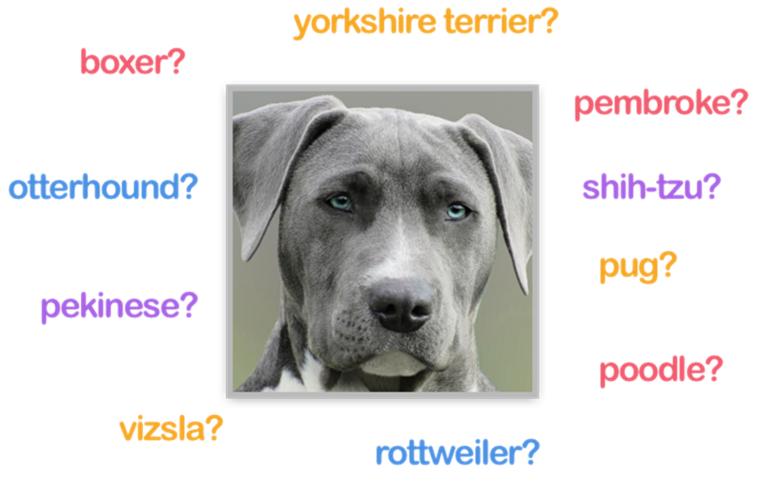
Demo and Questions

