Slide 1
Web Design Basics
Cindy Royal, Ph.D
Associate Professor
Texas State University
Knight Journalism Fellow at Stanford
cindyroyal@stanford.edu
cindyroyal.com
@cindyroyal

Slide 2
about me
Background in technology
Ph.D. from The University of Texas in 2005
Leads digital faculty at Texas State University
Knight Journalism Fellow at Stanford
Working on a platform to train journalists to code

Slide 3
what i teach
Web Publishing and Design
Fundamentals of Digital and Online Media
New Media Issues
Advanced Online Media
SXTXState project

Slide 4
background
HTML, later CSS
Blog platforms and content management systems
More advanced coding; JavaScript, JQuery, interactive tools
Portfolio platforms
Web design frameworks, Bootstrap
Development frameworks, like Ruby on Rails

Slide 5
design fundamentals
Alignment
Repetition
Proximity
Contrast

Slide 6
alignment
My Website
My Website
Home Resume Links
Home Resume Links
Welcome to my site
Cindy Royal is an associate professor in the School of Journalism and Mass Communication at Texas State University in San Marcos. She completed Ph.D. studies in Journalism and Mass Communication at The University of Texas at Austin in May 2005.
Courses
Web Design
Adv Media
New Media Issues
Fundamentals of Digital Media
Welcome to my site
Cindy Royal is an associate professor in the School of Journalism and Mass Communication at Texas State University in San Marcos. She completed Ph.D. studies in Journalism and Mass Communication at The University of Texas at Austin in May 2005.
Courses
Web Design
Adv Media
New Media Issues
Fundamentals of Digital Media
Choose an alignment and stick with it. Use sections to create interesting layouts.

Slide 7
repetition
My Website
Color scheme
Logo/Graphics
Navigation
Fonts
Home Resume Links
Welcome to my site
Cindy Royal is an associate professor in the School of Journalism and Mass Communication at Texas State University in San Marcos. She completed Ph.D. studies in Journalism and Mass Communication at The University of Texas at Austin in May 2005.
Courses
Web Design
Adv Media
New Media Issues
Fundamentals of Digital Media
Use repetition throughout the site. User should feel familiar with interface throughout site visit.

Slide 8
repetition
My Website
Color scheme
Graphics
Navigation
Fonts
Home Resume Links
Welcome to my site
Cindy Royal is an associate professor in the School of Journalism and Mass Communication at Texas State University in San Marcos. She completed Ph.D. studies in Journalism and Mass Communication at The University of Texas at Austin in May 2005.
Courses
Web Design
Adv Media
New Media Issues
Fundamentals of Digital Media
My Website
Resume
Experience
Associate Professor, Texas State University
Publications
"Gender and Technology: Women's Usage, Creation and Perspectives" in Gender and Pop Culture…
Home Resume Links
Bad

Slide 9
proximity
My Website
Things that are related should be close to each other
Home Resume Links
Welcome
Cindy Royal is an associate professor in the School of Journalism and Mass Communication at Texas State University in San Marcos. She completed Ph.D. studies in Journalism and Mass Communication at The University of Texas at Austin in May 2005.
Courses
Web Design
Adv Media
New Media Issues
Fundamentals of Digital Media

Slide 10
proximity
My Website
Things that are related should be close to each other
Home Resume Links
Welcome
Cindy Royal is an associate professor in the School of Journalism and Mass Communication at Texas State University in San Marcos. She completed Ph.D. studies in Journalism and Mass Communication at The University of Texas at Austin in May 2005.
Courses
Web Design
Adv Media
New Media Issues
Fundamentals of Digital Media

Slide 11
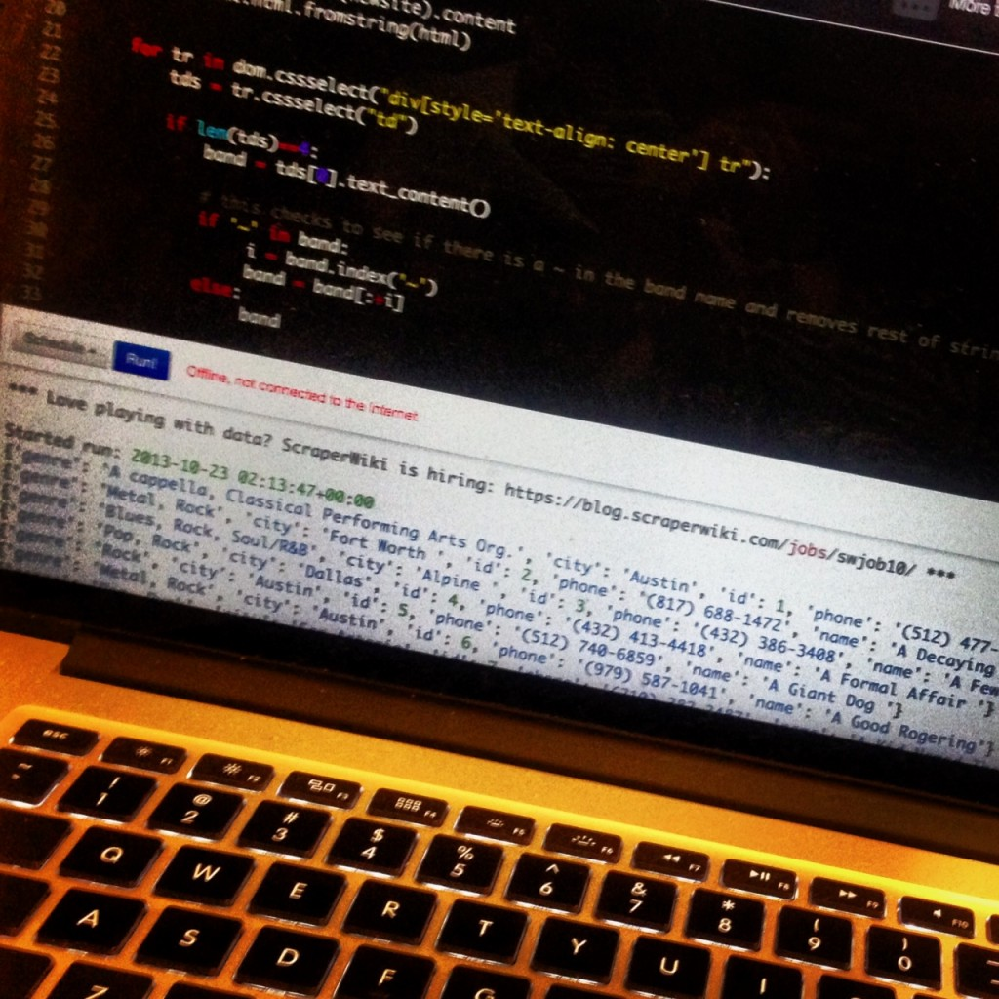
contrast
My Website
You can’t lose with dark text on white background.
Contrast also has to do with sizing and placement. Things that are different should look different
Home Resume Links
Welcome
Cindy Royal is an associate professor in the School of Journalism and Mass Communication at Texas State University in San Marcos. She completed Ph.D. studies in Journalism and Mass Communication at The University of Texas at Austin in May 2005.
Courses
Web Design
Adv Media
New Media Issues
Fundamentals of Digital Media

Slide 12
grammar, punctuation, spelling
Check and re-check
Have someone proofread
This is particularly important for communicators

Slide 13
a few words about fonts
Select fonts in graphics that reflect your style; avoid jokey or comic fonts for professional sites
The user must have the font on his/her computer for it to render in body text (exception, font libraries)
Sans-serif works best on Web, but some prefer serif. Serif can express more formal and authoritative feeling.
Fonts should be consistent; one, possibly two, at the most on the entire site
Rely on CSS to control font and layout aspects across your site

Slide 14
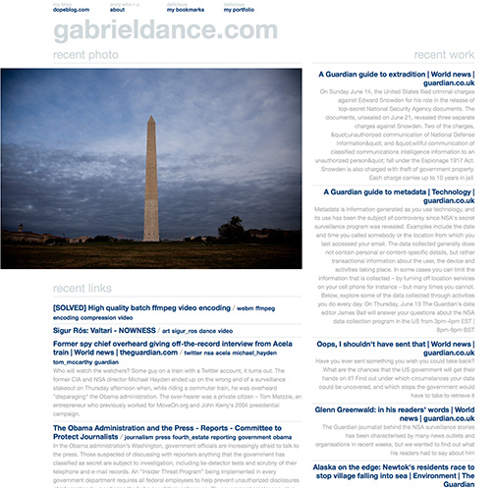
site examples

Slide 15
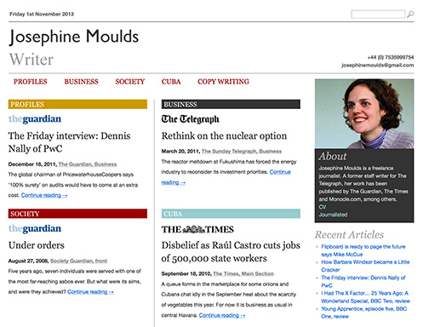
site examples

Slide 16
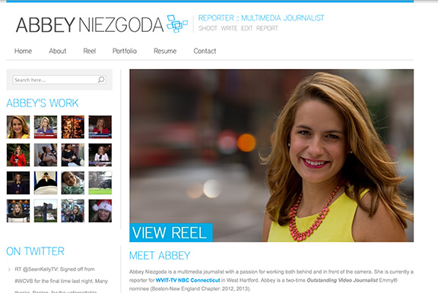
site examples

Slide 17
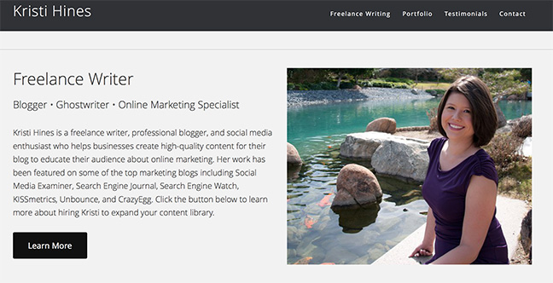
site examples

Slide 18
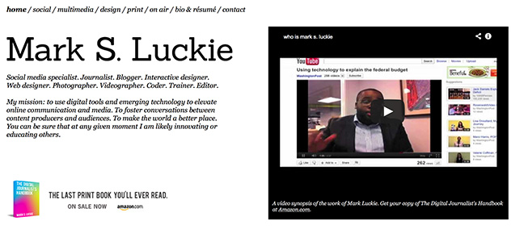
site examples

Slide 19
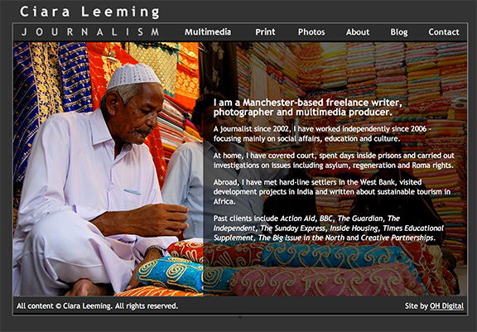
site examples

Slide 20
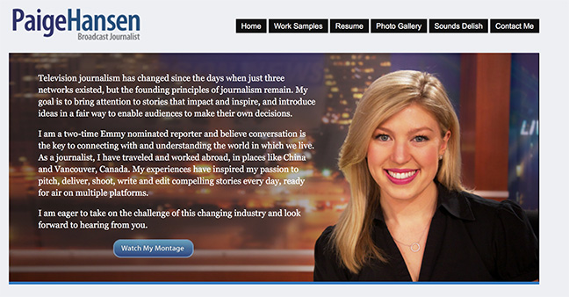
site examples

Slide 21
site examples
Other good sites for inspiration
Very Nice Sites - www.verynicesites.com
Mashable Web Design Inspiration - mashable.com/2013/10/09/web-design-inspiration-2

Slide 22
misc
Web design trends – dominant visual, flat design
Get your own domain. Use it on resume, business cards, etc.
Blogging can establish you as an expert in your area. Use it to demonstrate your talent, interests, passions in items you don’t necessarily want to have published.
Use social media to promote your work. Try to get consistent usernames across media.
Responsive design. Site should look great on mobile, at different formats.

Slide 23
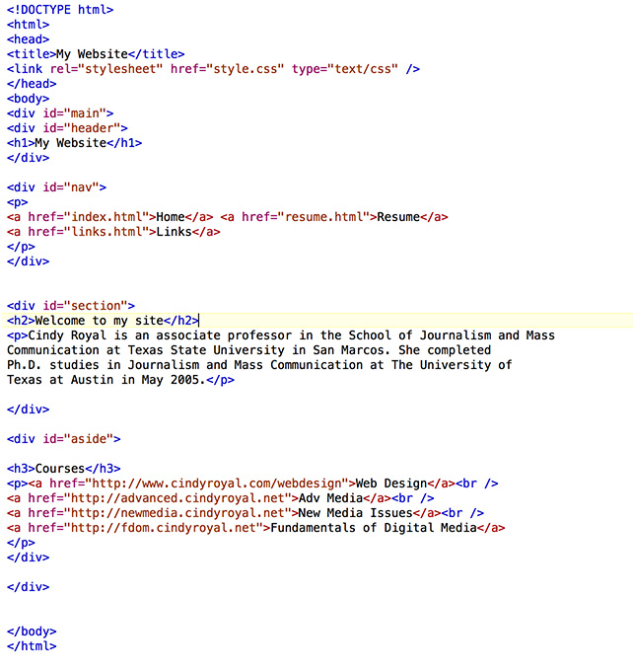
basic html
Hypertext Markup Language
Control structure of content
Need a good html editor; something like TextEdit will work, but better to use something like TextWrangler, KomodoEdit, SublimeText, TextMate
Open and close tags
<html>
</html>
Attributes and values: <a href=“http://www.google.com”>Google</a>

Slide 24
sample html
<!DOCTYPE html>
<html>
<head>
<title>Cindy Royal</title>
</head>
<body>
<h1>Cindy Royal</h1>
<h2>Welcome</h2>
<p>Welcome to my portfolio…</p>
</body>
</html>

Slide 25
basic css
Cascading Stylesheets
Controls the design and layout of the site
Use divs for sections, then use CSS for placement
Reference at the top of the html page with <link> tag
p { font-family: Helvetica; font-size: 12px; color: #0022aa; }
Media Queries for responsive design; also % width and % images
@media screen and (max-width: 480px)
Chrome Inspect Element

Slide 26
site options
Pressfolios.com – easy; limited customization; pay extra for custom domain name; sort of responsive
SquareSpace.com – more templates; responsive; comments and statistics; custom domain with paid
Wordpress.com – easy; variety of themes; limited customization; pay extra for CSS access and domain name; blog platform
Wordpress – self hosted for maximum customization; blog platform; I have used Bluehost, but there are many hosts
Bootstrap – advanced Web design; customization; flexibility; host on your own virtual host
Others – Weebly, Wix

Slide 27
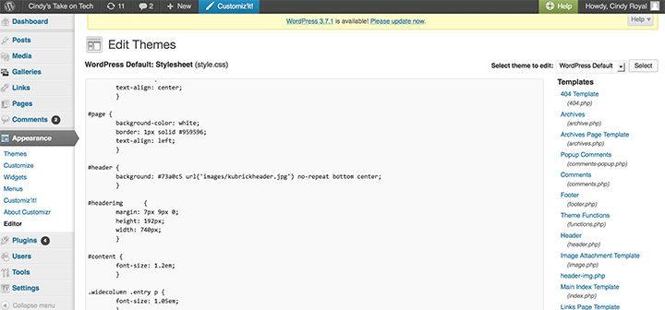
Wordpress

Slide 28
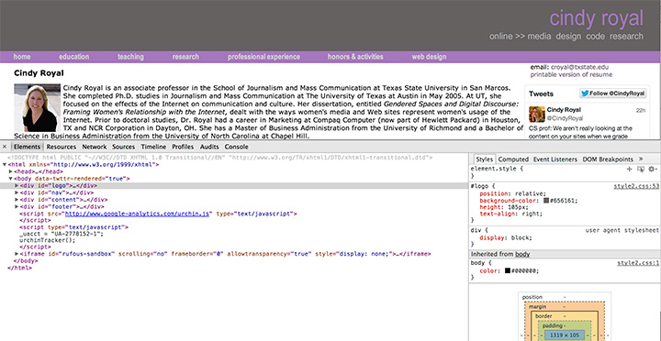
Chrome Inspect Element

Slide 29
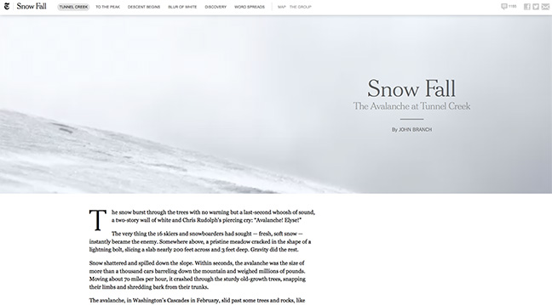

the future
Data visualization in investigative reporting
Snowfall-type interfaces
Mobile
Second-screen engagement

Slide 30
resources
DocHub – dochub.io
HTMLDog - htmldog.com
SitePoint CSS reference - reference.sitepoint.com/css
CSS3 Previews - www.css3.info/preview

