Slide 1
Fake Product Identification Using Blockchain
Nguyen Quang Canh - 22028200
Nguyen Van Thuan - 22028194

Slide 2
INTRODUCTION
In a world riddled with counterfeit goods, our project leverages the power of blockchain technology to establish a robust system for product authentication. This initiative not only addresses the pressing issue of fake products but also aims to redefine trust and transparency in the marketplace. Join us as we explore the innovative solutions designed to combat the proliferation of counterfeit items and protect consumers and businesses alike.

Slide 3
AIM
Enhance Consumer Trust:
The primary aim is to build a system that fosters trust among consumers by ensuring the authenticity of the products they purchase.
Combat Counterfeiting:
Implement robust measures using blockchain technology to effectively identify and eliminate counterfeit products from the market.
Establish Transparency:
Create a transparent and traceable supply chain through blockchain, providing stakeholders with real-time visibility into the production, distribution, and authentication of products

Slide 4
CHALLENGES
Browser Compatibility: Compatibility across different web browsers posed a challenge, as the project relied upon specific features of metamask extension that behaved differently across browsers.
Performance: Ensuring that the frontend operates efficiently and responds promptly to user interactions, even when interacting with the blockchain, was a concern. Slow loading times or lag in transactions can deter users.
Security: Implementing security measures in the frontend to protect user data and private keys was critical. Failing to do so could expose users to risks like unauthorized access and data breaches.

Slide 5
Requirements
Hardware
Blockchain Nodes
High-Performance Servers
Printers and Scanners
Software
Blockchain Framework
Smart Contract Development Tools
Database Management System

Slide 6
Project’s Workflow

Slide 7
A report with location and product info is generated that is then shared with the manufacturer.
Anyone who is buying the product can verify it’s authenticity using a QR present on the label.
Manufacturer registers the product and sells it to the seller.
Product Registration
Blockchain Authentication
Product Verification
Alerts for Counterfeit Detection
Sending Report to Manufacturer
Product registration and sale is authenticated using a blockchain.
If product is a counterfeit, the customer gets notified.

Slide 8
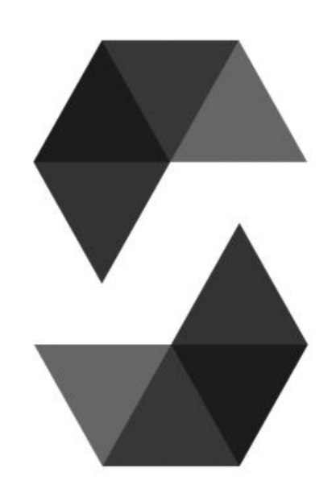




Tech Stack

Slide 9
Project’s Output

Slide 10
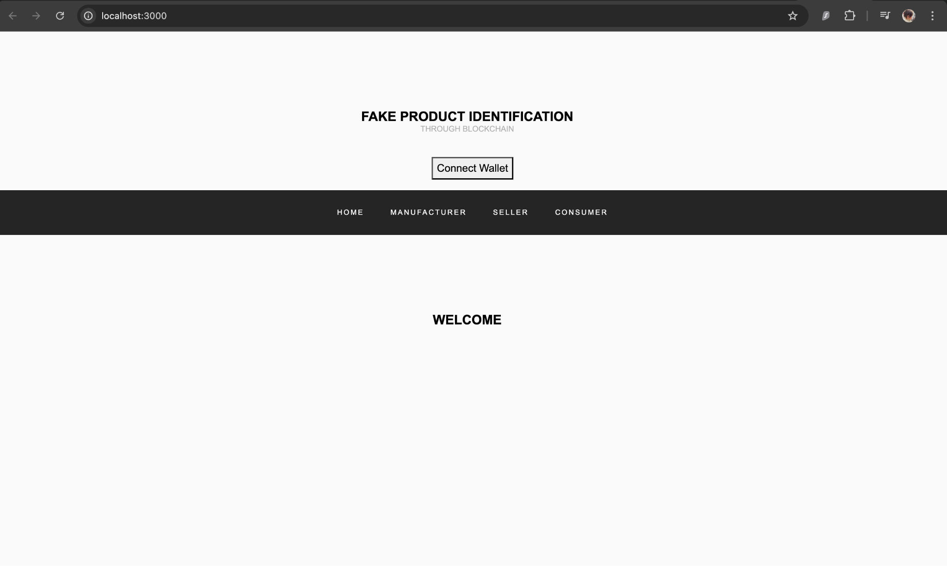

Slide 11
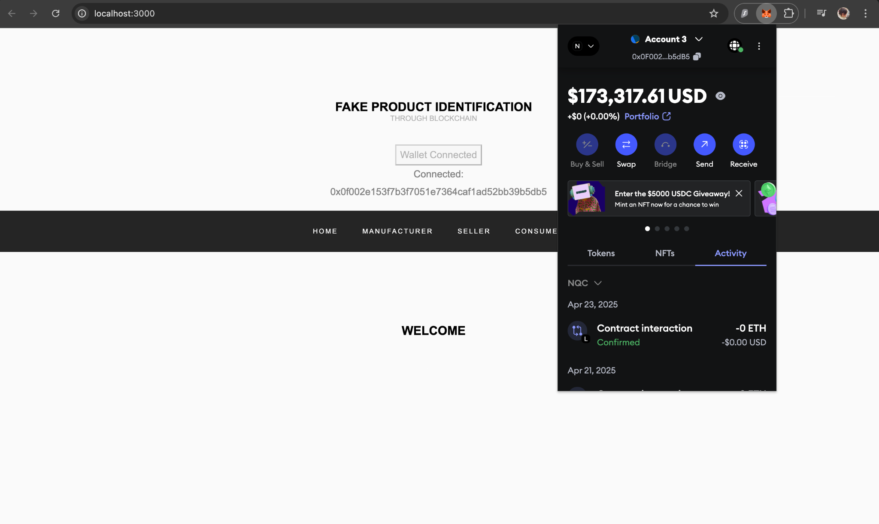

Slide 12
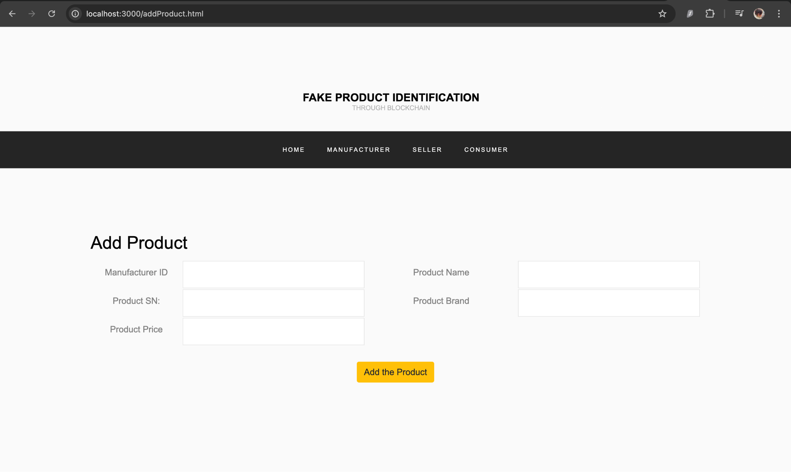

Slide 13
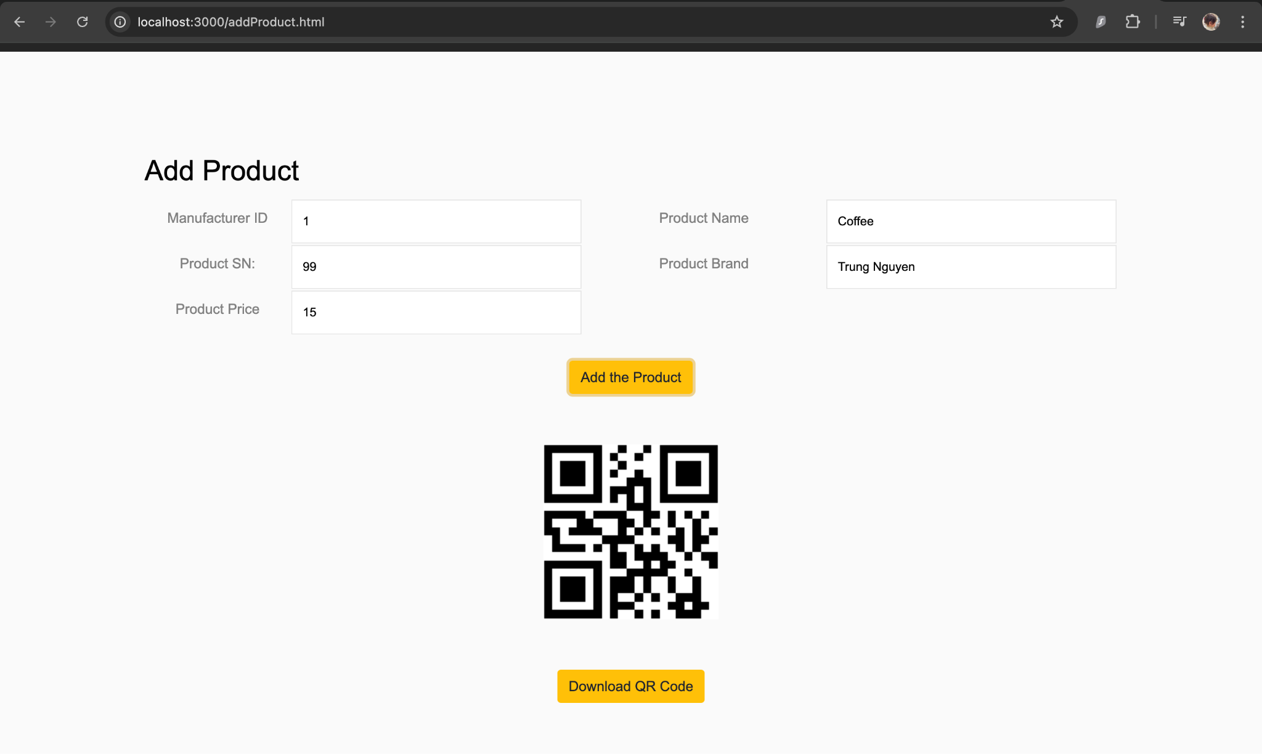

Slide 14
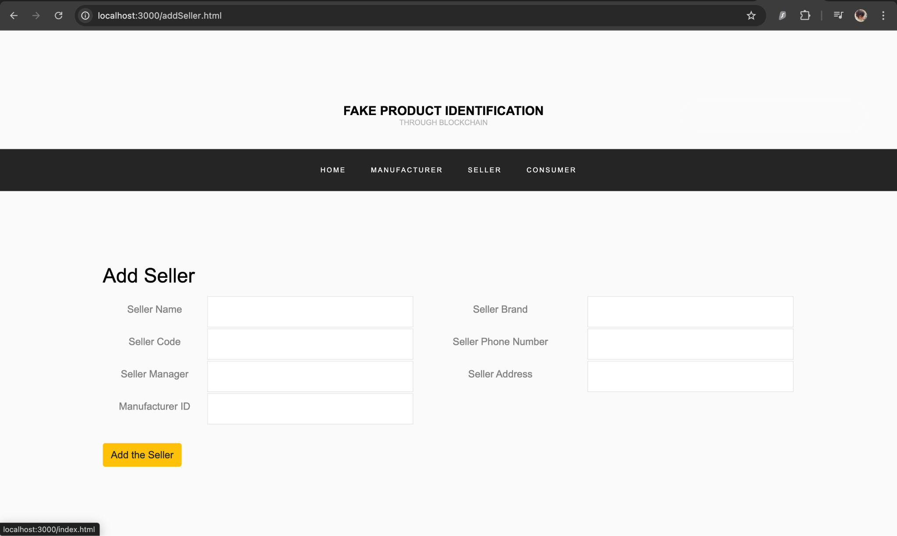

Slide 15
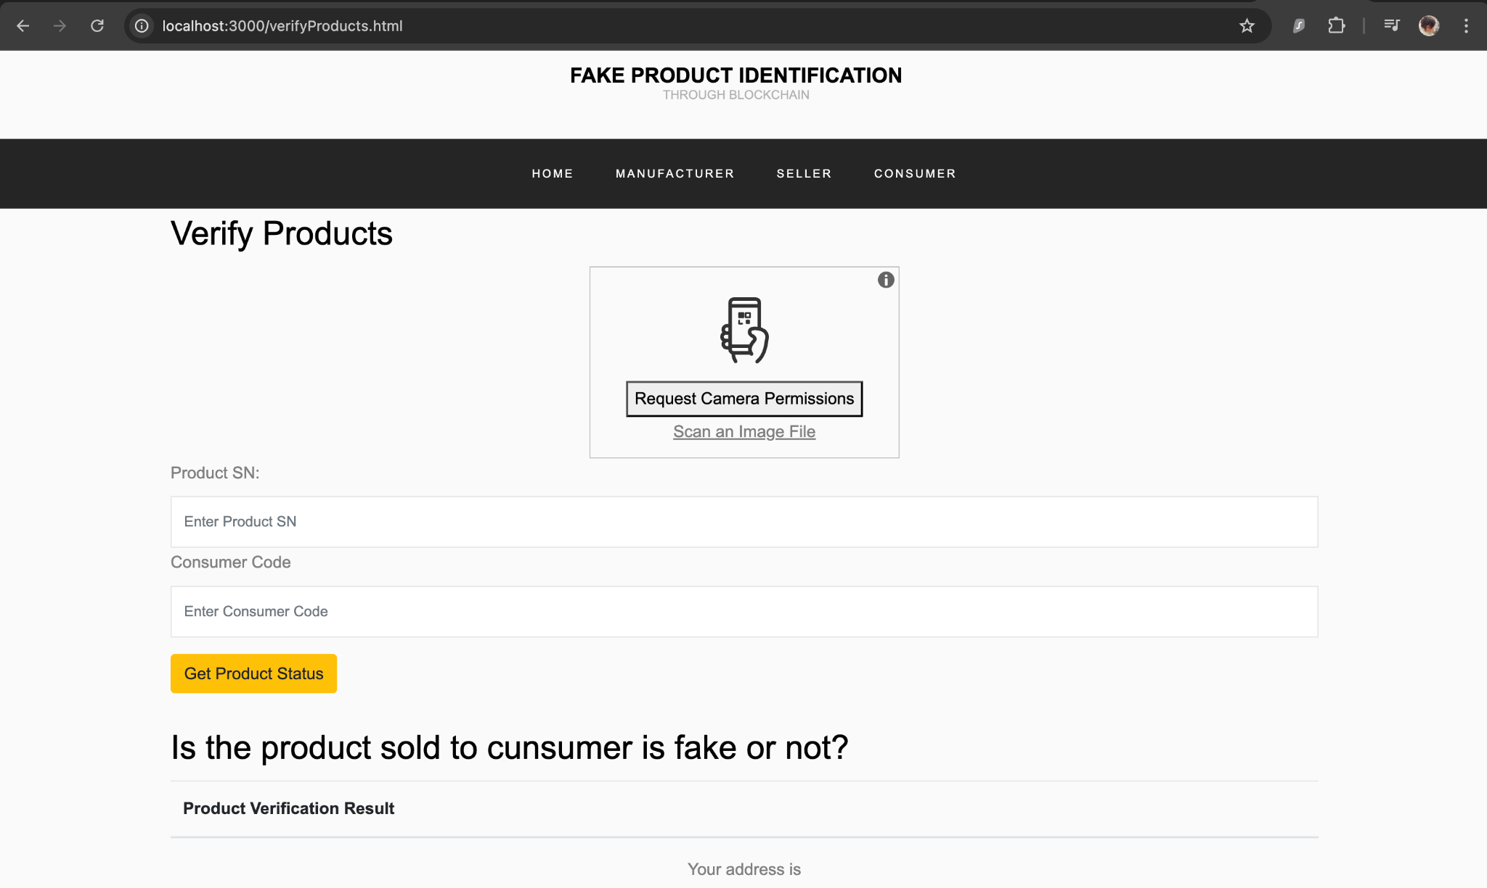

Slide 16
Applications
Pharmaceuticals:
Ensure the authenticity of medicines, preventing the circulation of counterfeit drugs and safeguarding public health.
Luxury Goods:
Authenticate high-end products such as designer handbags and watches, protecting both consumers and brands from counterfeit replicas.
Electronics:
Combat the proliferation of counterfeit electronics by verifying the legitimacy of devices and components at various stages of the supply chain.

Slide 17
Applications
Food and Beverages:
Guarantee the authenticity and safety of food products, reducing the risk of counterfeit consumables entering the market.
Automotive Parts:
Verify the authenticity of critical automotive components, mitigating the safety risks associated with counterfeit parts in the automotive industry.
Apparel and Fashion:
Protect fashion brands and consumers from fake apparel items, ensuring the purchase of genuine products with verified origins.

Slide 18
Future Works in the Project
Improving UI/UX of the website.
Designing a more user friendly and secure on boarding system.
Developing a mobile application for ease of use.
Optimizing engine to make it even faster and more resource efficient.
Designing a more secure server client communication system.

Slide 19
References
[1] A Blockchain-Based Fake Product Identification System - Yasmeen Dabbagh; Reem Khoja; Leena AlZahrani; Ghada AlShowaier; Nidal Nasser
[2] Fast-HotStuff: A Fast and Robust BFT Protocol for Blockchains -
Mohammad Jalalzai, Chen Feng, Jianyu Niu, Fangyu Gai
[3] AChecker: Statically Detecting Smart Contract Access Control
Vulnerabilities - Asem Ghaleb, Karthik Pattabiraman, Julia Rubin
[4] Trade in fake goods is now 3.3% of world trade and rising, March 2019, [online].

Slide 20
Thank you for listening!

