Slide 1
GRAFANA STACK
Not just a SRE toolkit
DENIS JAJCEVIC
CROZ

Slide 2

It’s a powerful visualization tool that allows you to create, explore, and share dashboards of your data. This can help you monitor system performance, identify trends, and spot anomalies.
@djajcevic | @croz

Slide 3
Grafana
27/02/2024
@djajcevic | @croz

Slide 4
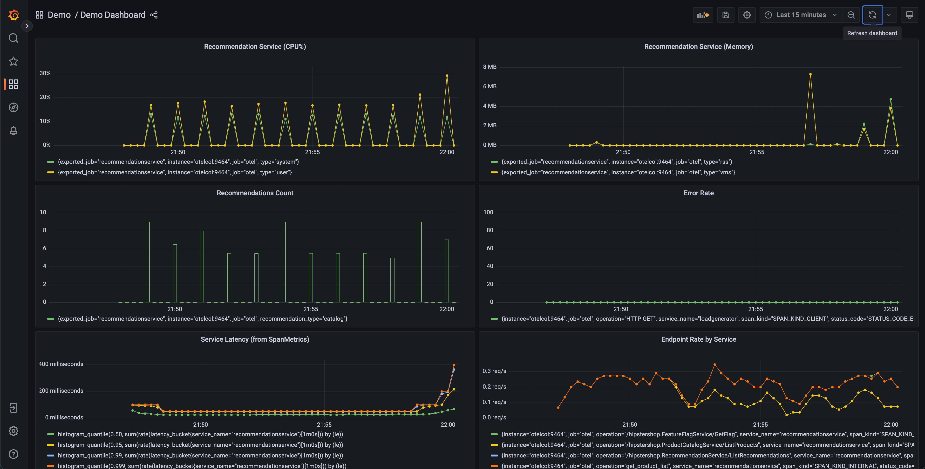
Grafana
@djajcevic | @croz

Slide 5

Loki is a horizontally-scalable, highly-available, multi-tenant log aggregation system.
Unlike other log aggregation systems, Loki only indexes the labels and metadata from each message, which allows it to process lots of messages quickly.
This can help you find the root cause of production system issues more efficiently.
@djajcevic | @croz

Slide 6
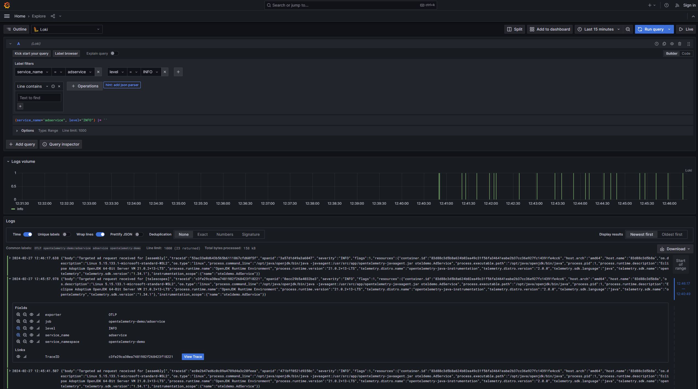
Grafana Loki
27/02/2024
@djajcevic | @croz

Slide 7

Mimir lets you scale metrics to 1 billion active series and beyond, with high availability, multi-tenancy, durable storage, and blazing fast query performance over long periods of time.
@djajcevic | @croz

Slide 8
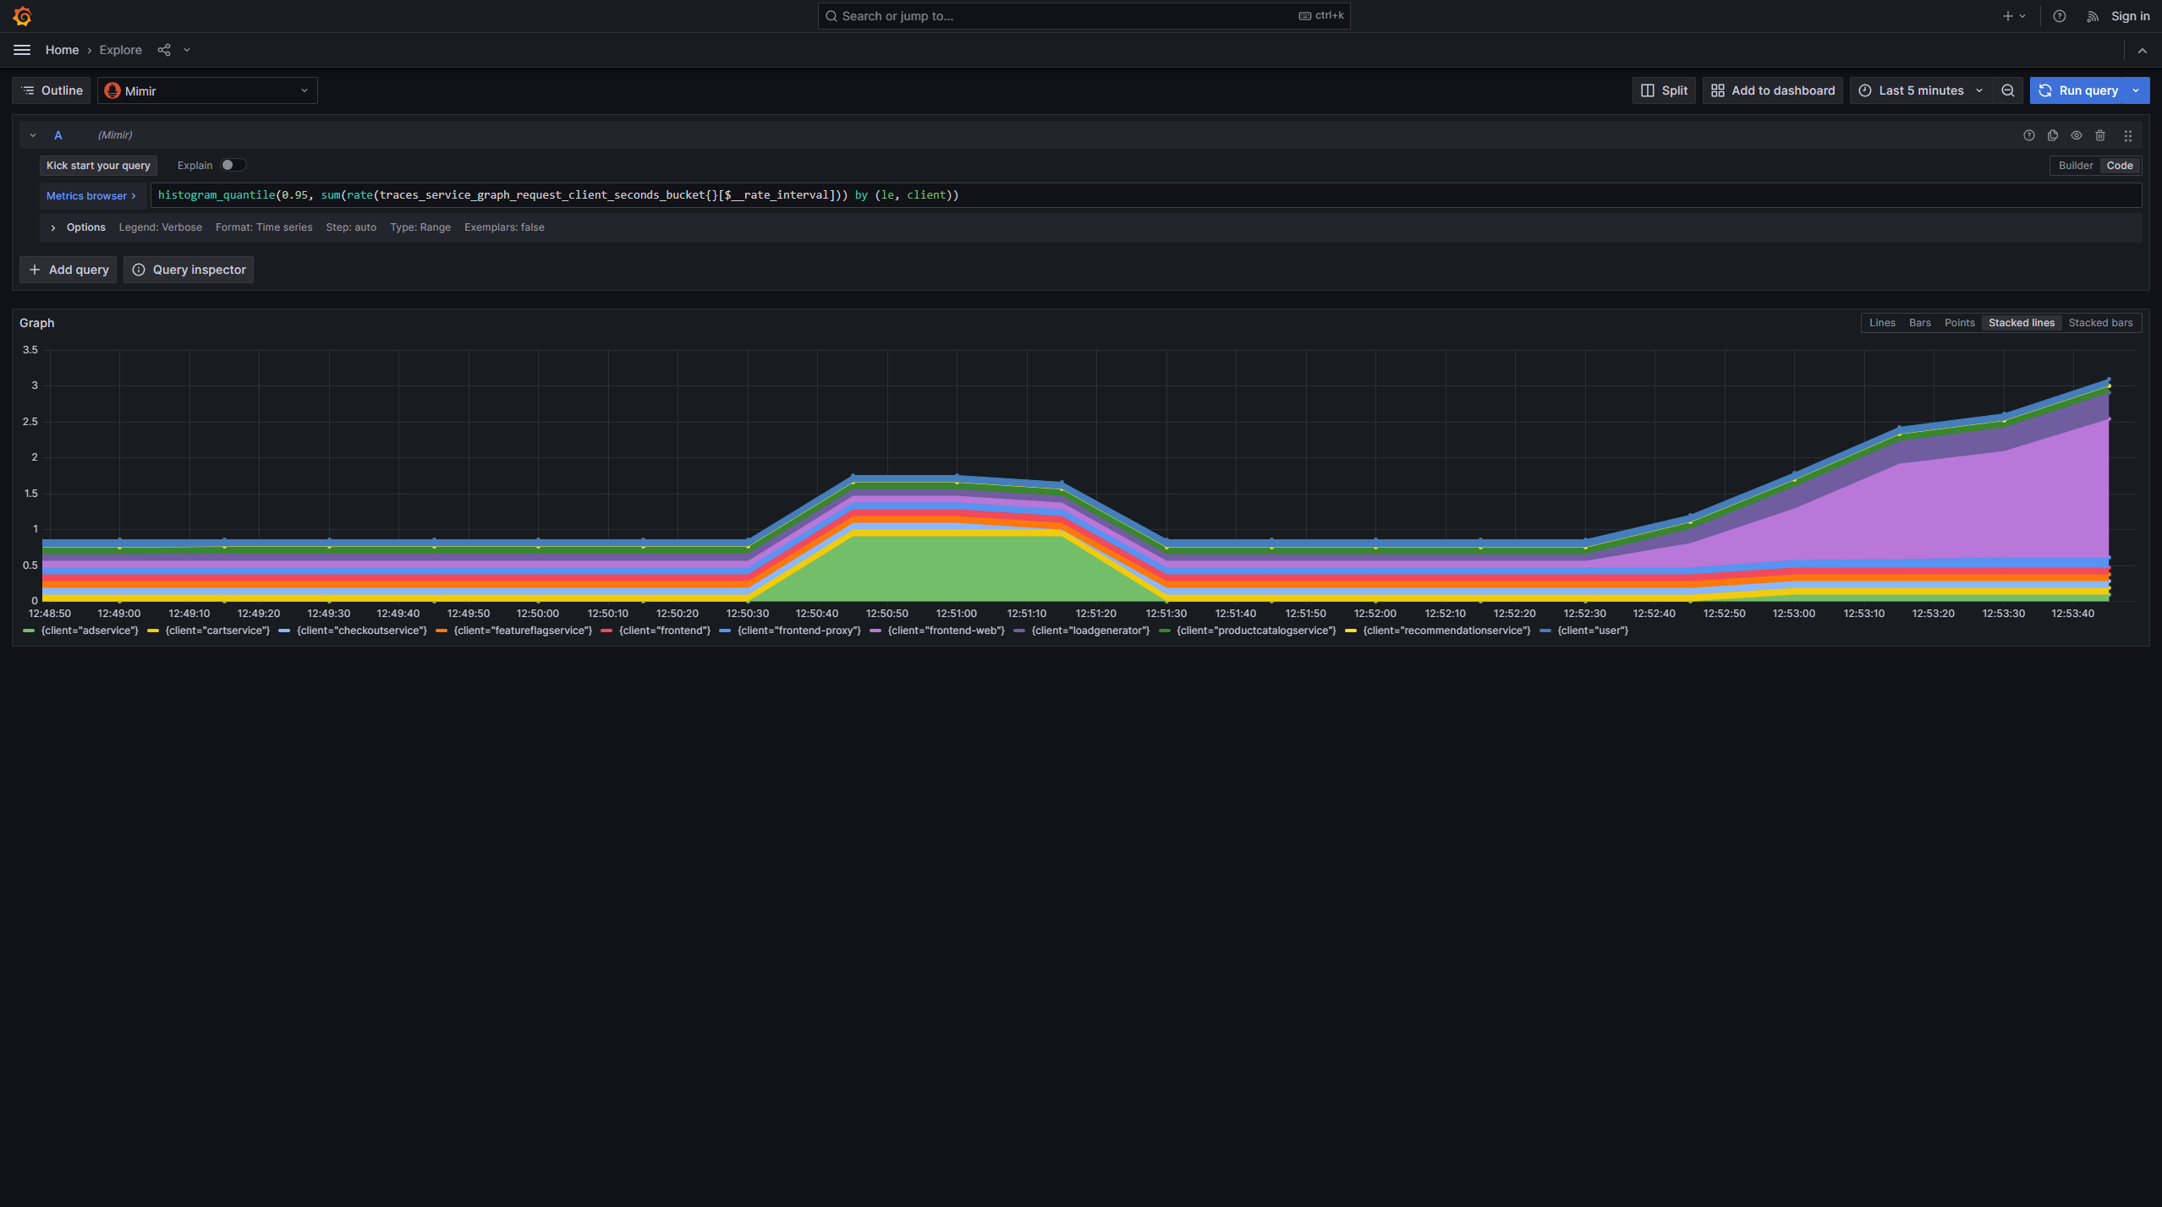
Grafana Mimir
27/02/2024
@djajcevic | @croz

Slide 9

Grafana Tempo is an open source, easy-to-use, and high-scale distributed tracing backend. Tempo is cost-efficient, requiring only object storage to operate, and is deeply integrated with Grafana, Prometheus, and Loki. Tempo can ingest common open source tracing protocols, including Jaeger, Zipkin, and OpenTelemetry.
@djajcevic | @croz

Slide 10
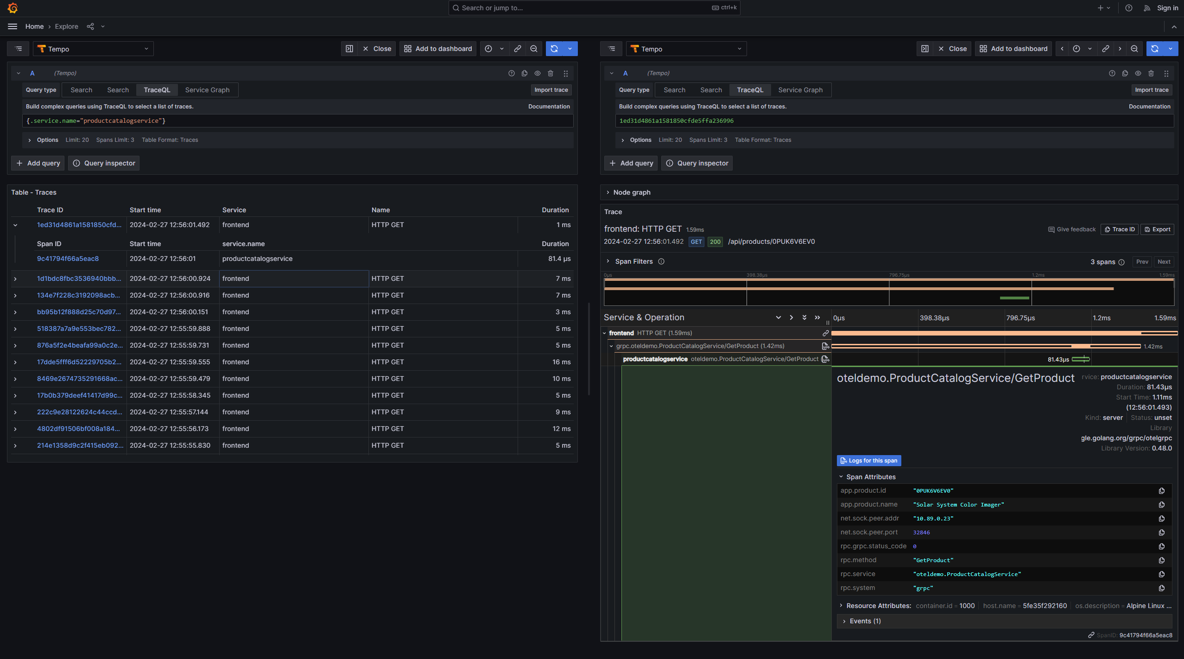
Grafana Tempo
27/02/2024
@djajcevic | @croz

Slide 11
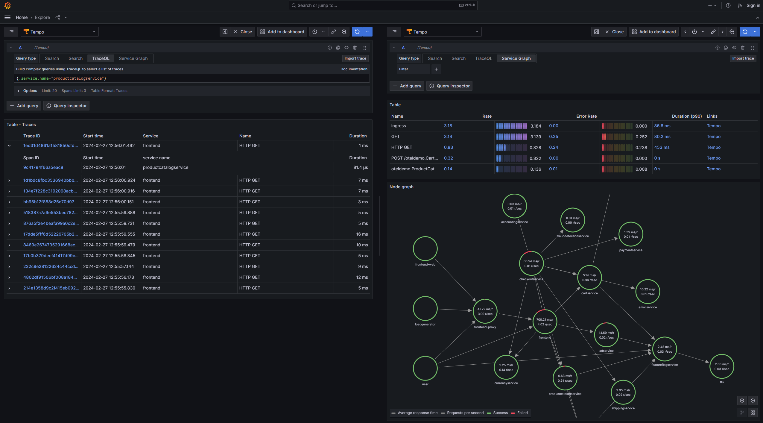
Grafana Tempo
27/02/2024
@djajcevic | @croz

Slide 12

OTel
OpenTelemetry is a collection of APIs, SDKs, and tools. Use it to instrument, generate, collect, and export telemetry data (metrics, logs, and traces) to help you analyze your software’s performance and behavior.
https://github.com/open-telemetry/opentelemetry-demo
https://opentelemetry.io/docs/demo/docker-deployment
@djajcevic | @croz

Slide 13
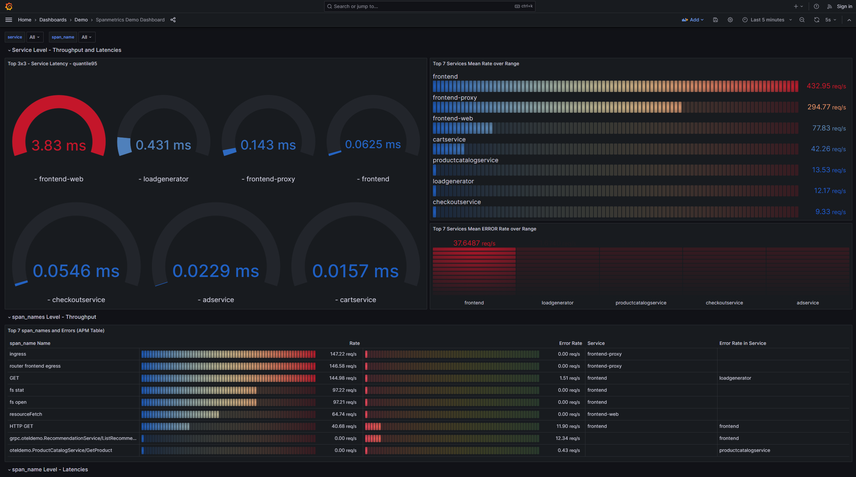
Grafana OTel Demo Dashboards
27/02/2024
@djajcevic | @croz

Slide 14
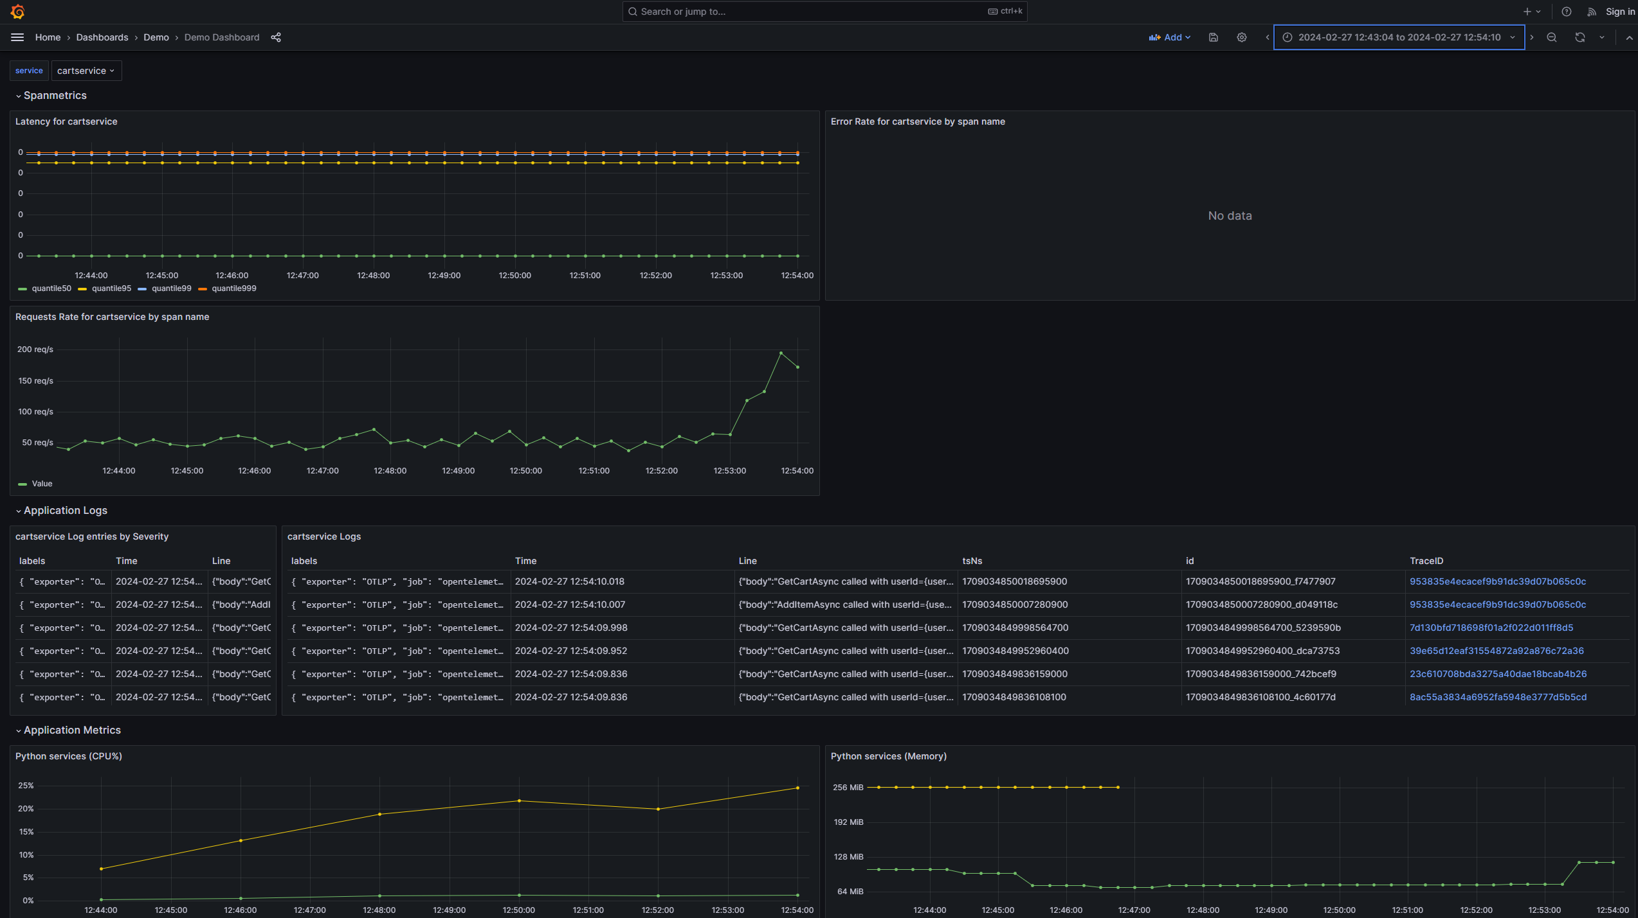
Grafana OTel Demo Dashboards
27/02/2024
@djajcevic | @croz

Slide 15
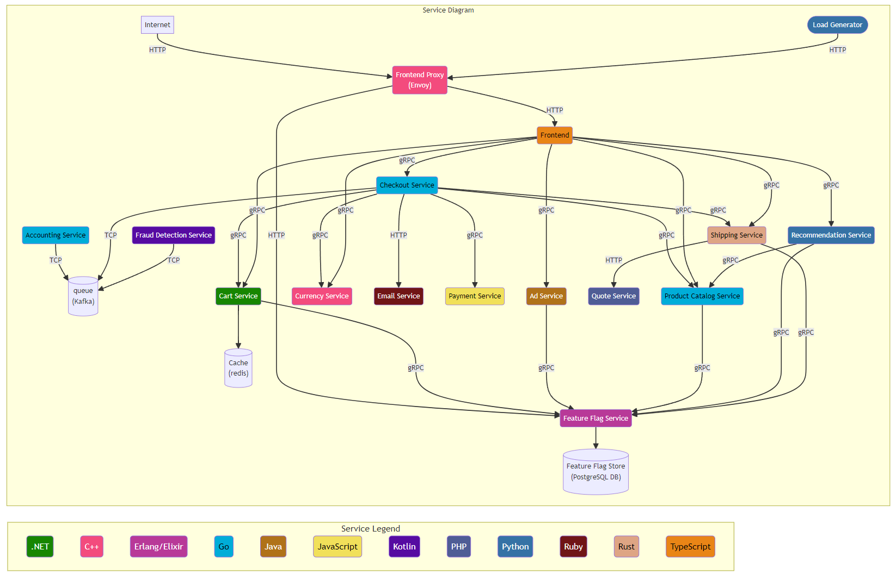
OTel Demo Architecture
27/02/2024
@djajcevic | @croz

Slide 16
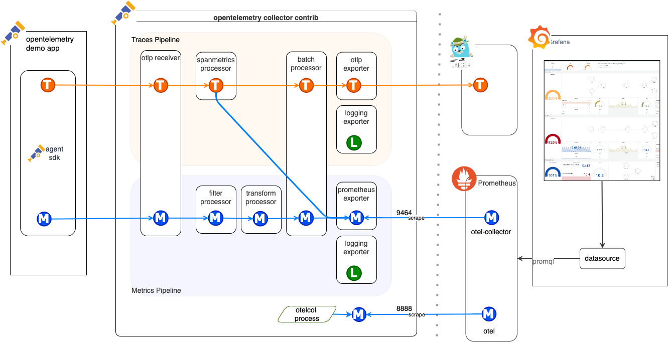
@djajcevic | @croz

Slide 17
DEMO TIME
@djajcevic | @croz

