Slide 1
QUBIT ZERO TO HERO
Vectors, matrices
and operators
S02 · Mathematical foundations
LaTeX derivations with NumPy and QuTiP checks
01 / 38
Notes:
This follows S01 complex numbers and phase. Allow two sessions of about 60 minutes, or one extended session with a break after slide 17. The 28 core slides cover linear algebra needed for qubit simulation. Four appendices supply notation, a proof, practice answers and run commands. Define each new symbol before using it. QuTiP stays the simulation framework. Formulas are compiled from LaTeX and embedded as rendered images; formulas.tex and Markdown retain the editable equation source.

Slide 2

S02 / LINEAR ALGEBRA
Column vectors and components
A column vector stores ordered complex components.
Its shape records two rows and one column.
A ket is a quantum-state column vector with a specified basis.
02 / 38
Notes:
Connect each component to S01 scalar complex numbers. C denotes the complex numbers, and the superscript 2 by 1 describes the shape. Order matters: exchanging entries generally changes the vector. A ket notation such as |psi> names a vector in an abstract Hilbert space; its displayed components depend on the chosen basis. In NumPy a one-dimensional array has shape (2,), so use an explicit column shape when comparing with QuTiP full(), whose ket shape is (2,1).
LaTeX:
v=\begin{pmatrix}v_1\\v_2\end{pmatrix}\in\mathbb C^{2\times1},\qquad v_1,v_2\in\mathbb C

Slide 3

S02 / LINEAR ALGEBRA
Matrix shapes and multiplication
The shared dimension n must agree.
Each output component is a row of A multiplied by the column v.
03 / 38
Notes:
Read m as the number of matrix rows and n as columns. Show a 2 by 2 matrix acting on a two-component column. Each output is a sum over the shared index j. This is a linear map: A(cu+dv)=cAu+dAv for complex scalars c and d. Matrix multiplication is not entrywise multiplication. In NumPy use @ for the linear-algebra product. In QuTiP, multiplication between Qobj instances uses *. This difference is revisited in the code walkthrough.
LaTeX:
A\in\mathbb C^{m\times n},\quad v\in\mathbb C^{n\times1},\quad Av\in\mathbb C^{m\times1}\\[12pt](Av)_i=\sum_{j=1}^{n}A_{ij}v_j

Slide 4

S02 / LINEAR ALGEBRA
Example 1 · Normalizing a vector
Normalization divides every component by the same positive norm.
The zero vector cannot be normalized.
04 / 38
Notes:
Worked example 1. Use |i|²=1 from S01. A raw vector is not automatically a normalized state. Dividing by sqrt(2) leaves relative phase and component ratios intact while setting total squared magnitude to one. This example anticipates the formal inner-product norm in slide 8. Ask learners to check the two squared magnitudes separately. A zero vector has norm zero, so division is undefined. QuTiP .unit() and a NumPy division by the norm are numerical counterparts for a nonzero vector.
LaTeX:
v=\begin{pmatrix}1\\ i\end{pmatrix},\qquad \|v\|=\sqrt{|1|^2+|i|^2}=\sqrt2\\[12pt]u=\frac{v}{\|v\|}=\frac1{\sqrt2}\begin{pmatrix}1\\ i\end{pmatrix},\qquad\|u\|=1

Slide 5
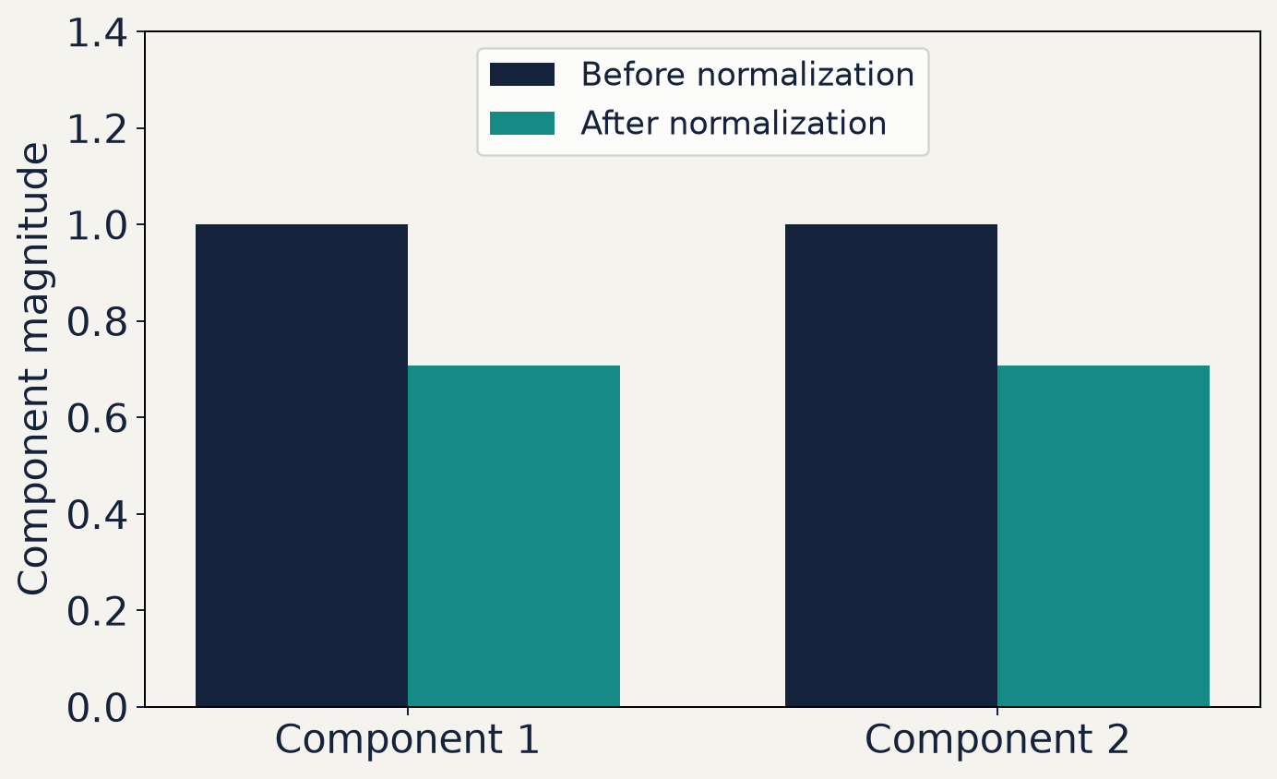
S02 / LINEAR ALGEBRA
Normalization preserves component ratios
The example vector has component magnitudes 1 and 1.
Dividing by √2 scales both magnitudes equally.
The sum of squared magnitudes changes from 2 to 1.
05 / 38
Notes:
This chart shows component magnitudes, not coordinates of a real two-dimensional arrow. The vector in Example 1 has complex entries 1 and i. Its two magnitudes are both one before normalization and 1/sqrt(2) afterward. The relative phase remains pi/2. Bars are deterministic values, not measurement samples. Ask learners to square and sum the bars. Source: plot_illustrations.py, normalization figure.

Slide 6

S02 / LINEAR ALGEBRA
Transpose, conjugate and adjoint
Transpose exchanges rows and columns.
Adjoint conjugates every entry and then transposes.
06 / 38
Notes:
The superscript T means transpose. Here A* means entrywise complex conjugation and dagger means conjugate transpose. This convention must be stated because some texts use a star for the adjoint. In NumPy use A.conj().T; A.T alone is insufficient for complex data. In QuTiP use A.dag(). The adjoint reverses multiplication order. A column becomes a row, enabling a scalar inner product. In Dirac notation the adjoint of a ket is a bra.
LaTeX:
v=\begin{pmatrix}1\\i\end{pmatrix},\quad v^{\mathsf T}=\begin{pmatrix}1&i\end{pmatrix},\quad v^\dagger=\begin{pmatrix}1&-i\end{pmatrix}\\[12pt]A^\dagger=(A^*)^{\mathsf T},\qquad (AB)^\dagger=B^\dagger A^\dagger

Slide 7

S02 / LINEAR ALGEBRA
The complex inner product
The first vector is conjugated in this convention.
The inner product is a complex scalar.
Orthogonal vectors have inner product zero.
07 / 38
Notes:
State the physicists’ convention: the first argument is conjugate linear and the second is linear. Conjugation is essential to get a nonnegative self-inner-product. Orthogonal means u†v=0. Zero vectors are orthogonal algebraically but do not represent normalized quantum states. In NumPy, np.vdot(u,v) conjugates the first flattened argument; use it for vector inputs here. Do not call np.dot a complex inner product without explicitly conjugating its first argument.
LaTeX:
\langle u,v\rangle=u^\dagger v=\sum_{j=1}^{n}u_j^*v_j\\[12pt]\langle v,u\rangle=\langle u,v\rangle^*

Slide 8

S02 / LINEAR ALGEBRA
Norm and overlap bound
The Euclidean norm is the nonnegative square root.
For normalized vectors, the squared overlap lies between zero and one.
08 / 38
Notes:
The second formula is Cauchy–Schwarz. It ensures |u†v|²<=1 for normalized vectors and supports probability interpretations. Norm zero occurs only for the zero vector. A normalized overlap is an amplitude; its squared magnitude can become a measurement probability in the appropriate rank-one projection setting. The norm defined here is the vector 2-norm. Later validation uses the Frobenius norm for matrices, which should be named separately.
LaTeX:
\|v\|^2=\langle v,v\rangle=\sum_j|v_j|^2\geq0\\[12pt]|\langle u,v\rangle|\leq\|u\|\,\|v\|

Slide 9

S02 / LINEAR ALGEBRA
Example 2 · A complex orthogonality check
Both vectors have norm one, and their inner product vanishes.
Without conjugation, the same component sum would give i.
09 / 38
Notes:
Worked example 2. Write u†=(1,−i)/sqrt(2) explicitly before multiplying. The two terms cancel. Without conjugation u transpose times v equals i, which falsely reports nonorthogonality. This is a concrete reason for the dagger. Ask students to compute v†u as a second check. It is the conjugate of zero and is still zero. examples.py checks this independent hand calculation and the unit norms.
LaTeX:
u=\frac1{\sqrt2}\begin{pmatrix}1\\ i\end{pmatrix},\quad v=\frac1{\sqrt2}\begin{pmatrix}i\\1\end{pmatrix}\\[12pt]u^\dagger v=\frac12\bigl(1\cdot i+(-i)\cdot1\bigr)=0

Slide 10

S02 / LINEAR ALGEBRA
Outer products are operators
An inner product gives a scalar. An outer product gives a matrix.
A normalized vector defines a projector onto its direction.
10 / 38
Notes:
Emphasize multiplication shapes. The same vectors in reversed order produce different objects: u†v is 1 by 1 while uv† is n by n. A rank-one outer product need not be Hermitian unless the two vectors coincide up to suitable factors. For unit u, P=uu† maps w to u(u†w), extracting the coefficient in the direction u. This linear operator is a projector. np.outer(u,u.conj()) is the explicit NumPy form for one-dimensional inputs.
LaTeX:
u\in\mathbb C^{n\times1},\quad v^\dagger\in\mathbb C^{1\times n}\\[12pt]uv^\dagger\in\mathbb C^{n\times n},\qquad (uv^\dagger)_{ij}=u_i v_j^*

Slide 11

S02 / LINEAR ALGEBRA
Example 3 · A rank-one projector
The projector keeps u and removes its orthogonal direction v.
Its trace is one, matching its one-dimensional range.
11 / 38
Notes:
Worked example 3. Use the u and v from slide 9. Expand the outer product entry by entry, including i times −i =1. Show P²= u(u†u)u†=uu† because u is normalized. Show Pv=u(u†v)=0 using the prior calculation. The diagonal entries sum to one. A normalized pure-state density matrix also has the form uu†; S08 develops that interpretation. Here the focus is shape, Hermiticity and idempotence.
LaTeX:
P=uu^\dagger=\frac12\begin{pmatrix}1&-i\\i&1\end{pmatrix}\\[12pt]P^\dagger=P,\quad P^2=P,\quad Pu=u,\quad Pv=0

Slide 12
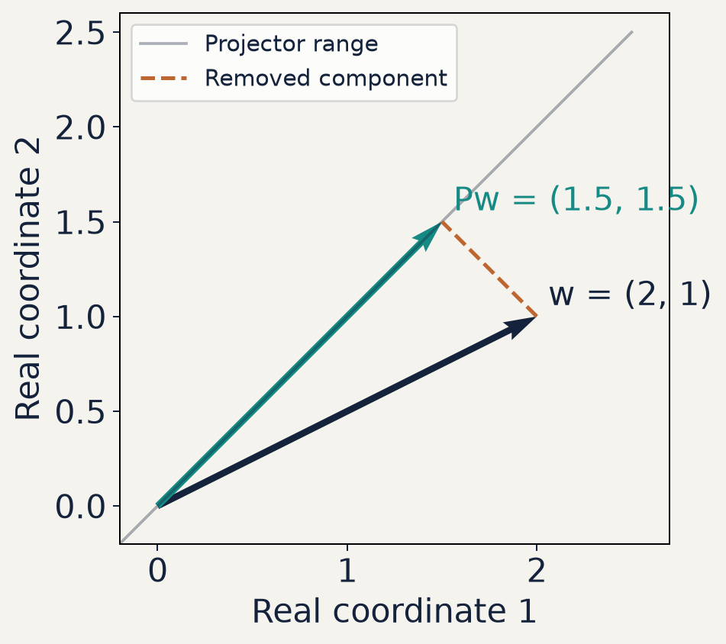
S02 / LINEAR ALGEBRA
Projection in a real plane
Additional real example: project onto the line y = x.
The vector (2, 1) projects to (1.5, 1.5).
The dashed residual is perpendicular to that line.
12 / 38
Notes:
This is an additional real-coordinate example, not a plot of the complex vector u from Example 3. Use u=(1,1)/sqrt(2), w=(2,1), and P=uu transpose, giving P=[[1,1],[1,1]]/2. The output is (1.5,1.5). The residual (0.5,−0.5) has zero dot product with the line direction. Projecting again changes nothing, showing idempotence geometrically. Source: plot_illustrations.py, projection figure.

Slide 13

S02 / LINEAR ALGEBRA
Hermitian operators
A Hermitian matrix equals its own adjoint.
Its eigenvalues are real, and it has an orthonormal eigenbasis.
13 / 38
Notes:
The examples Z and Y are Pauli operators. Hermitian does not mean every entry is real: the imaginary off-diagonal entries of Y demonstrate this. For a finite complex Hermitian matrix the spectral theorem supplies a complete orthonormal eigenbasis with real eigenvalues. Quantum observables use Hermitian operators in this finite-dimensional course. Avoid introducing infinite-dimensional domain issues here. Validate with A.conj().T or Qobj.dag(), not with transpose alone.
LaTeX:
A^\dagger=A\\[12pt]Z=\begin{pmatrix}1&0\\0&-1\end{pmatrix},\qquad Y=\begin{pmatrix}0&-i\\i&0\end{pmatrix}

Slide 14

S02 / LINEAR ALGEBRA
Why Hermitian expectations are real
A scalar equal to its own conjugate is real.
For a normalized state, this is the expectation of the observable A.
14 / 38
Notes:
The adjoint of a scalar is its conjugate. Reverse product order and use the fact that the adjoint of v† is v. Hermiticity then makes a equal to a*. Normalization is not needed for the algebraic reality claim, but it is needed for the stated expectation interpretation without dividing by v†v. An expectation is an average, and does not have to equal an eigenvalue. Tiny computed imaginary residues may result from roundoff; inspect their size before discarding them.
LaTeX:
a=v^\dagger Av\\[10pt]a^*=(v^\dagger Av)^\dagger=v^\dagger A^\dagger v=v^\dagger Av=a

Slide 15

S02 / LINEAR ALGEBRA
Unitary operators preserve inner products
A square unitary matrix preserves lengths and overlaps.
Its columns form an orthonormal basis.
15 / 38
Notes:
The square-matrix assumption is important for the inverse statement. For a square matrix, U†U=I implies UU†=I as well. Substituting u=v gives norm preservation. Unitary evolution therefore preserves normalization of closed-system states. Rectangular matrices can satisfy U†U=I without being invertible on the larger space; those are isometries and are outside this slide’s definition. Later gate matrices are unitary.
LaTeX:
U^\dagger U=I,\qquad U^{-1}=U^\dagger\\[12pt]\langle Uu,Uv\rangle=u^\dagger U^\dagger Uv=u^\dagger v

Slide 16
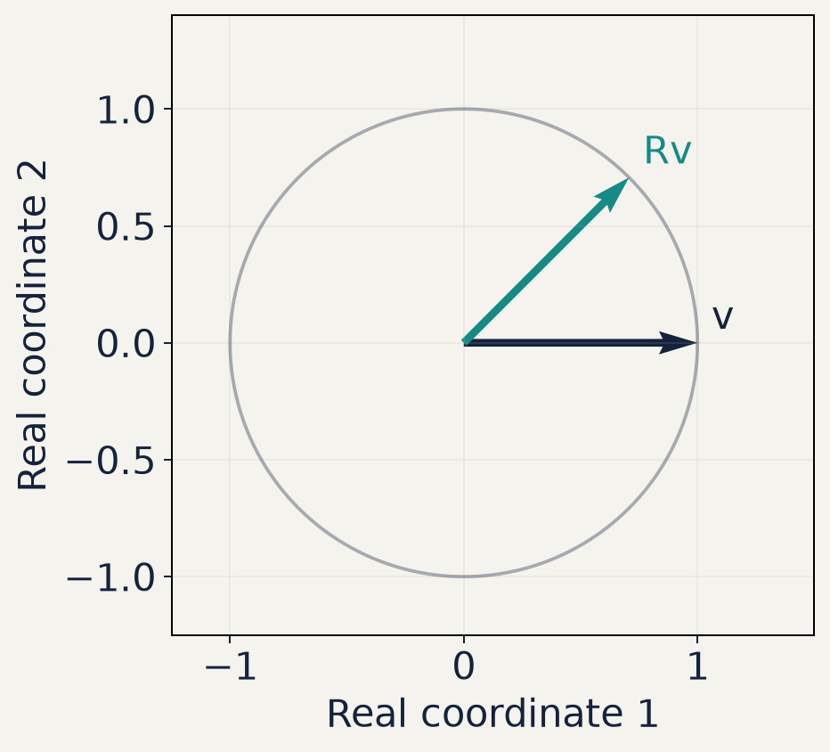
S02 / LINEAR ALGEBRA
A real rotation is a unitary example
The real rotation turns (1, 0) by π/4.
Both endpoints lie on the unit circle.
A real orthogonal rotation is a special case of a unitary matrix.
16 / 38
Notes:
Use R=[[cos(phi),−sin(phi)],[sin(phi),cos(phi)]] with phi=pi/4. Since R is real, its adjoint is its transpose, and R transpose R=I. The unit circle illustrates norm preservation. This is not the complex X rotation introduced later, and the arrows do not depict a general complex two-component state. Show how a general unitary preserves inner products as well as this one norm. Source: plot_illustrations.py, unitarity figure.

Slide 17

S02 / LINEAR ALGEBRA
Hermitian and unitary are different tests
Z passes both tests. 2Z is Hermitian but fails unitarity.
The diagonal U is unitary for real θ and generally is not Hermitian.
17 / 38
Notes:
Use examples instead of conflating the two properties. Z is both, which can mislead beginners if it is the only example shown. The real scalar multiple 2Z remains Hermitian but stretches every vector norm by two. The phase-diagonal U is unitary for every real theta; it is Hermitian only when sin(theta)=0. There is no general implication from one property to the other. Ask learners to explain each conclusion using the defining product or adjoint rather than appearance.
LaTeX:
Z^\dagger=Z,\quad Z^\dagger Z=I\\[10pt](2Z)^\dagger=2Z,\quad (2Z)^\dagger(2Z)=4I\\[10pt]U=\operatorname{diag}(e^{-i\theta},e^{i\theta}),\quad U^\dagger U=I

Slide 18

S02 / LINEAR ALGEBRA
Eigenvalues and eigenvectors
An eigenvector keeps its direction under the linear map.
Its eigenvalue gives the complex scale factor.
18 / 38
Notes:
The eigenvector must be nonzero or every lambda would satisfy the equation trivially. For a finite square matrix, a nonzero solution exists when A−lambda I is singular. For a general matrix eigenvalues may be complex and a full basis of eigenvectors may not exist. Hermitian matrices avoid that defect. An eigenvector is defined up to nonzero scalar scaling, and a normalized eigenvector still has arbitrary unit global phase. Compare eigenvectors with this freedom in mind.
LaTeX:
Av=\lambda v,\qquad v\neq0\\[12pt](A-\lambda I)v=0,\qquad \det(A-\lambda I)=0

Slide 19
S02 / LINEAR ALGEBRA
Hermitian eigensolvers and degeneracy
Columns of Q are orthonormal eigenvectors.
Use numpy.linalg.eigh for a Hermitian matrix.
Repeated eigenvalues define a subspace with many valid bases.
19 / 38
Notes:
eigh exploits the Hermitian problem and returns real eigenvalues within numerical precision. The eigenvectors are columns, not rows. Confirm the residual A@Q−Q@diag(values) and Q†Q−I. Degeneracy means the basis within a repeated-eigenvalue subspace is not unique. Even nondegenerate eigenvectors can differ by a unit phase. Do not grade eigenvectors by exact component equality. A matrix accidentally made non-Hermitian should not be passed blindly to eigh; check A≈A† first.
LaTeX:
AQ=Q\Lambda,\qquad Q^\dagger Q=I,\qquad \Lambda=\operatorname{diag}(\lambda_1,\ldots,\lambda_n)

Slide 20

S02 / LINEAR ALGEBRA
Spectral decomposition
This form applies here to a finite Hermitian matrix.
Each eigenprojector selects one orthonormal direction.
20 / 38
Notes:
Expand Q Lambda Q† by columns to obtain the sum. Completeness of the orthonormal basis gives the identity resolution. For a degenerate eigenvalue one may combine its rank-one terms into a projector onto the whole eigenspace; the combined projector is independent of the chosen basis. The Hermitian assumption provides a unitary Q. A general diagonalizable matrix instead has a potentially nonunitary inverse, and a defective matrix does not admit this eigenvector expansion.
LaTeX:
A=Q\Lambda Q^\dagger=\sum_{k=1}^{n}\lambda_k\,|q_k\rangle\langle q_k|\\[12pt]I=\sum_{k=1}^{n}|q_k\rangle\langle q_k|

Slide 21

S02 / LINEAR ALGEBRA
Example 4 · The spectrum of Pauli X
The eigenvalues are +1 and −1.
The two eigenprojectors sum to the identity.
21 / 38
Notes:
Worked example 4. Direct multiplication swaps the vector entries. For the plus vector this changes nothing. For the minus vector the swapped result is its negative. Form Pplus and Pminus from their outer products and subtract to recover X. Add them to recover I. This example becomes an independent spectral reference for the exponential in slide 27. No numerical eigensolver is needed to derive these particular eigenvectors.
LaTeX:
X=\begin{pmatrix}0&1\\1&0\end{pmatrix},\quad |+\rangle=\frac1{\sqrt2}\begin{pmatrix}1\\1\end{pmatrix},\quad |-\rangle=\frac1{\sqrt2}\begin{pmatrix}1\\-1\end{pmatrix}\\[12pt]X|+\rangle=|+\rangle,\quad X|-\rangle=-|-\rangle,\quad X=P_+-P_-

Slide 22
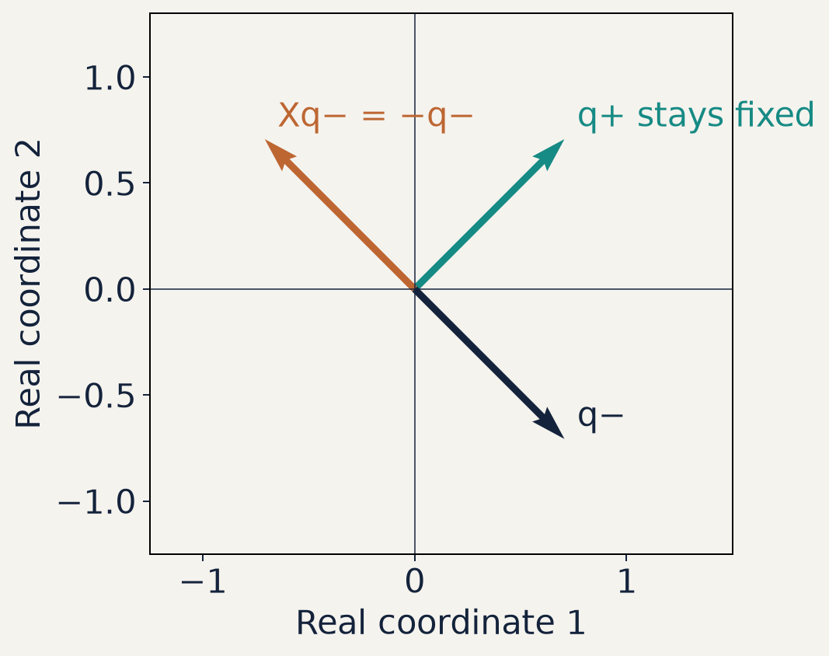
S02 / LINEAR ALGEBRA
Eigenvectors of X in a real plane
X exchanges the two real coordinates.
The plus direction stays fixed: eigenvalue +1.
The minus direction reverses: eigenvalue −1.
22 / 38
Notes:
The plotted qplus=(1,1)/sqrt(2) and qminus=(1,−1)/sqrt(2) are real, so a real coordinate plane faithfully represents these examples. X swaps coordinates. The plus vector is unchanged and the minus vector reverses direction. The two eigendirections are perpendicular. Ask learners why a vector off these eigendirections generally moves to a different line. Source: plot_illustrations.py, eigenvectors figure.

Slide 23

S02 / LINEAR ALGEBRA
Functions of a Hermitian matrix
For polynomials and the exponential, apply f to the eigenvalues.
Elementwise application to the entries of A generally gives a different matrix.
23 / 38
Notes:
For a polynomial, A^k=Q Lambda^k Q† follows because adjacent Q†Q factors cancel. The exponential follows by its convergent series. More general functions can be defined on the finite spectrum when their scalar values are defined. Do not treat branch-dependent functions such as logarithms as automatically unambiguous. Distinguish the matrix function from elementwise NumPy ufuncs. In this lesson f(A)=exp(A) is the target.
LaTeX:
A=Q\Lambda Q^\dagger\quad\Longrightarrow\quad f(A)=Qf(\Lambda)Q^\dagger\\[12pt]f(\Lambda)=\operatorname{diag}\bigl(f(\lambda_1),\ldots,f(\lambda_n)\bigr)

Slide 24

S02 / LINEAR ALGEBRA
The matrix exponential series
The zeroth matrix power is I. Each higher power uses matrix multiplication.
The series converges for every finite square matrix.
Use scipy.linalg.expm for numerical matrix exponentials.
24 / 38
Notes:
The matrix exponential is defined even when A has no eigenbasis. A^0 is the identity with the same square dimension. A^2 means A@A, not entrywise squaring. Factorials rapidly damp high-order terms for a fixed finite matrix, but naively truncating the series is not the preferred general numerical algorithm. SciPy expm uses dedicated matrix algorithms. np.exp(A) applies scalar exponentials entry by entry and is not a replacement. The next slides derive a special exact formula from powers of X.
LaTeX:
e^A=\sum_{k=0}^{\infty}\frac{A^k}{k!}=I+A+\frac{A^2}{2!}+\frac{A^3}{3!}+\cdots

Slide 25
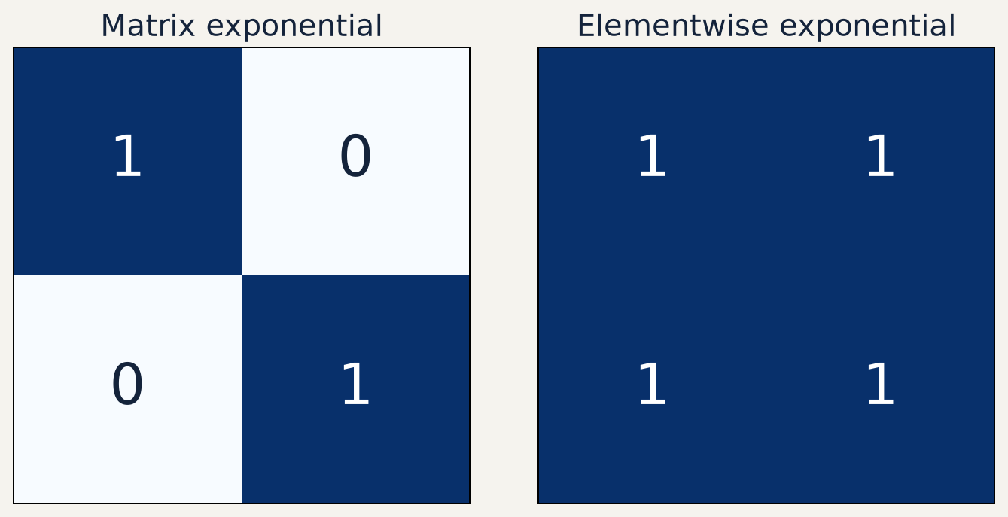
S02 / LINEAR ALGEBRA
Two exponentials of the zero matrix
Both panels start from the same 2 × 2 zero matrix.
Matrix exponentiation gives the identity.
Elementwise exponentiation gives a matrix of ones.
25 / 38
Notes:
This is a numerical counterexample to treating np.exp(A) as a matrix exponential. For A=0, the series has only the identity term, so expm(A)=I. Elementwise exp(0)=1 fills every entry with one. Colors encode literal entries zero and one, with numbers printed for clarity. This example supplies an immediate check independent of an eigensolver. Source: plot_illustrations.py, exponential figure.

Slide 26

S02 / LINEAR ALGEBRA
Pauli powers separate even and odd terms
Even powers contribute an identity term. Odd powers contribute an X term.
Cosine and sine are the two scalar series.
26 / 38
Notes:
Use a as a real scalar in this derivation. Start with e^(−iaX)=sum(−ia)^n X^n/n!. For n=2k the factor (−i)^(2k)=(-1)^k and X^(2k)=I. For n=2k+1 it is −i(-1)^k times X. This yields the two displayed scalar series. Both converge absolutely, allowing even and odd regrouping. For k=0 the even power is X^0=I. Compare the scalar pattern with the Euler derivation in S01.
LaTeX:
X^2=I,\qquad X^{2k}=I,\qquad X^{2k+1}=X\\[12pt]e^{-iaX}=\left[\sum_{k=0}^\infty\frac{(-1)^ka^{2k}}{(2k)!}\right]I-i\left[\sum_{k=0}^\infty\frac{(-1)^ka^{2k+1}}{(2k+1)!}\right]X

Slide 27

S02 / LINEAR ALGEBRA
A closed form for an X rotation
The angle θ is real and measured in radians.
At θ = π, the final state differs from |1⟩ only by a global phase.
27 / 38
Notes:
Set a=theta/2 in the previous slide. At theta=0 sine vanishes and cosine is one. At theta=pi the identity term vanishes and −iX sends basis zero to −i times basis one. Multiplying by a common phase does not change measurement probabilities. The spectral derivation gives exp(−i theta/2)Pplus+exp(+i theta/2)Pminus, providing an independent reference. examples.py compares that reference and the trigonometric formula with scipy.linalg.expm and QuTiP .expm().
LaTeX:
R_x(\theta)=e^{-i\theta X/2}=\cos\!\left(\frac\theta2\right)I-i\sin\!\left(\frac\theta2\right)X\\[12pt]R_x(\pi)|0\rangle=-i|1\rangle,\qquad R_x(0)=I

Slide 28
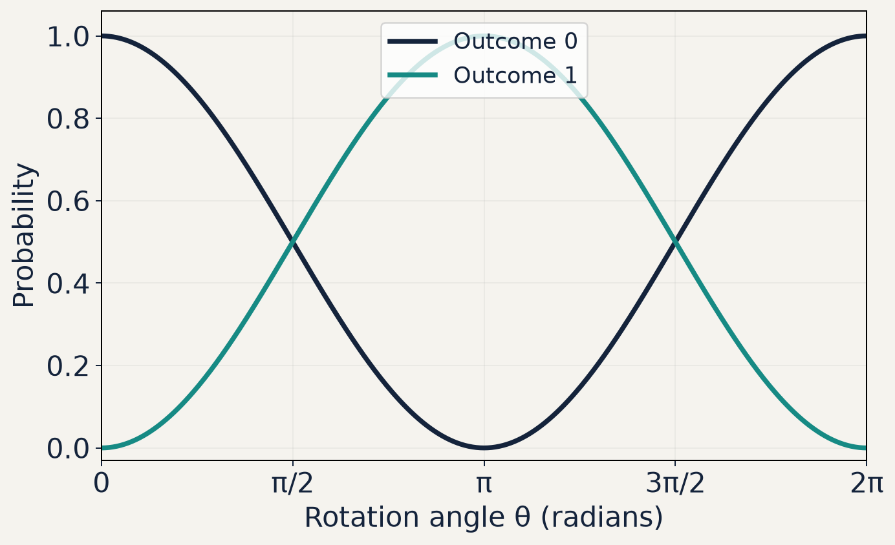
S02 / LINEAR ALGEBRA
X rotation changes measurement probabilities
The initial state is basis zero.
Both probabilities add to one at every angle.
At θ = π, outcome one has probability one.
28 / 38
Notes:
The curves are analytic probabilities cos²(theta/2) and sin²(theta/2) after Rx(theta) acts on basis zero. They are not finite-shot observations. The global factor −i at theta=pi changes no probability. At 2pi the state returns up to global phase. Ask learners to identify angles where both probabilities equal one half. Source: plot_illustrations.py, rotation figure; examples.py verifies the probability with QuTiP.

Slide 29

S02 / LINEAR ALGEBRA
Time evolution and the units of the exponent
This expression assumes a time-independent Hamiltonian.
The course uses time in μs and H/ℏ in rad/μs, so Ωt is dimensionless.
29 / 38
Notes:
The exponent must be dimensionless. In physical units H is an energy and H/hbar is an angular-frequency operator. The course sets hbar=1 numerically, so Hamiltonian coefficients carry angular-frequency units. Omega is in radians per microsecond and time is in microseconds. Real time and Hermitian H imply a unitary U, since the generator is anti-Hermitian. This equation prepares S07 dynamics; it does not claim that open-system noise is unitary. A time-dependent noncommuting Hamiltonian needs time ordering rather than simply inserting H(t)t.
LaTeX:
U(t)=e^{-iHt/\hbar},\qquad H^\dagger=H,\qquad \hbar=1\\[12pt]H=\frac{\Omega}{2}X\quad\Longrightarrow\quad U(t)=R_x(\Omega t)

Slide 30

S02 / LINEAR ALGEBRA
Matrix order matters
Arbitrary matrices need not obey the scalar exponential product rule.
Check commutation before splitting an exponential.
30 / 38
Notes:
Define the commutator by the displayed difference. Multiply XZ and ZX explicitly to confirm the sign: XZ=[[0,−1],[1,0]] and ZX=[[0,1],[−1,0]], so the commutator is −2iY with the Y convention shown earlier. Commutation is a sufficient condition for the exponential splitting rule; special noncommuting cases may coincide, so do not state it as a universal if-and-only-if. Products of unitary factors remain unitary but need not equal the exponential of their summed generators. This distinction matters for pulse composition and simulation approximations.
LaTeX:
XZ=-ZX,\qquad [X,Z]=XZ-ZX=-2iY\\[12pt]e^{A+B}=e^Ae^B\quad\text{is guaranteed when }AB=BA

Slide 31
S02 / LINEAR ALGEBRA
Code walkthrough 1 · NumPy and SciPy
import numpy as np
from scipy.linalg import expm
X = np.array([[0, 1], [1, 0]], dtype=complex)
values, Q = np.linalg.eigh(X)
theta = 0.7
U = expm(-1j * theta * X / 2)
U_spec = Q @ np.diag(np.exp(-1j*theta*values/2)) @ Q.conj().T
assert np.allclose(U, U_spec)
Use @ for matrix products and .conj().T for the adjoint.
31 / 38
Notes:
This is code walkthrough 1. Run examples.py and stop at the spectral exponential comparison. Explain np.diag builds a diagonal matrix from the scalar exponentials of the eigenvalues. eigh places eigenvectors in columns, matching Q Lambda Q†. np.exp is correct on the one-dimensional eigenvalue array but not on the entries of the full X matrix as a matrix-function substitute. Use dtype=complex to preserve imaginary components. A tolerance test compares matrices up to floating-point errors.

Slide 32
S02 / LINEAR ALGEBRA
Code walkthrough 2 · QuTiP
import qutip as qt
Xq = qt.sigmax()
Uq = (-1j * theta * Xq / 2).expm()
zero = qt.basis(2, 0)
final = Uq * zero
p1 = qt.expect(qt.basis(2, 1).proj(), final)
assert np.allclose(Uq.full(), U)
assert np.isclose(p1, np.sin(theta/2)**2)
This continues slide 31, with NumPy, θ and U already defined.
32 / 38
Notes:
Code walkthrough 2 continues the same Python process or examples.py. QuTiP Qobj multiplication uses *, unlike NumPy’s elementwise * between arrays. .expm() gives the matrix exponential, .dag() gives the adjoint and .full() gives a two-dimensional NumPy array. The probability for outcome one is sin²(theta/2), obtained by acting with the closed-form rotation on basis zero. This QuTiP implementation stays compatible with the course’s later Hamiltonian and noise simulations. The standalone examples.py includes all imports and definitions.

Slide 33

S02 / LINEAR ALGEBRA
Independent numerical checks
Check structure, a hand-derived reference and an eigenpair residual.
Unitarity alone cannot prove that U implements the intended rotation.
33 / 38
Notes:
Define the Frobenius norm as the square root of the sum of squared magnitudes of all matrix entries. It differs from the vector 2-norm used in r_k. An incorrect rotation angle still produces a unitary, so structural checks alone do not establish semantic correctness. For this two-dimensional double-precision example, examples.py uses errors below 1e−12 for deterministic references. That is an example-specific threshold, not a universal accuracy promise for large systems or optimizers. Print residuals and investigate scale and solver settings when adapting the code.
LaTeX:
\epsilon_U=\|U^\dagger U-I\|_{\mathrm F},\qquad\epsilon_{\rm ref}=\|U-U_{\rm analytic}\|_{\mathrm F}\\[12pt]r_k=\|Aq_k-\lambda_kq_k\|_2

Slide 34
S02 / LINEAR ALGEBRA
Practice and exit checkpoint
1. Compute the adjoint and normalize the vector from Example 1.
2. Build its projector and test its action on an orthogonal vector.
3. Derive the exponential of an imaginary scalar times Pauli Z.
4. Explain why unitary output alone cannot validate a rotation angle.
34 / 38
Notes:
Allow ten minutes for written work, then use the standalone starter.py task to implement a projector and an X rotation without using expm in the rotation implementation. Answers: v†=(1,−i), norm sqrt(2); u=v/sqrt(2). The projector is one half times [[1,−i],[i,1]]. exp(−iaZ)=diag(exp(−ia),exp(ia))=cos(a)I−i sin(a)Z. An incorrect angle can retain exact unitarity, so an analytic or independent reference is needed. Appendix 31 summarizes these answers. Next S03 uses this mathematics for qubit states and Bloch coordinates.

Slide 35

NOTATION
Appendix · Notation and dimensions
T means transpose. A star means entrywise conjugation here.
A dagger means conjugate transpose. I is the identity operator.
35 / 38
Notes:
Review notation without adding a new mathematical topic. The dimension n refers to the size of the chosen basis. The scalar inner product is customarily treated as a complex number even if a strict array implementation represents it with a 1 by 1 shape. All components are in the same fixed orthonormal basis in this lecture. Indexing in the displayed sums is mathematical 1 through n; code arrays start at zero. A ket is an abstract vector; the shown column is its representation.
LaTeX:
|v\rangle:\ n\times1,\qquad \langle v|=|v\rangle^\dagger:\ 1\times n\\[12pt]\langle u|v\rangle:\ 1\times1,\qquad |u\rangle\langle v|:\ n\times n

Slide 36

S02 / REFERENCE
Proof of eigenvector orthogonality
If the real eigenvalues differ, the inner product must be zero.
For a repeated eigenvalue, choose an orthonormal basis within its eigenspace.
36 / 38
Notes:
Multiply A qk=lambda_k qk on the left by qj†. For the other expression, use qj†A=(Aqj)† because A is Hermitian, then real lambda_j gives lambda_j qj†. Subtract. When lambda_k differs from lambda_j the scalar factor is nonzero, forcing orthogonality. If eigenvalues coincide the equation gives no orthogonality constraint, but Gram–Schmidt can choose an orthonormal basis within that eigenspace. This proof relies on Hermiticity and real eigenvalues, not on arbitrary matrix eigenvectors.
LaTeX:
Aq_j=\lambda_jq_j,\quad Aq_k=\lambda_kq_k,\quad A^\dagger=A\\[12pt]\lambda_k\,q_j^\dagger q_k=q_j^\dagger A q_k=\lambda_j\,q_j^\dagger q_k\\[12pt](\lambda_k-\lambda_j)\,q_j^\dagger q_k=0

Slide 37

S02 / REFERENCE
Appendix · Practice answers
The zero vector has no normalized version.
Projector checks: Hermiticity, idempotence and action on its range.
37 / 38
Notes:
Return to each practice question. For the projector use the orthogonal vector from slide 9 to check Pv=0 as well. The diagonal exponential follows either from the power series on a diagonal matrix or its two eigenvalues ±1. The formula requires real a for unitarity, though the matrix-function identity itself also extends to complex a. The exit-check answer about angle validation is conceptual: several different rotations satisfy U†U=I. Use a hand-derived special-angle action or a full analytic reference.
LaTeX:
u=\frac1{\sqrt2}\begin{pmatrix}1\\i\end{pmatrix},\qquad P=\frac12\begin{pmatrix}1&-i\\i&1\end{pmatrix}\\[12pt]e^{-iaZ}=\begin{pmatrix}e^{-ia}&0\\0&e^{ia}\end{pmatrix}=\cos(a)I-i\sin(a)Z

Slide 38
S02 / REFERENCE
Running on Windows and Ubuntu
Windows PowerShell, from the repository root
.\.venv\Scripts\python.exe lectures/S02-linear-algebra/examples.py
.\.venv\Scripts\python.exe lectures/S02-linear-algebra/starter.py
Ubuntu Bash, from the repository root
./.venv/bin/python lectures/S02-linear-algebra/examples.py
./.venv/bin/python lectures/S02-linear-algebra/starter.py
Run solution.py separately to check the reference implementation.
38 / 38
Notes:
Use the same virtual environment created in S00. The Python exercises need only course dependencies already installed. No LaTeX installation is required to run them or view the exported slides. The untouched starter raises NotImplementedError intentionally. Complete its two functions and rerun. The reference solution prints S02 exercises: PASSED. The examples print numerical errors and S02 examples: PASSED. The standalone exercises are not entries in qubit_course.labs. Rebuilding formula images additionally requires a TeX distribution and Poppler; see the lecture README.

