Slide 1
Automated Build and Deployment of Tomcat Apps
Presented by: Chris Peck
Institution/Company: College of William and Mary
Date: 9/29/2014
Session ID: 8743

Slide 2
Session Rules of Etiquette
Please silence your cell phone/pager
If you must leave the session early, please do so as discreetly as possible
Please avoid side conversation during the session
Please, feel free to ask questions at any time
Thank you for your cooperation!
Notes:
Who here has a pager?

Slide 3
How Ops Can Get out of the Way of Development, or, Automated Build and Deployment of Tomcat Apps
Notes:
Original Title, which got truncated by the committee to “How Ops can get out of the way of Development”

Slide 4
Opsvelopment, Ops and Devs, One Happy Family
Notes:
Even creating a title is an ongoing continuous improvement process

Slide 5
DEVOPS
Notes:
Easy to lose track of the Goal of the College, to do our best to “produce” graduates that can Change the World. Hopefully for the better.
It’s our job to work together to enable that to occur.

Slide 6
Automated Build and Deployment of Tomcat Apps
Presented by: Chris Peck
Institution/Company: College of William and Mary
Date: 9/29/2014
Session ID: 8743
Notes:
The sysadmin in me returned to

Slide 7
Introduction
This presentation will describe our journey to an automated process for building and deploying Apps to a Tomcat server. We plan to use this process for XE Apps.
The focus will be on using a variety of open-source “DevOps” tools.
A live demo – what could go wrong???

Slide 8
Introductions
About me
*nix sysadmin at William and Mary since 1998
Not a Developer
Used to “hand-craft” all our servers & applications, everything was a “snowflake”
Now we automate and define by code almost everything, we make snowballs out of snowflakes
Notes:
We started moving to Linux using Puppet 2 years ago. PuppetConf.

Slide 9
Agenda:
Pre-Jenkins – how we used to do this
Post-Jenkins – automation is sweet
Live Demo
Discuss the tools & how to get them
Q&A

Slide 10
Pre-Jenkins
Grails warfile built on Devs desktop
Warfile uploaded to a Shared Net Drive
Devs then ping Ops to deploy
Ops copy warfile to server, then deploy it
Note: We’re actually called Unix Engineering, but, I’ll be referring to our team as “Ops”.
Notes:
Let’s look at these “opportunities”, one at a time.

Slide 11
Pre-Jenkins Issues
Grails warfile built on Devs desktop
Java on their desktop
Grails on their Desktop
Build & Testing done on a Windows Desktop usually
Classic “but it ran ok on my Desktop” scenario, which lead to…
Notes:
Using their version of Java and Grails on their Desktop OS
This worked most of the time…

Slide 12
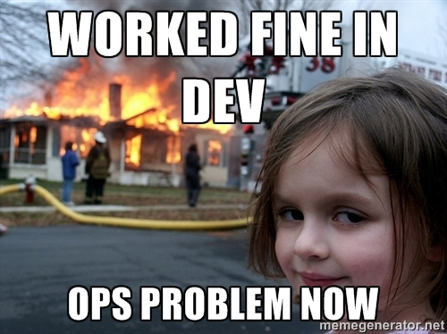

Slide 13
Pre-Jenkins Issues
Devs ping Ops to deploy
Slows down the process
Kind of feels like this…

Slide 14
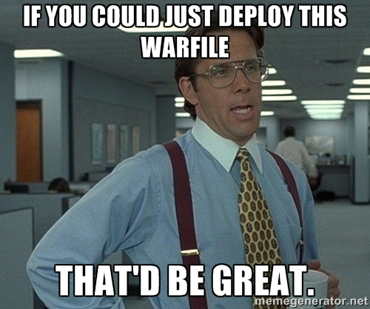

Slide 15
Pre-Jenkins Issues
Ops copies warfile to server
Ops don’t use Windows - PITA getting the file
Fragile process, must get the correct file and deploy to the correct server and location
Notes:
sed a script on the Tomcat server to deploy, but….

Slide 16

What is Jenkins?
“Jenkins is an award-winning application that monitors executions of repeated jobs.”
Hundreds of plugins
Grails, git, Tomcat, WebLogic, jabber
If you can script it, so can Jenkins
Jenkins allows us to…
Notes:
Publicly shame via jabber conference room. Never leave a build broke
Show Jenkins Website on Chrome

Slide 17
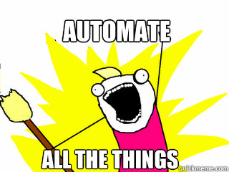

Slide 18
What we use Jenkins for
Ops had been using it for:
CAS - built & half-deployed
Puppet manifest – tested and deployed
Sympa Source - built, and, half-deployed
Devs are building 4 Grails Apps
Plan on using it to build & deploy XE Apps
Notes:
Able to select version of Grails to build with

Slide 19
Post Jenkins
Dev pushes code to git
Git pings Jenkins it has something for it
Jenkins git’s the updated code
Jenkins builds a warfile
Jenkins “deploys” the warfile to Tomcat
Notes:
App is deployed if there are NO errors
Jenkins can communicate using various methods – jabber, email…
Has a “Vagrant” plugin, can spin up a VM to run tests with

Slide 20
Post-Jenkins Pros
Jenkins server runs the same:
OS – built on the same image as the Tomcat servers
Same Java
Same Tomcat
Warfile is built automatically at git check-in
Jenkins deploys the correct warfile to the correct server

Slide 21
Demonstration
Vagrant – tool to create reproducible dev VM’s
OS – built on the same image as the servers using packer
Software – installed using the same Puppet manifest
Notes:
Show Packer & Vagrant Websites on Chrome

Slide 22
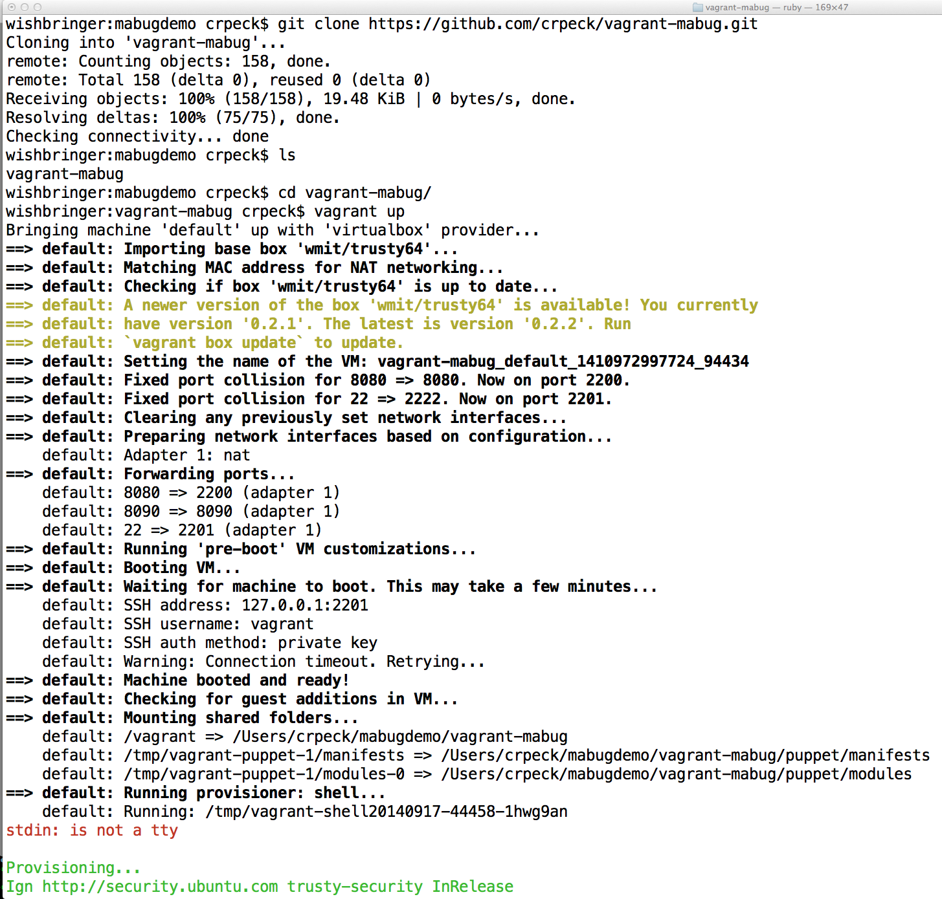

Slide 23
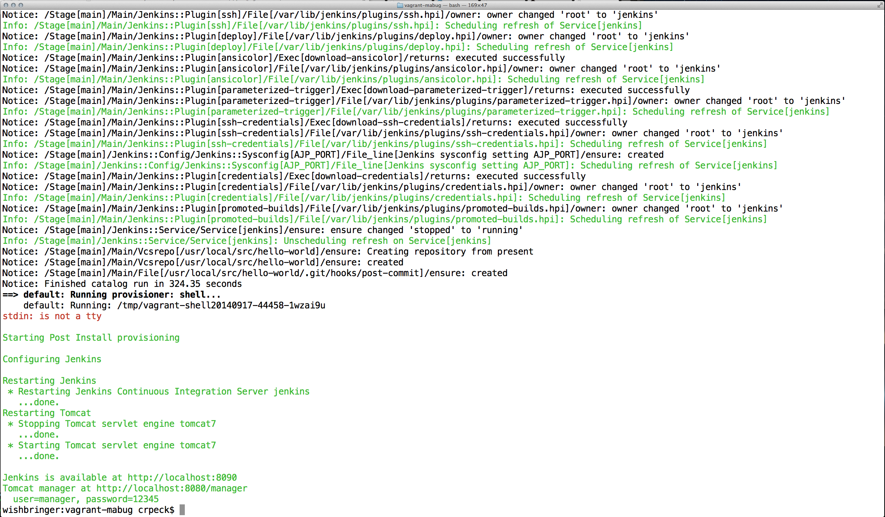

Slide 24
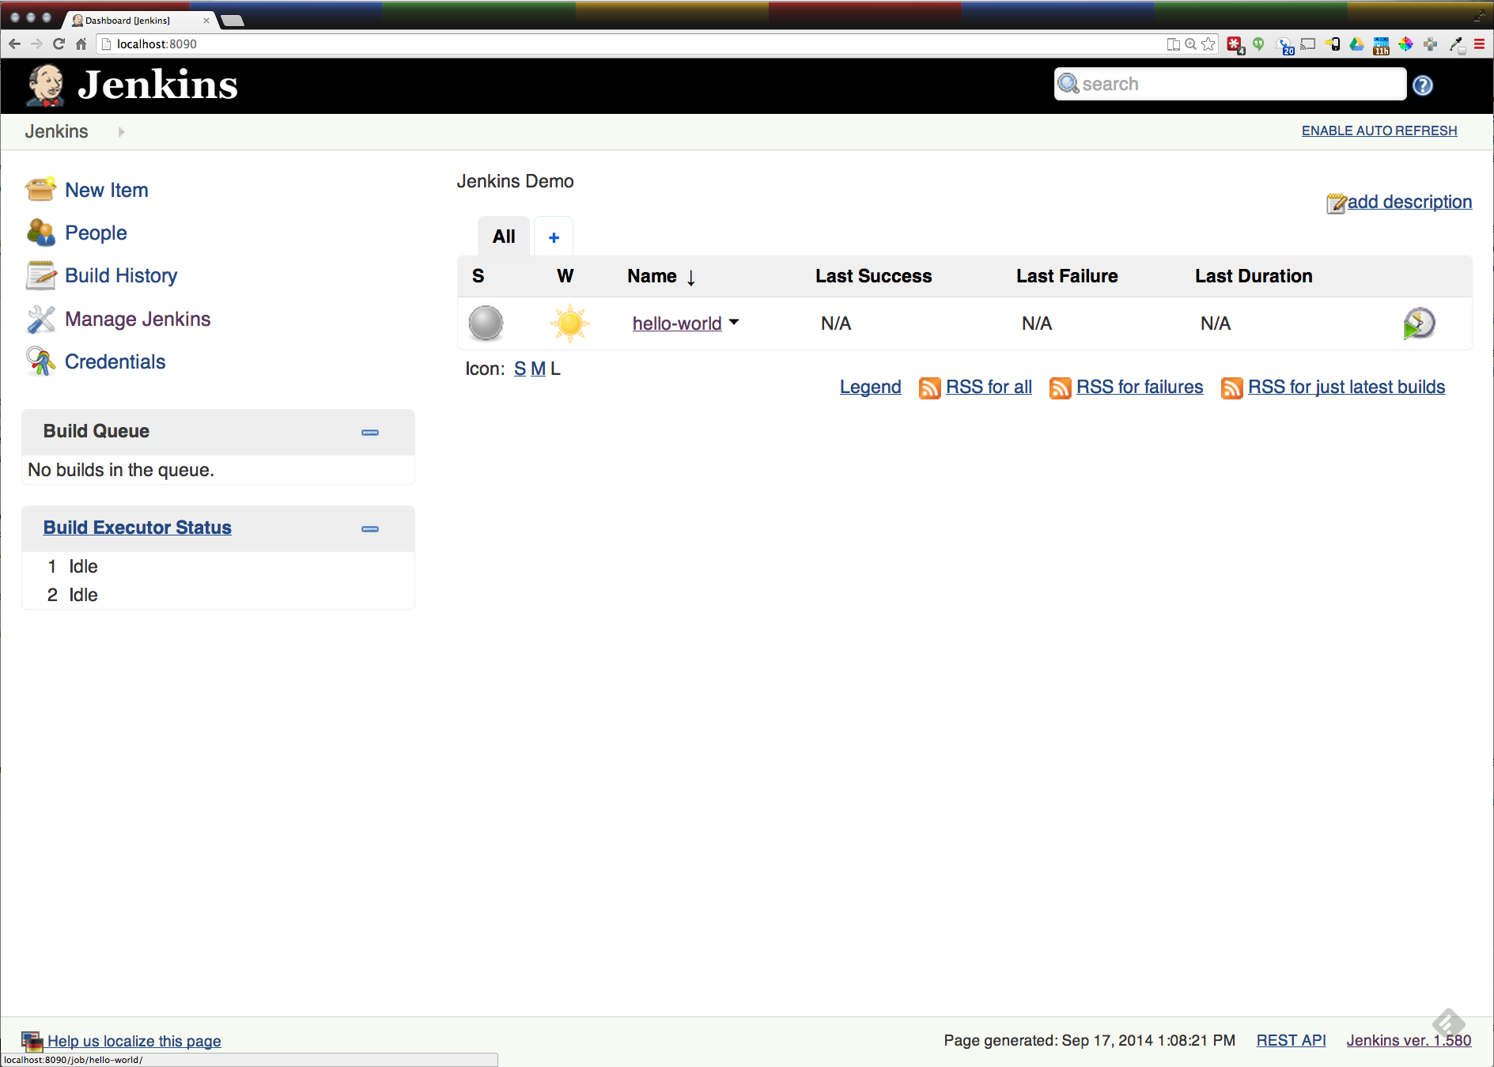

Slide 25
Demo Time!!!

Slide 26


“Building” and Deploying XE warfile the Ellucian Way
Download the Software – this is for the Student Faculty Grade Entry:
Go to Website, login
Click on Download Center
Click on Banner Student, List versions
Find the “Patches and Releases” you need
Click the checkbox next to the “Patch” you need
Check the “I wish to FTP” box
Click on “ZIP Selected Files”
Click on “Move Your Zip File to Our FTP Server”
Click on the Red “New! Now you can use this link to download your ZIP file”
Or wait for email from howard.frysinger@ellucian.com? →
Extract the file you need to start with
Unzip the file you just downloaded (it contains 2 files, a readme and a tarfile)
Untar the tarfile you just unzipped
Find the zipfile you just pulled from the tarfile, you’ll be unzipping it in a second, it’s most likely in java/release-StudentFacultyGradeEntry-9.2.0.1.zip
Now you’re ready to start the process, First - have a drink, you’ll thank me later
Notes:
Howard Frysinger is on Facebook, I googled him

Slide 27
Create a temporary directory to work from
mkdir $HOME/ban9temp
cd $HOME/ban9temp
unzip where-ever/release-StudentFacultyGradeEntry-9.2.0.1.zip
cd installer
chmod +x ant
./ant
bin/install home
Prompted for full path of module home & shared configuration directory, we’ll use /home/xeuser/banner_test_homes
Go and make all your local modifications

Slide 28
Regenerate the WAR file
cd /home/xeuser/banner_test_homes/current/installer
./ant
bin/systool war
Warfile is in /home/xeuser/banner_test_homes/current/dist
Manually deploy it

Slide 29
References
https://github.com/crpeck/mabug-2014
https://github.com/crpeck/vagrant-mabug
https://jenkins-ci.org
http://git-scm.com
http://www.packer.io
https://www.vagrantup.com
https://www.virtualbox.org
http://puppetlabs.com

Slide 30
U.S. Digital Services Playbook https://playbook.cio.gov/
DevOps http://devops.com
FlowCon Conference http://http://flowcon.org/
O'Reilly Conference http://velocityconf.com/
IT Revolution Press http://itrevolution.com/
The Phoenix Project: A Novel About IT, DevOps, and Helping Your Business Win, Gene Kim, Kevin Behr, George Spafford
Continuous Delivery: Reliable Software Releases through Build, Test, and Deployment Automation, Jez Humble and David Farley

Slide 31
Questions & Answers

Slide 32
Thank You for Attending!
Chris Peck
crpeck@wm.edu
@crpeck on twitter
http://crpeck.gethub.io
Stick around for DevOps in a Banner World!
Please complete the session evaluation for
Automated Build and Deployment of Tomcat Apps
Session ID#: 8743

