Slide 1

VitalChain-AI
Protecting Life-Saving Medicines with AI and Blockchain
Autonomous Pharmaceutical Cold Chain Monitoring System

Slide 2
The $35 Billion Cold Chain Crisis
$35B
2-8°C
2B+
Annual Medicine Losses
Critical Temperature Range
Patients at Risk
Worth of pharmaceuticals destroyed yearly due to temperature excursions
Precise thermal control required for vaccines and biologic medicines
Global population relying on temperature-sensitive medicines
“Every year, billions of life-saving medicines travel across the globe. When cooling systems fail, these shipments are silently destroyed, leading to medicine shortages and, most tragically, putting millions of patient lives at risk.”

Slide 3
Why Current Systems Fail
Slow Monitoring
Manual Response Required
Data collection intervals are too long—temperature spikes go undetected until damage occurs
Alerts demand human intervention, causing delays when every minute counts
Data Manipulation Risk
Reactive Instead of Predictive
Temperature records can be altered, compromising regulatory compliance and trust
Systems respond after failure rather than preventing it through intelligent forecasting

Slide 4
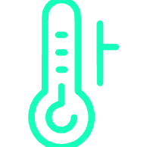



Introducing VitalChain-AI
An intelligent pharmaceutical logistics platform combining IoT sensors, artificial intelligence, blockchain, and smart contracts to autonomously protect temperature-sensitive medicines.
IoT Sensors
AI Prediction Engine
Real-time monitoring of temperature, humidity, and location
Forecasts equipment failure before temperature excursions occur
Blockchain Ledger
Smart Contracts
Immutable records ensuring data integrity and compliance
Autonomous rerouting to cold storage when risks are detected

Slide 5




How The System Works
IoT Monitoring
Blockchain Recording
Sensors track temperature, humidity, and location every 10 minutes
Data securely recorded on distributed ledger
AI Analysis
Autonomous Action
Patterns analysed and equipment failure predicted
Smart contracts reroute shipments to safe storage

Slide 6

Self-Protecting Supply Chain
The WOW Feature
When AI predicts cooling failure:
Smart contract activates automatically
System identifies nearest cold storage facility
Driver receives new route instantly
Shipment saved before damage occurs
No manual intervention required

Slide 7
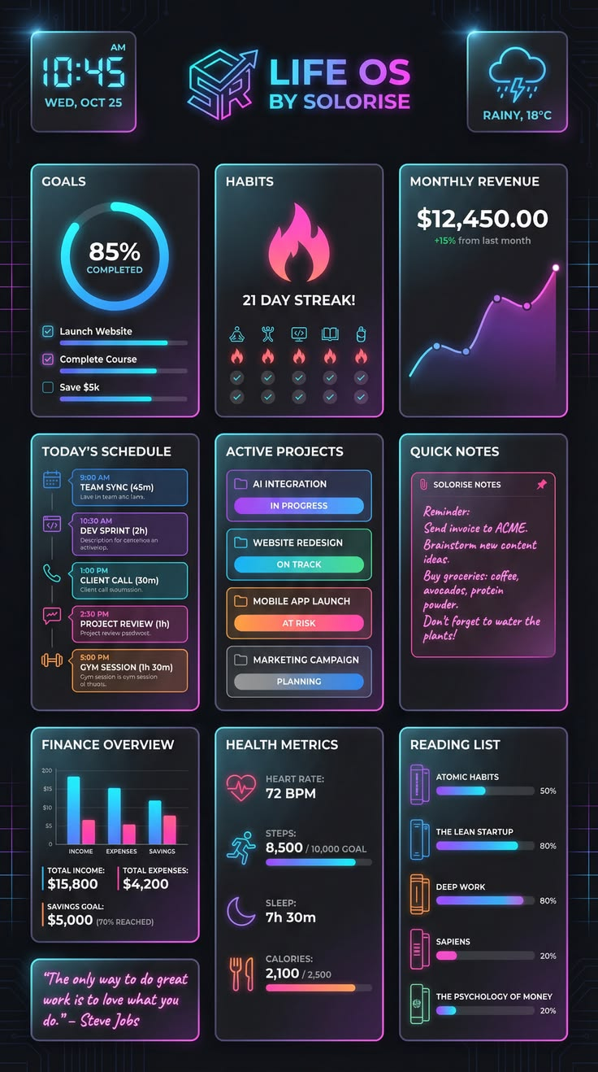




Real-Time Monitoring Dashboard
Live Shipment Tracking
Real-time location and route visualization
Temperature Graphs
Continuous thermal monitoring with historical data
AI Risk Alerts
Predictive notifications of potential failures
Verified Records
Blockchain-secured shipment documentation

Slide 8







Why VitalChain-AI Matters
Prevent Losses
Patient Safety
Save billions in medicine value annually
Ensure medicines reach patients effective
Supply Chain Transparency
Regulatory Compliance
Complete visibility from manufacturer to patient
Meet pharmaceutical standards effortlessly

Slide 9
Market Opportunity & Competitive Advantage
Why VitalChain-AI Leads the Industry
Vast Market Opportunity
Unmatched Competitive Edge
The global pharmaceutical cold chain market exceeds $35 billion annually. With increasing demand for temperature-sensitive drugs like vaccines and biologics, this critical sector requires advanced solutions to prevent immense losses and ensure patient safety.
ThermoChain AI stands alone as the only comprehensive solution by seamlessly integrating:
Real-time AI prediction for proactive intervention
Immutable blockchain for unparalleled data integrity
Autonomous smart contracts for instant, self-correcting actions

Slide 10




Use Cases & Real-World Applications
ThermoChain AI provides critical support across diverse and highly sensitive pharmaceutical logistics scenarios, ensuring product integrity and patient safety.
Last-Mile Vaccine Delivery
Biologics & Insulin Integrity
Focus: Ensuring 100% vaccine potency for rural healthcare centres :
Focus: Tamper-proof tracking for highly sensitive life-saving drugs.
Impact: Protects the health of millions in remote areas
Impact: Guarantees that the medicine received is safe and effective.
Time-Critical Organ Transports
Regulatory Data Compliance
Focus: Fail-safe, real-time environment monitoring for organ transplants.
Focus: Providing automated, audit-ready data for the Food and Drug Administration (FDA) and World Health Organization (WHO).
Impact: Dramatically increases success rates for life-saving surgeries.
Impact: Eliminates compliance risks and builds global trust.

Slide 11
Implementation Timeline
Our strategic roadmap outlines a phased approach to bring ThermoChain AI to market, ensuring robust development and successful deployment.
Phase 1: Foundation
1
Months 1-3: MVP development, IoT sensor integration, and initial blockchain setup.
2
Phase 2: Refinement & Testing
Months 4-6: AI model training, followed by pilot testing with key logistics partners.
Phase 3: Launch & Onboarding
3
Months 7-9: Full platform launch and initial enterprise client onboarding.
4
Phase 4: Scale & Expand
Months 10-12: Scale operations, optimize performance, and expand into international markets.

Slide 12
The Competitive Advantage Matrix
Feature
Traditional Cold Chain
VitalChain AI
Monitoring
Reactive (Post-Damage)
Proactive (Predictive)
Response
Manual/Delayed
Instant/Autonomous
Data Security
Centralized (Editable)
Blockchain (Immutable)
Compliance
Risk of Manipulation
100% Audit-Ready

Slide 13

Thank you
Team :- Byte-X- ploit

