Slide 1
Milestone 3 Part A Implementation of Mashup Features
Group #4 : Software Gurus
Jagrut Desai, Haoxuan Dong, Matteo Sarica, Patrick Truong, Hieu Tran, Keith Ngo
CS160-Spring 2015
Notes:
‹#›

Slide 2
Overview
Implementation of selected features
Login/Registration
Front page slider
Search/Results
Bookmark (a.k.a. “like” feature)
Merged Data
Overall Design & Demo
Notes:
‹#›

Slide 3

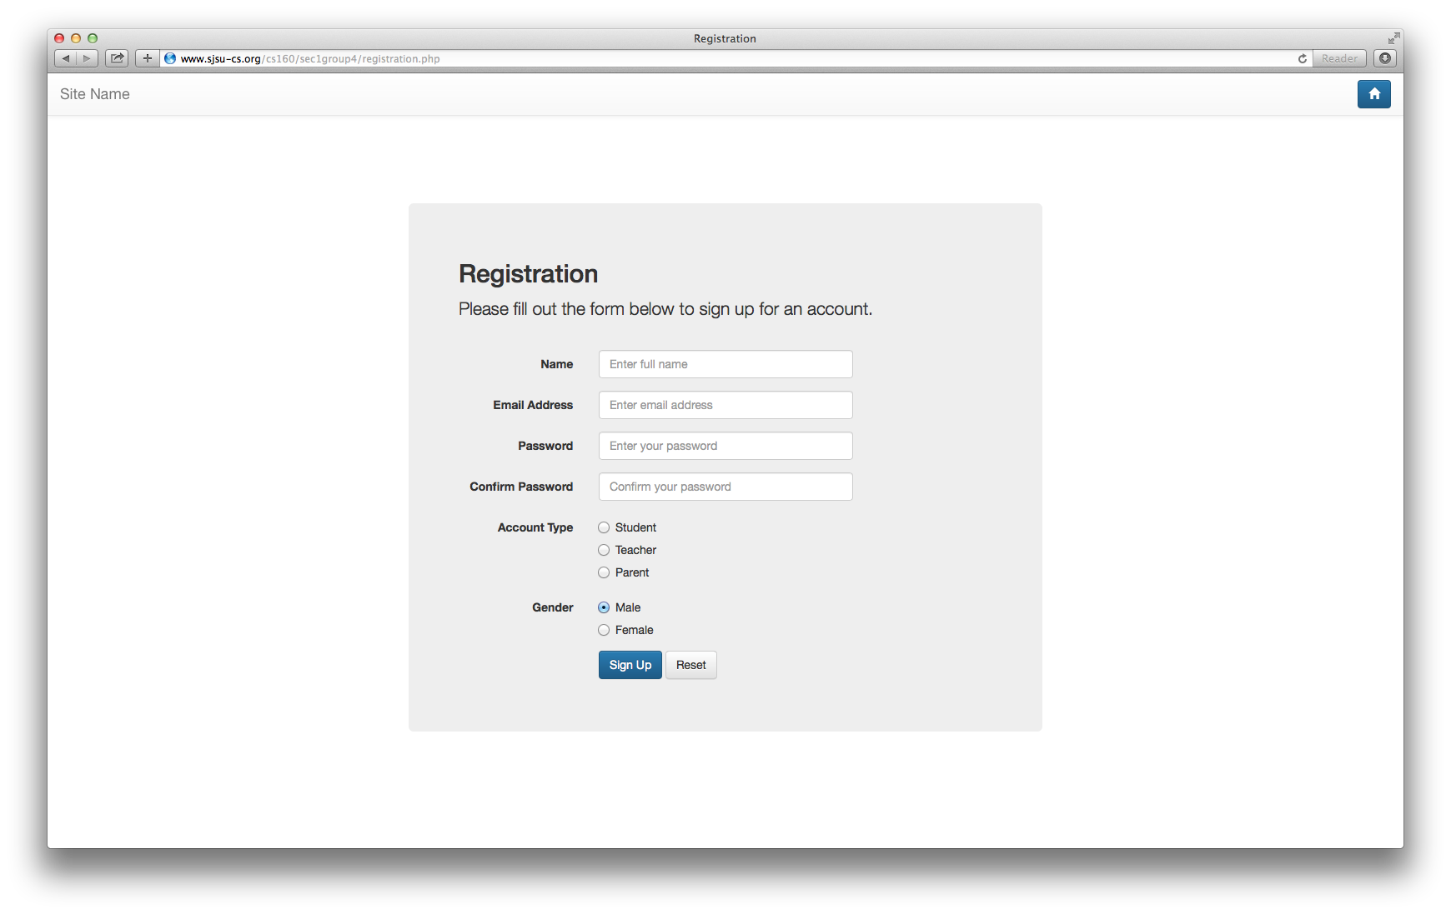
Implementation of Selected Features
Feature #1: Login / Registration
Notes:
‹#›

Slide 4
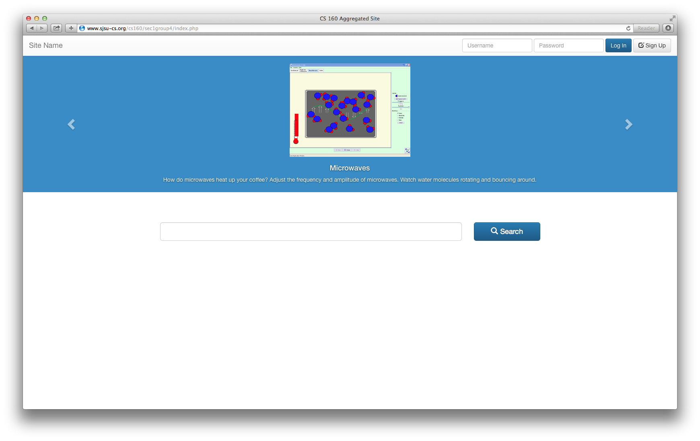
Implementation of Selected Features
Feature #2: Front page slider
Notes:
‹#›

Slide 5
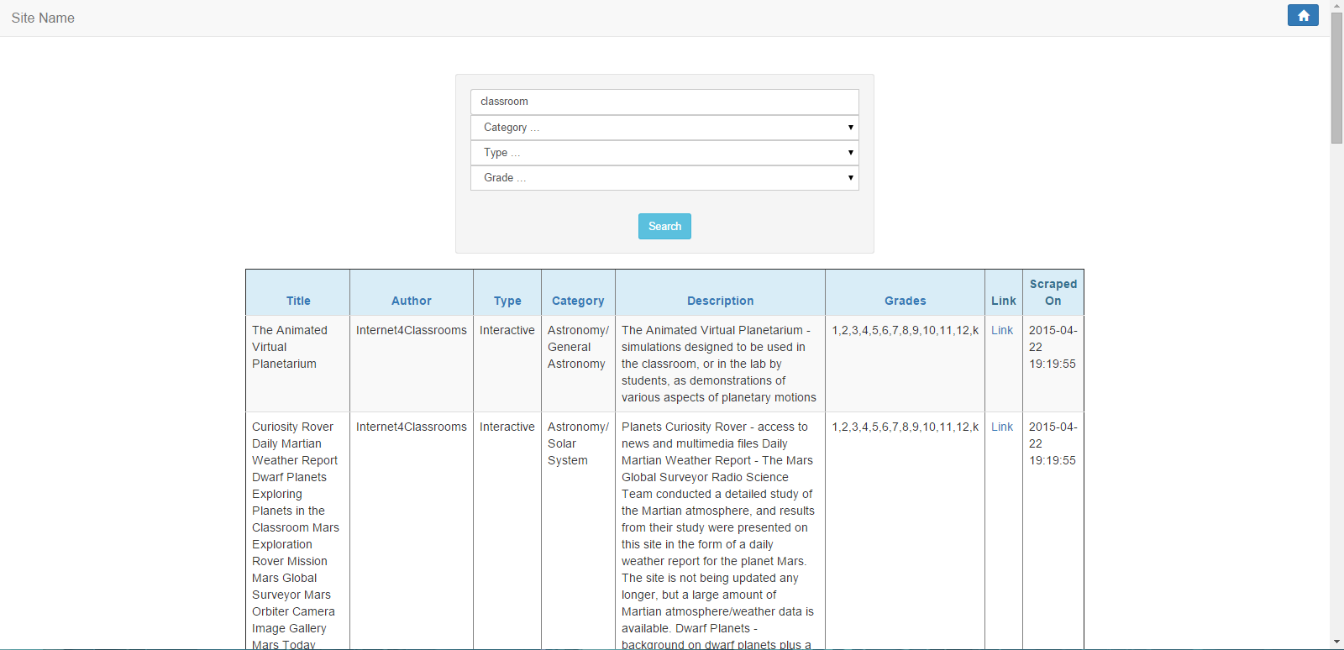
Implementation of Selected Features
Feature #3: Search / Results
Notes:
‹#›

Slide 6
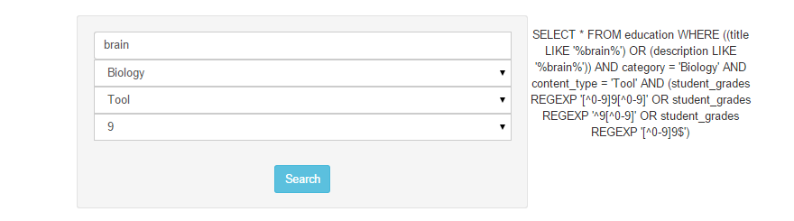
Schema is not optimized for searching:
Category / grades are stored as lists
Use ‘LIKE’ query on 4 fields (title, description, category, grade) -> potential performance problem
Possible solutions:
Have separate tables for category and grade
Full-text index

Slide 7
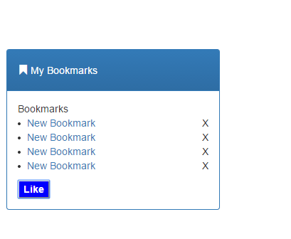
Implementation of Selected Features
Feature #4: Bookmarks (a.k.a. “Like” feature)
Notes:
‹#›

Slide 8
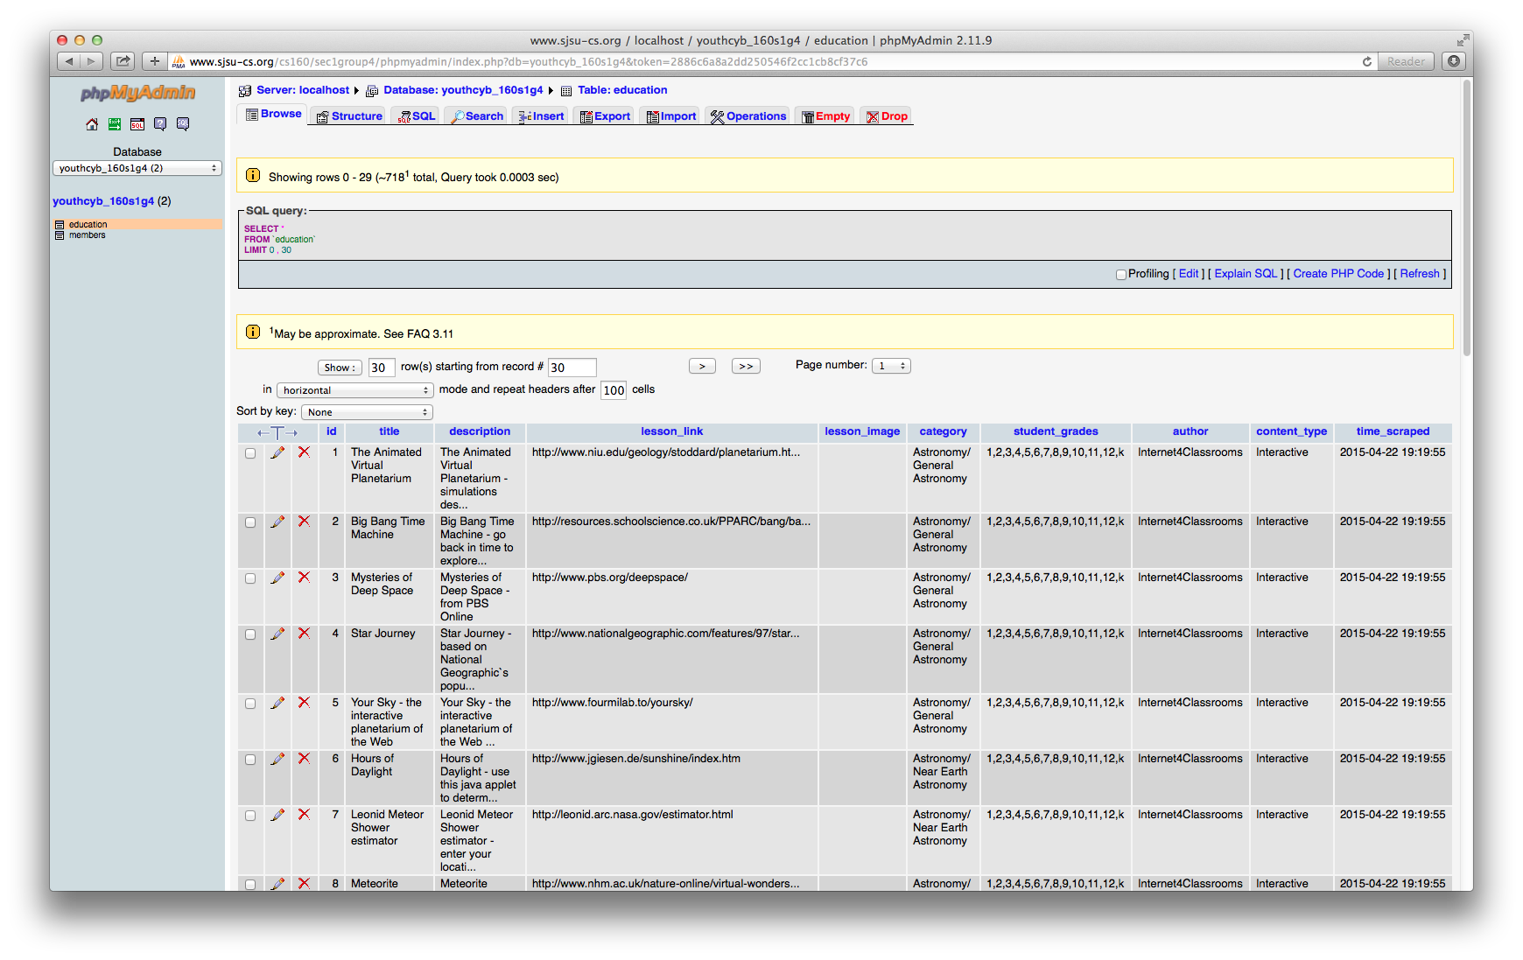
Merged Data
Describe how you detect and remove duplicated lesson entries in your report.
Notes:
‹#›

Slide 9
Overall Design & Demo
Overall design
User Sign Up
User Inputs (Name, Email Address, Password, Account Type, and Gender)
We create account and display them to log in
User search for the interactive lesson or clicks on slider to see that interactive lesson. (Search by keywords, category, type, grade).
User can like the lesson after searching.
User can go back to home.

