Slide 1

Other standards and guidelines: HL7 v2, CDA2 Roberta Gazzarata
InterHealth2022 – 10/02/2022 – Session 5.1

Slide 2

HL7 v2
What is HL7 v2?
It is a simple protocol to exchange clinical data through messages:
encoded as ASCII text strings
character-delimited
positional
variable-length.
June 1990: publication of Version 2.1

Slide 3
HL7 v2
Structure
It is organized in chapters:
Chapter 1: Introduction
Chapter 2: Control
Chapter 2A: Control - Data Types
Chapter 2B: Control - Conformance
Chapter 2C: Control - Code Tables
Chapter 3: Patient Administration
Chapter 4: Order Entry
Chapter 4A: Order Entry: Pharmacy/Treatment, Vaccination
Chapter 5: Query
Chapter 6: Financial Management
Chapter 7: Observation Reporting
Chapter 8: Master Files
Chapter 9: Medical Records/Information Management
Chapter 10: Scheduling
Chapter 11: Patient Referral
Chapter 12: Patient Care
Chapter 13: Clinical Laboratory Automation
Chapter 14: Application Management
Chapter 15: Personnel Management
Chapter 16: eClaims
Chapter 17: Materials Management
«Control» chapters
Specific domain chapters

Slide 4
HL7 v2
Transaction
TRIGGER EVENT
SENDING SYSTEM
MESSAGE
RECEIVING SYSTEM
NETWORK
ACK

Slide 5
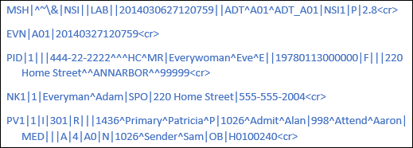
HL7 v2
message
It is the atomic unit transferred between systems
It is formed by:
segments
fields
components
sub-components
repeats
delimiter characters
«Admit a Patient»
A01

Slide 6
HL7 v2 Message
SEGMENTS
It is a logical grouping of data fields.
It can be required or optional.
It can occur only once or it may be allowed to repeat.
It is identified by a three-character code, the Segment ID, and a name.
MSH: MESSAGE HEADER

Slide 7
HL7 v2 Message
SEGMENTS
It is a logical grouping of data fields.
It can be required or optional.
It can occur only once or it may be allowed to repeat.
It is identified by a three-character code, the Segment ID, and a name.
EVN: EVENT TYPE

Slide 8
HL7 v2 Message
SEGMENTS
It is a logical grouping of data fields.
It can be required or optional.
It can occur only once or it may be allowed to repeat.
It is identified by a three-character code, the Segment ID, and a name.
PID: PATIENT ID

Slide 9
HL7 v2 Message
SEGMENTS
It is a logical grouping of data fields.
It can be required or optional.
It can occur only once or it may be allowed to repeat.
It is identified by a three-character code, the Segment ID, and a name.
NK1: NEXT OF KIN

Slide 10
HL7 v2 Message
SEGMENTS
It is a logical grouping of data fields.
It can be required or optional.
It can occur only once or it may be allowed to repeat.
It is identified by a three-character code, the Segment ID, and a name.
PV1: PATIENT VISIT

Slide 11


HL7 v2 Message
MSH SEGMENT
TYPE (chapter) and TRIGGER EVENT

Slide 12
HL7 v2 Message
FIELD
A message is formed by segments separated from each other by the segment terminator (always <CR>).
Each segment is formed by fields separated by the field separator (usually |).

Slide 13
HL7 v2 Message
COMPONET and SUBCOMPONENT
Each field is composed of one or more components separated by the component separator (usually ^) and the raw content of each component is defined by a specific data type.
Depending on its data type, a component can contain one or more subcomponents separated by the subcomponent separator (usually &).

Slide 14
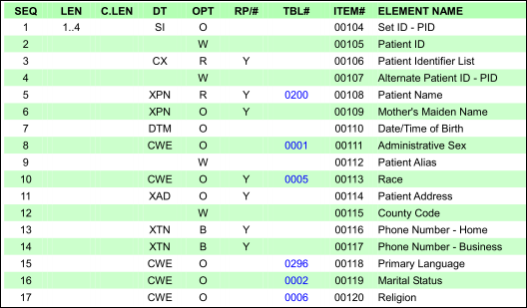
HL7 v2 Message
Data Types
Their purpose is to constrain the contents of a field
They may have a single component or set of components.
HL7 V2.8 standard defines over 90 different data types.
PID segment attribute table

Slide 15
HL7 v2 Message
Data Types
HL7 V2.8 Data types categories:
String (ST TX FT)
Numerical (CQ MO NM SI SN)
Identifiers (ID IS HD EI RP PL PT VID)
Date / Time (DTM DT TM)
Coded values (CF CK CX XCN CNE CWE)
Generic (CM)
Demographic (XAD XPN XON XTN SAD FN)
Waveforms (CD MA NA ED)
Price (CP)
Finance (FC)
Master File tables (DLN JCC VH)
Medical records (PPN)
Temporary series (DR RI SCV TQ)

Slide 16
HL7 v2 Message
HL7 v2 Patient Administration
Chapter 3 Patient Administration:
Allow to communicate location, demographic or visit information for the patient
Also known as Admission, Discharge and Transfer (ADT) or Admission, Transfer and Discharge (ATD)
Is one of the most used chapters
63 Trigger Events, more commonly used :
Admit/visit notification (event A01): to communicate the admission of a patient
Patient transfer (event A02): to communicate the transfer of a patient (change bed)
Discharge/end visit (event A03): to communicate the discharge of a patient
Update patient information (event A08): to communicate updated information for a patient (e.g. change attending physician)

Slide 17
HL7 v2 Message
HL7 v2 Patient Administration
Main segments:
Event Type (EVN) (R): information on the event: date of the event, type, location, etc.
Patient Identification (PID) (Usually R): patient demographics, identification and contact information.
Patient Visit (PV1) (Usually R): visit details, e.g. the patient visit/encounter ID, the type of episode (outpatient, inpatient, emergency, etc.), the patient's doctors (admitting doctor, attending doctor, referring doctor, consultant, etc.) and the location of the patient.
Patient Visit - Additional Information (PV2) (O): reason for admission or transfer, the location of valuable objects for the patient, estimates of date and time of hospitalization, special privacy codes, indicators for newborns, etc.
Patient Additional Demographics (PD1) (O): additional patient demographic data (living arrangements, student status, organ donors, vaccines, degree and/or military status, etc.)
Patient Allergy Information (AL1) (O)
Next of Kin/Family Contacts/Associated Parties (NK1) (O): relatives of the patient or person(s) responsible for the patient contact details
Patient Disability (DB1) (O)
Merge Patient Information (MRG) (O)
Patient Death and Autopsy (PDA) (O): information on the patient's death: cause and date of death, location, death certificates, autopsy details, etc.

Slide 18

ThANKS for your attention!
Roberta Gazzarata
R&D Director and Co-founder
roberta.gazzarata@healthropy.it
3891506691

