Slide 1
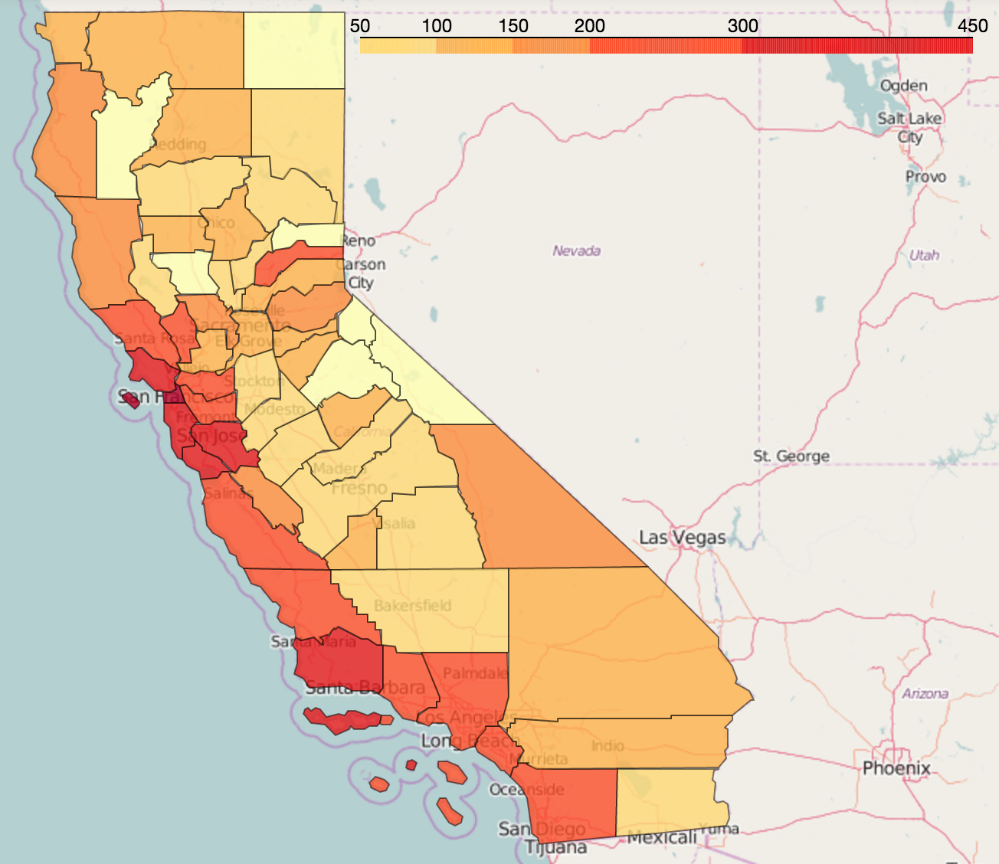
Impact of Community Indicators on Real Estate Value
DS-SF-24 Final Project
Chris Salviati
August 18, 2016

Slide 2
DS-SF-24 Final Project
C. Salviati
BACKGROUND

Slide 3
DS-SF-24 Final Project
C. Salviati
Sources
California Healthy Communities Indicators

Slide 4
DS-SF-24 Final Project
C. Salviati
Data Dictionary

Slide 5
DS-SF-24 Final Project
C. Salviati
Goals

Slide 6
DS-SF-24 Final Project
C. Salviati
Cleaning

Slide 7
DS-SF-24 Final Project
C. Salviati
Data Dictionary

Slide 8
DS-SF-24 Final Project
C. Salviati
MODELS

Slide 9
DS-SF-24 Final Project
C. Salviati
Lasso

Slide 10
DS-SF-24 Final Project
C. Salviati
Linear Regression

Slide 11
DS-SF-24 Final Project
C. Salviati
Decision Tree

Slide 12
DS-SF-24 Final Project
C. Salviati
MAPS

Slide 13
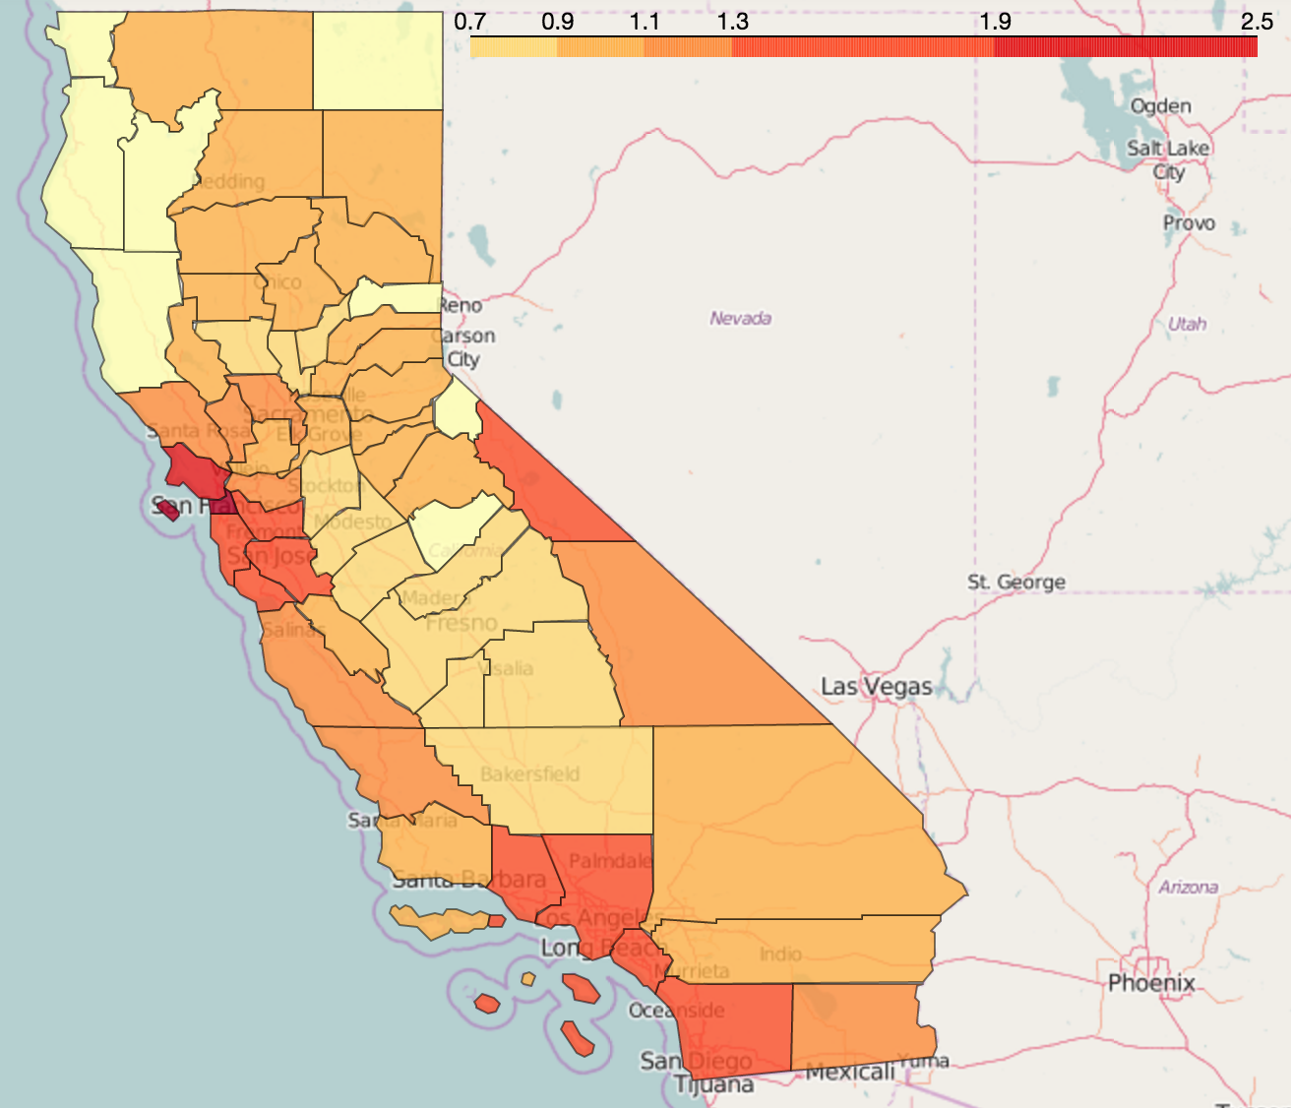
DS-SF-24 Final Project
C. Salviati
Home Value Per Sqft.
Rental Price Per Sqft.

