Slide 1
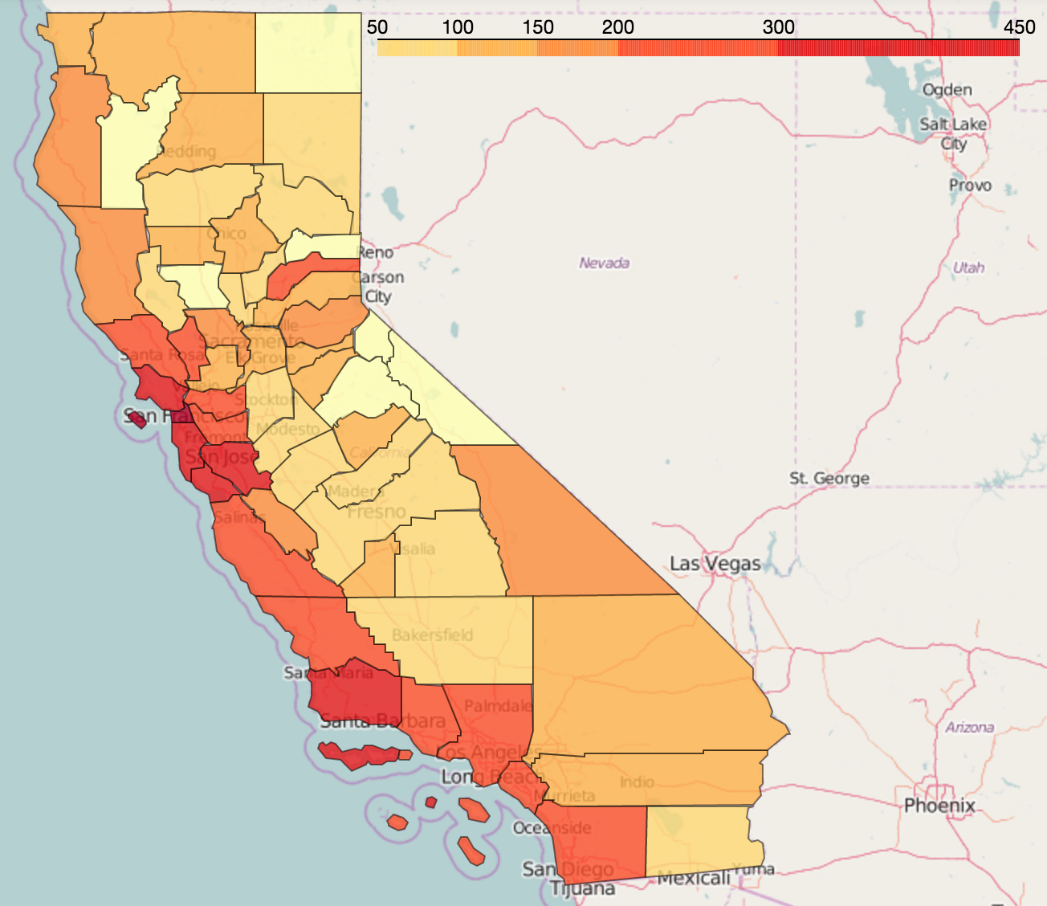
Impact of Community Indicators on Real Estate Value
DS-SF-24 Final Project
Chris Salviati
August 18, 2016

Slide 2
DS-SF-24 Final Project
C. Salviati
BACKGROUND

Slide 3

DS-SF-24 Final Project
C. Salviati
Sources
California Healthy Communities Indicators
“The goal of HCI is to enhance public health by providing data, a standardized set of statistical measures, and tools that a broad array of sectors can use for planning healthy communities and evaluating the impact of plans, projects, policy, and environmental changes on community health.”
E.g. Poverty/Unemployment Rates, Access to Parks/Public Transit
Data for most cities/towns in California at different levels of geographic specificity

Slide 4

DS-SF-24 Final Project
C. Salviati
Sources
Zillow Data
“Zillow is the leading real estate and rental marketplace dedicated to empowering consumers with data, inspiration and knowledge around the place they call home, and connecting them with the best local professionals who can help.”
Provides time series data for a wide variety of real estate value and rental price metrics
Nationwide data at different levels of geographic specificity

Slide 5
DS-SF-24 Final Project
C. Salviati
Goals

Slide 6
DS-SF-24 Final Project
C. Salviati
Cleaning

Slide 7
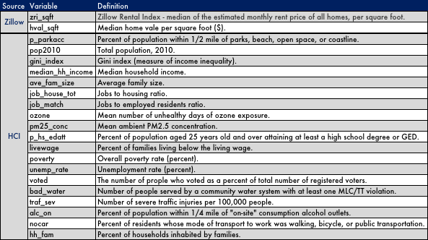
DS-SF-24 Final Project
C. Salviati
Data Dictionary

Slide 8
DS-SF-24 Final Project
C. Salviati
MODELS

Slide 9
DS-SF-24 Final Project
C. Salviati
Lasso

Slide 10
DS-SF-24 Final Project
C. Salviati
Linear Regression

Slide 11
DS-SF-24 Final Project
C. Salviati
Decision Tree

Slide 12
DS-SF-24 Final Project
C. Salviati
MAPS

Slide 13
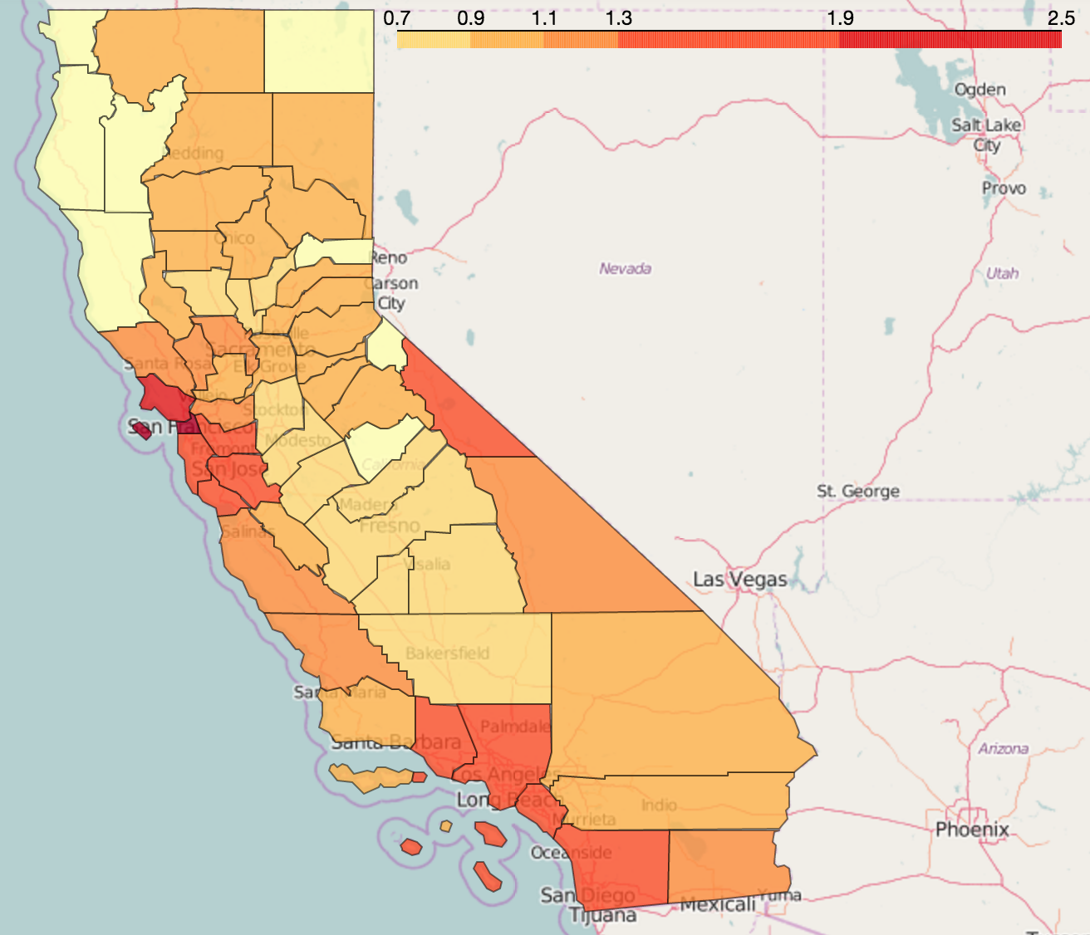
DS-SF-24 Final Project
C. Salviati
Home Value Per Sqft.
Rental Price Per Sqft.

