Slide 1
TECHNICAL ANALYSIS
Evidence for the buyer hypotheses
Three hypotheses tested against the buyer brief, followed by a property recommendation
Historic homes · large lots · four or more bathrooms · no waterfront
KING COUNTY, WASHINGTON
Notes:
Source: user-provided King County housing analysis.

Slide 2
THE BRIEF
Buyer brief and analytical frame
01
21,597 joined sales records were translated into four measurable buyer criteria and three testable hypotheses.
Historic
Large lot
4+ bathrooms
No waterfront
Built in 1945 or earlier
Top quartile among qualifying historic homes
At least four full or partial bathrooms
Confirmed waterfront value of 0
No price cap
First apply the requirements. Then rank the surviving homes by price and evaluate location and renovation trade-offs.
King County Housing EDA

Slide 3
HYPOTHESIS 1
Premium features drive the highest sale prices
02
$2.30M
Median sale price when all four buyer criteria are met
The median rises from $0.32M at zero criteria to $2.30M when all four are met.
H1 supported
Number of buyer criteria met
King County Housing EDA
Notes:
Hypothesis 1: Premium features drive the highest sale prices. The horizontal axis shows the number of buyer criteria met, from zero to four. This chart operationalizes the premium combination through the four measurable buyer criteria. Values reconstructed from the user-provided chart and should be treated as approximate.

Slide 4
HIGHEST-VALUE HOMES
House 6762700020 leads the qualified shortlist
03
$7.7M
Highest recorded sale among qualifying homes
6762700020
The leader is more than $4M above the next home in the observed shortlist. It receives first priority for validation.
King County Housing EDA
Notes:
Values reconstructed from the user-provided ranking chart and are approximate.

Slide 5
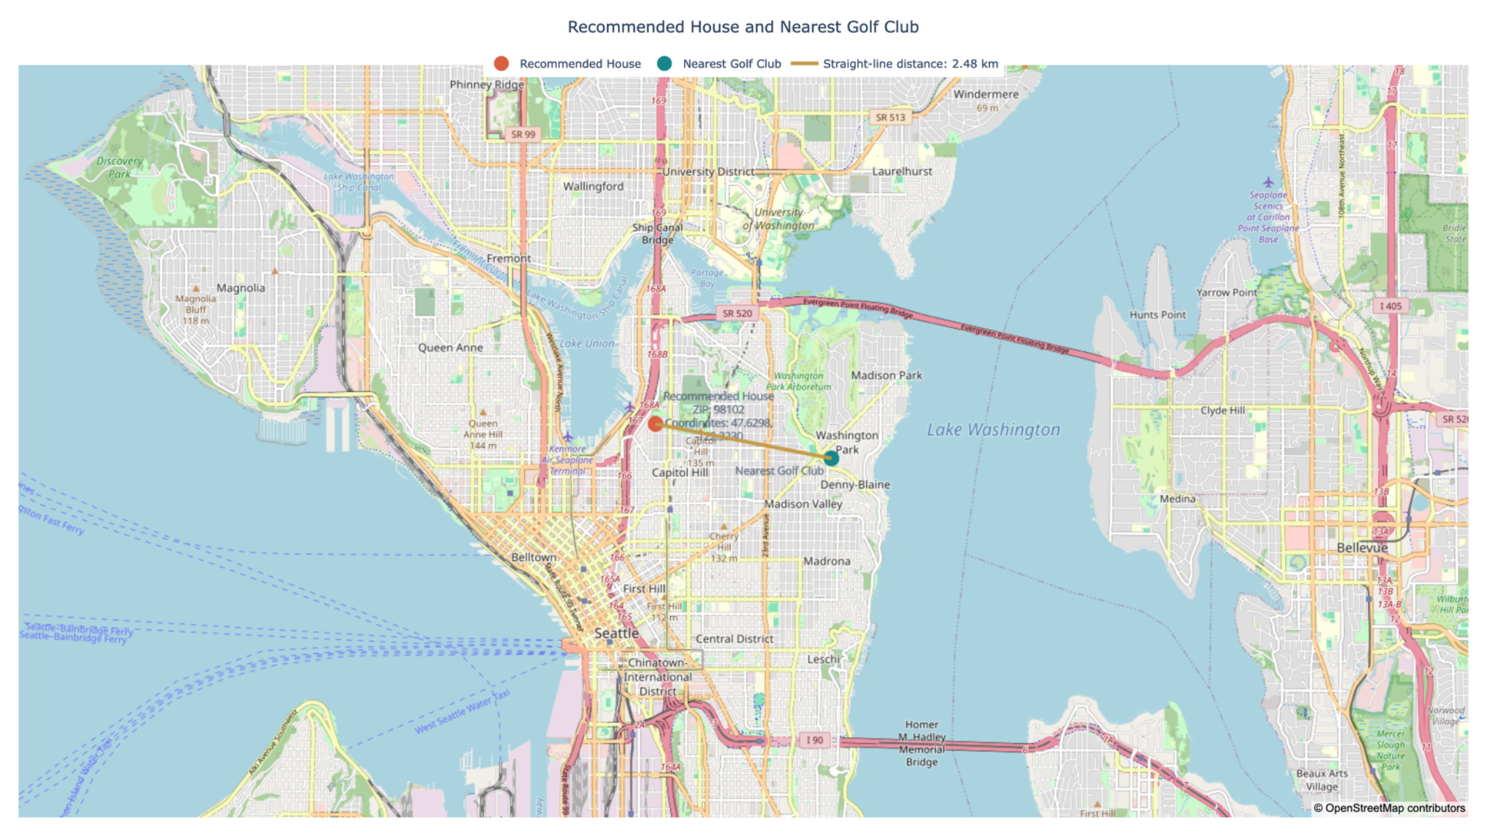
PROPERTY LOCATION
The home and Broadmoor Golf Club are 1.54 miles apart
04
98102
Postal code
1.54 mi
Straight-line distance
2.48 km
Driving distance and club access require separate verification.
King County Housing EDA
Notes:
Property: 47.6298, -122.3230. Broadmoor Golf Club coordinate used: approximately 47.6400, -122.2920. Haversine straight-line distance: about 1.6 miles / 2.6 km. Map © OpenStreetMap contributors. Broadmoor Golf Club address: 2340 Broadmoor Drive E, Seattle, WA 98112.

Slide 6
HYPOTHESIS 2
Urban and golf-adjacent locations may limit lot size
05
10,000
Median sqft in the 10–20 mile band
Lot size increases outside the urban core and peaks 10–20 miles away. The graph tests distance from central Seattle, but not golf adjacency directly.
Partly supported
King County Housing EDA
Notes:
Hypothesis 2: Urban and golf-adjacent locations may limit lot size. The distance chart supports the urban-core component. It does not isolate or directly test golf adjacency. Chart values reconstructed from the user-provided chart and are approximate.

Slide 7
HYPOTHESIS 3
Under-featured historic homes may sell at a discount
06
$247
Median price per sqft for renovation opportunities
$470
Median price per sqft for ready premium homes
Hypothesis supported
King County Housing EDA
Notes:
Hypothesis 3: Under-featured historic homes may sell at a discount. Values reconstructed from the user-provided chart. The observed discount is approximate and excludes renovation costs.

Slide 8
THE RESULT
Two hypotheses are supported and one is partly supported
07
H1 Premium features drive the highest sale prices
SUPPORTED
H2 Urban and golf-adjacent locations may limit lot size
PARTLY SUPPORTED
H3 Under-featured historic homes may sell at a discount
SUPPORTED
CLIENT DECISION
Validate house 6762700020 first. Keep larger-lot and renovation candidates as explicit alternatives, not substitutes hidden inside the main recommendation.
King County Housing EDA

Slide 9
LIMITATIONS
Property-level checks remain necessary
08
01
Availability and ownership
Confirm current listing status, ownership and asking terms.
02
Access and route
Validate driving time to Broadmoor and private-club eligibility.
03
Condition and renovation scope
Use an inspection and renovation estimate before comparing alternatives.
King County Housing EDA

Slide 10
CONCLUSION
Evidence, recommendation and alternatives
09
WHICH GRAPH SUPPORTS WHICH HYPOTHESIS?
RECOMMENDED PROPERTY
ALTERNATIVES
H1 Premium features and price
House 6762700020
Next qualified homes
The criteria-count price graph supports H1. Median price rises from $0.32M to $2.30M as the full premium combination is met.
House 1118000320 at $3.39M and house 1346300150 at $3.29M provide lower-priced backup options.
$7.7M
H2 Location and lot size
Why it ranks first
Larger-lot search
The distance and lot-size graph partly supports H2. It tests proximity to the urban core, but not golf adjacency directly.
It meets all four buyer criteria and has the highest recorded sale price in the qualified shortlist. Its $7.7M price stands more than $4M above the next candidate.
The 10–20 mile band has the largest median lots. Use this alternative if land matters more than central location.
H3 Under-featured homes and discount
Renovation opportunity
The price-per-sqft group graph supports H3. Renovation opportunities average $247 versus $470 for ready premium homes.
Location
The lower $247-per-sqft group offers value, subject to inspection and renovation-cost validation.
Postal code 98102. About 1.54 miles from Broadmoor Golf Club by straight-line distance.
King County Housing EDA
Notes:
Conclusion slide maps each chart to its hypothesis, explains the primary recommendation and identifies the main alternatives. Prices and group values come from the user-provided analysis and remain approximate.

