Slide 1
KING COUNTY HOUSING EDA
From hypotheses to a
property recommendation
A decision story for Jacob Phillips
Premium quality
Location–lot balance
Renovation optionality
H1
H2
H3
Evidence → trade-offs → weighted buyer fit → recommendation
Notes:
Open with the decision question: which qualified historic home best balances premium quality, land and golf access?

Slide 2
DECISION FRAME
Three hypotheses turn the buyer brief into a testable search
02
BUYER BRIEF
Unlimited budget
Historic character
Large lot
4+ bathrooms
No waterfront
Optimize fit, not price
Built before 1945
Land is a priority
Non-negotiable
Explicit exclusion
H1
Premium features drive the highest sale prices
Quality should explain the price premium.
Decision rule
H2
Location creates a lot-size trade-off
Choose the home with the strongest overall buyer fit—not simply the lowest price or the shortest golf distance.
Golf access should be balanced against land.
H3
Under-featured historic homes sell at a discount
Renovation can create a lower-cost alternative.
KING COUNTY HOUSING EDA
Notes:
Explain that each hypothesis answers a different part of the buying decision.

Slide 3
HYPOTHESIS 1
Premium features correspond with higher median prices
03
$2.30M
median price when all four premium criteria are present
Evidence
Median price rises at every step and accelerates sharply at four criteria.
H1 SUPPORTED
KING COUNTY HOUSING EDA
Notes:
Premium criteria: large living area, high grade, 4+ bathrooms and large lot among historic non-waterfront homes.

Slide 4
HYPOTHESIS 1 — SHORTLIST CHECK
The recommended home is the clear premium outlier
04
House 6762700020
$7.70M
12,050 sq ft living
Grade 13
27,600 sq ft lot
Interpretation
Its price is justified only if its premium specifications also win the buyer-fit comparison.
KING COUNTY HOUSING EDA
Notes:
Do not recommend the house because it is expensive. Use this slide only to establish premium-market positioning.

Slide 5
HYPOTHESIS 2
Closer-in locations tend to trade land for access
05
Market pattern
Median lot size increases as homes move away from the urban core.
Decision implication
The right property must find a workable point between proximity and land—not maximize either one alone.
H2 TO TEST ON SHORTLIST
KING COUNTY HOUSING EDA
Notes:
This is a market-level relationship. The next two slides test it directly among the qualified candidates.

Slide 6
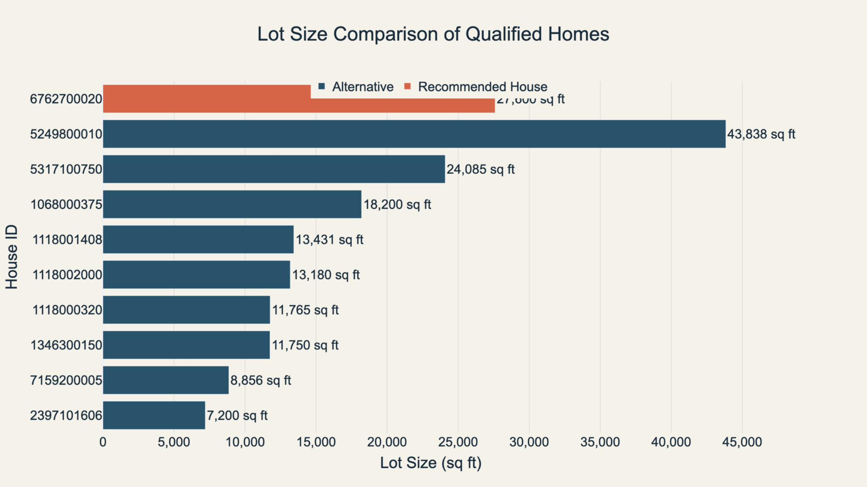
HYPOTHESIS 2 — SHORTLIST CHECK
Land advantage is concentrated in only a few candidates
06
The trade-off
43,838 sq ft
Largest lot:
5249800010
27,600 sq ft
Recommended home:
second-largest lot
The recommendation preserves substantial land without accepting the golf-access penalty of the largest lot.
KING COUNTY HOUSING EDA
Notes:
House 5249800010 wins on lot size alone. The next slide shows why it is not the best overall choice.

Slide 7
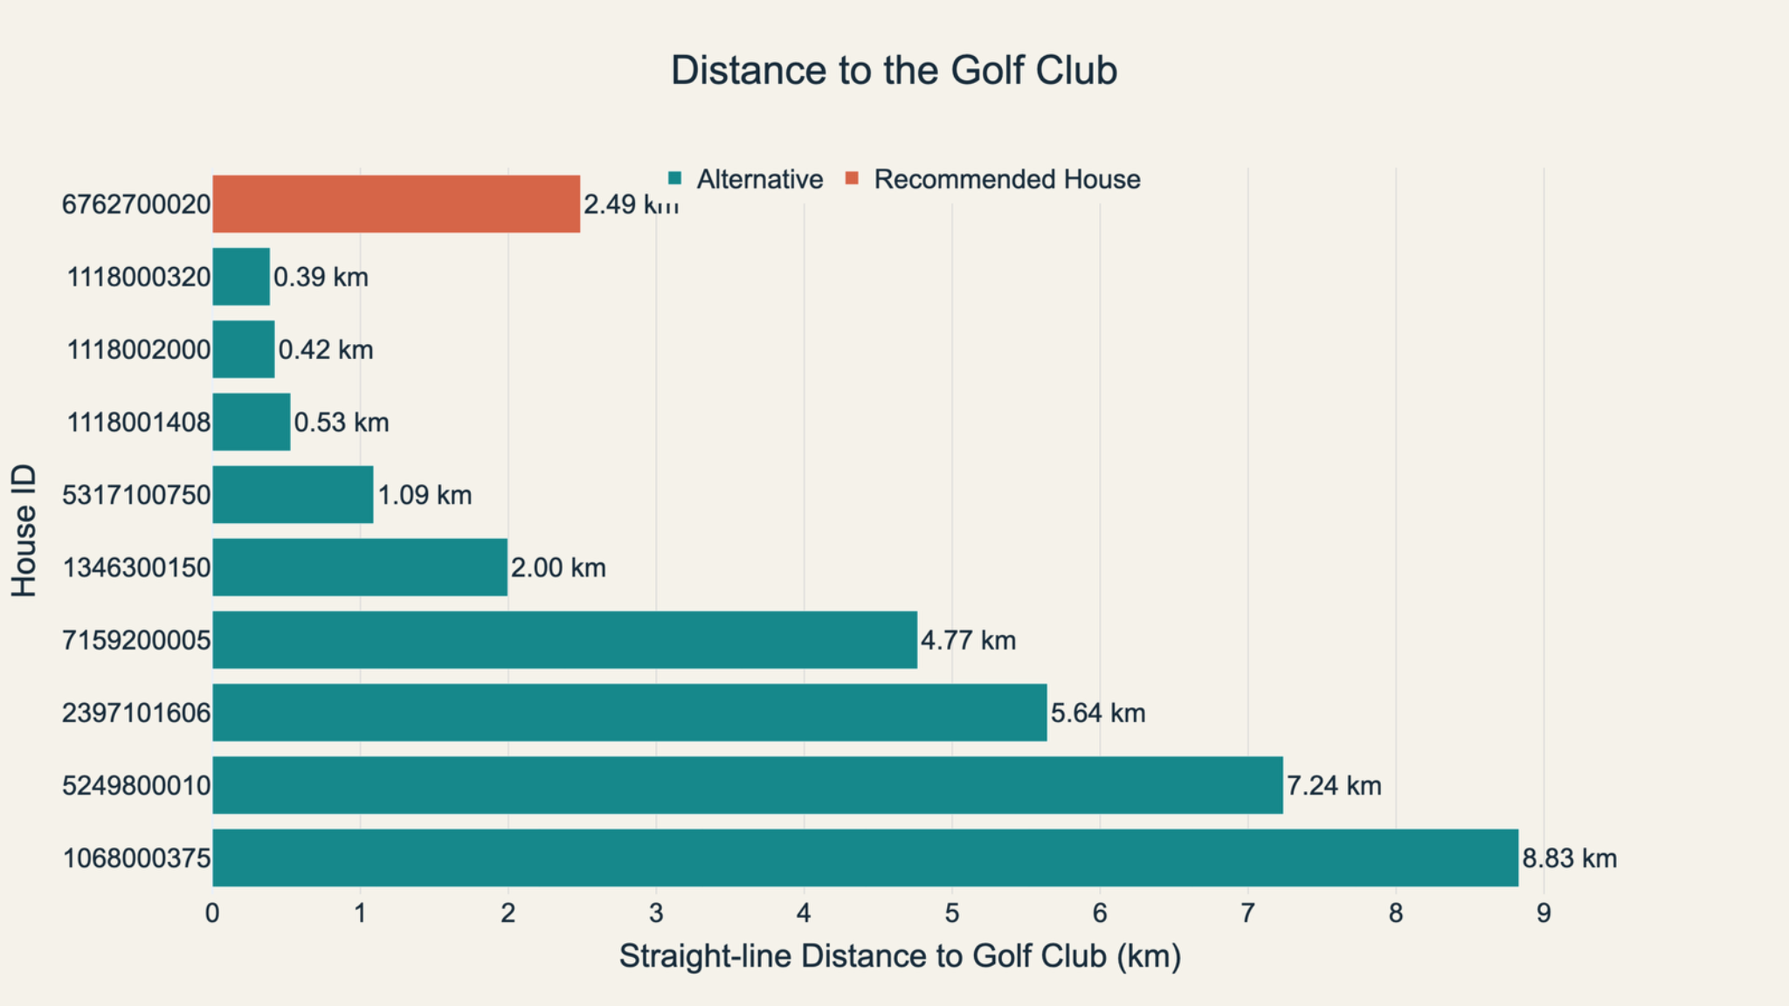
HYPOTHESIS 2 — SHORTLIST CHECK
The closest golf homes sacrifice space and premium quality
07
Recommended
2.49 km
Balanced access
Closest homes
0.39–0.53 km
But they offer only 11,765–13,431 sq ft lots and smaller living areas. Proximity alone does not satisfy the brief.
KING COUNTY HOUSING EDA
Notes:
The recommended property is not the closest to golf. It is the strongest land-access compromise.

Slide 8
HYPOTHESIS 3
Renovation candidates offer a meaningful price discount
08
48% lower
median price per sq ft for the renovation profile
Decision implication
The renovation path is economically attractive, but it optimizes value—not the buyer’s stated preference for premium quality.
H3 SUPPORTED
KING COUNTY HOUSING EDA
Notes:
Unlimited budget changes the decision: discount is an option, not the primary objective.

Slide 9
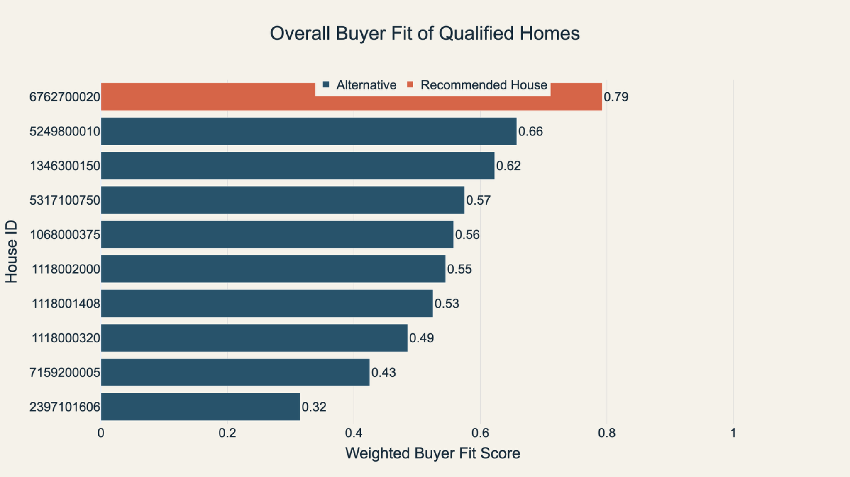
DECISION SYNTHESIS
Weighted buyer fit resolves the competing trade-offs
09
0.79
Highest overall buyer fit
+0.13
lead over the next candidate
Weights
Lot 30% • Golf 25%
Living 20% • Grade 15%
Condition 10%
A transparent decision aid—not a market valuation model.
KING COUNTY HOUSING EDA
Notes:
Buyer-fit score normalizes the shortlisted homes and applies the stated weights. Use it to compare fit, not to predict price.

Slide 10
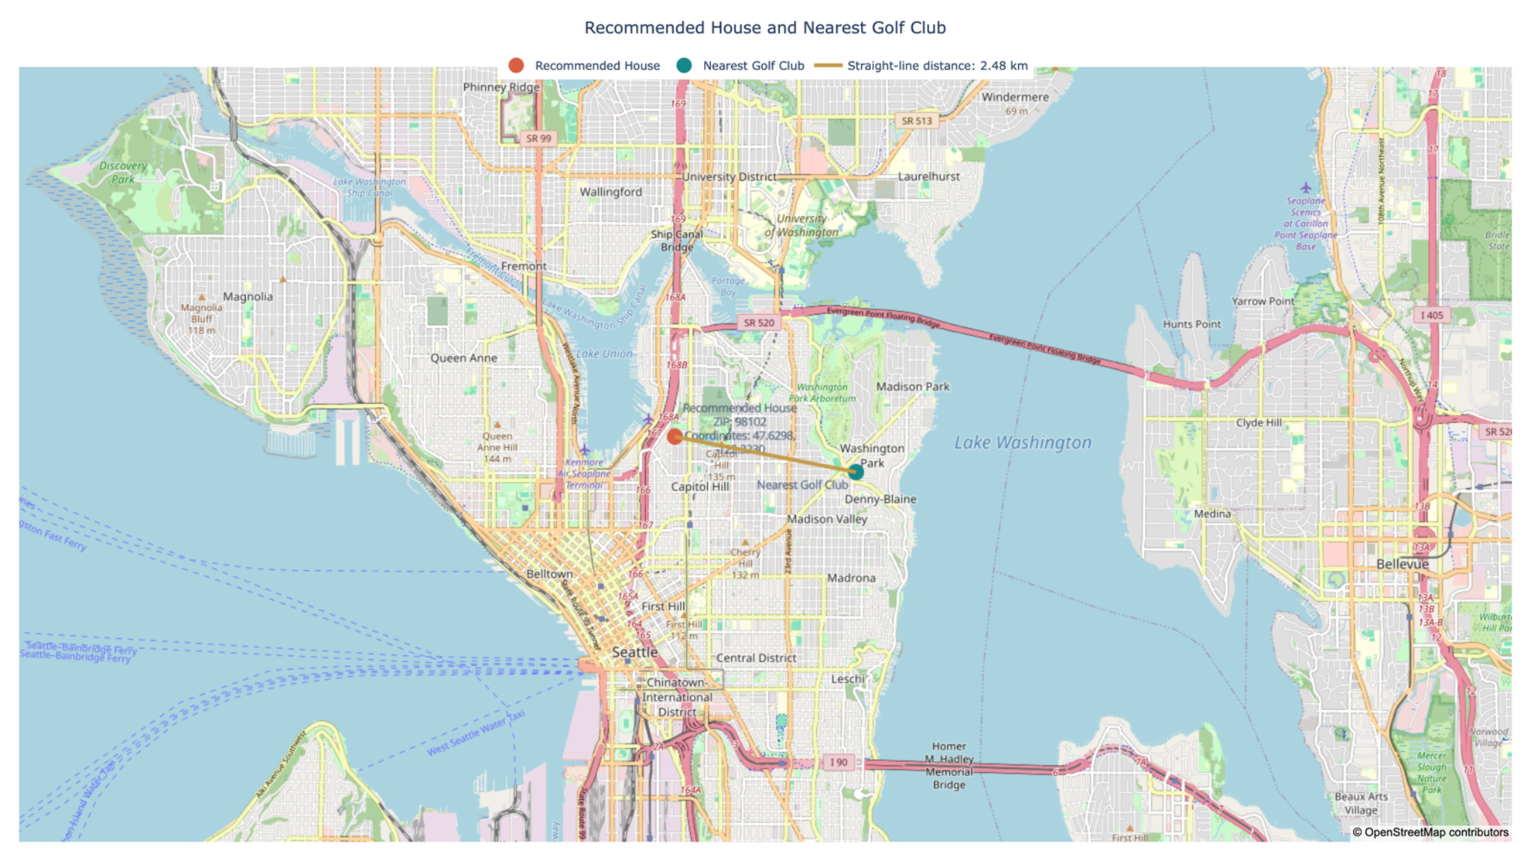
RECOMMENDED PROPERTY
The selected home sits within practical reach of the golf club
10
House 6762700020
ZIP 98102
2.49 km
straight-line distance
Location verdict
Not golf-adjacent, but close enough to preserve access while retaining a 27,600 sq ft lot.
KING COUNTY HOUSING EDA
Notes:
Clarify that the distance is straight-line, not driving distance.

Slide 11
EVIDENCE LEDGER
Each chart answers a specific hypothesis—and a decision question
11
Chart / evidence
Result
What the graph shows
How it changes the decision
H1
Premium-criteria median price
Supported
$0.32M → $2.30M as criteria rise from 0 to 4
Premium quality merits a higher price.
H1
Qualified-home price comparison
Supported
$7.70M recommendation is the premium outlier
Validate price through specifications and fit.
H2
Distance vs. median lot size
Supported
Closer-in homes generally have smaller lots
Expect a proximity–land trade-off.
H2
Candidate lot + golf distance
Supported
27,600 sq ft at 2.49 km balances both
Choose balance, not a single-variable winner.
H3
Ready vs. renovation $/sq ft
Supported
$470 vs. $247 per sq ft
Keep renovation as the value alternative.
Synthesis
Weighted buyer fit
Decision
0.79, ahead of 0.66 next-best
Recommend house 6762700020.
KING COUNTY HOUSING EDA
Notes:
This slide makes the evidence-to-hypothesis mapping explicit.

Slide 12
FINAL RECOMMENDATION
Choose the strongest overall fit—not the cheapest single-metric winner
12
Why the premium is rational
RECOMMENDED
The $7.70M price buys the only candidate that leads on overall fit while combining exceptional living area, top grade, substantial land and acceptable golf access.
House 6762700020
Buyer fit 0.79
✓
Largest living area: 12,050 sq ft
Alternatives by priority
✓
Top grade: 13
Land-first
5249800010
43,838 sq ft lot • 7.24 km to golf • fit 0.66
✓
Second-largest lot: 27,600 sq ft
Balanced lower-cost
1346300150
✓
Practical golf access: 2.49 km
2.00 km to golf • 7,710 sq ft living • fit 0.62
Golf-first
1118000320
0.39 km to golf • smaller lot/living • fit 0.49
Decision: prioritize the rarest complete package; use alternatives only if the buyer changes the priority hierarchy.
KING COUNTY HOUSING EDA
Notes:
Close by distinguishing overall fit from price. The alternatives are not backups; each represents a different priority strategy.

